Slide 1








Slide 2
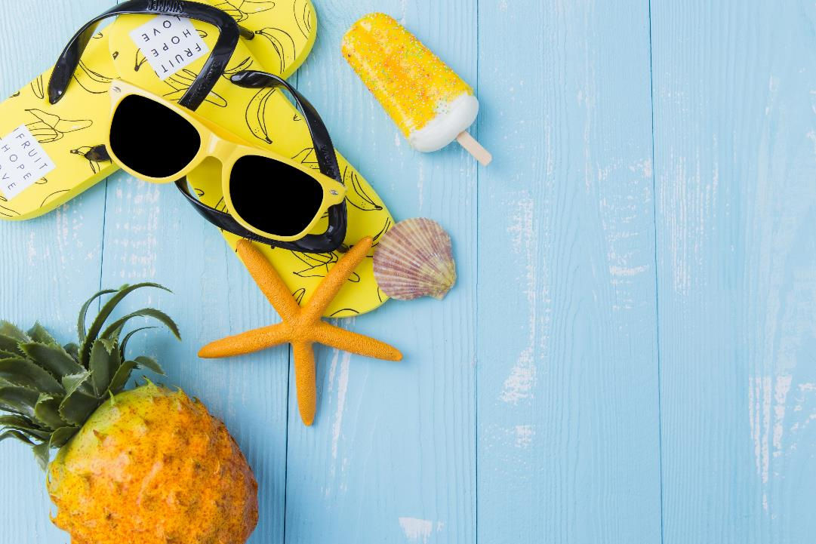
2019
Hello, June
Click here to add your title

Slide 3
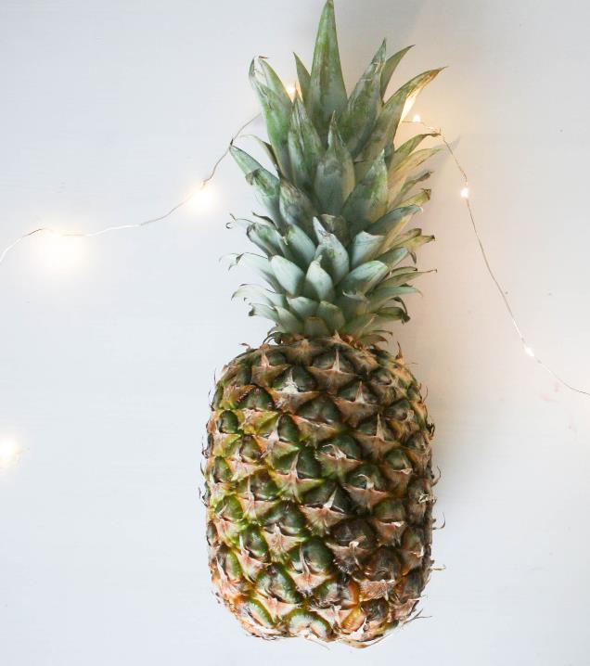

PART ONE

Slide 4
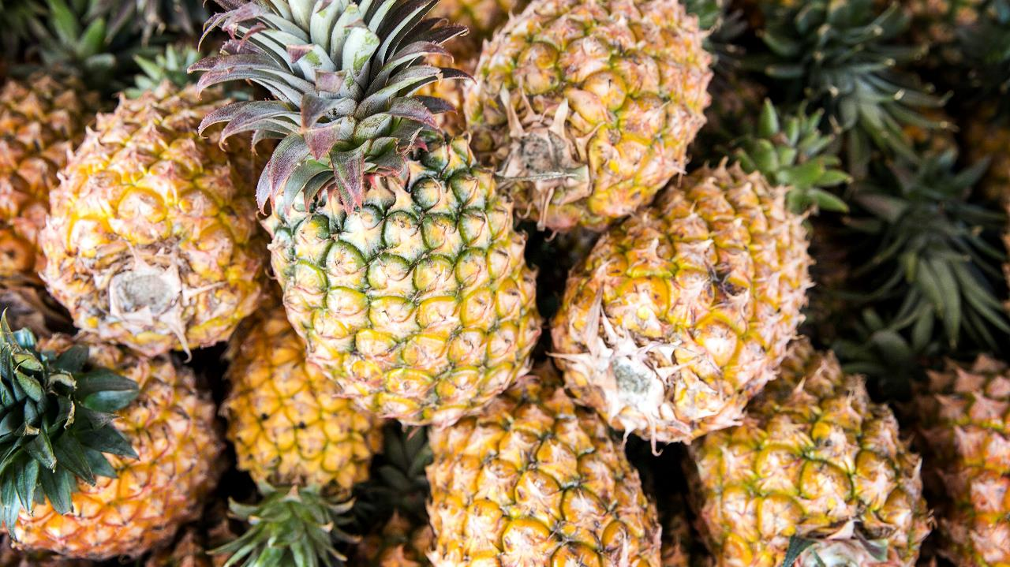
Hello, June
I love you more than I've ever loved any woman. And I've waited longer for you than I've waited for any woman.
I love you more than I've ever loved any woman. And I've waited longer for you than I've waited for any woman.I love you more than I've ever loved any woman. And I've waited longer for you than I've waited for any woman.

Slide 5
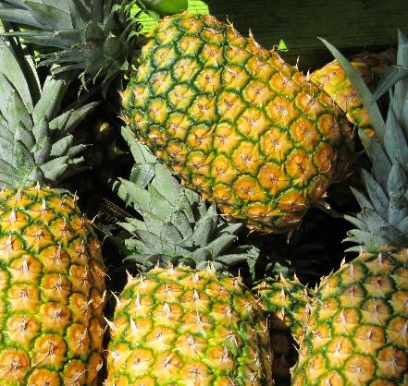
Hello, June
Click here to add your title
one
I love you more than I've ever loved any woman. And I've waited longer for you than I've waited for any woman.
two
I love you more than I've ever loved any woman. And I've waited longer for you than I've waited for any woman.
three
Click here to add your title
I love you more than I've ever loved any woman. And I've waited longer for you than I've waited for any woman.
I love you more than I've ever loved any woman. And I've waited longer for you than I've waited for any woman.

Slide 6
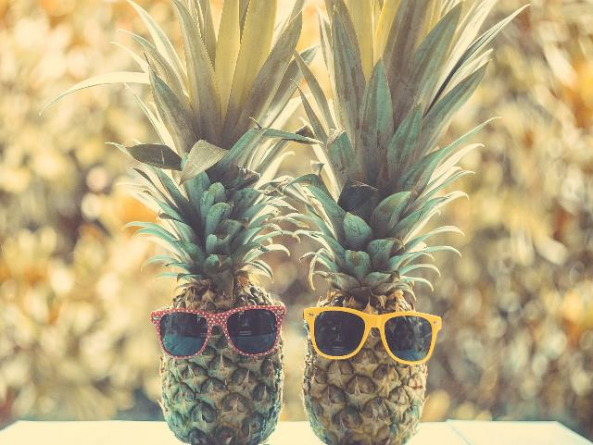

Click here to add your title
I love you more than I've ever loved any woman. And I've waited longer for you than I've waited for any woman.I love you more than I've ever loved any woman. And I've waited longer for you than I've waited for any woman.
I love you more than I've ever loved any woman. And I've waited longer for you than I've waited for any woman.I love you more than I've ever loved any woman. And I've waited longer for you than I've waited for any woman.
I love you more than I've ever loved any woman. And I've waited longer for you than I've waited for any woman.
I love you . I love you
I love you more than I've ever loved any woman. And I've waited longer for you than I've waited for any woman.

Slide 7

Click here to add your title
I love you more than I've ever loved any woman. And I've waited longer for you than I've waited for any woman.
Hello, June
Click here to add your title
I love you more than I've ever loved any woman. And I've waited longer for you than I've waited for any woman.

Slide 8
PART TWO

Slide 9

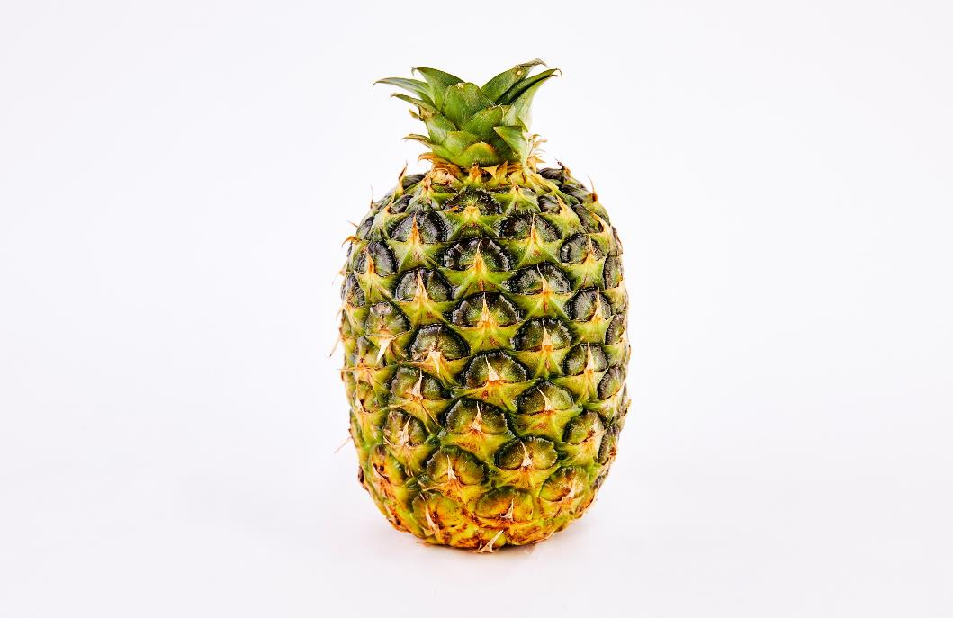
Hello, June
I love you more than I've ever loved any woman. And I've waited longer for you than I've waited for any woman.

Slide 10
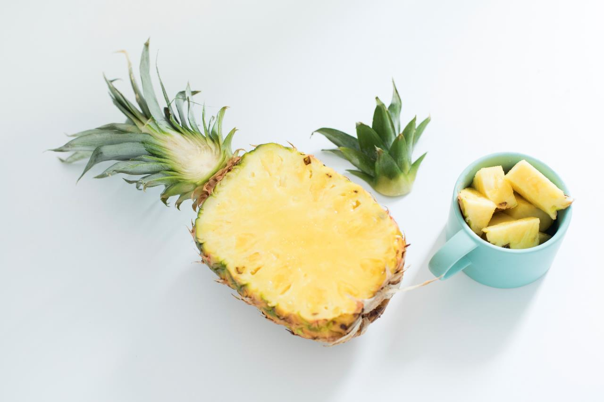
Hello, June
I love you more than I've ever loved any woman. And I've waited longer for you than I've waited for any woman.
I love you more than I've ever loved any woman. And I've waited longer for you than I've waited for any woman.
I love you more than I've ever loved any woman. And I've waited longer for you than I've waited for any woman.

Slide 11

Hello, June
Click here to add your title
I love you more than I've ever loved any woman. And I've waited longer for you than I've waited for any woman.
I love you more than I've ever loved any woman. And I've waited longer for you than I've waited for any woman. I love you more than I've ever loved any woman. And I've waited longer for you than I've waited for any woman.

Slide 12
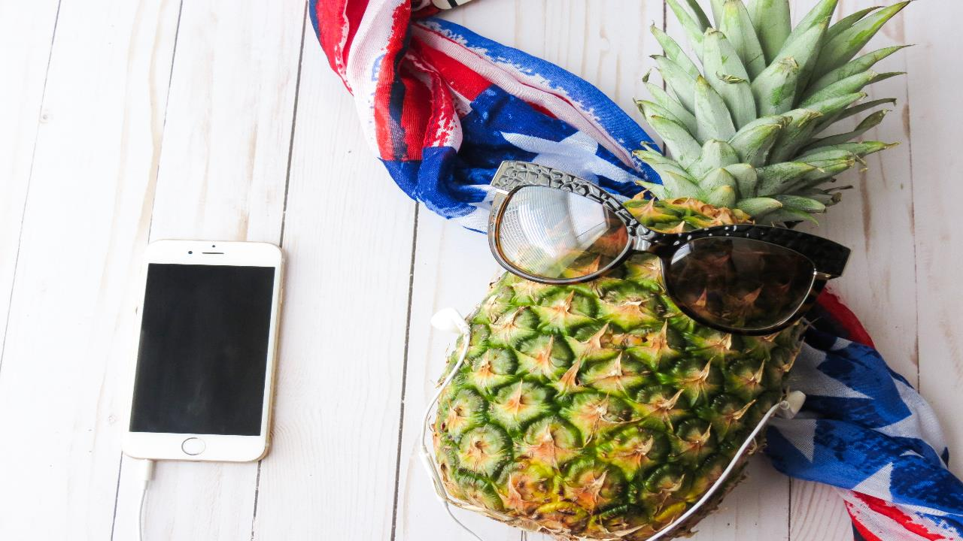
Hello, June
I love you more than I've ever loved any woman. And I've waited longer for you than I've waited for any woman.

Slide 13



Hello, June
Click here to add your title
I love you more than I've ever loved any woman. And I've waited longer for you than I've waited for any woman.

Slide 14
PART THREE

Slide 15
Click here to add your title
Click here to add your title
I love you more than I've ever loved any woman. And I've waited longer for you than I've waited for any woman.
I love you more than I've ever loved any woman. And I've waited longer for you than I've waited for any woman.
Click here to add your title
Click here to add your title
I love you more than I've ever loved any woman. And I've waited longer for you than I've waited for any woman.
I love you more than I've ever loved any woman. And I've waited longer for you than I've waited for any woman.

Slide 16
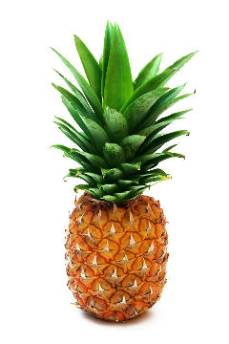
Hello, June
Click here to add your title
Click here to add your title
Click here to add your title

Slide 17
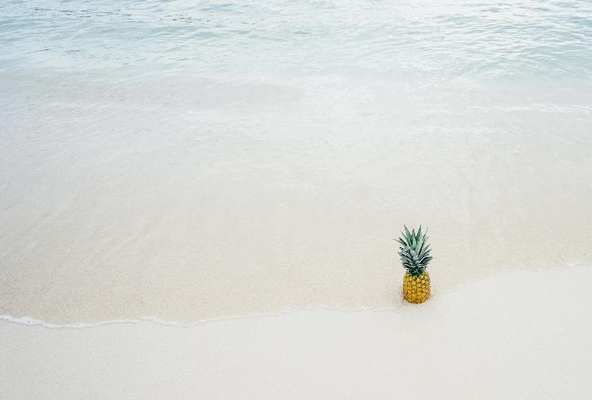
Hello, June
I love you more than I've ever loved any woman. And I've waited longer for you than I've waited for any woman.
I love you more than I've ever loved any woman. And I've waited longer for you than I've waited for any woman.
I love you more than I've ever loved any woman. And I've waited longer for you than I've waited for any woman.

Slide 18
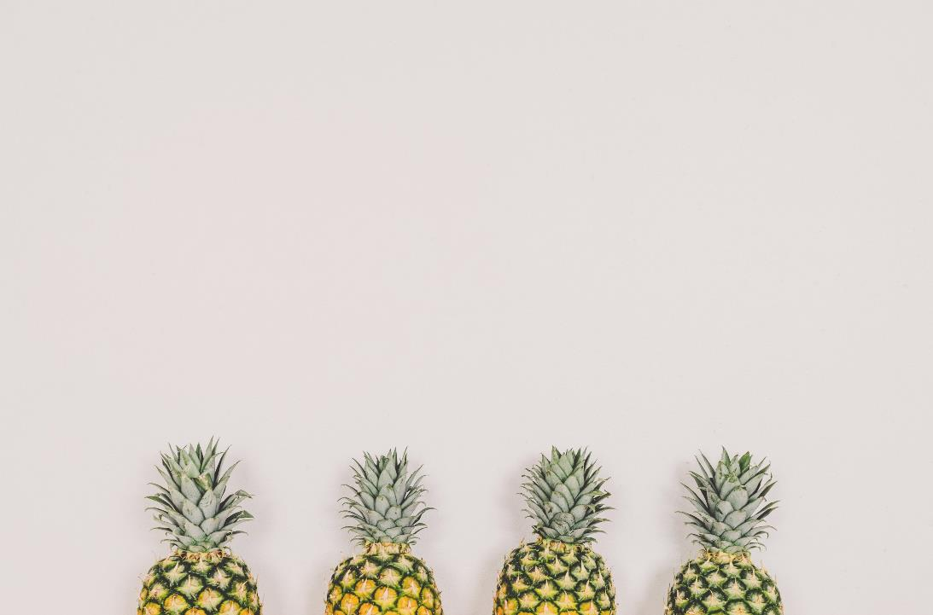

Hello, June
Click here to add your title
I love you more than I've ever loved any woman. And I've waited longer for you than I've waited for any woman.
I love you more than I've ever loved any woman. And I've waited longer for you than I've waited for any woman. I love you more than I've ever loved any woman. And I've waited longer for you than I've waited for any woman.

Slide 19
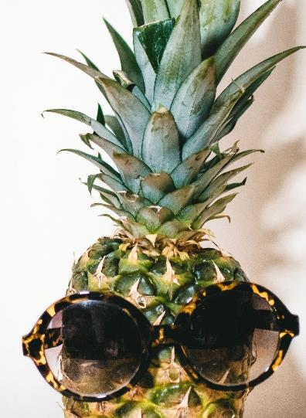

Hello, June
Click here to add your title
I love you more than I've ever loved any woman. And I've waited longer for you than I've waited for any woman.

Slide 20
PART FOUR

Slide 21
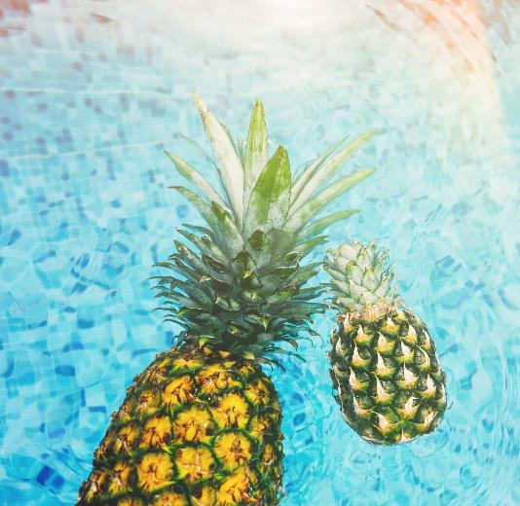
Hello, June
Click here to add your title
I love you more than I've ever loved any woman. And I've waited longer for you than I've waited for any woman.

Slide 22
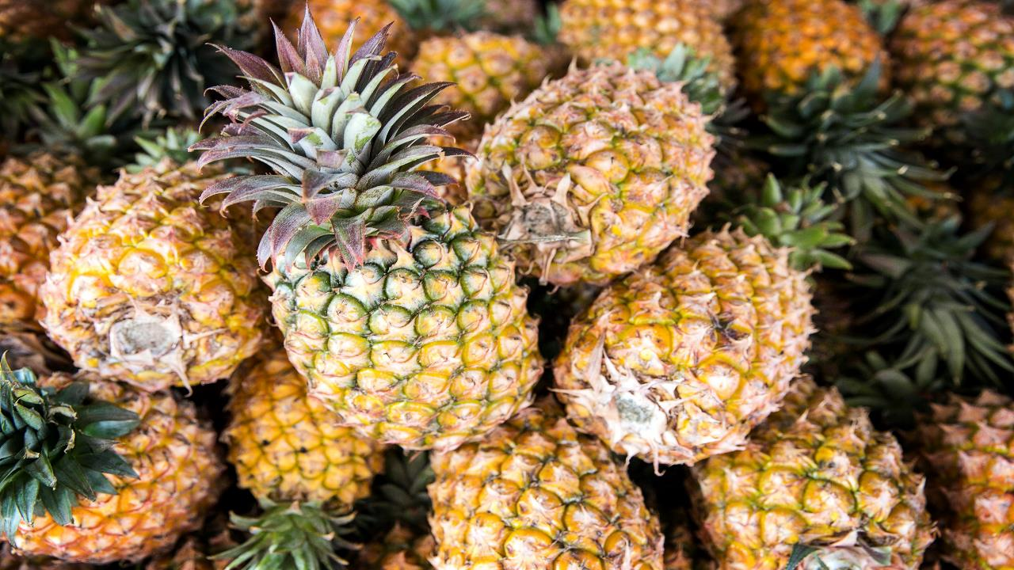
Hello, June
Click here to add your title
I love you more than I've ever loved any woman. And I've waited longer for you than I've waited for any woman.

Slide 23
Hello, June
Click here to add your title
I love you more than I've ever loved any woman. And I've waited longer for you than I've waited for any woman.

Slide 24
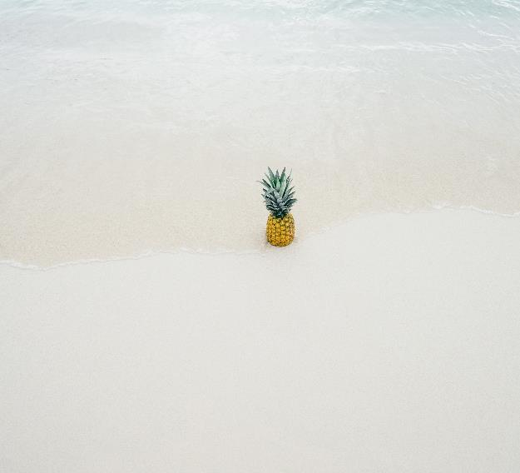
Hello, June
Click here to add your title
I love you more than I've ever loved any woman. And I've waited longer for you than I've waited for any woman.
I love you more than I've ever loved any woman. And I've waited longer for you than I've waited for any woman.

Slide 25
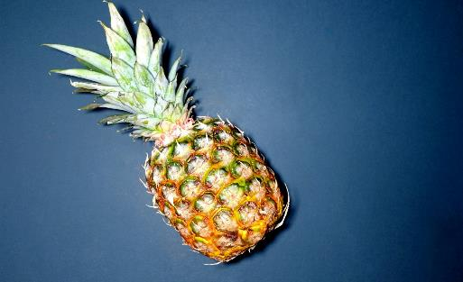
THANK YOU

