Slide 1
Entrepreneurial activities differ substantially depending on the type of

Slide 2
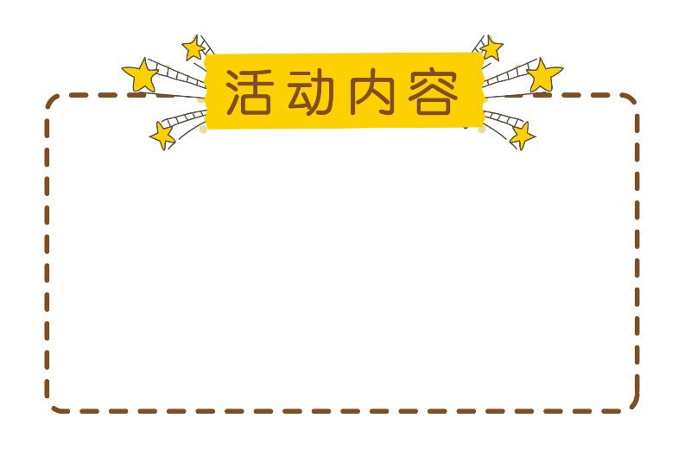
Entrepreneurial activities differ substantially depending on the type of organization and creativity. Entrepreneurial activities differ Entrepreneurial activities differ substantially depending on the type of

Slide 3
目录
01.单击添加标题
02.单击添加标题
03.单击添加标题
04.单击添加标题

Slide 4
01.单击添加标题
Entrepreneurial activities differ substantially depending on the type of organization and creativity. Entrepreneurial activities differ

Slide 5
Entrepreneurial activities differ substantially depending on the type of organization and creativity. Entrepreneurial activities differ

Slide 6
Entrepreneurial activities differ substantially depending on the type of organization and creativity. Entrepreneurial activities differ

Slide 7
Entrepreneurial activities differ substantially depending on the type of organization and creativity. Entrepreneurial activities differ

Slide 8
02.单击添加标题
Entrepreneurial activities differ substantially depending on the type of organization and creativity. Entrepreneurial activities differ

Slide 9
Entrepreneurial activities differ substantially depending on the type of organization and creativity. Entrepreneurial activities differ

Slide 10
Entrepreneurial activities differ substantially depending on the type of organization and creativity.

Slide 11
Entrepreneurial activities differ substantially depending on the type of organization and creativity. Entrepreneurial activities differ

Slide 12
Entrepreneurial activities differ substantially depending on the type of organization and creativity. Entrepreneurial activities differ

Slide 13
03.单击添加标题
Entrepreneurial activities differ substantially depending on the type of organization and creativity. Entrepreneurial activities differ

Slide 14
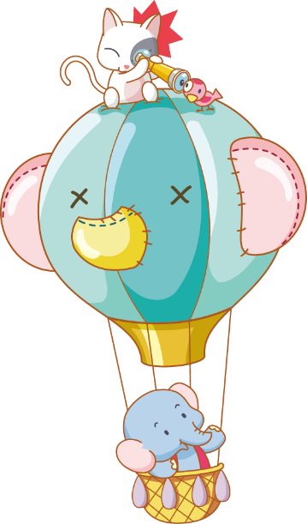
Entrepreneurial activities differ substantially depending on the type of organization and creativity. Entrepreneurial activities differ

Slide 15
Entrepreneurial activities differ substantially depending on the type of organization and creativity. Entrepreneurial activities differ

Slide 16
儿童节
Entrepreneurial activities differ substantially depending on the type of organization and creativity. Entrepreneurial activities differ

Slide 17
04.单击添加标题
Entrepreneurial activities differ substantially depending on the type of organization and creativity. Entrepreneurial activities differ

Slide 18
儿童节
Entrepreneurial activities differ substantially depending on the type of organization and creativity. Entrepreneurial activities differ

Slide 19
Entrepreneurial activities differ substantially depending on the type of organization and creativity. Entrepreneurial activities differ

Slide 20
儿童节
Entrepreneurial activities differ substantially depending on the type of organization and creativity. Entrepreneurial activities differ

Slide 21
Entrepreneurial activities differ substantially depending on the type of

