Slide 1
商务风 · 总结计划
THIS IS A ART TEMPLATE , THANK YOU WATCHING THIS ONE.
Just for today I will try to live through this day only and not tackle my whole life problem at once Just for today I will try to live through this
汇报人：xiazaii 时间：×月

Slide 2
目 录
01
02
03
04
季 度 总 结
案 例 分 析
不 足 之 处
未 来 计 划
单击此处可编辑内容，根据您的需要自由拉伸文本框大小
单击此处可编辑内容，根据您的需要自由拉伸文本框大小
单击此处可编辑内容，根据您的需要自由拉伸文本框大小
单击此处可编辑内容，根据您的需要自由拉伸文本框大小

Slide 3
第一部分
点击输入本栏的具体文字，简明扼要的说明分项内容，点击输入本栏的具体文字

Slide 4
添加标题
97%
Just for today I will try to live through this day only and not tackle my whole life problem at once Just for
添加标题
50%
Just for today I will try to live through this day only and not tackle my whole life problem at once Just for
Just for today I will try to live through this day only and not tackle my whole life problem at once Just for

Slide 5
添加标题
添加标题
添加标题
添加标题
Just for today I will try to live through this day only and not tackle my whole life problem at once Just for
Just for today I will try to live through this day only and not tackle my whole life problem at once Just for
Just for today I will try to live through this day only and not tackle my whole life problem at once Just for
Just for today I will try to live through this day only and not tackle my whole life problem at once Just for

Slide 6
点击此处添加标题
Just for today I will try to live through this day only and not tackle my whole life problem at once. Just for today
点击此处添加标题
Just for today I will try to live through this day only and not tackle my whole life problem at once. Just for today
点击此处添加标题
Just for today I will try to live through this day only and not tackle my whole life problem at once. Just for today
点击此处添加标题
Just for today I will try to live through this day only and not tackle my whole life problem at once. Just for today

Slide 7
ADD YOUR TITTLE HERE
Just for today I will try to live through this day only and not tackle my whole life problem at once Just for today I will try to live through this。Just for today I will try to live through this day only and not tackle my whole life problem at once Just for today I will try to live through this
Just for today I will try to live through this day only and not tackle my whole life problem at once Just for
Just for today I will try to live through this day only and not tackle my whole life problem at once Just for

Slide 8
第二部分
点击输入本栏的具体文字，简明扼要的说明分项内容，点击输入本栏的具体文字

Slide 9
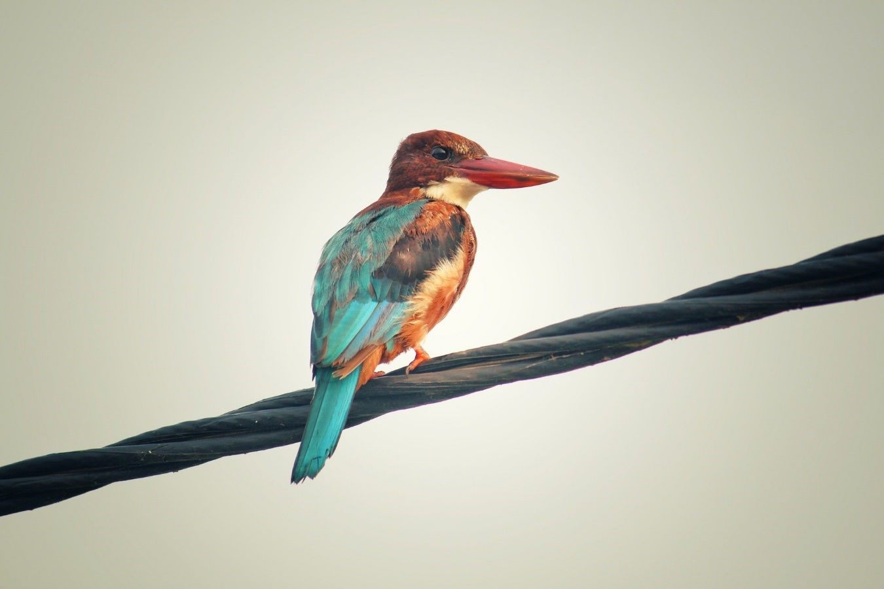
点击输入标题
Just for today I will try to live through this day only and not tackle my whole life problem at once Just for
点击输入标题
Just for today I will try to live through this day only and not tackle my whole life problem at once Just for
点击输入标题
Just for today I will try to live through this day only and not tackle my whole life problem at once Just for

Slide 10
ADD YOUR TITTLE
Just for today I will try to live through this day only and not tackle my whole life problem at once. I can do for twelve hours that Just for
ADD YOUR TITTLE
Just for today I will try to live through this day only and not tackle my whole life problem at once. I can do for twelve hours that Just for
ADD YOUR TITTLE
Just for today I will try to live through this day only and not tackle my whole life problem at once. I can do for twelve hours that Just for
ADD YOUR TITTLE
Just for today I will try to live through this day only and not tackle my whole life problem at once. I can do for twelve hours that Just for

Slide 11
此处添加标题
Just for today I will try to live through this day only and not tackle my whole life problem at once. I can do for twelve hours that Just for
此处添加标题
Just for today I will try to live through this day only and not tackle my whole life problem at once. I can do for twelve hours that Just for

Slide 12
第三部分
点击输入本栏的具体文字，简明扼要的说明分项内容，点击输入本栏的具体文字

Slide 13
1
hours that Just for today I will try to live through this day only and not tackle my whole life problem at
2
hours that Just for today I will try to live through this day only and not tackle my whole life problem at
3
hours that Just for today I will try to live through this day only and not tackle my whole life problem at

Slide 14
添加标题
添加标题
hours that Just for today I will try to live through this day only and not tackle my whole life problem at
hours that Just for today I will try to live through this day only and not tackle my whole life problem at
添加标题
添加标题
hours that Just for today I will try to live through this day only and not tackle my whole life problem at
hours that Just for today I will try to live through this day only and not tackle my whole life problem at

Slide 15
第四部分
点击输入本栏的具体文字，简明扼要的说明分项内容，点击输入本栏的具体文字

Slide 16
You can click here to enter you text. You can click here to enter you text. You can click here to enter you text. You can click here to enter you text.
2015
2016
2017
2018
You can click here to enter you text. You can click here to enter you text. You can click here to enter you text.
You can click here to enter you text. You can click here to enter you text. You can click here to enter you text.
You can click here to enter you text. You can click here to enter you text. You can click here to enter you text.
You can click here to enter you text. You can click here to enter you text. You can click here to enter you text.

Slide 17
商务风 · 谢谢大家
THIS IS A ART TEMPLATE , THANK YOU WATCHING THIS ONE.
Just for today I will try to live through this day only and not tackle my whole life problem at once Just for today I will try to live through this
汇报人：xiazaii 时间：×月

