Slide 1
Resume

Slide 2
ABOUT
·
ME

Slide 3
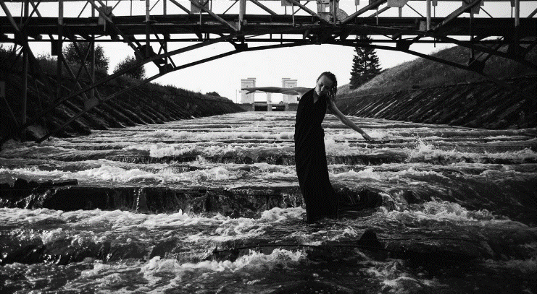
NAME:
GENDE:
AGE:
MAJOR:
Abigail
Female
23
English
BASIC
information

Slide 4
THIS IS MY
MOTTO
The road of life is not Everything is
going smoothly. the cause of the journey is full of rugged and dangerous,
only struggle, only hard work, can reach the shore of success.

Slide 5
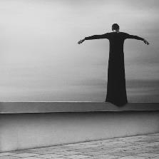
Writing
Playing
Traveling
Reading
WG
PG
TG
RG
Interests
hobbies
AND

Slide 6
WORKING
·
EXPERIENCE

Slide 7
1
ALTERNATIVE
2
ENTERPRISE
Feature A
Sevice A
We were one of the first energy companies in 1997 to acknowledge the threat of climate change, to call for action by governments, our industry and energy users, and to take action ourselves.
We were one of the first energy companies.
Sevice B
We were one of the first energy companies.
Feature B
Sevice C
our industry and energy users, and to take action ourselves.
We were one of the first energy companies.

Slide 8
3
SERVICE
4
STRENGTH
Service A
Strength A
We were one of the first energy companies.
We were one of the first energy companies in 1997 to acknowledge the threat of climate change, to call for action by governments, our industry and energy users, and to take action ourselves.
Strength B
We were one of the first energy companies.
Service B
Strength C
We were one of the first energy companies.
our industry and energy users, and to take action ourselves.
our industry and energy users, and to take action ourselves.

Slide 9
5
DESIGN
6
PUBLIC
7
CONTACT
PR CAMPAINGE
E-MAIL
We were one of the first energy companies in 1997 to acknowledge the threat of climate change, to call for action by governments, our industry and energy users, and to take action ourselves.
XXX@XXX.com
IM
Tweeter:@XXXXXX
VIEW
PR
FAX
our industry and energy users, and to take action ourselves.
+01 XXXXXXXXX
our industry and energy users, and to take action ourselves.

Slide 10
WORKING
·
SKILL

Slide 11
1
3
Original design
studio of slide show
Most Talent experts
in E-Commercial
PS
AI
AE
PR
2
4
an original design
studio of slide show
An unicorn Company
in further future

Slide 12
POSITION
OF·
THE JOB

Slide 13
Design means
everything.
Hugo J. Aderson
The website's name stems from the colloquial name of books given to students at the start of the academic year by university administrations in the US with the intention of helping students to get to know each other better.

Slide 14
BELIEF
IN·
WORK

Slide 15
We have made efforts to reduce the emissions of local pollutants from our operations.
This has involved a wide range of investments to upgrade facilities, install cleaner-burning equipment and sulphur dioxide capture technology.
opini n

