Slide 1
When facing the sun
There would be no shadow

Slide 2
Contents
Memories
Favorite City
My Hobbies
Basic Info

Slide 3
First Part
Basic Info
Basic Info

Slide 4
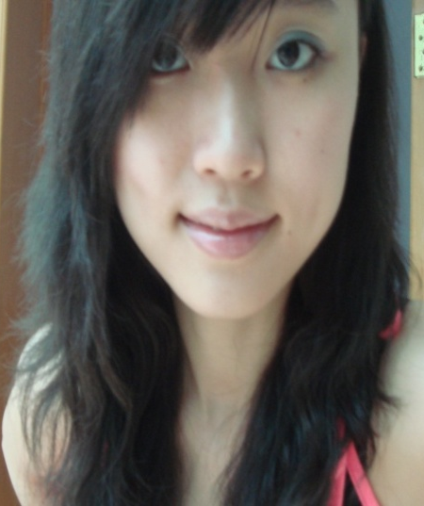
Basic Information
Name: QiaoJia Li
English Name: Crystal
Age: 23
My Family: Father、Mother
Sister and Brother-in-law、
My little nephew

Slide 5
Second Part
My Hobbies
My Hobbies

Slide 6
My Hobbies
Play Ping-Pong
Interesting, Easy
China is the best!

Slide 7
My Hobbies
Friends

Slide 8
Third Part
Favorite City
Favorite City

Slide 9
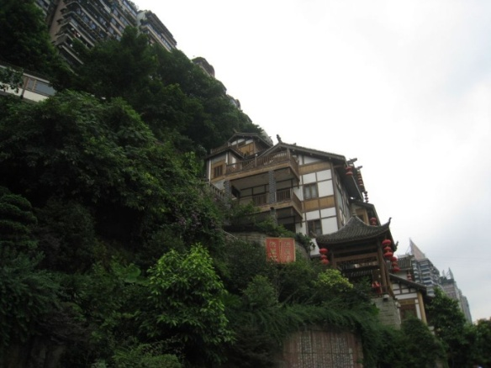
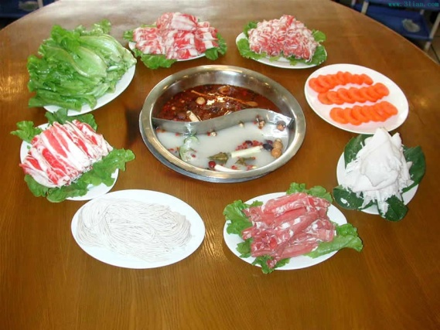
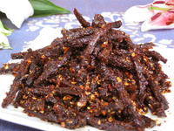
Favorite Cities
ChongQing – Delicious food

Slide 10
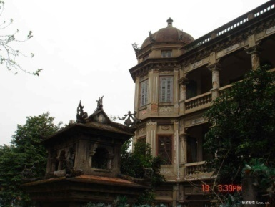
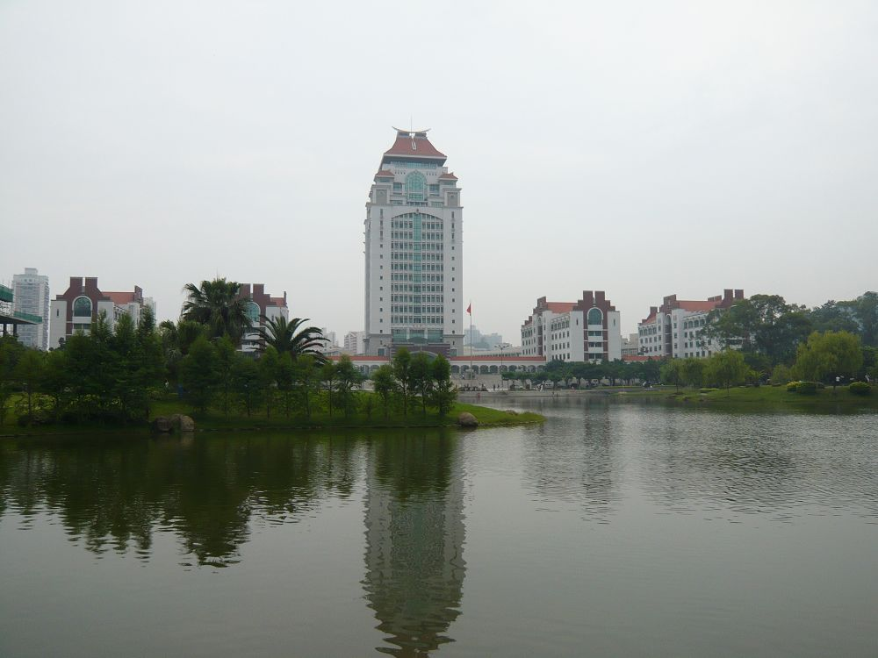
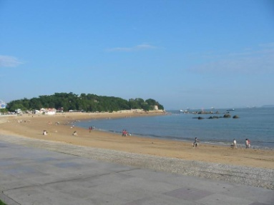
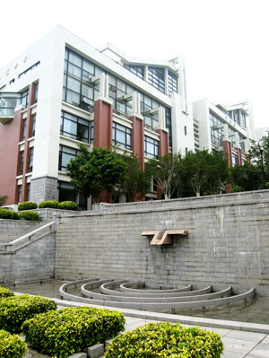
Favorite Cities
XiaMen - Beautiful、Comfortable

Slide 11
Fourth Part
Memories
Memories

Slide 12
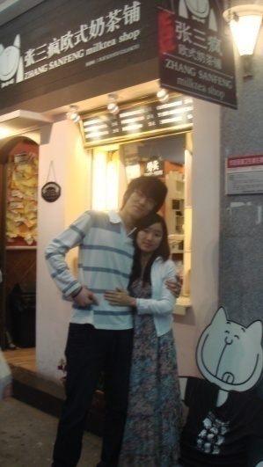
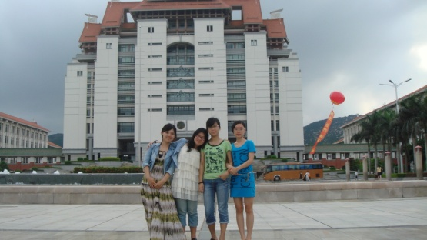
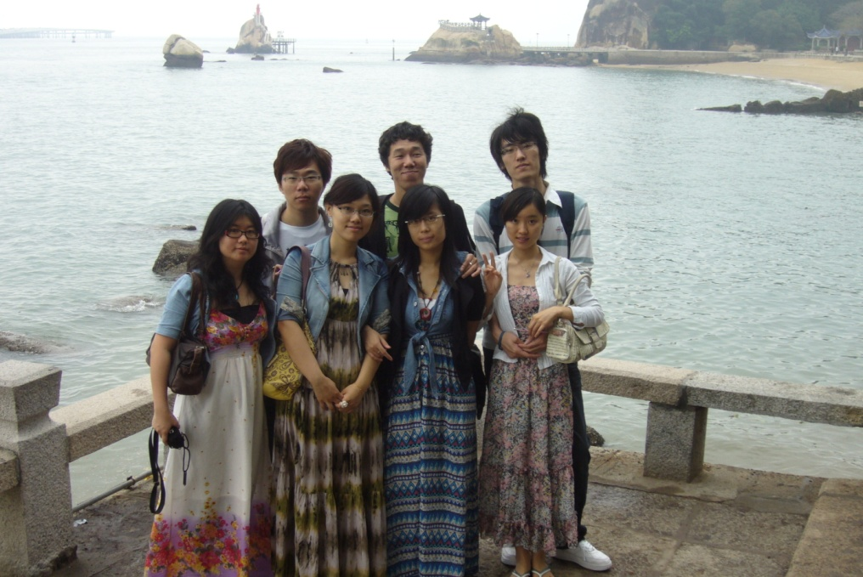
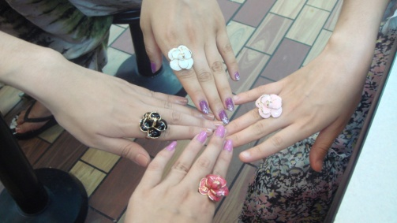
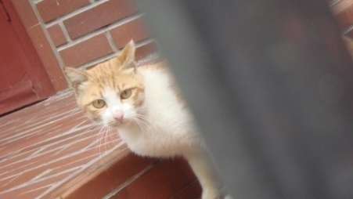
Precious Memories
Never Forget

Slide 13
When facing the sun
There would be no shadow

Slide 14
Thank you!

