Slide 1
SUZANNE VEGA
RESUME

Slide 2
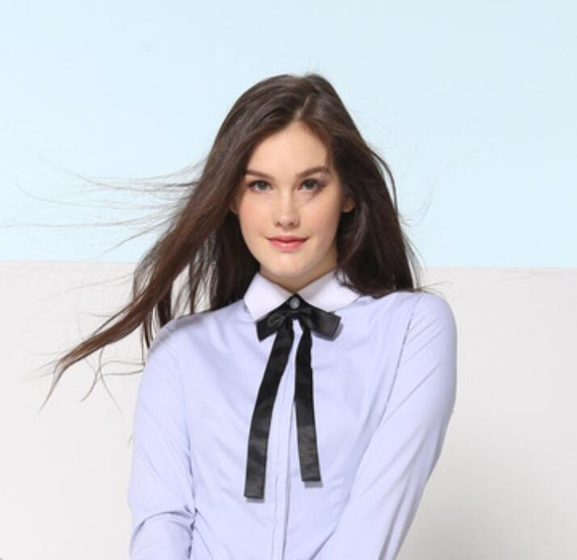
JOB DESCRIPTION

Slide 3



SHANGHAI
+86+021+0762
POWERPOINT
Where Bob Dylan Performed For The First Time. Due To The Performance Of The Club In The Village Of Greenwich By Peers And The Audience's Praise, Which Makes Suzanne's Confidence Doubled, But Also Strengthened Her Confidence In Her Own Singing Career Go Down. In 1979, Vega Saw A Famous American Punk Rock Pioneer Lou Reed After The Concert, Shocked, I Feel Like Lou Reed As Creative.
IN 1978
PERFORMED AT A CLUB IN THE VILLAGE OF GREENWICH

Slide 4
INTRODUCTION
SUSAN VEGA, BORN IN JULY 11, 1959 IN CALIFORNIA, USA, SINGER AND SONGWRITER.
She Is Considered To Be The Leader Of The 80s Movement Folk Revival, She Often Embrace The Guitar Club Appeared In The Village Of Greenwich, Singing That Through Her Own Adaptation Of The Black Bruce Songs And Modern Folk Songs.

Slide 5
INTRODUCTION
SUSAN VEGA, BORN IN JULY 11
1959 IN CALIFORNIA, USA, SINGER AND SONGWRITER
She Is Considered To Be The Leader Of The 80s Movement Folk Revival
She Often Embrace The Guitar Club Appeared In T
HE VILLAGE OF GREENWICHSINGING
That Through Her Own Adaptation Of The Black Bruce Songs And Modern Folk Songs.

Slide 6
STATEMENT
FAITHFUL INTEGRITY, PRINCIPLES, SAYS IT WILL DO, AND NEVER SHIRK RESPONSIBILITY
Self-control, Do Things Always Adhere To The Beginnings And Ends, Never Give Up Halfway
Willing To Learn, Have A Problem, Not To Escape, Is Willing To Learn From Others
Confident But Not Conceited, Not Self-centered;we Are Willing To Accept The Superior Who Commends Humility, With Authority
we Will Use 100% Of The Enthusiasm And Energy Into Work
Approachable.Is Sincere, Cheerful, Proactive, Adaptable, Studious, Down To Earth, There Is A Strong Team Spirit
Proactive Work Attitude Seriously.

Slide 7


SPECIALITIES
Brand Design
Mobile Web Planning
Creative Alike

Slide 8
DESIGN SKILLS
Adobe Photoshop
Claris Home Page
Adobe Iiiustator
Adobe Dreamweaver
Adobe Coreldraw
Adobe Fireworks
Adobe Freehand
Adobe Flash
Adobe Pagemaker
Adobe Pagemill
Adobe Indsign
Microsoft Frontpage

Slide 9
LANGUAGE
CHINA
Mother language
ENGLISH
Advanced level
SHANGHAINESE
Mother language

Slide 10
EDUCATION
2012-2016 / Southeast University
Disciplines Including Statistics
International Business English, International Business Negotiations
2016
2010-2012 / Experimental High School
Disciplines Including Statistics
International Business English, International Business Negotiations
2008-2010 / Experimental Junior High School
Disciplines Including Statistics
International Business English, International Business Negotiations
2003
2003-2008 / Experimental Primary School
Disciplines Including Statistics
International Business English, International Business Negotiations

Slide 11
EXPERIENCE
1
3
From 2010 To 2011
Creative Design Company To Do The Design Work Related Internships
From 2012 To 2015
Fortune 500 Company Design Designer

Slide 12
RECOGNITIONS
Feng Ai Award
Practical Action To Care For The Class With The Studentsactively Organize Or Participate In Volunteer Service Activitieswith Strong Dedication And Sense
1-2
Technology Award
Love Of Science And Technology Inventionswith A Strong Innovative Spirit And Practical Ability
Get The Highest Scores In The Municipal Science And Technology Class
3-6

Slide 13
HOBBIES
Hot Balloon
On Foot
Game
Calligraphy
Football
Boxing
Badminton
Swim
Dancing
Reading

Slide 14


SOCIAL MEDIA
SUZANNE VEGA
SUZANNE VEGA
SUZANNE VEGA
SUZANNE VEGA
SUZANNE VEGA
SUZANNE VEGA

Slide 15
SUZANNE VEGA

Slide 16
THANKS
RESUME

