Slide 1

2018
BUSINESS PLAN
公司简介
The user can demonstrate on a projector or computer, or print the presentation and make it into a film to be used in a wider field. Using PowerPoint

Slide 2

CONTENT
1
公司历程介绍
2
产品服务推广
3
企业文化荣誉
4
企业发展规划

Slide 3
PART 01
公司历程介绍
The user can demonstrate on a projector or computer, or print the presentation and make it into a film to be used in a wider field.

Slide 4


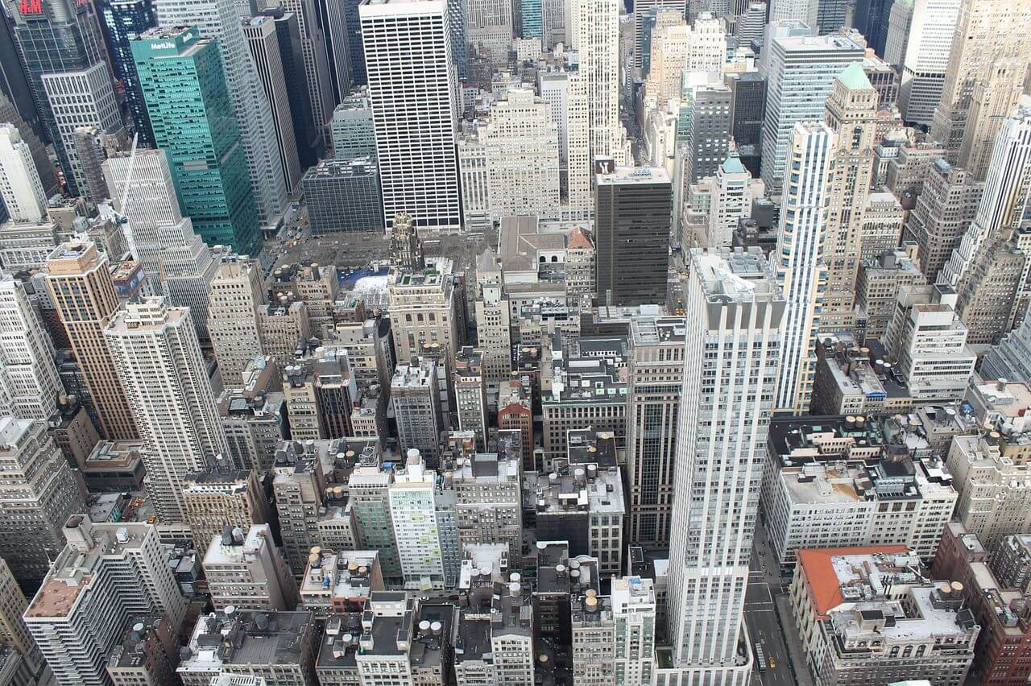
公司历程介绍
The user can demonstrate on a projector or computer
标题文字添加
The user can demonstrate on a projector or computer, or print the presentation and make it into a film to be used in a wider field. Using PowerPoint,
标题文字添加
The user can demonstrate on a projector or computer, or print the presentation and make it into a film to be used in a wider field. Using PowerPoint, The user can demonstrate on a projector or computer, or print the presentation and make it into a film to be used in a wider field. Using PowerPoint, The user can demonstrate on a projector or computer, or print the presentation and make it into a film to be used in a wider field. Using PowerPoint,
The user can demonstrate on a projector or computer, or print the presentation and make it into a film to be used in a wider field. Using PowerPoint,

Slide 5
公司历程介绍
The user can demonstrate on a projector or computer
2018
标题文字添加
The user can demonstrate on a projector or computer, or print the presentation and make it into a film to be used in a wider field. Using PowerPoint,

Slide 6

标题文字添加
The user can demonstrate on a projector or computer, or print the presentation and make it into a film to be used in a wider field. Using PowerPoint,
2017
标题文字添加
The user can demonstrate on a projector or computer, or print the presentation and make it into a film to be used in a wider field. Using PowerPoint,
标题文字添加
The user can demonstrate on a projector or computer, or print the presentation and make it into a film to be used in a wider field. Using PowerPoint,

Slide 7
2016
标题文字添加
The user can demonstrate on a projector or computer, or print the presentation and make it into a film to be used in a wider field. Using PowerPoint,
标题文字添加
The user can demonstrate on a projector or computer, or print the presentation and make it into a film to be used in a wider field. Using PowerPoint,

Slide 8




公司历程介绍
The user can demonstrate on a projector or computer
标题文字添加
The user can demonstrate on a projector or computer, or print the presentation and make it into a film to be used in a wider field. Using PowerPoint,

Slide 9
PART 02
产品服务推广
The user can demonstrate on a projector or computer, or print the presentation and make it into a film to be used in a wider field.

Slide 10

The user can demonstrate on a projector or computer
产品服务推广
标题文字添加
The user can demonstrate on a projector or computer, or print the presentation and make it into a film to be used in a wider field. Using PowerPoint,

Slide 11




产品服务推广
The user can demonstrate on a projector or computer
标题文字添加
标题文字添加
标题文字添加
标题文字添加
The user can demonstrate on a projector or computer, or print the presentation and make it into a film to be used in a wider field. Using PowerPoint,
The user can demonstrate on a projector or computer, or print the presentation and make it into a film to be used in a wider field. Using PowerPoint,
The user can demonstrate on a projector or computer, or print the presentation and make it into a film to be used in a wider field. Using PowerPoint,
The user can demonstrate on a projector or computer, or print the presentation and make it into a film to be used in a wider field. Using PowerPoint,

Slide 12
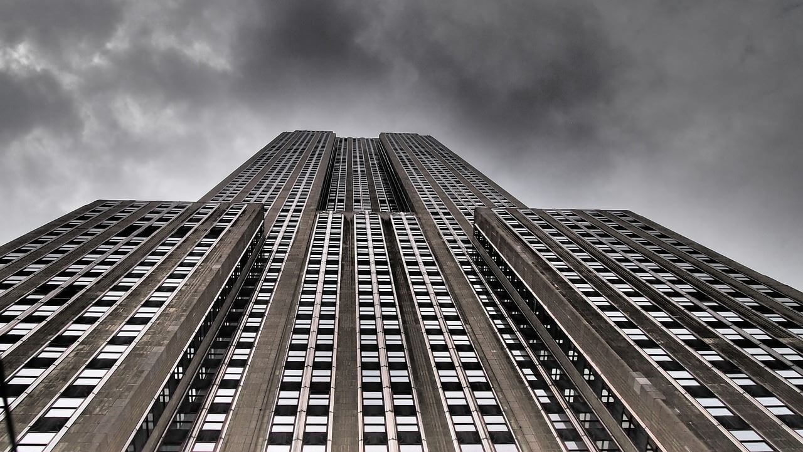
产品服务推广
The user can demonstrate on a projector or computer
标题文字添加
The user can demonstrate on a projector or computer, or print the presentation and make it into a film to be used in a wider field. Using PowerPoint, The user can demonstrate on a projector or computer, or print the presentation and make it into a film to be used in a wider field. Using PowerPoint, The user can demonstrate on a projector or computer, or print the presentation and make it into a film to be used in a wider field. Using PowerPoint,
The user can demonstrate on a projector or computer, or print the presentation and make it into a film to be used in a wider field. Using PowerPoint, The user can demonstrate on a projector or computer, or print the presentation and make it into a film to be used in a wider field. Using PowerPoint, The user can demonstrate on a projector or computer, or print the presentation and make it into a film to be used in a wider field. Using PowerPoint,

Slide 13
产品服务推广
The user can demonstrate on a projector or computer
标题文字添加
标题文字添加
The user can demonstrate on a projector or computer, or print the presentation and make it into a film to be used in a wider field. Using PowerPoint,
The user can demonstrate on a projector or computer, or print the presentation and make it into a film to be used in a wider field. Using PowerPoint,
标题文字添加
标题文字添加
The user can demonstrate on a projector or computer, or print the presentation and make it into a film to be used in a wider field. Using PowerPoint,
The user can demonstrate on a projector or computer, or print the presentation and make it into a film to be used in a wider field. Using PowerPoint,

Slide 14
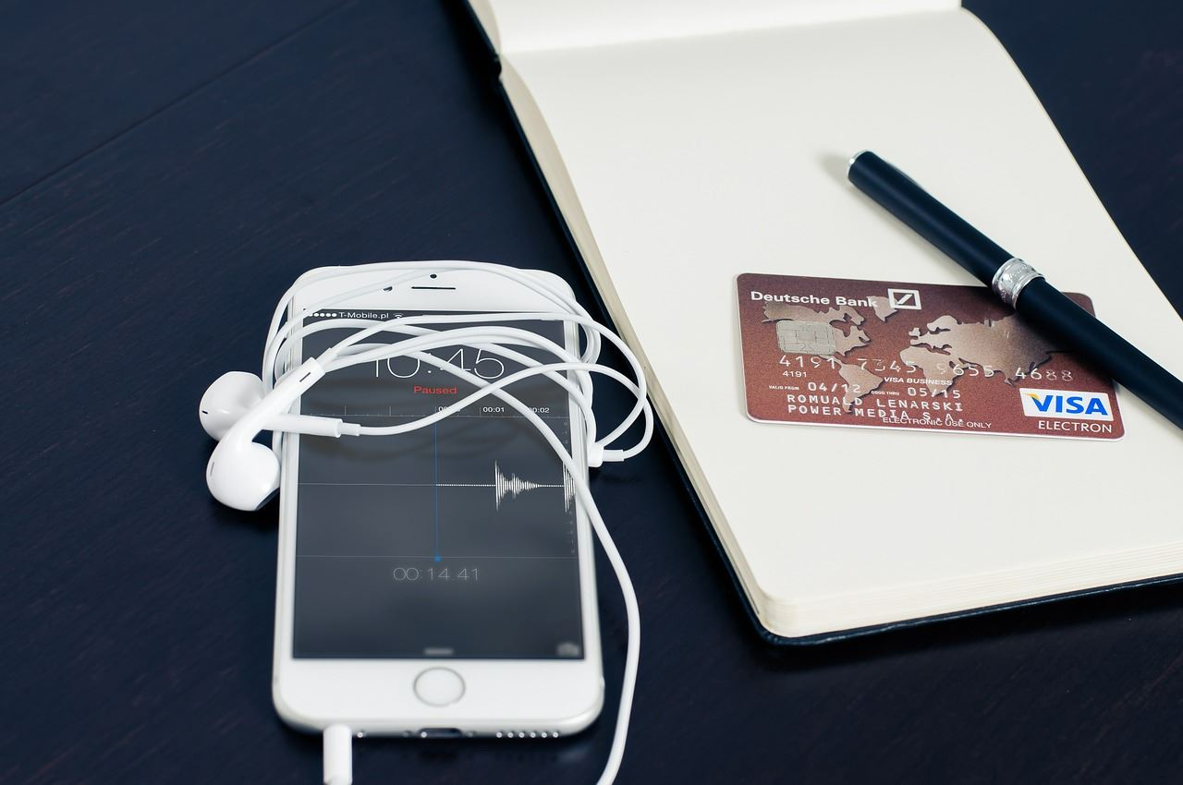

产品服务推广
The user can demonstrate on a projector or computer
标题文字添加
标题文字添加
The user can demonstrate on a projector or computer, or print the presentation and make it into a film to be used in a wider field. Using PowerPoint,
The user can demonstrate on a projector or computer, or print the presentation and make it into a film to be used in a wider field. Using PowerPoint,
标题文字添加
标题文字添加
The user can demonstrate on a projector or computer, or print the presentation and make it into a film to be used in a wider field. Using PowerPoint,
The user can demonstrate on a projector or computer, or print the presentation and make it into a film to be used in a wider field. Using PowerPoint,

Slide 15
PART 03
企业文化荣誉
The user can demonstrate on a projector or computer, or print the presentation and make it into a film to be used in a wider field.

Slide 16
企业文化荣誉
The user can demonstrate on a projector or computer
The user can demonstrate on a projector or computer, or print the presentation and make it into a film to be used in a wider field. Using PowerPoint, The user can demonstrate on a projector or computer, or print the presentation and make it into a film to be used in a wider field. Using PowerPoint, The user can demonstrate on a projector or computer, or print the presentation and make it into a film to be used in a wider field. Using PowerPoint,

Slide 17
企业文化荣誉
The user can demonstrate on a projector or computer
标题文字添加
The user can demonstrate on a projector or computer, or print the presentation and make it into a film to be used in a wider field. Using PowerPoint,
标题文字添加
The user can demonstrate on a projector or computer, or print the presentation and make it into a film to be used in a wider field. Using PowerPoint,
标题文字添加
The user can demonstrate on a projector or computer, or print the presentation and make it into a film to be used in a wider field. Using PowerPoint,

Slide 18



企业文化荣誉
The user can demonstrate on a projector or computer
标题文字添加
标题文字添加
The user can demonstrate on a projector or computer, or print the presentation and make it into a film to be used in a wider field. Using PowerPoint,
The user can demonstrate on a projector or computer, or print the presentation and make it into a film to be used in a wider field. Using PowerPoint,
标题文字添加
标题文字添加
The user can demonstrate on a projector or computer, or print the presentation and make it into a film to be used in a wider field. Using PowerPoint,
The user can demonstrate on a projector or computer, or print the presentation and make it into a film to be used in a wider field. Using PowerPoint,

Slide 19
企业文化荣誉
The user can demonstrate on a projector or computer
标题文字添加
The user can demonstrate on a projector or computer, or print the presentation and make it into a film to be used in a wider field. Using PowerPoint,
标题文字添加
The user can demonstrate on a projector or computer, or print the presentation and make it into a film to be used in a wider field. Using PowerPoint,
The user can demonstrate on a projector or computer, or print the presentation and make it into a film to be used in a wider field. Using PowerPoint, The user can demonstrate on a projector or computer, or print the presentation and make it into a film to be used in a wider field. Using PowerPoint, The user can demonstrate on a projector or computer, or print the presentation and make it into a film to be used in a wider field. Using PowerPoint,

Slide 20
PART 04
企业发展规划
The user can demonstrate on a projector or computer, or print the presentation and make it into a film to be used in a wider field.

Slide 21
企业发展规划
The user can demonstrate on a projector or computer
标题文字添加
The user can demonstrate on a projector or computer, or print the presentation and make it into a film to be used in a wider field. Using PowerPoint, The user can demonstrate on a projector or computer, or print the presentation and make it into a film to be used in a wider field. Using PowerPoint, The user can demonstrate on a projector or computer, or print the presentation and make it into a film to be used in a wider field. Using PowerPoint,
标题文字添加
The user can demonstrate on a projector or computer, or print the presentation and make it into a film to be used in a wider field. Using PowerPoint, The user can demonstrate on a projector or computer, or print the presentation and make it into a film to be used in a wider field. Using PowerPoint, The user can demonstrate on a projector or computer, or print the presentation and make it into a film to be used in a wider field. Using PowerPoint,

Slide 22
企业发展规划
The user can demonstrate on a projector or computer
标题文字添加
标题文字添加
标题文字添加
标题文字添加
The user can demonstrate on a projector or computer, or print the presentation and make it into a film to be used in a wider field. Using PowerPoint,
The user can demonstrate on a projector or computer, or print the presentation and make it into a film to be used in a wider field. Using PowerPoint,
The user can demonstrate on a projector or computer, or print the presentation and make it into a film to be used in a wider field. Using PowerPoint,
The user can demonstrate on a projector or computer, or print the presentation and make it into a film to be used in a wider field. Using PowerPoint,

Slide 23
企业发展规划
The user can demonstrate on a projector or computer
标题文字添加
标题文字添加
标题文字添加
标题文字添加
The user can demonstrate on a projector or computer, or print the presentation and make it into
The user can demonstrate on a projector or computer, or print the presentation and make it into
The user can demonstrate on a projector or computer, or print the presentation and make it into
The user can demonstrate on a projector or computer, or print the presentation and make it into
The user can demonstrate on a projector or computer, or print the presentation and make it into a film to be used in a wider field. Using PowerPoint, The user can demonstrate on a projector or computer, or print the presentation and make it into a film to be used in a wider field. Using PowerPoint, The user can demonstrate on a projector or computer, or print the presentation and make it into a film to be used in a wider field. Using PowerPoint,

Slide 24
企业发展规划
The user can demonstrate on a projector or computer
标题文字添加
The user can demonstrate on a projector or computer, or print the presentation and make it into a film to be used in a wider field. Using PowerPoint, The user can demonstrate on a projector or computer, or print the presentation and make it into a film to be used in a wider field. Using PowerPoint, The user can demonstrate on a projector or computer, or print the presentation and make it into a film to be used in a wider field. Using PowerPoint,
标题文字添加
标题文字添加
The user can demonstrate on a projector or computer, or print the presentation and make it into a film to be used in a wider field. Using PowerPoint,
The user can demonstrate on a projector or computer, or print the presentation and make it into a film to be used in a wider field. Using PowerPoint,

Slide 25
2018
BUSINESS PLAN
THANKS
The user can demonstrate on a projector or computer, or print the presentation and make it into a film to be used in a wider field. Using PowerPoint

