Slide 1
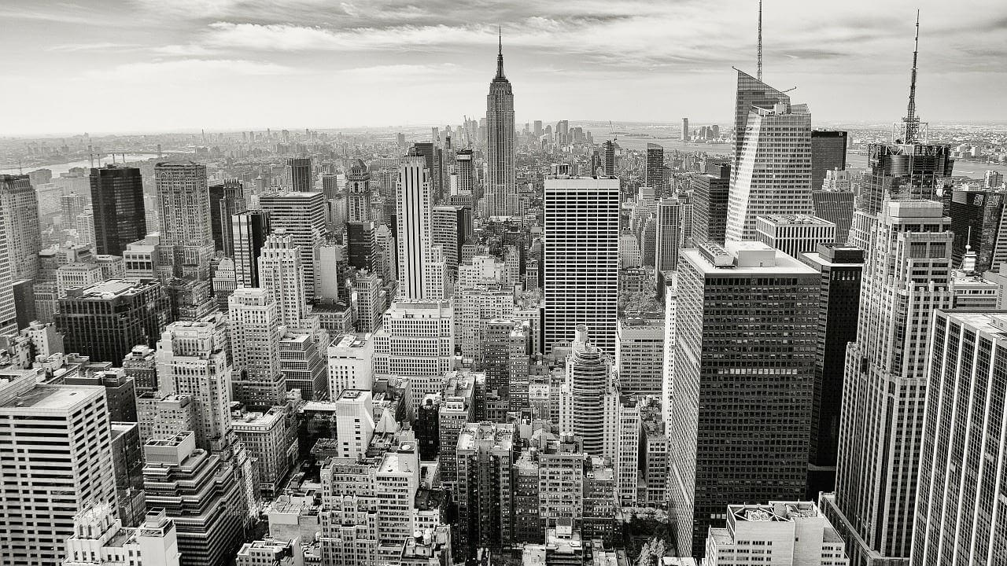
BUSINESS PLAN
2020
半年工作总结汇报
The user can demonstrate on a projector or computer, or print the presentation and make it into a film to be used in a wider field The user can demonstrate

Slide 2
CONTENTS
01 . 年度工作概述
03 . 工作存在不足
print the presentation and make it into a film a wider field
print the presentation and make it into a film a wider field
02 . 工作完成情况
04 . 明年工作计划
print the presentation and make it into a film a wider field
print the presentation and make it into a film a wider field

Slide 3
PART 01
年度工作概述
print the presentation and make it into a film to be used in a wider field The user can demonstrate on a projector or computer

Slide 4
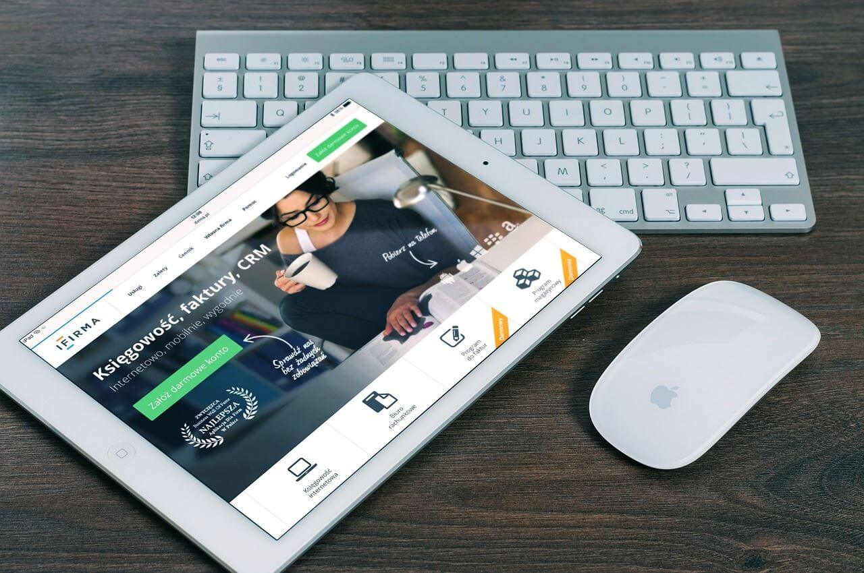
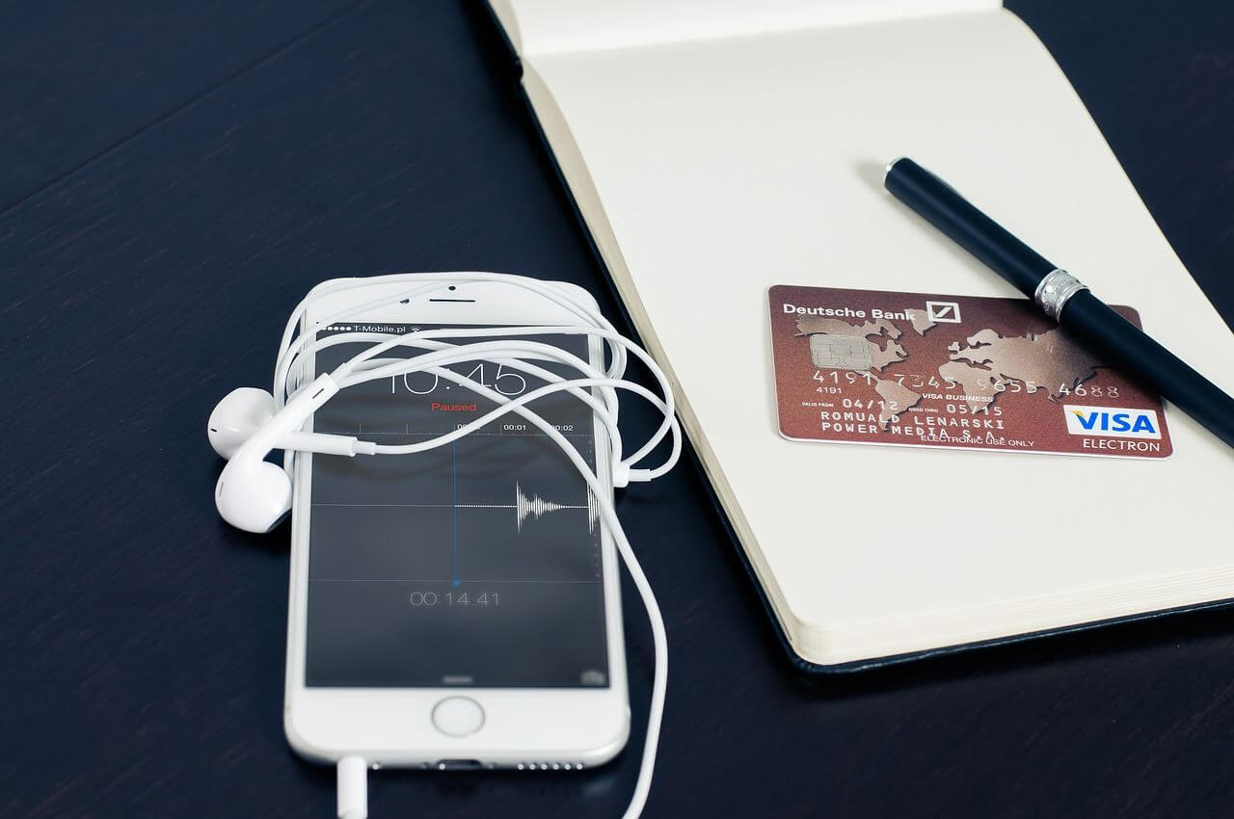
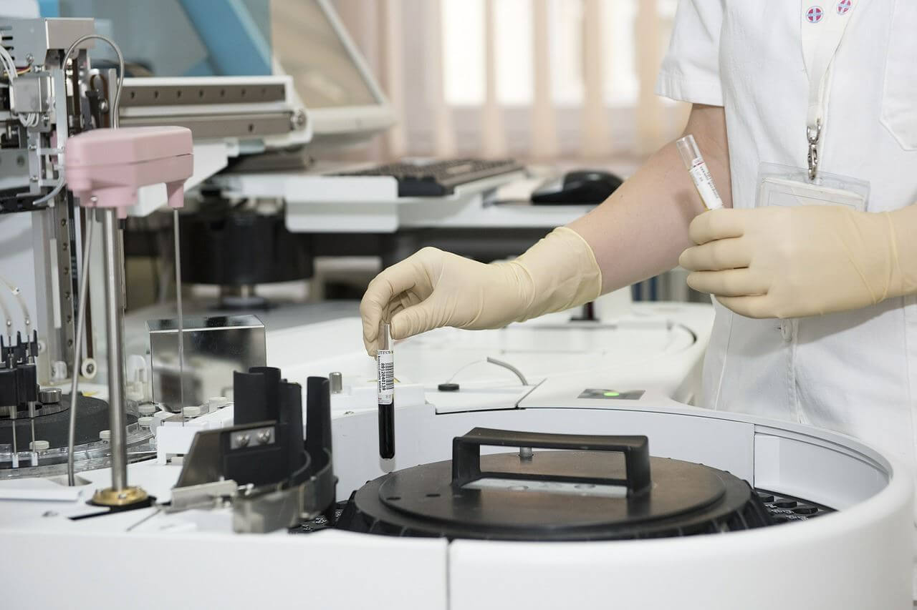

年度工作概述
print the presentation and make it into a film to be used in a wider
标题文字添加
The user can demonstrate on a projector or computer, or preseand make it film to be used in a wider field
标题文字添加
The user can demonstrate on a projector or computer, or preseand make it film to be used in a wider field

Slide 5

年度工作概述
print the presentation and make it into a film to be used in a wider
标题文字添加
标题文字添加
The user can demonstrate on a projector or computer, or presentation and make it film to be used in a wider field
The user can demonstrate on a projector or computer, or presentation and make it film to be used in a wider field
标题文字添加
标题文字添加
The user can demonstrate on a projector or computer, or presentation and make it film to be used in a wider field
The user can demonstrate on a projector or computer, or presentation and make it film to be used in a wider field

Slide 6
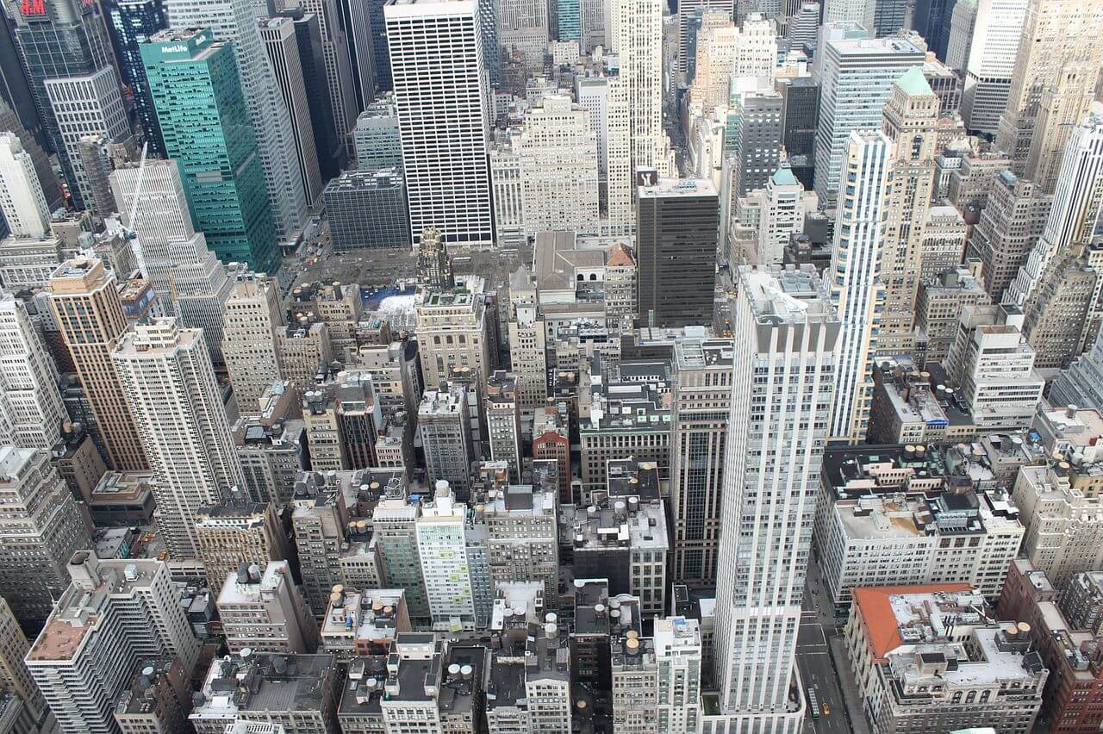



年度工作概述
print the presentation and make it into a film to be used in a wider
The user can demonstrate on a projector or computer, or presentation and make it film to be used in a wider field
The user can demonstrate on a projector or computer, or presentation and make it film to be used in a wider field
The user can demonstrate on a projector or computer, or presentation and make it film to be used in a wider field

Slide 7
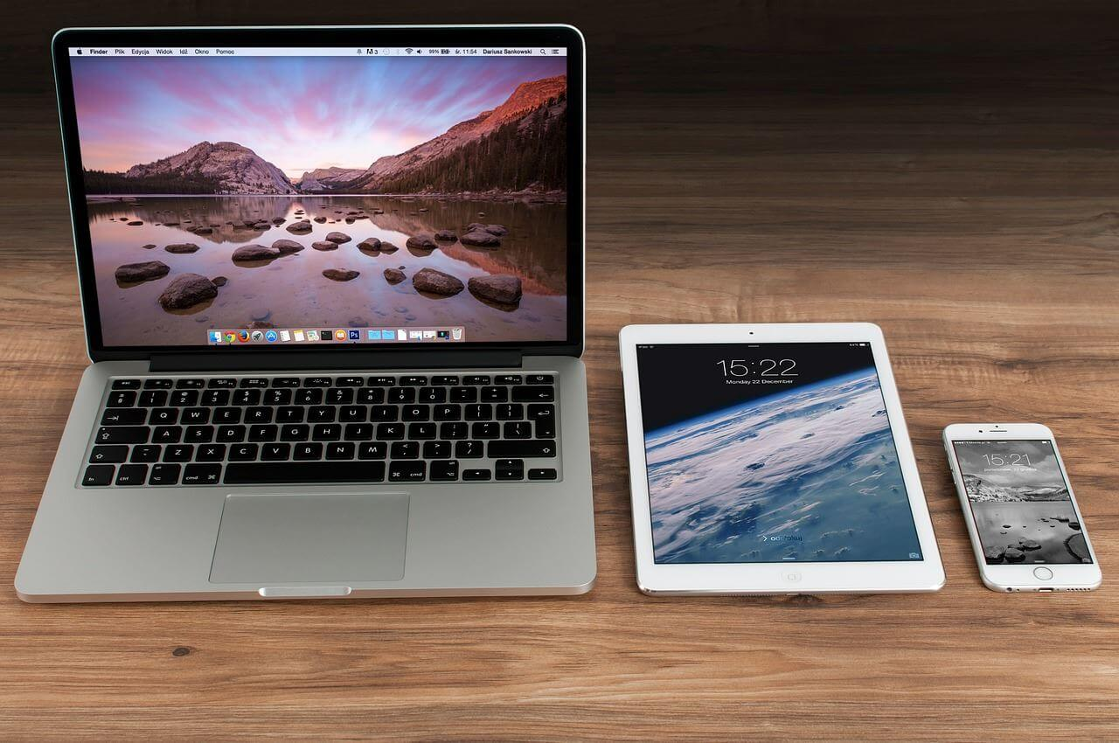

年度工作概述
print the presentation and make it into a film to be used in a wider
标题文字添加
标题文字添加
The user can demonstrate on a projector or computer, or presentation and make it film to be used in a wider field
The user can demonstrate on a projector or computer, or presentation and make it film to be used in a wider field
标题文字添加
The user can demonstrate on a projector or computer, or presentation and make it film to be used in a wider field

Slide 8
年度工作概述
print the presentation and make it into a film to be used in a wider
The user can demonstrate on a projector or computer, or presentation and make it film to be used in a wider field
The user can demonstrate on a projector or computer, or presentation and make it film to be used in a wider field
The user can demonstrate on a projector or computer, or presentation and make it film to be used in a wider field
The user can demonstrate on a projector or computer, or presentation and make it film to be used in a wider field

Slide 9
PART 02
工作完成情况
print the presentation and make it into a film to be used in a wider field The user can demonstrate on a projector or computer

Slide 10
工作完成情况
print the presentation and make it into a film to be used in a wider
The user can demonstrate on a projector or computer, or presentation and make it film to be used in a wider field
标题文字添加
标题文字添加
标题文字添加
标题文字添加
The user can demonstrate on a projector or computer, or presentation and make it film to be used in a wider field
The user can demonstrate on a projector or computer, or presentation and make it film to be used in a wider field
The user can demonstrate on a projector or computer, or presentation and make it film to be used in a wider field
The user can demonstrate on a projector or computer, or presentation and make it film to be used in a wider field

Slide 11
工作完成情况
print the presentation and make it into a film to be used in a wider
The user can demonstrate on a projector or computer, orThe user can demonstrate on a projector or computer, or print the presentation and make it into a film printThe user can demonstrate on a projector or computer, or print the presentation and make it into a film theThe user
The user can demonstrate on a projector or computer, or presentation and make it film to be used in a wider field
标题文字添加
The user can demonstrate on a projector or computer, or presentation and make it film to be used in a wider field
标题文字添加
标题文字添加
The user can demonstrate on a projector or computer, or presentation and make it film to be used in a wider field
标题文字添加
The user can demonstrate on a projector or computer, or presentation and make it film to be used in a wider field

Slide 12
工作完成情况
print the presentation and make it into a film to be used in a wider
标题文字添加
The user can demonstrate on a projector or computer, or presentation and make it film to be used in a wider field
标题文字添加
The user can demonstrate on a projector or computer, or presentation and make it film to be used in a wider field
标题文字添加
The user can demonstrate on a projector or computer, or presentation and make it film to be used in a wider field
标题文字添加
The user can demonstrate on a projector or computer, or presentation and make it film to be used in a wider field
标题文字添加
The user can demonstrate on a projector or computer, or presentation and make it film to be used in a wider field

Slide 13
工作完成情况
print the presentation and make it into a film to be used in a wider
40%
70%
标题文字添加
标题文字添加
The user can demonstrate on a projector or computer, or presentation and make it film to be used in a wider field
The user can demonstrate on a projector or computer, or presentation and make it film to be used in a wider field

Slide 14
工作完成情况
print the presentation and make it into a film to be used in a wider
The user can demonstrate on a projector or computer, orThe user can demonstrate on a projector or computer, or print the presentation and make it into a film printThe user can demonstrate on a projector or computer, or print the presentation and make it into a film theThe user
标题文字添加
标题文字添加
The user can demonstrate on a projector or computer, or presentation and make it film to be used in a wider field
The user can demonstrate on a projector or computer, or presentation and make it film to be used in a wider field
标题文字添加
标题文字添加
The user can demonstrate on a projector or computer, or presentation and make it film to be used in a wider field
The user can demonstrate on a projector or computer, or presentation and make it film to be used in a wider field

Slide 15
PART 03
工作存在不足
print the presentation and make it into a film to be used in a wider field The user can demonstrate on a projector or computer

Slide 16


工作存在不足
print the presentation and make it into a film to be used in a wider
标题文字添加
The user can demonstrate on a projector or computer, or presentation and make it film to be used in a wider field
标题文字添加
标题文字添加
The user can demonstrate on a projector or computer, or presentation and make it film to be used in a wider field
The user can demonstrate on a projector or computer, or presentation and make it film to be used in a wider field

Slide 17
工作存在不足
print the presentation and make it into a film to be used in a wider
The user can demonstrate on a projector or computer, orThe user can demonstrate on a projector or computer, or print the presentation and make it into a film printThe user can demonstrate on a projector or computer, or print the presentation and make it into a film theThe user
标题文字添加
The user can demonstrate on a projector or computer
标题文字添加
The user can demonstrate on a projector or computer
标题文字添加
The user can demonstrate on a projector or computer
标题文字添加
The user can demonstrate on a projector or computer

Slide 18
工作存在不足
print the presentation and make it into a film to be used in a wider
标题文字添加
标题文字添加
The user can demonstrate on a projector or computer, or presentation and make it film to be used in a wider field
The user can demonstrate on a projector or computer, or presentation and make it film to be used in a wider field
标题文字添加
标题文字添加
The user can demonstrate on a projector or computer, or presentation and make it film to be used in a wider field
The user can demonstrate on a projector or computer, or presentation and make it film to be used in a wider field

Slide 19
工作存在不足
print the presentation and make it into a film to be used in a wider
The user can demonstrate on a projector or computer, orThe user can demonstrate on a projector or computer, or print the presentation and make it into a film printThe user can demonstrate on a projector or computer, or print the presentation and make it into a film theThe user
42%
91%
48%
73%
标题文字添加
标题文字添加
标题文字添加
标题文字添加
The user can demonstrate on a projector or computer, or presentation and make it film to be used in a wider field
The user can demonstrate on a projector or computer, or presentation and make it film to be used in a wider field
The user can demonstrate on a projector or computer, or presentation and make it film to be used in a wider field
The user can demonstrate on a projector or computer, or presentation and make it film to be used in a wider field

Slide 20
PART 04
明年工作计划
print the presentation and make it into a film to be used in a wider field The user can demonstrate on a projector or computer

Slide 21
明年工作计划
print the presentation and make it into a film to be used in a wider
标题文字添加
标题文字添加
标题文字添加
The user can demonstrate on a projector or computer, or presentation and make it film to be used in a wider field
The user can demonstrate on a projector or computer, or presentation and make it film to be used in a wider field
The user can demonstrate on a projector or computer, or presentation and make it film to be used in a wider field

Slide 22
明年工作计划
print the presentation and make it into a film to be used in a wider
标题文字添加
标题文字添加
The user can demonstrate on a projector or computer, or presentation and make it film to be used in a wider field
The user can demonstrate on a projector or computer, or presentation and make it film to be used in a wider field
标题文字添加
标题文字添加
The user can demonstrate on a projector or computer, or presentation and make it film to be used in a wider field
The user can demonstrate on a projector or computer, or presentation and make it film to be used in a wider field

Slide 23
明年工作计划
print the presentation and make it into a film to be used in a wider
文字添加
文字添加
文字添加
文字添加
文字添加
文字添加
标题文字添加
The user can demonstrate on a projector or computer, or presentation and make it film to be used in a wider fieldThe user can demonstrate on a projector or computer, or presentation and make it film to be used in a wider field

Slide 24
明年工作计划
print the presentation and make it into a film to be used in a wider
The user can demonstrate on a projector or computer, orThe user can demonstrate on a projector or computer, or print the presentation and make it into a film printThe user can demonstrate on a projector or computer, or print the presentation and make it into a film theThe user
标题文字添加
标题文字添加
The user can demonstrate on a projector or computer, or presentation and make it film to be used in a wider field
The user can demonstrate on a projector or computer, or presentation and make it film to be used in a wider field
标题文字添加
标题文字添加
The user can demonstrate on a projector or computer, or presentation and make it film to be used in a wider field
The user can demonstrate on a projector or computer, or presentation and make it film to be used in a wider field

Slide 25
BUSINESS PLAN
2020
感谢您的观看
The user can demonstrate on a projector or computer, or print the presentation and make it into a film to be used in a wider field The user can demonstrate

