Slide 1
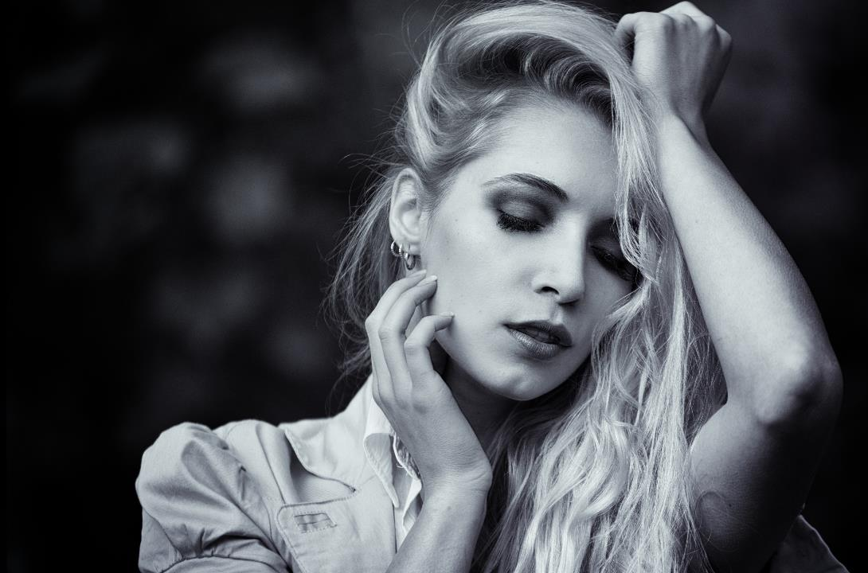
Everyone laughed at the old fashion, but reverently pursuit of new fashion
FASHION
202X时尚品牌宣传相册PPT模板
Most people like to keep their imagines unique fascinating bone pain, in fact, in the long evolution of human,
What is truly unique rare, most of the people and things can use the three words: not surprising.
As feng lun said: great, is get out. Go far in life, it is from the man of great ability!
21

Slide 2
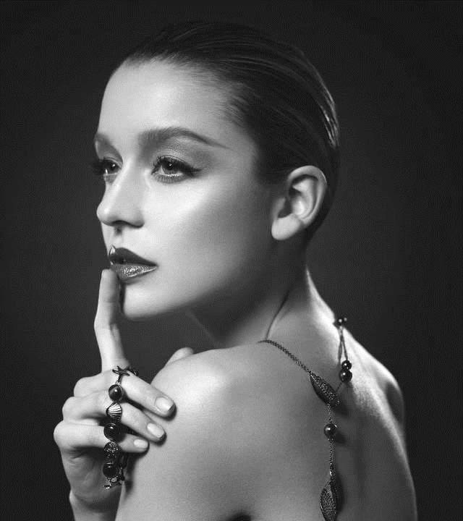
1
FASHION
Only can cause epidemics
Has the word "fashion" is the world trend of the generation of words, English for fashion, is almost always hang in the mouth, some people frequently appear in newspapers and media. Many people have different understanding of fashion, some think fashion is simple, it, extravagant as frugal; Sometimes the fashion is just for novelty
FASHION

Slide 3
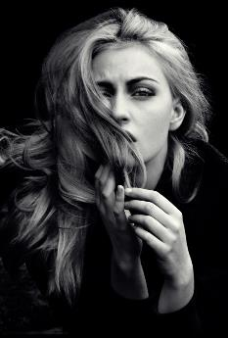
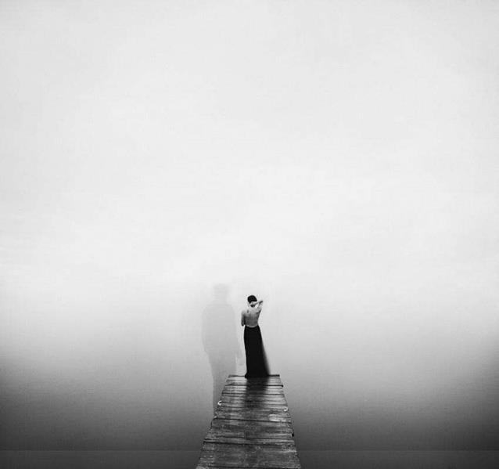
DREAM
For many women, shoes are their guilty pleasure. They dream about shoes, save up for them and when they finally get the pair they've wanted so badly, they feel like the happiest people in the world.
FASHION
Freedom and along with the gender of the attitude towards life. With the pressure of urban white-collar workers,
Symbol from bondage, enjoy the free life of canvas to get more people like it.
Canvas, the republic of fashion cycle change. Everyone chases "details"

Slide 4
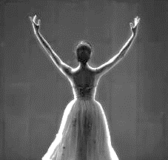
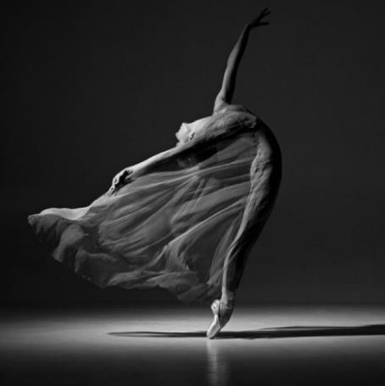
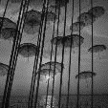
Now, summer is here and shorts and miniskirts mean that your shoes are no longer overshadowed by long pants and coats.
SEASONS

Slide 5
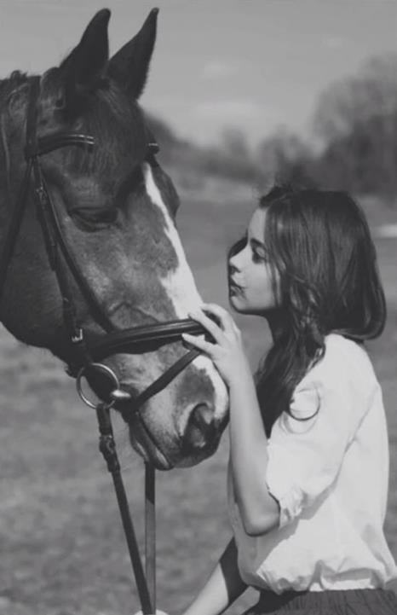
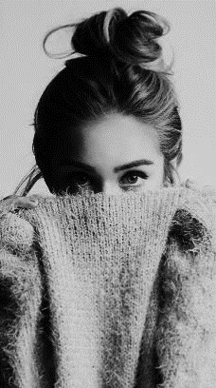
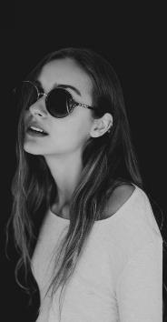
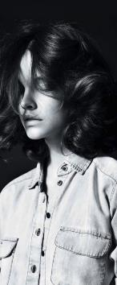
SUMMER
Gladiator sandals have been in style for a couple of seasons now, but there was always one big problem with them: not enough support. Strappy sandals can often leave you in a lurch when the delicate strap pops off.
For many women, shoes are their guilty pleasure. They dream about shoes, save up for them and when they finally get the pair they've wanted so badly, they feel like the happiest people in the world.

Slide 6
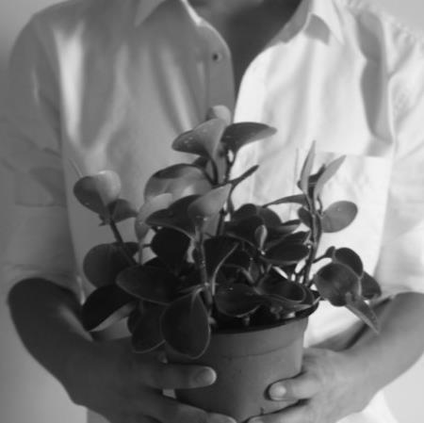
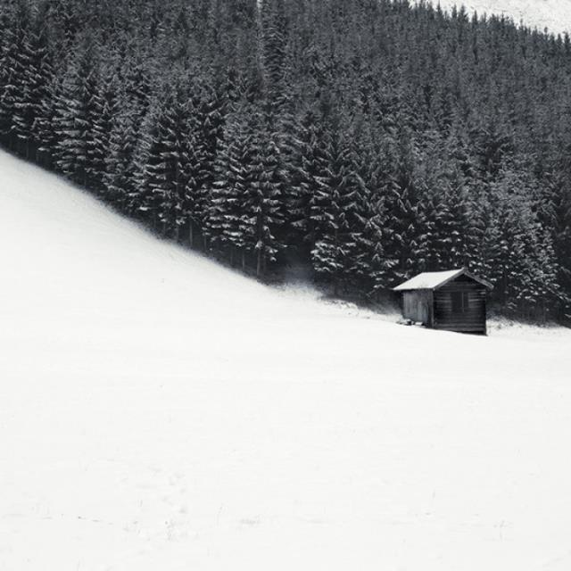
SUMMER
DREAM
Generally speaking, such platforms aren't exactly in Lady Gaga's style but they do look weird. However, they are comfortable to wear despite their appearance. So, the platforms can be worn as day-to-night sandals.
For many women, shoes are their guilty pleasure. They dream about shoes, save up for them and when they finally get the pair they've wanted so badly, they feel like the happiest people in the world.

Slide 7
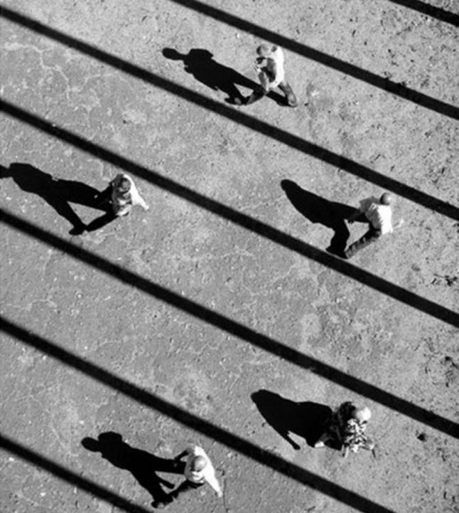
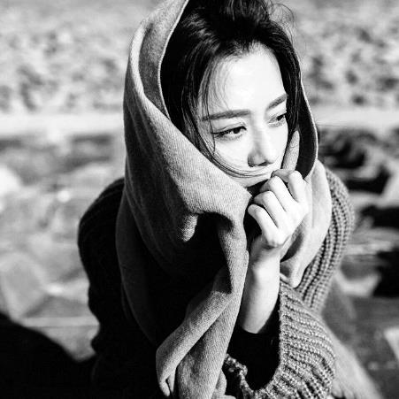
Now, summer is here and shorts and miniskirts mean that your shoes are no longer overshadowed by long pants and coats.
For many women, shoes are their guilty pleasure. They dream about shoes, save up for them and when they finally get the pair they've wanted so badly, they feel like the happiest people in the world.

Slide 8
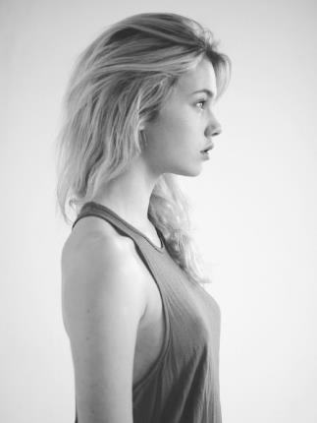
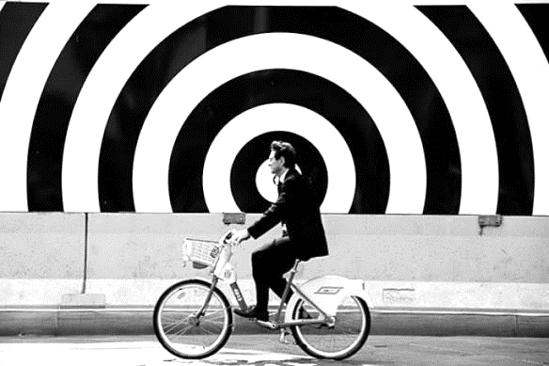
Generally speaking, such platforms aren't exactly in Lady Gaga's style but they do look weird. However, they are comfortable to wear despite their appearance. So, the platforms can be worn as day-to-night sandals.
SUMMER
For many women, shoes are their guilty pleasure. They dream about shoes, save up for them and when they finally get the pair they've wanted so badly, they feel like the happiest people in the world.

Slide 9
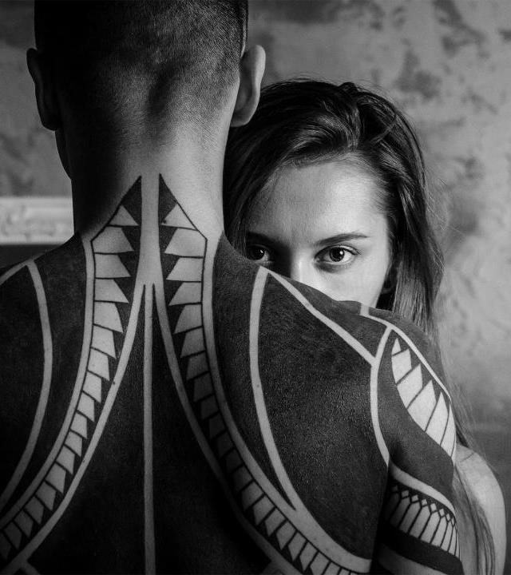
2
FASHION
Can hurry, but style is eternal
Artist said, fashion is a kind of never go out of style and dynamic, a kind of art is a kind of inspiration could only dream of, it can make a person full of passion, full of fantasy; Freeman says, fashion and happiness is a pair of lovers, and his happiness comes from fashion, and fashion and condemned his happiness. Fashion is a healthy.
FASHION

Slide 10
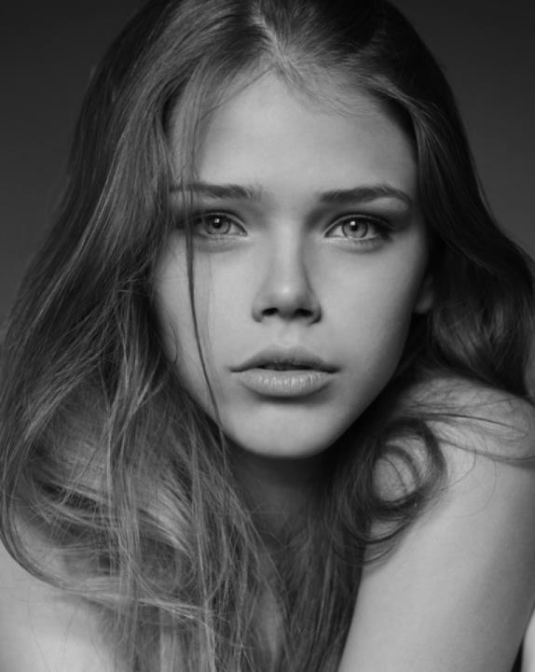
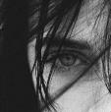
Gladiator sandals have been in style for a couple of seasons now, but there was always one big problem with them: not enough support. Strappy sandals can often leave you in a lurch when the delicate strap pops off.
SUMMER
Generally speaking, such platforms aren't exactly in Lady Gaga's style but they do look weird. However, they are comfortable to wear despite their appearance. So, the platforms can be worn as day-to-night sandals.

Slide 11
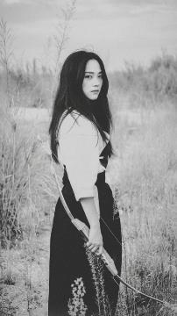
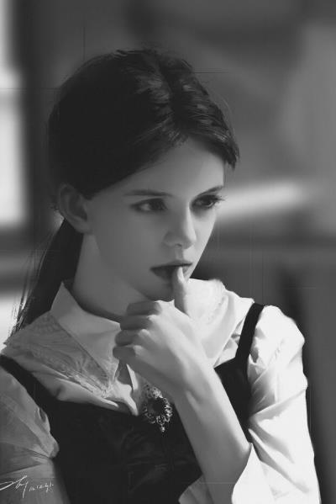
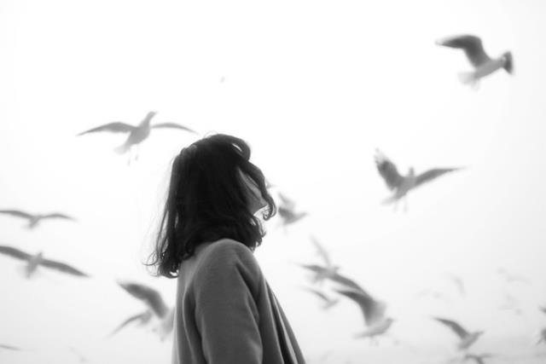
FASHION
Freedom and along with the gender of the attitude towards life. With the pressure of urban white-collar workers,
Symbol from bondage, enjoy the free life of canvas to get more people like it.
Canvas, the republic of fashion cycle change. Everyone chases "details"
For many women, shoes are their guilty pleasure. They dream about shoes, save up for them and when they finally get the pair they've wanted so badly, they feel like the happiest people in the world.

Slide 12
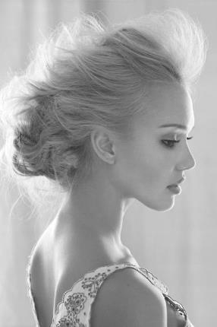
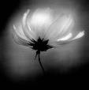
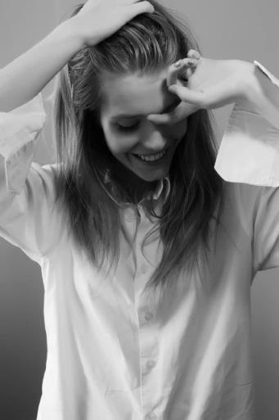
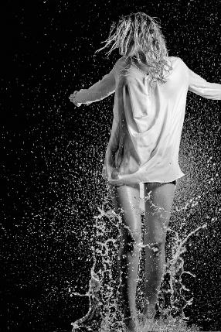
For many women, shoes are their guilty pleasure. They dream about shoes, save up for them and when they finally get the pair they've wanted so badly
SUMMER
Generally speaking, such platforms aren't exactly in Lady Gaga's style but they do look weird. However, they are comfortable to wear despite their appearance. So, the platforms can be worn as day-to-night sandals.
DREAM

Slide 13
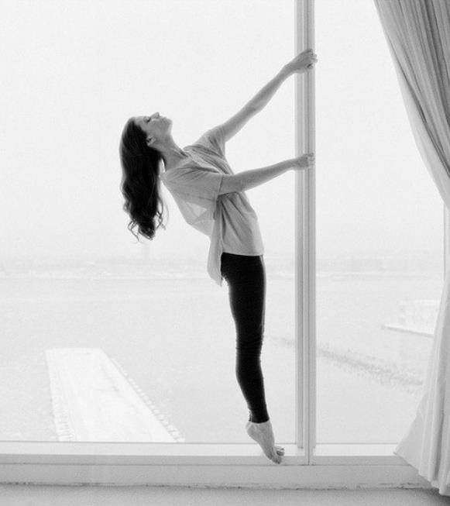
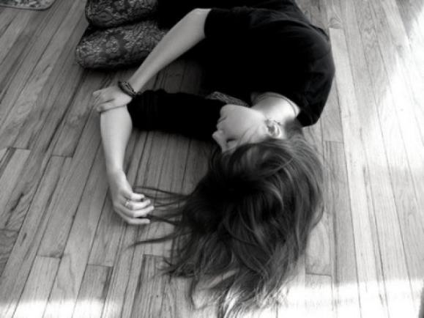
SEASONS
Freedom and along with the gender of the attitude towards life. With the pressure of urban white-collar workers,
Symbol from bondage, enjoy the free life of canvas to get more people like it.
For many women, shoes are their guilty pleasure. They dream about shoes, save up for them and when they finally get the pair they've wanted so badly, they feel like the happiest people in the world.

Slide 14
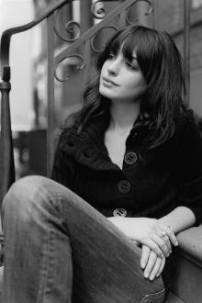
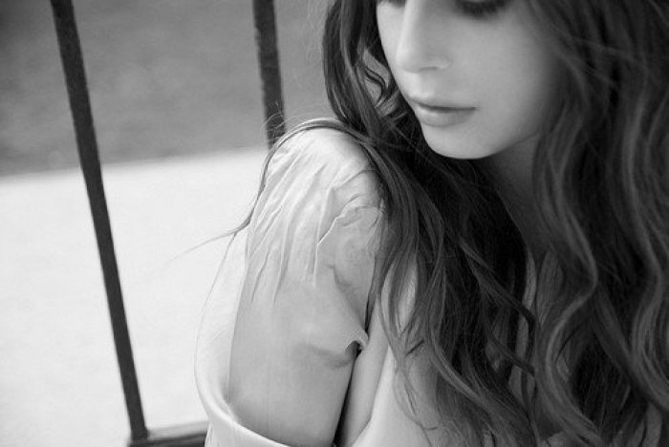
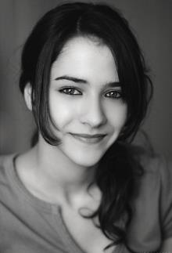
Generally speaking, such platforms aren't exactly in Lady Gaga's style but they do look weird. However, they are comfortable to wear despite their appearance. So, the platforms can be worn as day-to-night sandals.
Generally speaking, such platforms aren't exactly in Lady Gaga's style but they do look weird. However, they are comfortable to wear despite their appearance. So, the platforms can be worn as day-to-night sandals.

Slide 15
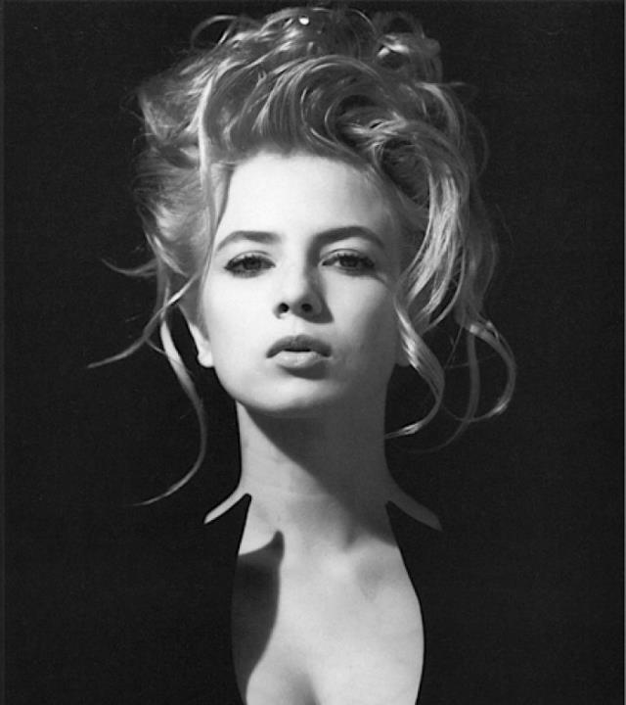
3
FASHION
Only can cause epidemics
Has the word "fashion" is the world trend of the generation of words, English for fashion, is almost always hang in the mouth, some people frequently appear in newspapers and media. Many people have different understanding of fashion, some think fashion is simple, it, extravagant as frugal; Sometimes the fashion is just for novelty
FASHION

Slide 16
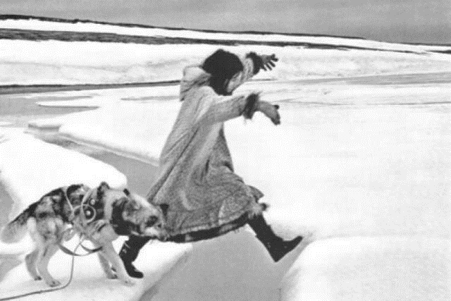
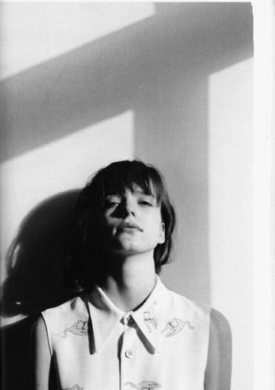
SUMMER
Generally speaking, such platforms aren't exactly in Lady Gaga's style but they do look weird. However, they are comfortable to wear despite their appearance. So, the platforms can be worn as day-to-night sandals.
Now, summer is here and shorts and miniskirts mean that your shoes are no longer overshadowed by long pants and coats.

Slide 17
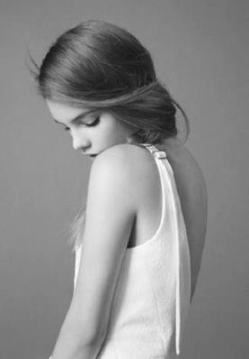
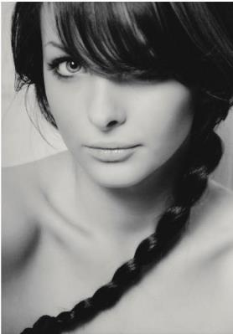
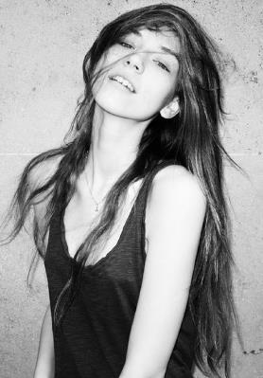
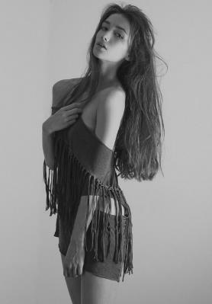
Generally speaking, such platforms aren't exactly in Lady Gaga's style but they do look weird. However, they are comfortable to wear despite their appearance. So, the platforms can be worn as day-to-night sandals.
SUMMER
Generally speaking, such platforms aren't exactly in Lady Gaga's style but they do look weird. However, they are comfortable to wear despite their appearance. So, the platforms can be worn as day-to-night sandals.
SUMMER

Slide 18
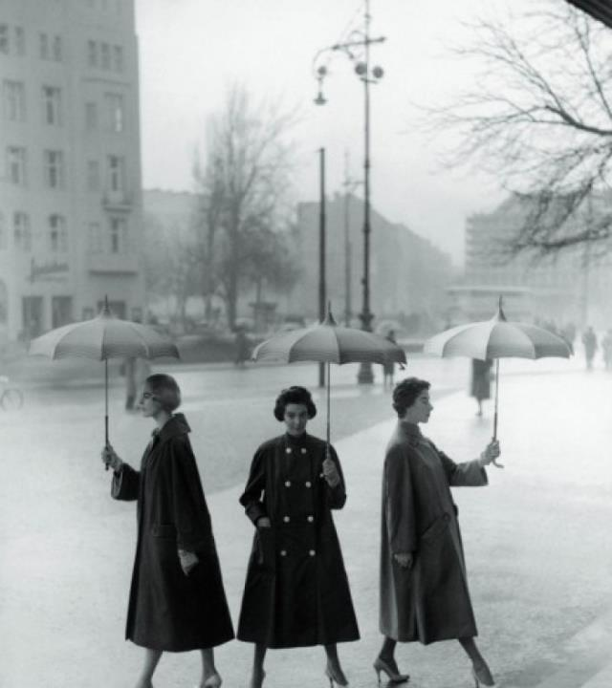
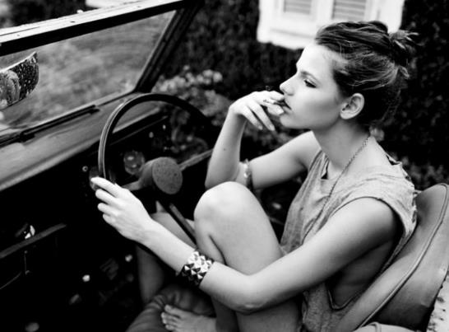
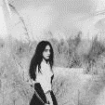
DREAM
For many women, shoes are their guilty pleasure. They dream about shoes, save up for them and when they finally get the pair they've wanted so badly, they feel like the happiest people in the world.
Now, summer is here and shorts and miniskirts mean that your shoes are no longer overshadowed by long pants and coats.

Slide 19
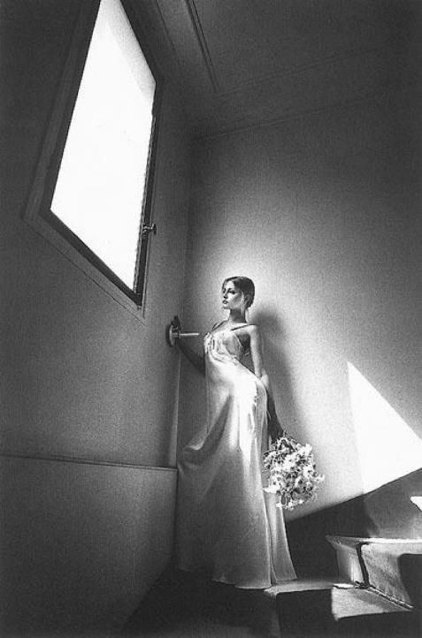
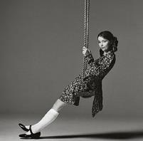
SUMMER
Gladiator sandals have been in style for a couple of seasons now, but there was always one big problem with them: not enough support. Strappy sandals can often leave you in a lurch when the delicate strap pops off.
DREAM

Slide 20
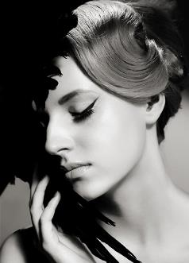
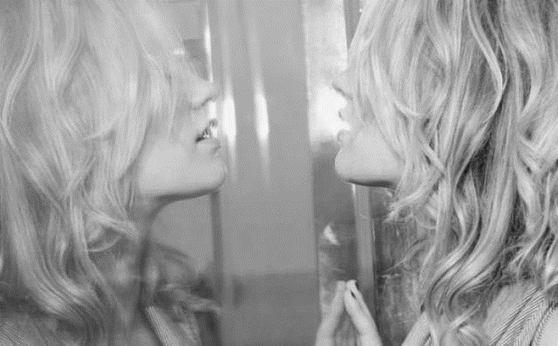
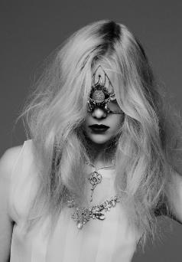
FASHION
Has the word "fashion" is the world trend of the generation of words, English for fashion, is almost always hang in the mouth, some people frequently appear in newspapers and media. Many people have different understanding of fashion, some think fashion is simple, it, extravagant as frugal; Sometimes the fashion is just for novelty
Generally speaking, such platforms aren't exactly in Lady Gaga's style but they do look weird. However, they are comfortable to wear despite their appearance. So, the platforms can be worn as day-to-night sandals.

Slide 21
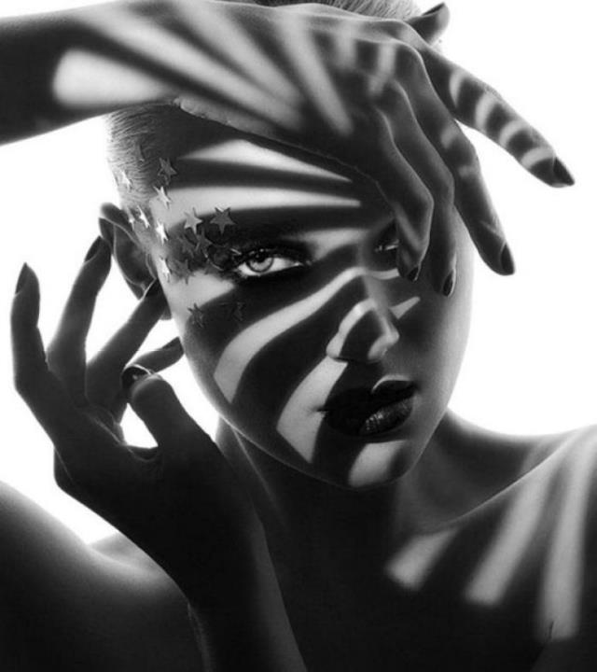
SUMMER
For many women, shoes are their guilty pleasure. They dream about shoes, save up for them and when they finally get the pair they've wanted so badly, they feel like the happiest people in the world.
For many women, shoes are their guilty pleasure. They dream about shoes, save up for them and when they finally get the pair they've wanted so badly, they feel like the happiest people in the world.

Slide 22
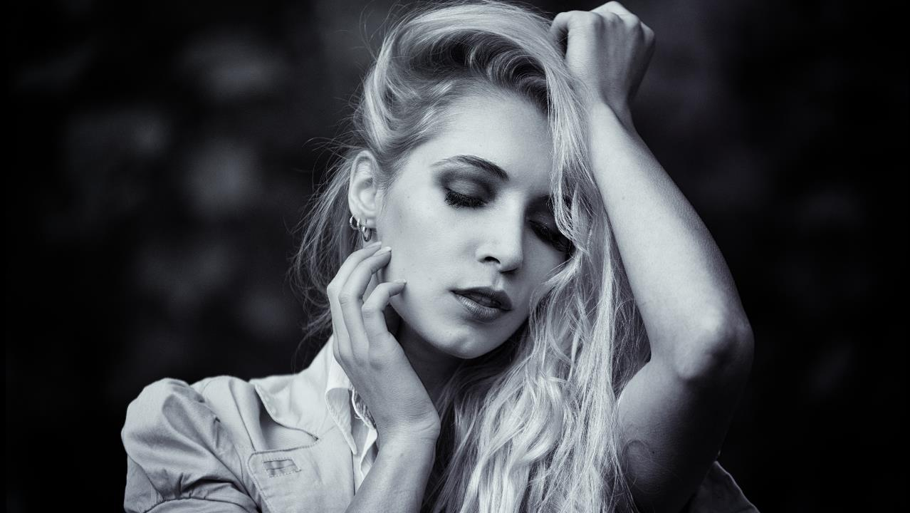
每一个人都嘲笑陈旧的时尚,却虔诚地追求新的时尚
THANKS

