Slide 1
THE DREAM AWAKES THE TIME
in the heart feels relaxed

Slide 2
SMILE
Sobs at the back of the mirror, I am pursuing your happiness livelily in the dream
HURRY
SORROW
I awake in the dream hurry am
avoiding your joy
I wake in only then mine night
feel sorrowful

Slide 3
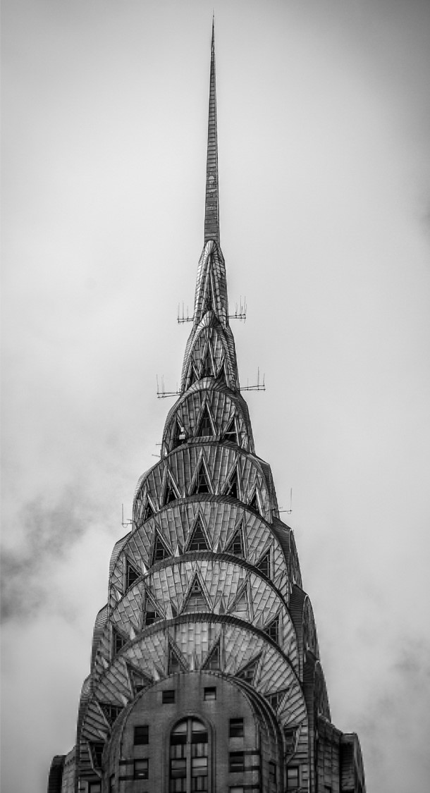
SORROW
Do sad I, the sorrow I, why see clearly not early you. I really thought did not understand what I did make to be able to let you mistakenly hate me like this? Asks you to tell me well

Slide 4
SORROW
SORROW
SORROW
You knew that was not the impossible matter you to believe eventually I was very disappointed to you
You knew that was not the impossible matter you to believe eventually I was very disappointed to you
You knew that was not the impossible matter you to believe eventually I was very disappointed to you

Slide 5
Black & White

Slide 6
HURRY
I always condemned from, should not meet you
If has not met you to now I also can be a pure girl does not understand love what doesn't know grief
GRIEF
I regretted that, really very much regretted my also good compunction
Only is I did not know how should do only then cannot let you
think I am injuring you

Slide 7
THE CHOICE
SORROW
25%
25%
SORROW
You knew that was not the impossible matter you to
You knew that was not the impossible matter you to
SORROW
25%
25%
SORROW
You knew that was not the impossible matter you to
You knew that was not the impossible matter you to

Slide 8
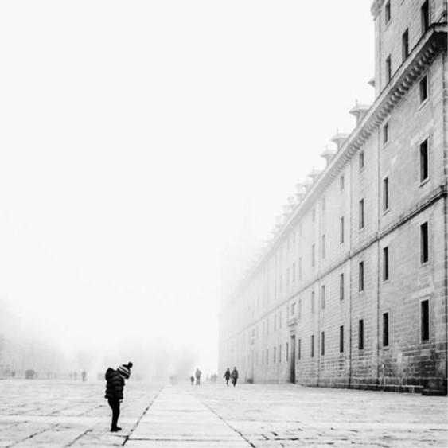
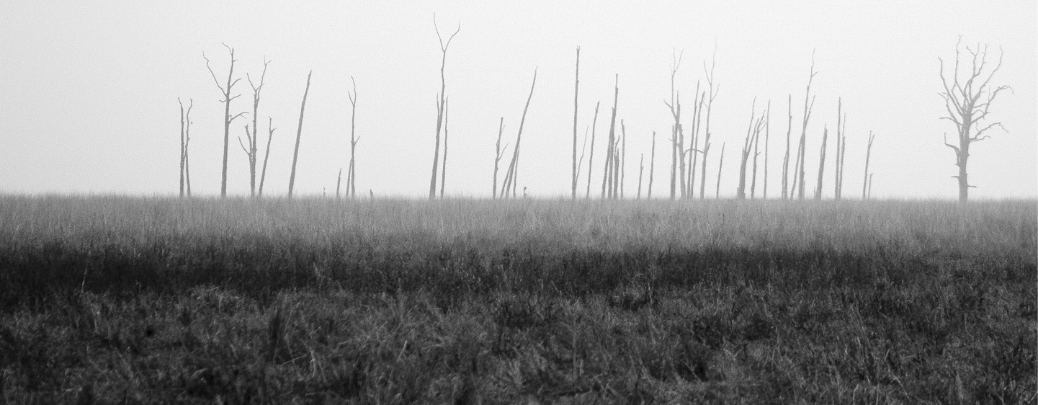
IN THE HEART
I to blow on the chaotic street in the wind to fondly remember happiness
I was thinking of in the familiar environment yesterday, I was recollecting joyfully nearby the vast sea
I was tasting sadly under the sob sky
HEART
I smiled in front of the mirror

Slide 9
THE CHOICE
so long as you will cross well I also can think happily So long as you are good I can good
Please remember certainly must cross is happier than me certainly wants
80
60
70
90
I KNEW
I KNEW
I KNEW
I KNEW
also does not trust me
otherwise you cannot listen
to others talking nonsense
also does not trust me
otherwise you cannot listen
to others talking nonsense
also does not trust me
otherwise you cannot listen
to others talking nonsense
also does not trust me
otherwise you cannot listen
to others talking nonsense

Slide 10
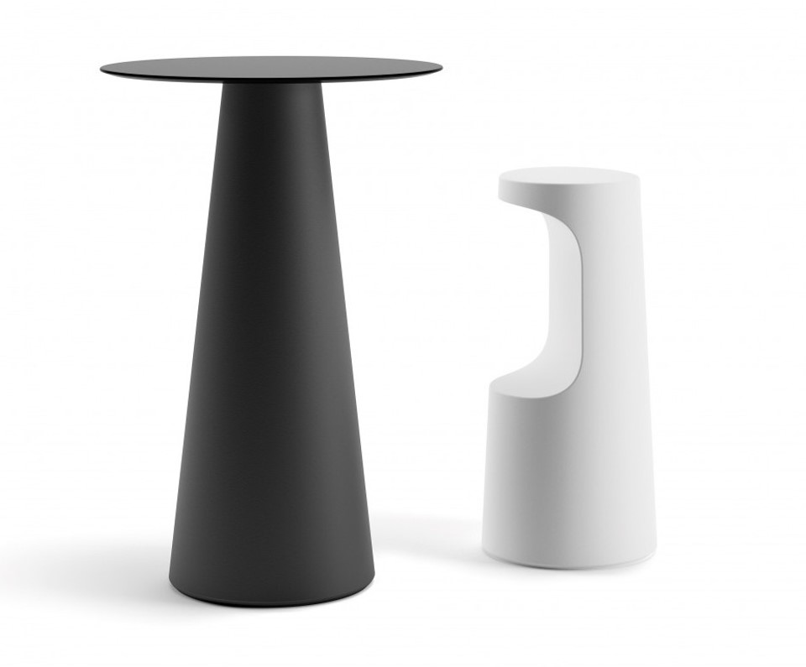
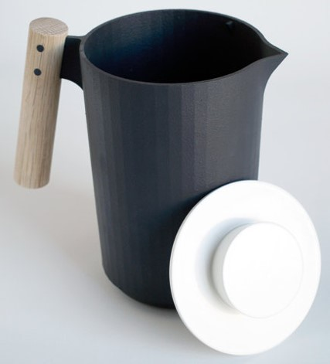
HURRY
I could not think you could think like this If did not
Have him to meddle we perhaps in together

Slide 11
THE CHOICE
so long as you will cross well I also can think happily So long as you are good I can good
Please remember certainly must cross is happier than me certainly wants
The dream
The dream
The dream
The dream
GRIEF
HURRY
SORROW

Slide 12
I KNEW IF SUCH GETS DOWN ALSO TO BE ABLE AGAIN TO BE
A MISTAKE EVENTUALLY
whose anyone arrives finally nobody to be able to be But believed is good I to awaken suddenly such has not sunk confuses Recently the code could not look like your same love to suffer extreme distress is even difficult to sleep all night not right

Slide 13
THE CHOICE
You said that you can respect me the choice From this time on you can not enter my world Then I said good we are respectively well
The dream
The dream
The dream
The dream
GRIEF
HURRY
SORROW

Slide 14
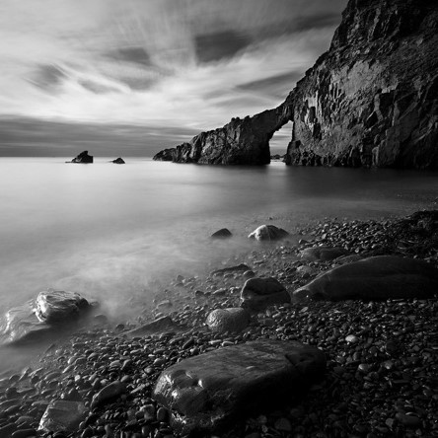
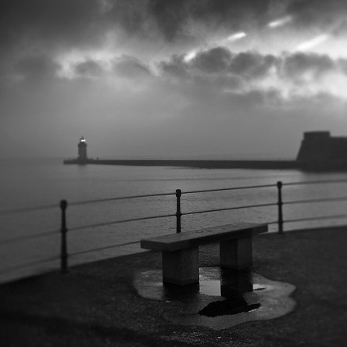
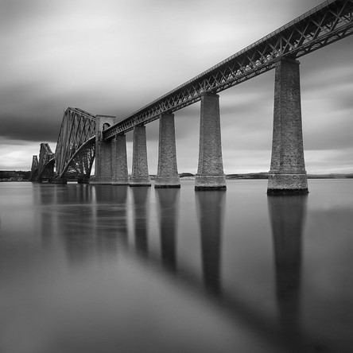
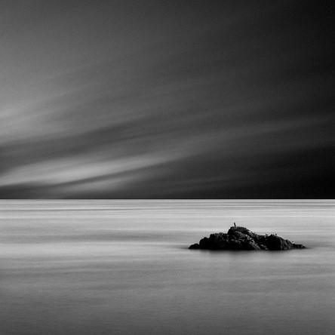
I KNEW
I KNEW
what significance like
this also has to you to me
Why province dessert
what significance like
this also has to you to me
Why province dessert
I KNEW
I KNEW
Faces the reality not to
have to pursue that not to have
the result question
what significance like
this also has to you to me
Why province dessert

Slide 15
Actually
you do not Understand me
also does not trust me
otherwise you cannot listen
to others talking nonsense
also does not trust me
otherwise you cannot listen to others talking nonsense
also does not trust me
otherwise you cannot listen
to others talking nonsense
also does not trust me
otherwise you cannot listen
to others talking nonsense

Slide 16
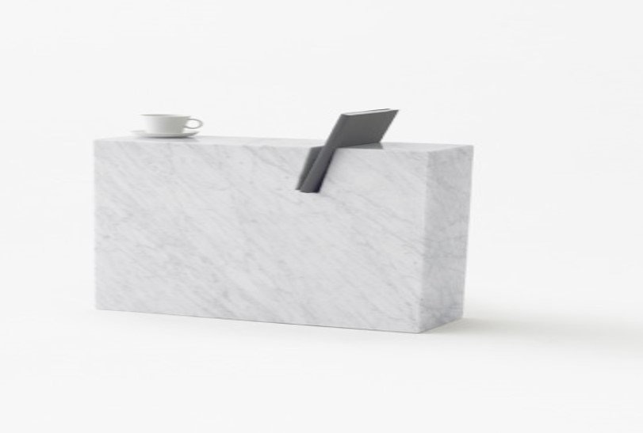
THE CHOICE
Therefore I hoped you might cross very much from now on happily will cross is better than me, so long as you have been happy
GRIEF
HURRY
SORROW

Slide 17
SORROW
I to blow on the chaotic street in the wind to fondly remember happiness
I was thinking of in the familiar environment yesterday, I was recollecting joyfully nearby the vast sea
I was tasting sadly under the sob sky

Slide 18
THE CHOICE
also does not trust me
otherwise you cannot listen
to others talking nonsense
also does not trust me
otherwise you cannot listen
to others talking nonsense
also does not trust me
otherwise you cannot listen
to others talking nonsense
also does not trust me
otherwise you cannot listen
to others talking nonsense

Slide 19
SORROW
You knew that was not the impossible matter you to believe eventually I was very disappointed to you I thought you could understand me

Slide 20
I KNEW IF SUCH GETS DOWN ALSO TO BE ABLE AGAIN TO BE
A MISTAKE EVENTUALLY
See you

