Slide 1
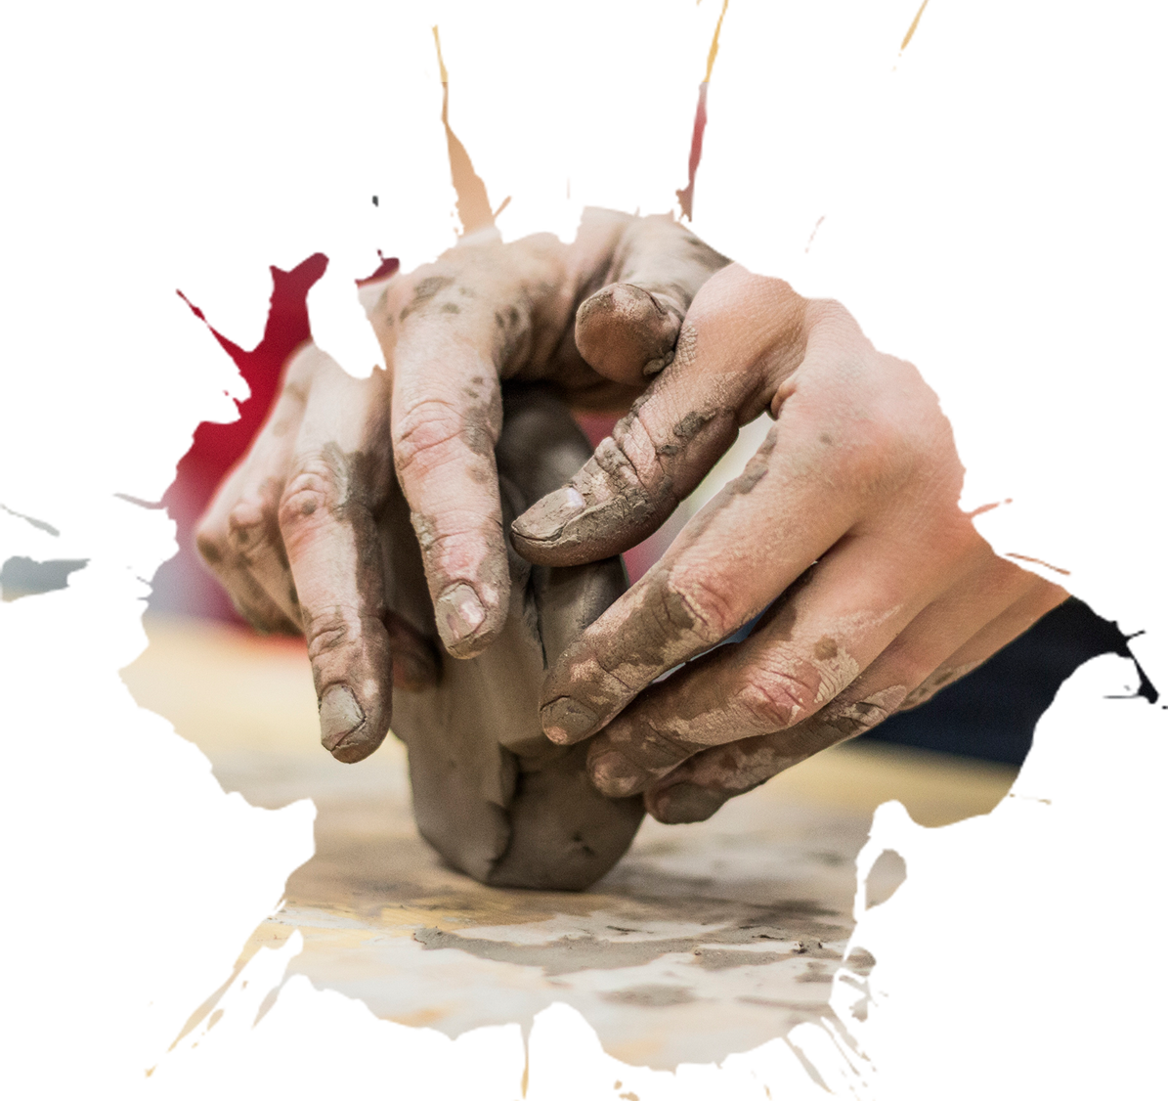
匠心永恒，不负光阴。
匠
永 恒
Xin
心
Yong Heng
Jiang
世界再嘈杂，匠人的内心，
绝对必须是安静、安定的。
When a cigarette falls in love with a match,it is destined to be hurt.When a cigarette falls in love with a match,it is destined to be hurt.

Slide 2
匠心永恒，不负光阴。
目 录
Contents
01
单击此处输入标题文本
If they throw stones at you, don’t throw back, use them to build your own foundation instead.
02
单击此处输入标题文本
If they throw stones at you, don’t throw back, use them to build your own foundation instead.
03
单击此处输入标题文本
If they throw stones at you, don’t throw back, use them to build your own foundation instead.
04
单击此处输入标题文本
If they throw stones at you, don’t throw back, use them to build your own foundation instead.

Slide 3
01
单击此处输入标题文本
When a cigarette falls in love with a match,it is destined to be hurt.When a cigarette falls in love with a match,it is destined to be hurt.

Slide 4
单击此处输入标题文本
单击此处输入标题
单击此处输入标题
单击此处输入标题
单击此处输入标题
If they throw stones at you, don’t throw back, use them to build your own foundation instead.
If they throw stones at you, don’t throw back, use them to build your own foundation instead.
If they throw stones at you, don’t throw back, use them to build your own foundation instead.
If they throw stones at you, don’t throw back, use them to build your own foundation instead.

Slide 5
单击此处输入标题文本
01
02
单击此处输入标题
单击此处输入标题
If they throw stones at you, don’t throw back, use them to build your own foundation instead.
If they throw stones at you, don’t throw back, use them to build your own foundation instead.
单击此处输入标题
单击此处输入标题
If they throw stones at you, don’t throw back, use them to build your own foundation instead.
If they throw stones at you, don’t throw back, use them to build your own foundation instead.
03
04

Slide 6
单击此处输入标题文本
单击此处输入标题
单击此处输入标题
If they throw stones at you, don’t throw back, use them to build your own foundation instead.
If they throw stones at you, don’t throw back, use them to build your own foundation instead.
单击此处输入标题
单击此处输入标题
If they throw stones at you, don’t throw back, use them to build your own foundation instead.
If they throw stones at you, don’t throw back, use them to build your own foundation instead.

Slide 7
单击此处输入标题文本
单击此处输入标题
When a cigarette falls in love with a match,it is destined to be hurt.
单击此处输入标题
When a cigarette falls in love with a match,it is destined to be hurt.
输入
标题
输入
标题
输入
标题
单击此处输入标题
When a cigarette falls in love with a match,it is destined to be hurt.
输入
标题
单击此处输入标题
When a cigarette falls in love with a match,it is destined to be hurt.
输入
标题
输入
标题

Slide 8
02
单击此处输入标题文本
When a cigarette falls in love with a match,it is destined to be hurt.When a cigarette falls in love with a match,it is destined to be hurt.

Slide 9
单击此处输入标题文本
单击此处输入标题
When a cigarette falls in love with a match,it is destined to be hurt.
01
单击此处输入标题
When a cigarette falls in love with a match,it is destined to be hurt.
单击此处输入标题
When a cigarette falls in love with a match,it is destined to be hurt.
04
02
03
单击此处输入标题
When a cigarette falls in love with a match,it is destined to be hurt.

Slide 10
单击此处输入标题文本
单击此处输入标题
If they throw stones at you, don’t throw back, use them to build your own foundation instead.
单击此处输入标题
If they throw stones at you, don’t throw back, use them to build your own foundation instead.
单击此处输入标题
If they throw stones at you, don’t throw back, use them to build your own foundation instead.

Slide 11
单击此处输入标题文本
单击此处输入标题
When a cigarette falls in love with a match,it is destined to be hurt.
单击此处输入标题
When a cigarette falls in love with a match,it is destined to be hurt.
单击此处
输入标题
1
2
3
4
单击此处输入标题
When a cigarette falls in love with a match,it is destined to be hurt.
单击此处输入标题
When a cigarette falls in love with a match,it is destined to be hurt.

Slide 12
单击此处输入标题文本
单击此处输入标题
When a cigarette falls in love with a match,it is destined to be hurt.
单击此处输入标题
When a cigarette falls in love with a match,it is destined to be hurt.
单击此处输入标题
When a cigarette falls in love with a match,it is destined to be hurt.
单击此处输入标题
When a cigarette falls in love with a match,it is destined to be hurt.

Slide 13
单击此处输入标题文本
单击此处输入标题
When a cigarette falls in love with a match,it is destined to be hurt.
单击此处输入标题
When a cigarette falls in love with a match,it is destined to be hurt.
输入标题
单击此处输入标题
When a cigarette falls in love with a match,it is destined to be hurt.
单击此处输入标题
When a cigarette falls in love with a match,it is destined to be hurt.

Slide 14
03
单击此处输入标题文本
When a cigarette falls in love with a match,it is destined to be hurt.When a cigarette falls in love with a match,it is destined to be hurt.

Slide 15
单击此处输入标题文本
单击此处输入标题
单击此处输入标题
If they throw stones at you, don’t throw back, use them to build your own foundation instead.If they throw stones at you, don’t throw back, use them to build your own foundation instead.
单击此处输入标题
If they throw stones at you, don’t throw back, use them to build your own foundation instead.If they throw stones at you, don’t throw back, use them to build your own foundation instead.

Slide 16
单击此处输入标题文本
单击此处输入标题
If they throw stones at you, don’t throw back, use them to build your own foundation instead.
单击此处输入标题
If they throw stones at you, don’t throw back, use them to build your own foundation instead.

Slide 17
单击此处输入标题文本
单击此处输入标题
If they throw stones at you, don’t throw back, use them to build your own foundation instead.
单击此处
输入标题
单击此处
输入标题
If they throw stones at you, don’t throw back, use them to build your own foundation instead.
单击此处输入标题

Slide 18
单击此处输入标题文本
单击此处
输入文本
单击此处
输入文本
单击此处
输入文本
单击此处
输入文本
单击此处
输入文本
If they throw stones at you, don’t throw back, use them to build your own foundation instead.If they throw stones at you, don’t throw back, use them to build your own foundation instead.If they throw stones at you, don’t throw back, use them to build your own foundation instead.

Slide 19
单击此处输入标题文本
单击此处输入标题
单击此处输入标题
单击此处输入标题
If they throw stones at you, don’t throw back, use them to build your own foundation instead.If they throw stones at you, don’t throw back, use them to build your own foundation instead.
If they throw stones at you, don’t throw back, use them to build your own foundation instead.If they throw stones at you, don’t throw back, use them to build your own foundation instead.
If they throw stones at you, don’t throw back, use them to build your own foundation instead.If they throw stones at you, don’t throw back, use them to build your own foundation instead.

Slide 20
04
单击此处输入标题文本
When a cigarette falls in love with a match,it is destined to be hurt.When a cigarette falls in love with a match,it is destined to be hurt.

Slide 21
单击此处输入标题文本
单击此处输入标题
单击此处输入标题
单击此处输入标题
单击此处输入标题
If they throw stones at you, don’t throw back, use them to build your own foundation instead.
If they throw stones at you, don’t throw back, use them to build your own foundation instead.
If they throw stones at you, don’t throw back, use them to build your own foundation instead.
If they throw stones at you, don’t throw back, use them to build your own foundation instead.

Slide 22
单击此处输入标题文本
单击此处输入标题
03
If they throw stones at you, don’t throw back, use them to build your own foundation instead.
单击此处输入标题
02
If they throw stones at you, don’t throw back, use them to build your own foundation instead.
01
单击此处输入标题
If they throw stones at you, don’t throw back, use them to build your own foundation instead.

Slide 23
单击此处输入标题文本
If they throw stones at you, don’t throw back, use them to build your own foundation instead.
单击此处输入标题
If they throw stones at you, don’t throw back, use them to build your own foundation instead.
单击此处输入标题
If they throw stones at you, don’t throw back, use them to build your own foundation instead.
单击此处输入标题
If they throw stones at you, don’t throw back, use them to build your own foundation instead.
If they throw stones at you, don’t throw back, use them to build your own foundation instead.

Slide 24
单击此处输入标题文本
单击此处输入标题
单击此处输入标题
单击此处输入标题
单击此处输入标题
If they throw stones at you, don’t throw back, use them to build your own foundation instead.
If they throw stones at you, don’t throw back, use them to build your own foundation instead.
If they throw stones at you, don’t throw back, use them to build your own foundation instead.
If they throw stones at you, don’t throw back, use them to build your own foundation instead.

Slide 25
THANK YOU
When a cigarette falls in love with a match,it is destined to be hurt.When a cigarette falls in love with a match,it is destined to be hurt.When a cigarette falls in love with a match,it is destined to be hurt.

