Slide 1
世界自闭症日 关爱自闭症儿童

Slide 2
01+TITLE
DANJISHURUMULUBIAOTI
02+TITLE
DANJISHURUMULUBIAOTI
03+TITLE
DANJISHURUMULUBIAOTI
04+TITLE
DANJISHURUMULUBIAOTI

Slide 3
01+TITLE
DANJISHURUMULUBIAOTI

Slide 4
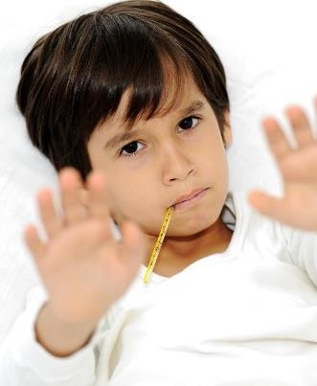
BIANJIBIAOTI
Everyone has their own dreams, I am the same. But my dream is not a lawyer, not a doctor, not actors, not even an industry. Everyone has their own dreams, I am the same. But my dream is not a lawyer.
TITLE
TITLE
Everyone has their own dreams, I am the same. But my dream is not a lawyer, not a doctor, not actors, not even an industry.
Everyone has their own dreams, I am the same. But my dream is not a lawyer, not a doctor, not actors, not even an industry.

Slide 5
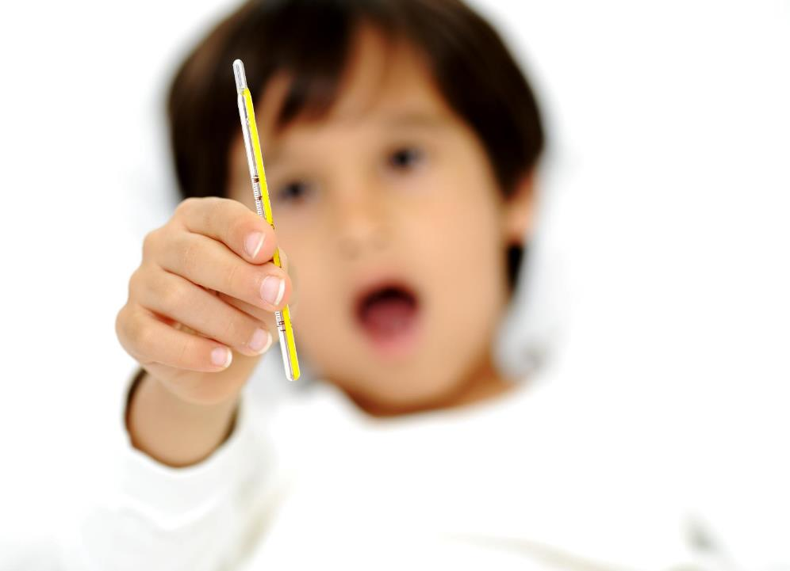
BIANJIBIAOTI
Everyone has their own dreams, I am the same. But my dream is not a lawyer, not a doctor, not actors, not even an industry.
Everyone has their own dreams, I am the same. But my dream is not a lawyer, not a doctor, not actors, not even an industry.
Everyone has their own dreams, I am the same. But my dream is not a lawyer, not a doctor, not actors, not even an industry.

Slide 6
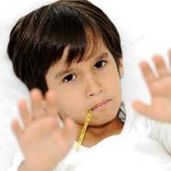
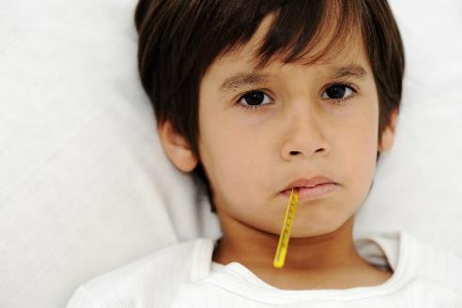
TITLE
Everyone has their own dreams, I am the same. But my dream is not a lawyer, not a doctor, not actors, not even an industry. Everyone has their own dreams, I am the same. But my dream is not a lawyer, not a doctor, not actors, not even an industry.
Everyone has their own dreams, I am the same. But my dream is not a lawyer, not a doctor, not actors, not even an industry.
BIANJIBIAOTI

Slide 7
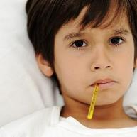
BIANJIBIAOTI
DANJISHURUMULUBIAOTI
TITLE
Everyone has their own dreams, I am the same.
TITLE
TITLE
Everyone has their own dreams, I am the same.
Everyone has their own dreams, I am the same.

Slide 8
02+TITLE
DANJISHURUMULUBIAOTI

Slide 9
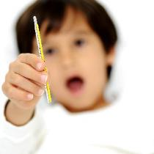
BIANJIBIAOTI
DANJISHURUMULUBIAOTI
BIANJIBIAOTI
TITLE
1
DANJISHURUMULUBIAOTI
BIANJIBIAOTI
9%
2
TITLE
15%
3
TITLE
3%
BIANJIBIAOTI
DANJISHURUMULUBIAOTI

Slide 10
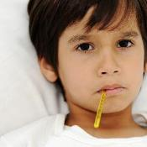
TITLE
30%
Everyone has their own dreams, I am the same. But my dream is not a lawyer, not a doctor, not actors, not even an industry.
TITLE
70%
Everyone has their own dreams, I am the same. But my dream is not a lawyer, not a doctor, not actors, not even an industry.
TITLE
50%
Everyone has their own dreams, I am the same. But my dream is not a lawyer, not a doctor, not actors, not even an industry.

Slide 11
当前电竞行业
收入分成情况
TITLE
Everyone has their own dreams, I am the same.
BIANJIBIAOTI
DANJISHURUMULUBIAOTI
TITLE
Everyone has their own dreams, I am the same.
TITLE
$696M
+41.3
vs2019
TITLE
Everyone has their own dreams, I am the same.
TITLE
Everyone has their own dreams, I am the same.
TITLE
Everyone has their own dreams, I am the same.

Slide 12
BIANJIBIAOTI
DANJISHURUMULUBIAOTI
TITLE
TITLE
TITLE
Everyone has their own dreams, I am the same.
Everyone has their own dreams, I am the same.
Everyone has their own dreams, I am the same.

Slide 13
03+TITLE
DANJISHURUMULUBIAOTI

Slide 14
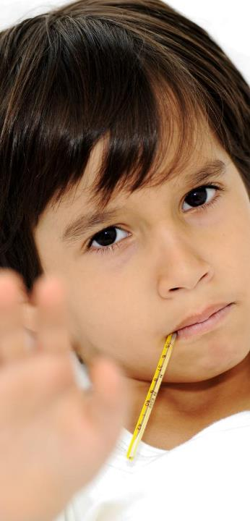
2019
BIANJIBIAOTI
TITLE
Everyone has their own dreams, I am the same. But my dream is not a lawyer, not a doctor, not actors, not even an industry. Everyone has their own dreams, I am the same. But my dream is not a lawyer, not a doctor, not actors, not even an industry.
Everyone has their own dreams, I am the same. But my dream is not a lawyer, not a doctor, not actors, not even an industry.
TITLE
Everyone has their own dreams, I am the same. But my dream is not a lawyer, not a doctor, not actors, not even an industry. Everyone has their own dreams, I am the same. But my dream is not a lawyer, not a doctor, not actors, not even an industry.

Slide 15
TITLE
Everyone has their own dreams, I am the same.
TITLE
Everyone has their own dreams, I am the same. But my dream is not a lawyer, not a doctor, not actors, not even an industry.
TITLE
Everyone has their own dreams, I am the same.
TITLE
Everyone has their own dreams, I am the same.

Slide 16
BIANJIBIAOTI
DANJISHURUMULUBIAOTI
TITLE
TITLE
TITLE
TITLE
Everyone has their own dreams, I am the same.
Everyone has their own dreams, I am the same.
Everyone has their own dreams, I am the same.
Everyone has their own dreams, I am the same.

Slide 17
BIANJIBIAOTI
Everyone has their own dreams, I am the same. But my dream is not a lawyer, not a doctor, not actors, not even an industry. Everyone has their own dreams, I am the same.
BIANJIBIAOTI
Everyone has their own dreams, I am the same. But my dream is not a lawyer, not a doctor, not actors, not even an industry. Everyone has their own dreams, I am the same.

Slide 18
04+TITLE
DANJISHURUMULUBIAOTI

Slide 19
BIANJIBIAOTI
DANJISHURUMULUBIAOTI
TITLE
TITLE
Everyone has their own dreams, I am the same.
Everyone has their own dreams, I am the same.
TITLE
TITLE
Everyone has their own dreams, I am the same.
Everyone has their own dreams, I am the same.

Slide 20
BIANJIBIAOTI
DANJISHURUMULUBIAOTI
TITLE
Everyone has their own dreams, I am the same. But my dream is not a lawyer, not a doctor, not actors, not even an industry. Everyone has their own dreams, I am the same. But my dream is not a lawyer, not a doctor, not actors, not even an industry.

Slide 21
BIANJIBIAOTI
DANJISHURUMULUBIAOTI
TITLE
TITLE
TITLE
TITLE
Everyone has their own dreams, I am the same. But my dream is not a lawyer, not a doctor, not actors, not even an industry. Everyone has their own dreams, I am the same. But my dream is not a lawyer, not a doctor, not actors, not even an industry.
Everyone has their own dreams, I am the same. But my dream is not a lawyer, not a doctor, not actors, not even an industry. Everyone has their own dreams, I am the same. But my dream is not a lawyer, not a doctor, not actors, not even an industry.
Everyone has their own dreams, I am the same. But my dream is not a lawyer, not a doctor, not actors, not even an industry. Everyone has their own dreams, I am the same. But my dream is not a lawyer, not a doctor, not actors, not even an industry.
Everyone has their own dreams, I am the same. But my dream is not a lawyer, not a doctor, not actors, not even an industry. Everyone has their own dreams, I am the same. But my dream is not a lawyer, not a doctor, not actors, not even an industry.

Slide 22
BIANJIBIAOTI
DANJISHURUMULUBIAOTI
TITLE
TITLE
Everyone has their own dreams, I am the same. But my dream is not a lawyer, not a doctor, not actors, not even an industry. Everyone has their own dreams, I am the same. But my dream is not a lawyer, not a doctor, not actors, not even an industry.
Everyone has their own dreams, I am the same. But my dream is not a lawyer, not a doctor, not actors, not even an industry. Everyone has their own dreams, I am the same. But my dream is not a lawyer, not a doctor, not actors, not even an industry.
DANJICICHUBIANJIBIAOTI

Slide 23
THANKS

