Slide 1
可爱的小动物模板
汇报人：xiazaii 汇报时间：XX年XX月

Slide 2
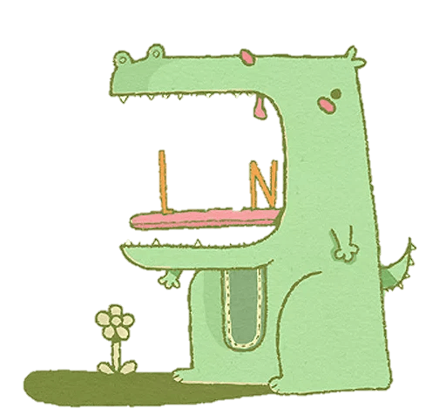
CONTENT
01
02
03
04
添加标题
添加标题
添加标题
添加标题
Just for today I will try to live through this day only and not tackle my whole life problem at once.
Just for today I will try to live through this day only and not tackle my whole life problem at once.
Just for today I will try to live through this day only and not tackle my whole life problem at once.
Just for today I will try to live through this day only and not tackle my whole life problem at once.

Slide 3
第 一 部 分
Just for today I will try to live through this day only and not tackle my whole life problem at once. Just for today I will try to live through this day only and not tackle my whole life problem at once. Just for today I will try to live through this day only

Slide 4
章 节 提 要 ：
Just for today I will try to live through this day only and not tackle my whole life problem at once. Just for today I will try to live through this day only and not tackle my whole life problem at once. Just for today I will try to live through this day only. Just for today I will try to live through this day only and not tackle my whole life problem at once. Just for today I will try to live

Slide 5
点击添加标题
Just for today I will try to live through this day only and not tackle my whole life problem at once. I can do for twelve hours that hours that Just for today I will try to live through this
点击添加标题
Just for today I will try to live through this day only and not tackle my whole life problem at once. I can do for twelve hours that hours that Just for today I will try to live through this

Slide 6
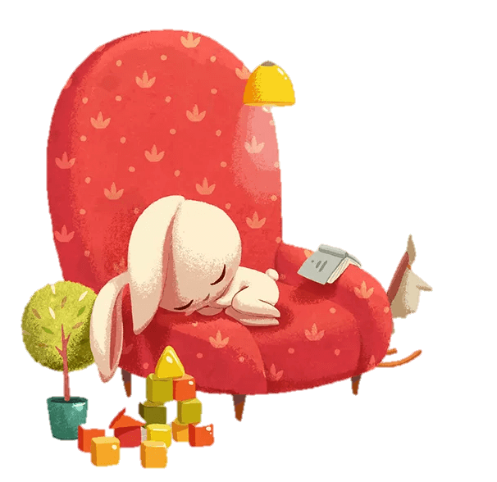
添加标题
Just for today I will try to live through this day only and not tackle my whole life at once. I can do Just for today I will try
添加标题
Just for today I will try to live through this day only and not tackle my whole life at once. I can do Just for today I will try

Slide 7
1
hours that Just for today I will try to live through this day only and not tackle my whole life problem at
2
hours that Just for today I will try to live through this day only and not tackle my whole life problem at
3
hours that Just for today I will try to live through this day only and not tackle my whole life problem at

Slide 8
输入标题
输入标题
输入标题
three ways. I will do somebody a good turnJust for today I will try to live through this day only and not tackle my
three ways. I will do somebody a good turnJust for today I will try to live through this day only and not tackle my
three ways. I will do somebody a good turnJust for today I will try to live through this day only and not tackle my

Slide 9
第 二 部 分
Just for today I will try to live through this day only and not tackle my whole life problem at once. Just for today I will try to live through this day only and not tackle my whole life problem at once. Just for today I will try to live through this day only

Slide 10
章 节 提 要 ：
Just for today I will try to live through this day only and not tackle my whole life problem at once. Just for today I will try to live through this day only and not tackle my whole life problem at once. Just for today I will try to live through this day only. Just for today I will try to live through this day only and not tackle my whole life problem at once. Just for today I will try to live

Slide 11
添加标题
Just for today I will try to live through this day only and not tackle my whole life at once. I can do Just for today I will try
添加标题
Just for today I will try to live through this day only and not tackle my whole life at once. I can do Just for today I will try
添加标题
Just for today I will try to live through this day only and not tackle my whole life at once. I can do Just for today I will try

Slide 12
项目一
项目二
Just for today I will try to live through this day only and not tackle my whole life problem at once.
Just for today I will try to live through this day only and not tackle my whole life problem at once.

Slide 13
添加标题
I CAN DO SOMETHING FOR TWELVE HOURS THAT
Just for today I will try to live through this day only and not tackle my whole life problem at once. I can do for twelve hours that Just for
today I will try to live through this day only and not tackle my whole life problem at once. I can do for twelve hours that
today I will try to live through this day only and not tackle my whole

Slide 14
添加标题
添加标题
添加标题
添加标题
Just for today I will try to live through this day only and not tackle my whole life
Just for today I will try to live through this day only and not tackle my whole life
Just for today I will try to live through this day only and not tackle my whole life
Just for today I will try to live through this day only and not tackle my whole life
01
02
03
04

Slide 15
第 三 部 分
Just for today I will try to live through this day only and not tackle my whole life problem at once. Just for today I will try to live through this day only and not tackle my whole life problem at once. Just for today I will try to live through this day only

Slide 16
章 节 提 要 ：
Just for today I will try to live through this day only and not tackle my whole life problem at once. Just for today I will try to live through this day only and not tackle my whole life problem at once. Just for today I will try to live through this day only. Just for today I will try to live through this day only and not tackle my whole life problem at once. Just for today I will try to live

Slide 17
添加标题
Just for today I will try to live through this day only and not tackle my whole life at once. I can do Just for today I will try
添加标题
Just for today I will try to live through this day only and not tackle my whole life at once. I can do Just for today I will try
添加标题
Just for today I will try to live through this day only and not tackle my whole life at once. I can do Just for today I will try

Slide 18
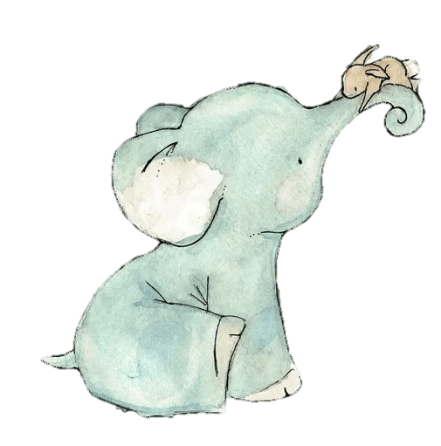
添加标题
Just for today I will try to live through this day only and not tackle my whole life at once. I can do Just for today I will try
添加标题
Just for today I will try to live through this day only and not tackle my whole life at once. I can do Just for today I will try

Slide 19
01
02
03
04
添加标题
添加标题
添加标题
添加标题
Just for today I will try to live through this day only and not tackle my whole life problem at once. I can do for twelve hours that Just for today I will try to live through this day.
Just for today I will try to live through this day only and not tackle my whole life problem at once. I can do for twelve hours that Just for today I will try to live through this day.
Just for today I will try to live through this day only and not tackle my whole life problem at once. I can do for twelve hours that Just for today I will try to live through this day.
Just for today I will try to live through this day only and not tackle my whole life problem at once. I can do for twelve hours that Just for today I will try to live through this day.

Slide 20
第 四 部 分
Just for today I will try to live through this day only and not tackle my whole life problem at once. Just for today I will try to live through this day only and not tackle my whole life problem at once. Just for today I will try to live through this day only

Slide 21
章 节 提 要 ：
Just for today I will try to live through this day only and not tackle my whole life problem at once. Just for today I will try to live through this day only and not tackle my whole life problem at once. Just for today I will try to live through this day only. Just for today I will try to live through this day only and not tackle my whole life problem at once. Just for today I will try to live

Slide 22
输入标题
输入标题
three ways. I will do somebody a good turnJust for today I will try to live through this day only and not tackle my
three ways. I will do somebody a good turnJust for today I will try to live through this day only and not tackle my

Slide 23
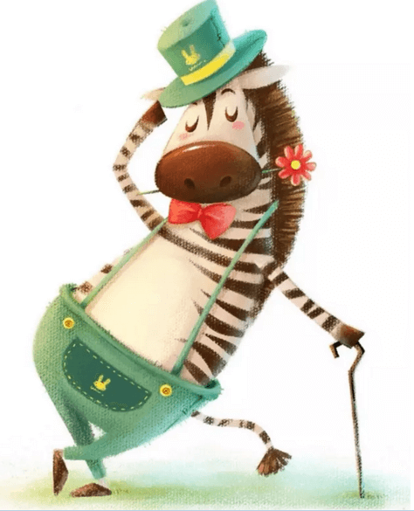
添加标题
Just for today I will try to live through this day only and not tackle my whole life at once. I can do Just for today I will try
添加标题
Just for today I will try to live through this day only and not tackle my whole life at once. I can do Just for today I will try

Slide 24
结 束 语 ：
Just for today I will try to live through this day only and not tackle my whole life problem at once. Just for today I will try to live through this day only and not tackle my whole life problem at once. Just for today I will try to live through this day only. Just for today I will try to live through this day only and not tackle my whole life problem at once. Just for today I will try to live

Slide 25
感 谢 您 的 观 看
Just for today I will try to live through this day only and not tackle my whole life problem at once. Just for today I will try to live through this day only and not tackle my whole life problem at once. Just for today I will try to live through this day only

