Slide 1
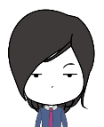
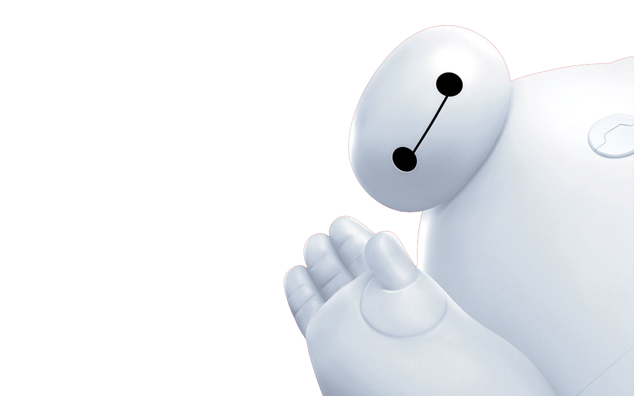
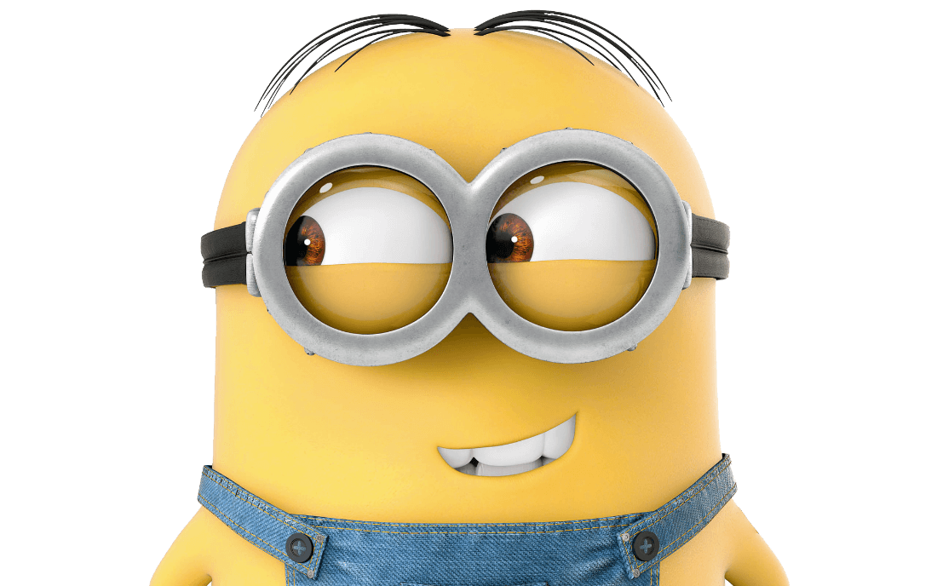
MR.MU iPPT
Baymax
MINIONS

Slide 2
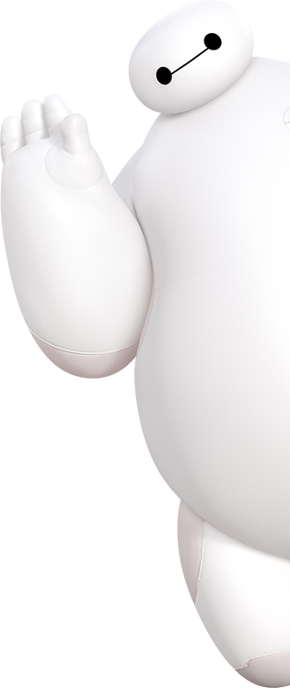
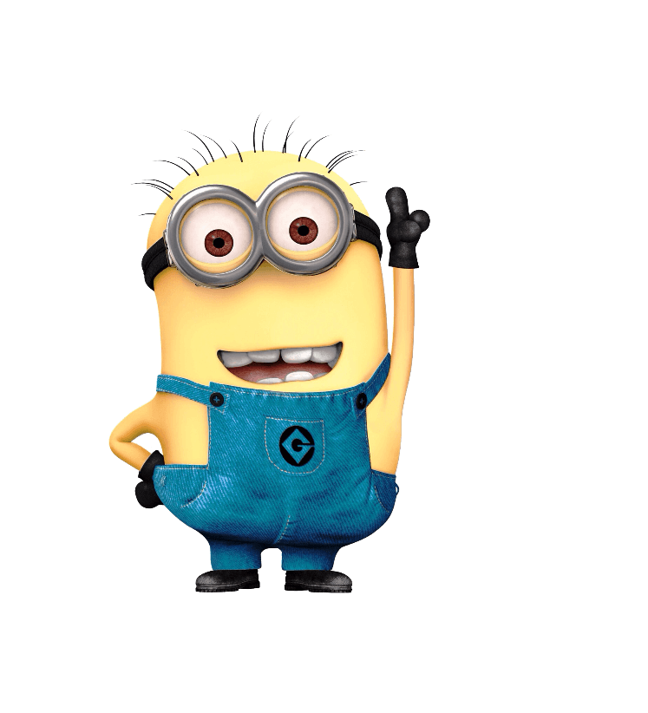
CONTENT
PPT never sleeps
Hello.
iPPT Balalalala
Ba-ba-na~
iPPT Banana
iPPT Balalalala
iPPT Banana

Slide 3
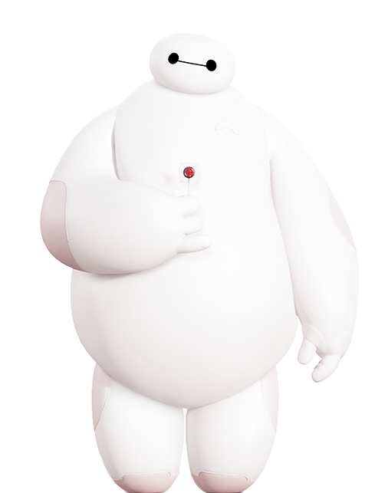
1
I am Baymax,
your personal
healthcare
companion.

Slide 4
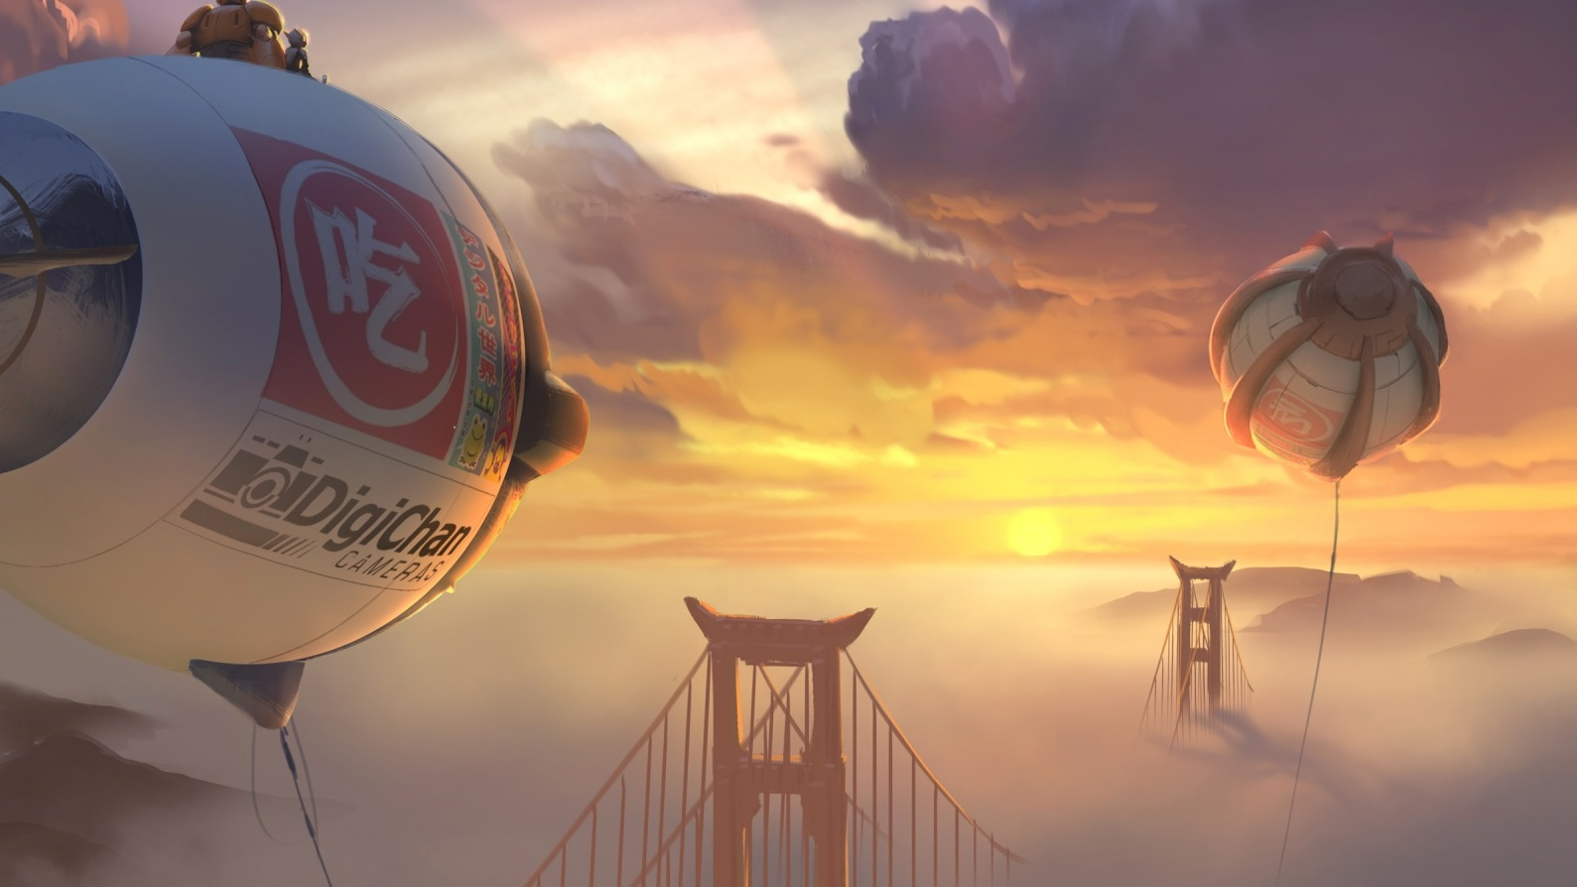
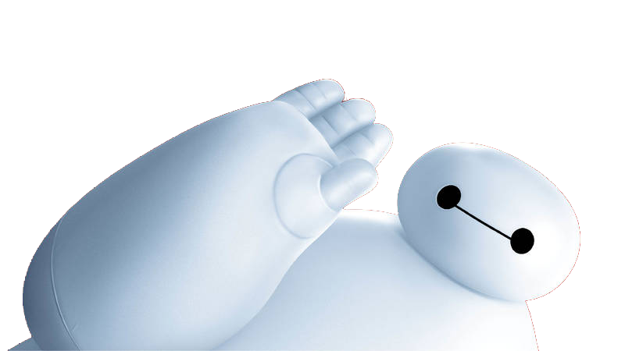
iPPT Balala
All this takes place in a futuristic Japanese-American city called San Fransokyo, which might be Disney’s way of reaching out caringly across the Pacific — or, more likely, looking shrewdly at all that box-office yen.

Slide 5
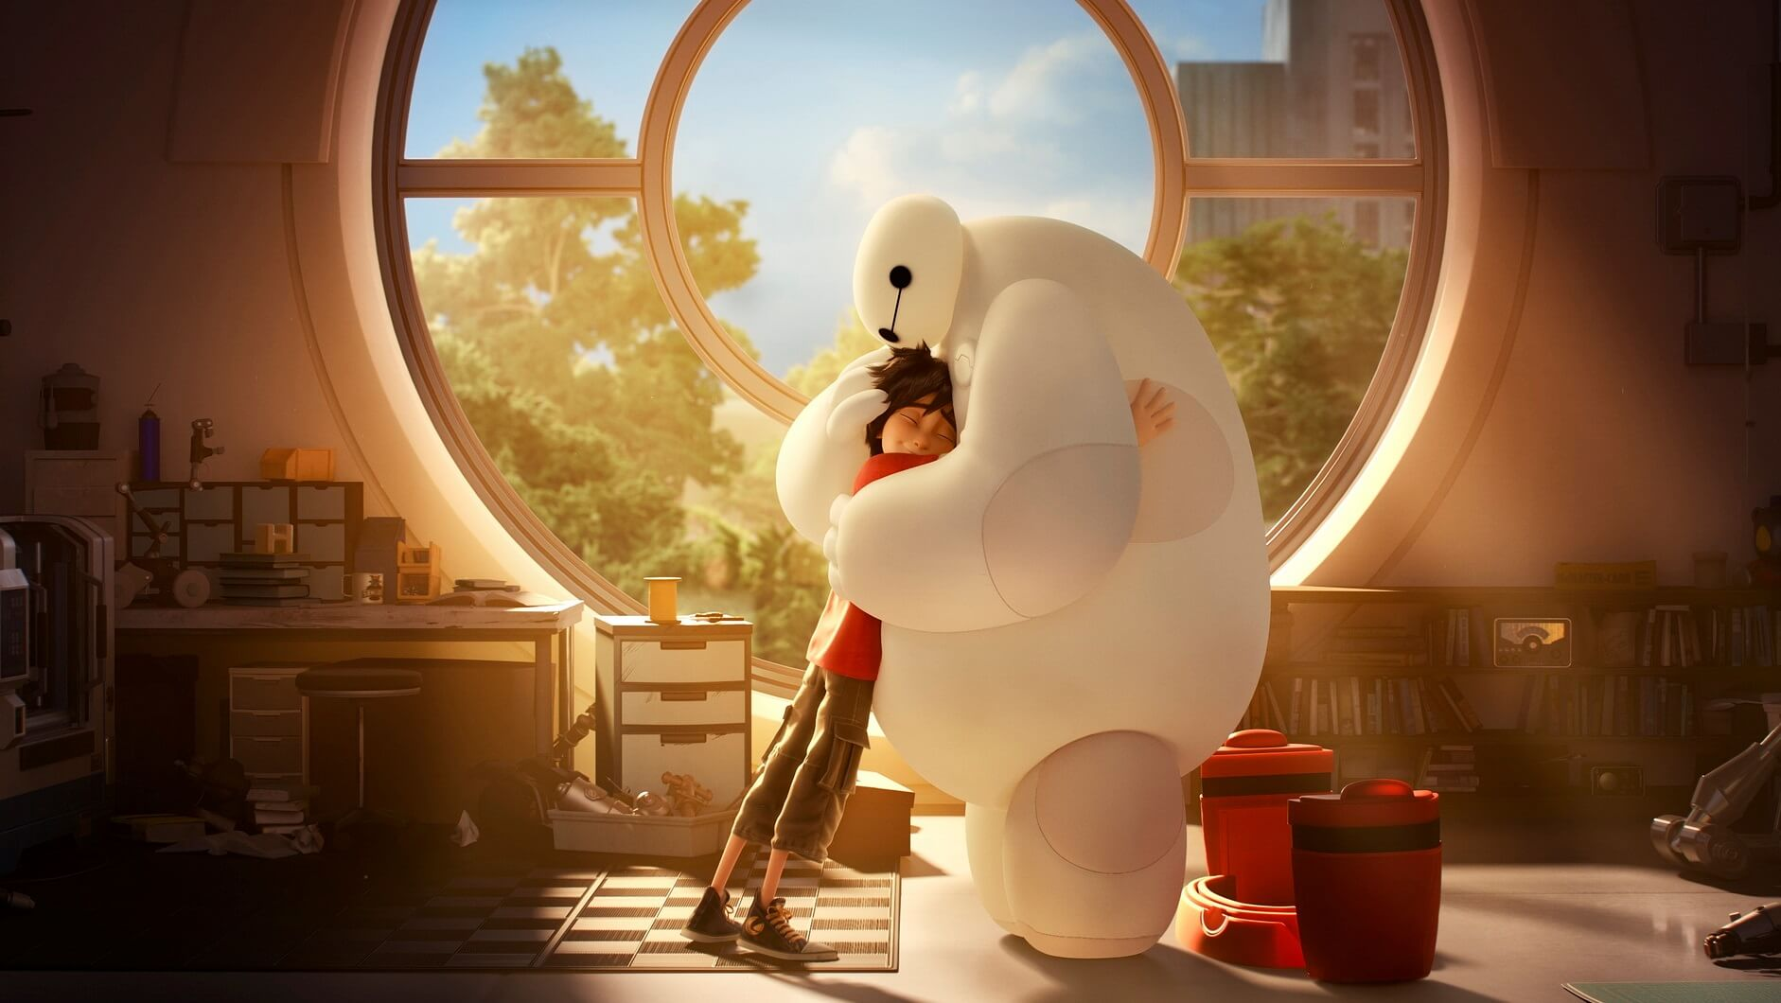
Baymax
Disney have come up with a memorable superhero, in the highly improbable form of Baymax, a huge robot who is like the Michelin Man crossed with Florence Nightingale — a caring, sharing blob.

Slide 6
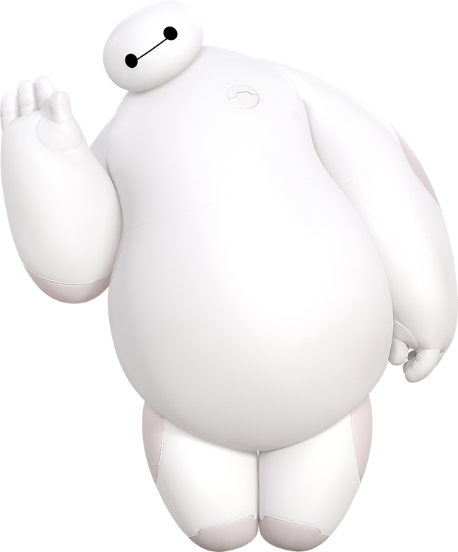
There There
I will always be with you.
TEXT
TEXT
I cannot deactivate until you say you are satisfied with your care.
On a scale of 1 to 10, how would you rate your pain?
TEXT

Slide 7
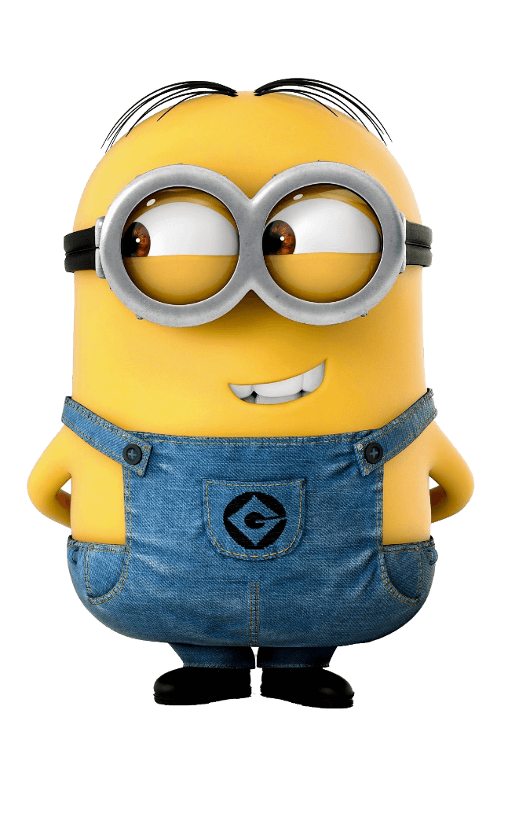
2
Bananaah!!! Potato naaahhh! Bananaaahh!! Togali no potato ni gani balo banika no jiga. Ba-ba, ba-banana.

Slide 8
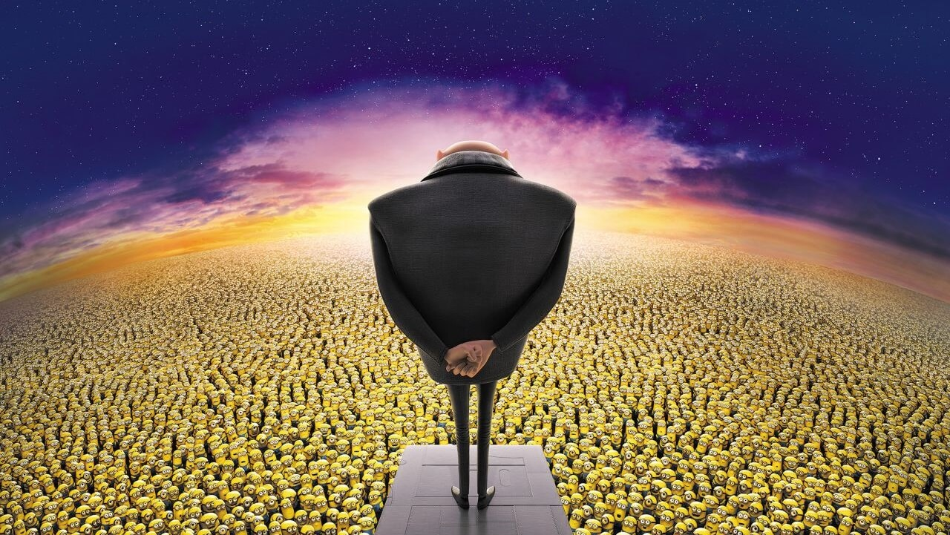
Then,
we notice.
Steal the moon
Rob a bank, we're not interested. Abc Kill someone, not our deal.

Slide 9
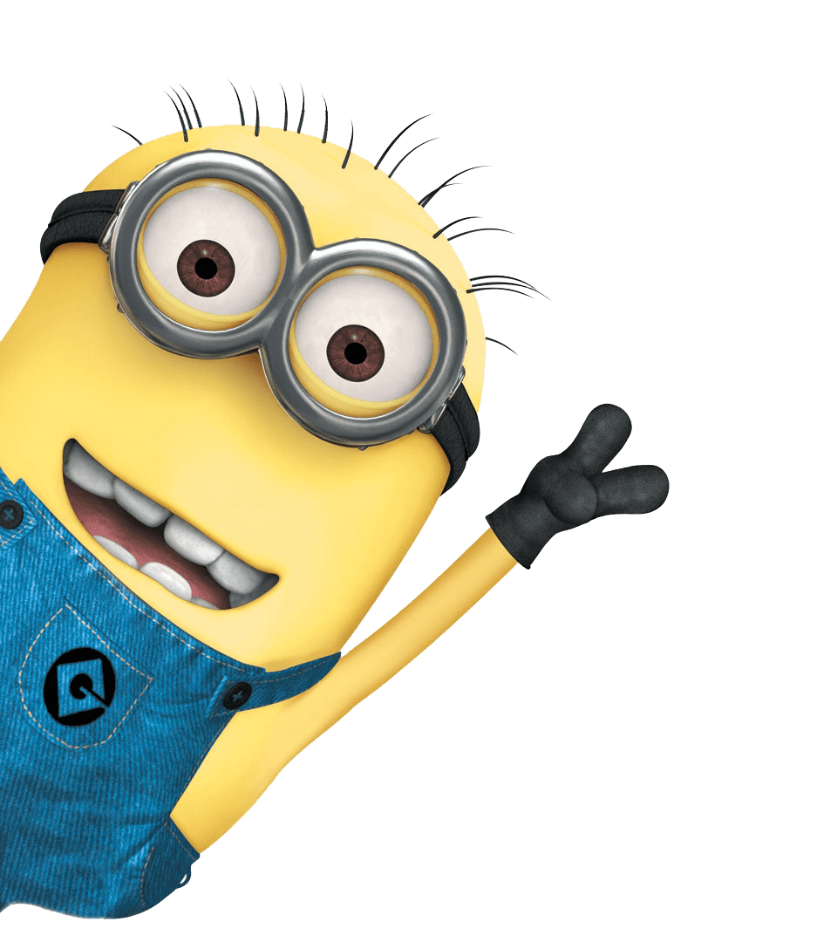
2030
Despicable Me 2 is an upcoming 2013 American computer animated comedy film and the sequel to the 2010 animated film Despicable Me. P
roduced by Illumination Entertainment and distributed by Universal Pictures, it will be directed again by Pierre Coffin and Chris Renaud, and written by Cinco Paul and Ken Daurio. Steve Carell, Russell Brand, Miranda Cosgrove and Kristen Wiig will reprise their roles.
2020
2015
New cast members include Al Pacino as Gru's nemesis, and Steve Coogan in a yet unnamed role. The film is scheduled to be released on July 3, 2013.

Slide 10
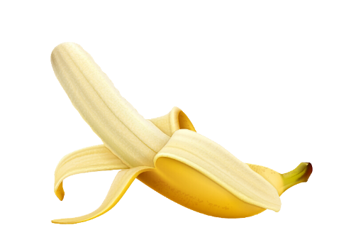
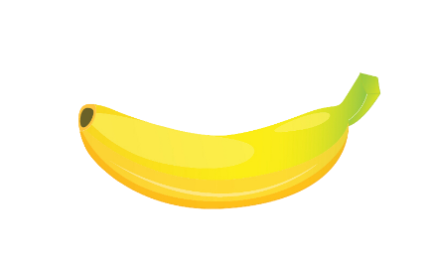
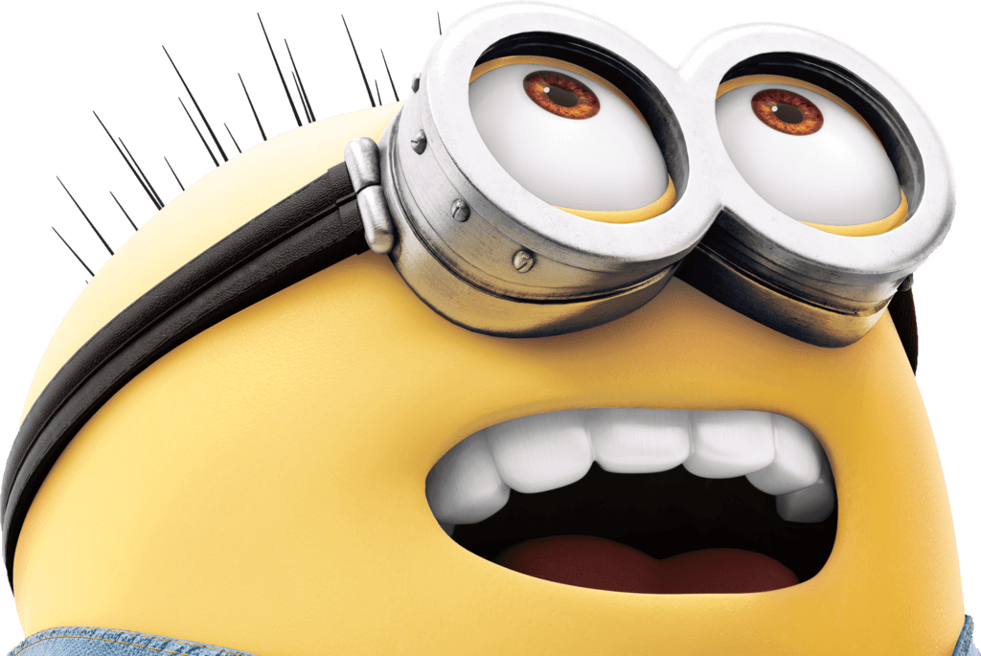
Rob a bank, we're not interested. abc Kill someone, not our deal.
But you were to melt the polar abc ice caps, or vaporize Mount Fuji, or even, Steal the moon... Then, we notice.
We are the Anti-Villain League. An ultra secret organization dedicate dabcto fighting crime on a global scale.

Slide 11
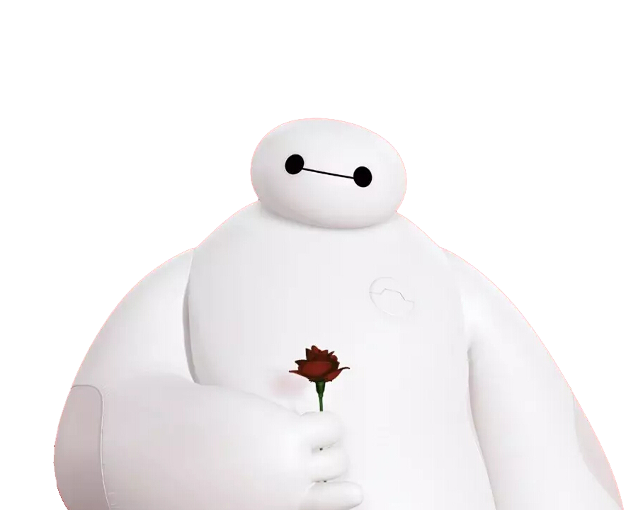
3
Oh! On!
I cannot deactivate until you say you are satisfied with your care.

Slide 12
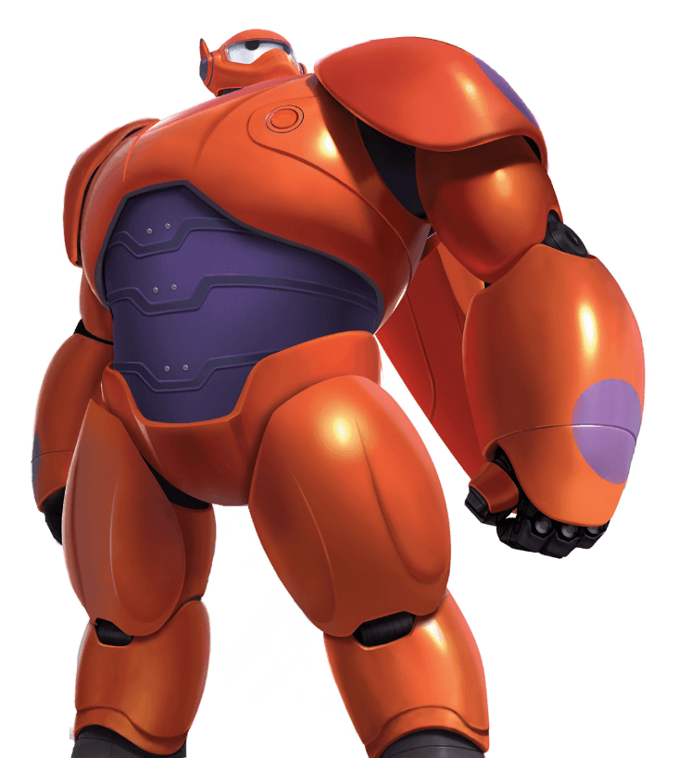
iPPT Balala
308%
iPPT Balala
⬆
iPPT Balala
iPPT Balala
1.0
2.0

Slide 13
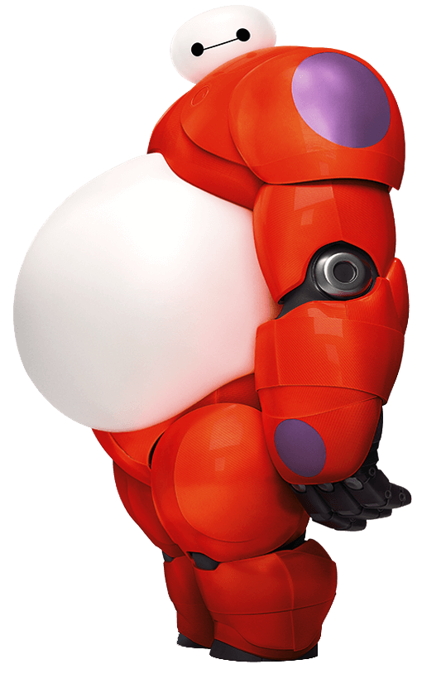
Baymax upgrades
What?
On a scale of 1 to 10, how would you rate your pain?

Slide 14
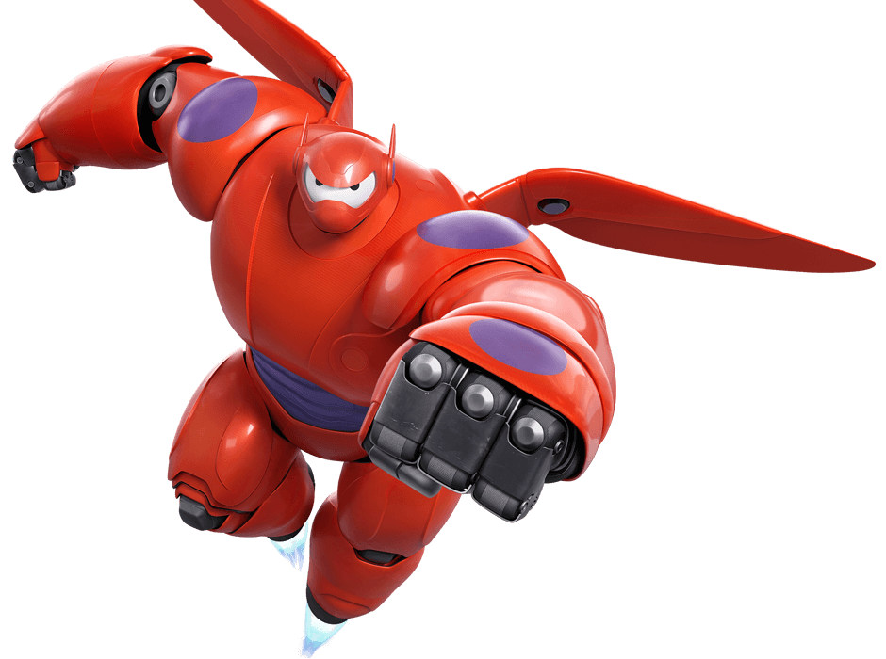
iPPT Balala
iPPT Balala
Baymax, a huge robot who is like the Michelin Man crossed with Florence Nightingale — a caring, sharing blob.
I will always be with you. On a scale of 1 to 10, how would you rate your pain?
iPPT Balala
iPPT Balala
I cannot deactivate until you say you are satisfied with your care.
Hello. I am Baymax, your personal healthcare companion.

Slide 15
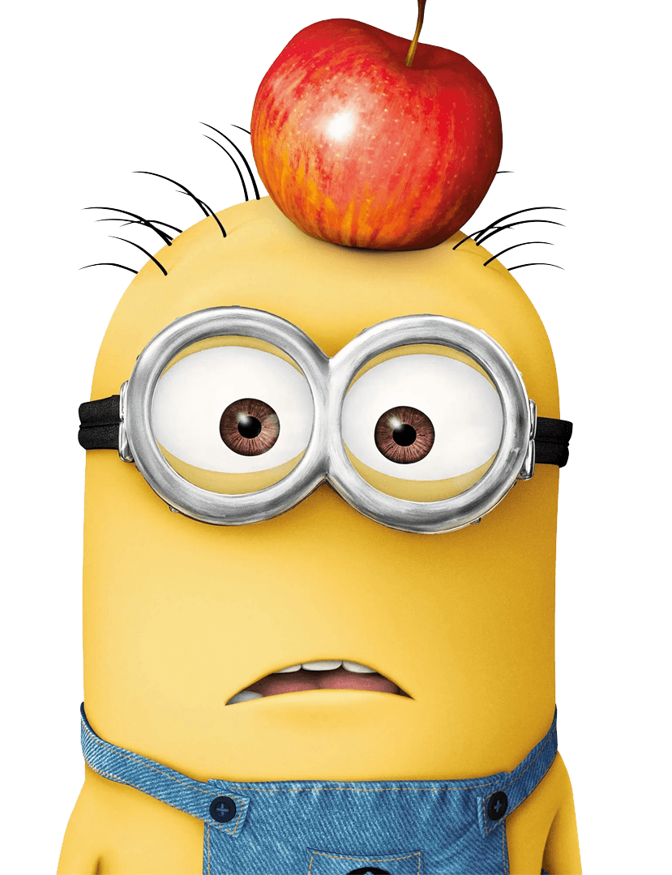
4
Bananaah!!! Potato naaahhh! Bananaaahh!! Togali no potato ni gani balo banika no jiga. Ba-ba, ba-banana.

Slide 16
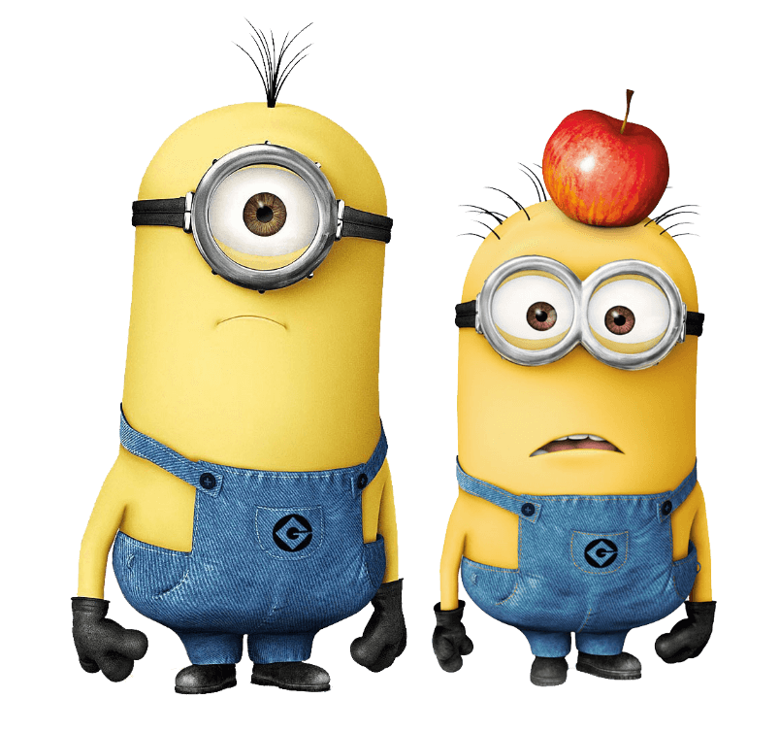
More MINIONS
Potatooooooohhhh!
Togali no potato ni ganibalo banika no jiga. Ba-ba, ba-bananaaahh!!
Bananaaaahhh!!! Potato naaaaahhhh! Bananaaaahhh!!
Togali no potato ni gani balo banika no jiga. Ba-ba, ba-banana.Yo plano hu. Lapa nonotu.
Bananaaaahhh!!! Potato naaaaahhhh! Bananaaaahhh!!

Slide 17
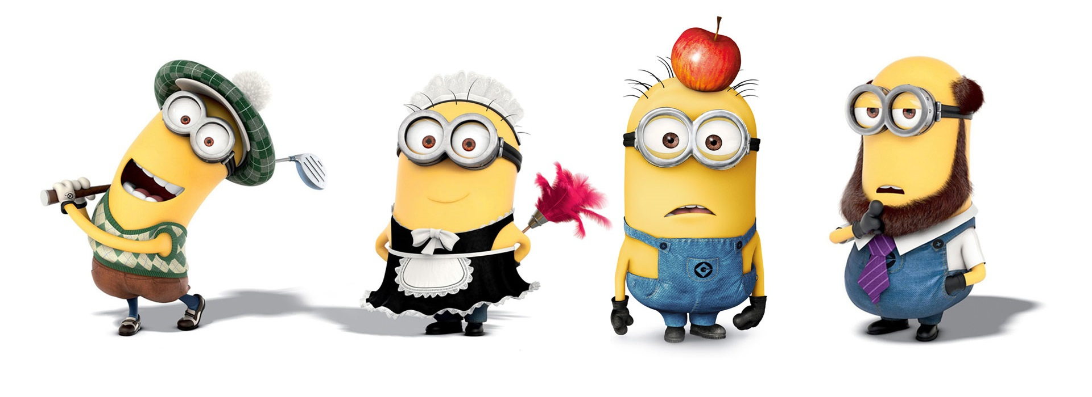
Banana
MINIONS
Minions are some small robots in a movie. they are yellow, and they always wear blue trousers. some have one eye and some have two eyes. their arms and legs are short, so they look very funny. Bananas are their favorite food.
Minions are small. but they are very smart, minions work hard and they have different jobs. some work as policemen some work as tennis players and some work as teachers many people like bees cute yellow robots. let s meet three of them.
Minion’s
Day

Slide 18
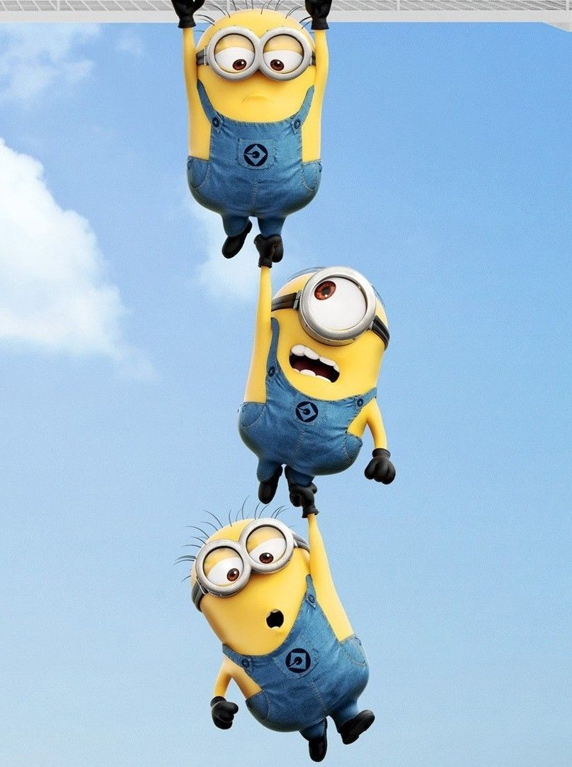
iPPT Banana
Ba-ba-ba-ba-ba-nana ba-ba-ba-ba-na-na banana banana banana.
iPPT Banana
You got me rocking and a rolling, got rocking me banana na na ba-ba-nana. Went to dance looking for a man. Shaw banana so I Fnially took a chance.
iPPT Banana
Banana na na POtatooo. You got me rocking and a rolling rocking me. ba ba ba ba bananaaaaaaaaa.

Slide 19
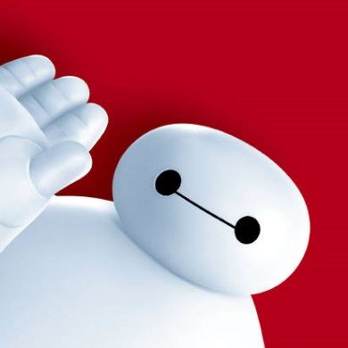
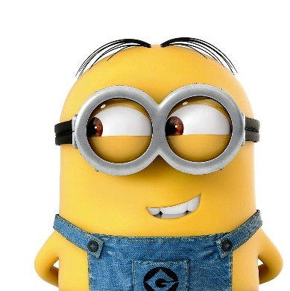
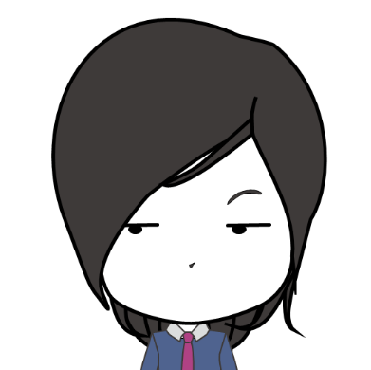
Mr.mu’s Trio
Baymax
MINION
MUMu
I cannot deactivate until you say you are satisfied with your care.
Potatooooooohhhh!
Togali no potato ni ganibalo banika no jiga. Ba-ba, ba-bananaaahh!!
Come on！Guys！
PPT Never Sleeps！
To be a funny PPTer！

Slide 20
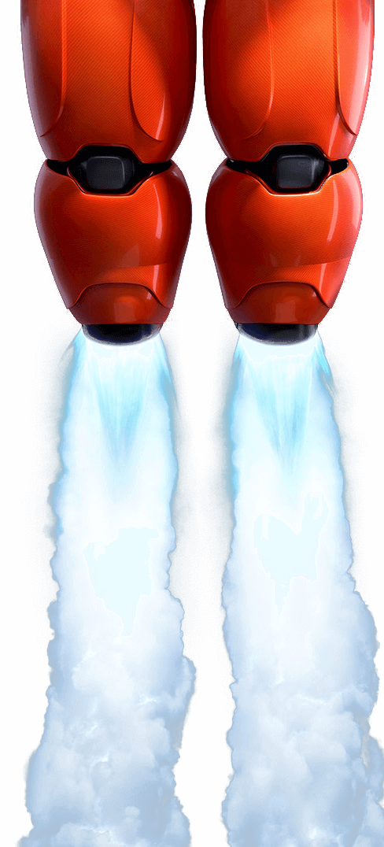
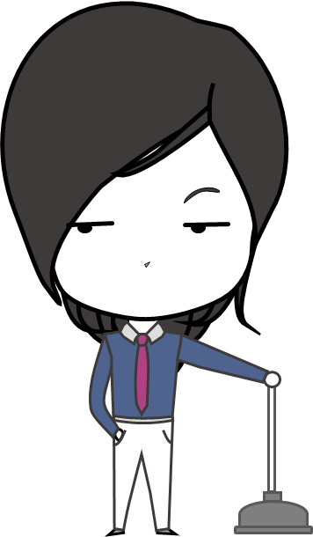
Ba-ba-na~
Thanks

Slide 21
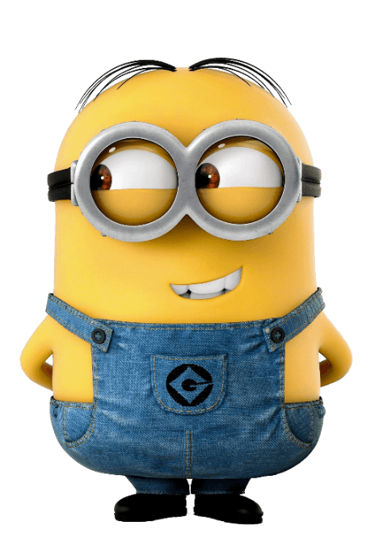
MR.MU
PPT Never Sleeps
字体
Big Hero 6
Nakadai

Slide 22
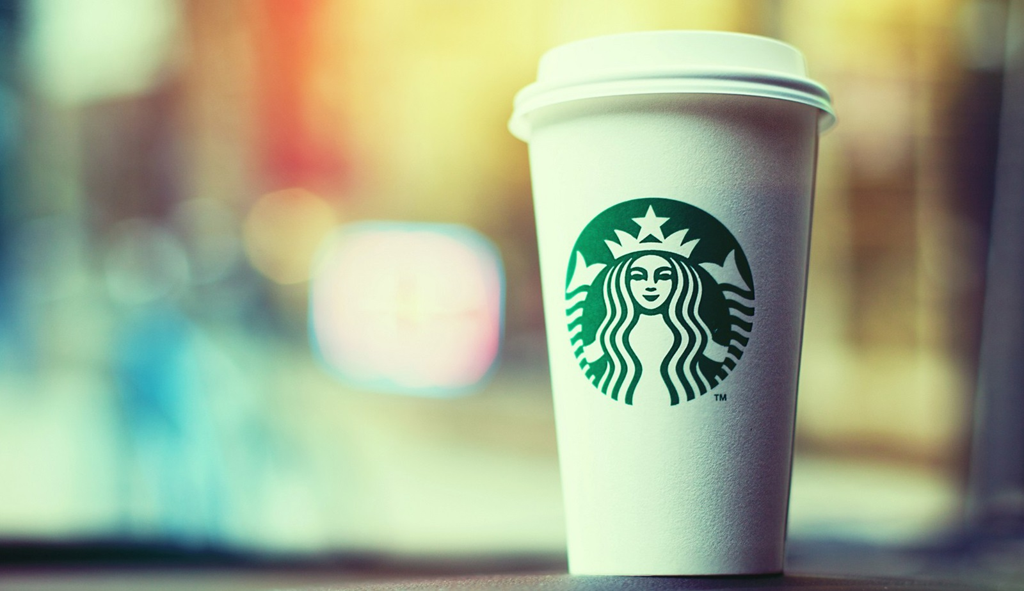
如觉得这份作品还不错，
请木先生喝杯星巴克吧！

