Slide 2
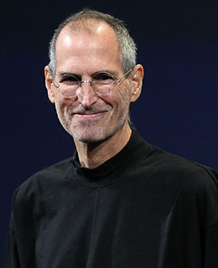
Main Page
Topic 1
Topic 2
Topic 3
Topic 4
Topic 5
苹果电脑公司由Steve Paul Jobs、Stephen Gary等于1976年4月1日创立

Slide 3
Main Page
Topic 1
Topic 2
Topic 3
Topic 4
Topic 5
iTunes
Mac
iPad
Apple
iPod
iPhone

Slide 4
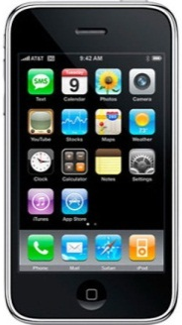
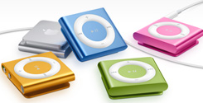
Main Page
Topic 1
Topic 2
Topic 3
Topic 4
Topic 5
You can add your text
in this way
2007
1984
2001

Slide 5
Main Page
Topic 1
Topic 2
Topic 3
Topic 4
Topic 5
Picture speaks louder than words

Slide 6
Main Page
Topic 1
Topic 2
Topic 3
Topic 4
Topic 5
iPhone
iPad
Try as simple as possible…
并列关系

Slide 7
Main Page
Topic 1
Topic 2
Topic 3
Topic 4
Topic 5
iPhone
iPad
VS
强调

Slide 8
Main Page
Topic 1
Topic 2
Topic 3
Topic 4
Topic 5
iPhone
iPad
iPad
递进

Slide 9
Main Page
Topic 1
Topic 2
Topic 3
Topic 4
Topic 5
如果你一定要彩色

Slide 10
谢
谢

