Slide 1
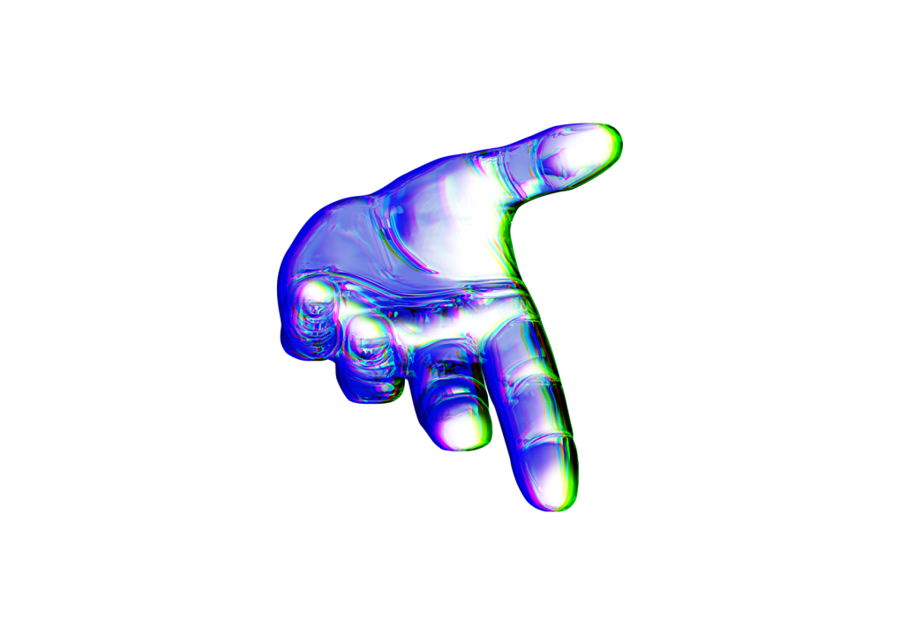
Dynamically impact just in time innovation before leveraged customer service.

Slide 2
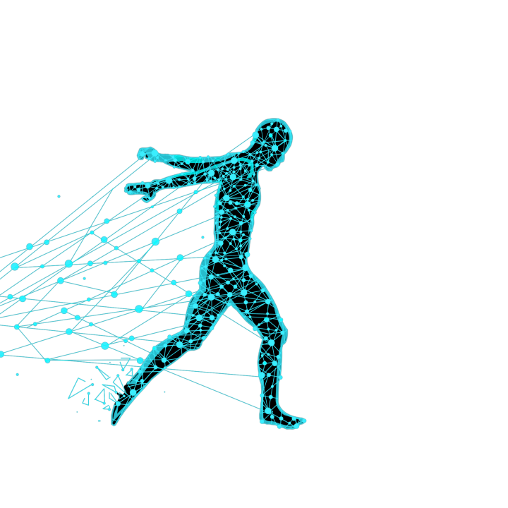
目录
录
1
科技改变生活
Assertively unleash flexible technology whereas equity invested internal
2
科技改变生活
Assertively unleash flexible technology whereas equity invested internal
3
科技改变生活
Assertively unleash flexible technology whereas equity invested internal
4
科技改变生活
Assertively unleash flexible technology whereas equity invested internal

Slide 3
未来已来

Slide 4
10
科技改变未来生活
1
2
3
4
Olicia Carr
Designer
Assertively unleash flexible technology whereas equity invested internal or "organic" sources.
Jose Rice
Developer
Assertively unleash flexible technology whereas equity invested internal or "organic" sources.
Janet Perry
Consulting
Assertively unleash flexible technology whereas equity invested internal or "organic" sources.
Jean Jones
Manager
Assertively unleash flexible technology whereas equity invested internal or "organic" sources.

Slide 5
06
科技改变未来生活

Design and Illsutartions
Assertively unleash flexible technology whereas equity invested internal

Business Proejct & Plan
Assertively unleash flexible technology whereas equity invested internal

Marketing & Analysis
Assertively unleash flexible technology whereas equity invested internal

Media & Photos
Assertively unleash flexible technology whereas equity invested internal
ESSENTIAL
ESSENTIAL
ESSENTIAL
ESSENTIAL
Marketing Team Work Process
Assertively unleash flexible technology whereas equity invested internal or "organic" sources. Collaboratively disintermediate maintainable leadership with team building internal or "organic" sources. Globally deploy enterprise-wide vortals for magnetic quality vectors.

Slide 6
07
科技改变未来生活











➔


➔


➔
Download System
Assertively unleash flexible technology whereas equity invested internal or "organic" sources.
App System
Assertively unleash flexible technology whereas equity invested internal or "organic" sources.
Project System
Assertively unleash flexible technology whereas equity invested internal or "organic" sources.

Slide 7
11
科技改变未来生活
MANAGER
Assertively unleash flexible technology whereas equity invested internal
OPERATOR
Assertively unleash flexible technology whereas equity invested internal
STUDENT
Assertively unleash flexible technology whereas equity invested internal
DOCTOR PH
Assertively unleash flexible technology whereas equity invested internal
COSTUMER
Assertively unleash flexible technology whereas equity invested internal
Member Valuation
Assertively unleash flexible technology whereas equity invested internal or "organic" sources. Collaboratively disintermediate maintainable leadership with team building internal or "organic" sources. .

Slide 8
未来科技

Slide 9
40
科技改变未来生活
Marketing Informations
Assertively unleash flexible technology whereas equity invested internal or "organic" sources. Collaboratively disintermediate maintainable leadership with team building internal or "organic" sources. Globally deploy enterprise-wide vortals for magnetic quality vectors.
Result
Primary Idea
Header Info In Area
Efficiently pontificate B2B imperatives for principle-centered schemas. Collaboratively engineer next-generation ideas
BUSINESS
Assertively unleash flexible technology
Implementation
Process Planning
STRATGEY
Research
Assertively unleash flexible technology

Slide 10
41
科技改变未来生活
●
⇩

PHOTO PORTFOLIO SITE
Assertively unleash flexible technology whereas equity
BUSINESS PLAN
Assertively unleash flexible technology whereas equity
EXCLUSIVE AGENCY
Assertively unleash flexible technology whereas equity
BUSINESS PROCESS
Assertively unleash flexible technology whereas equity
ESSENTIAL FEATURES
Assertively unleash flexible technology whereas equity
CONSULTING SERVICE
Assertively unleash flexible technology whereas equity




Slide 11
47
科技改变未来生活
Marketing & Management Team
Marketing Informations
Assertively unleash flexible technology whereas equity invested internal or "organic" sources. Collaboratively disintermediate maintainable leadership with team building internal or "organic" sources. Globally deploy enterprise-wide vortals for magnetic quality vectors.
Aunleash flexible technology whereas equity invested internal or "organic" sources. Collaboratively disintermediate maintainable leadership with team
Aunleash flexible technology whereas equity invested internal or "organic" sources. Collaboratively disintermediate maintainable leadership with team
Aunleash flexible technology whereas equity invested internal or "organic" sources. Collaboratively disintermediate maintainable leadership with team

Slide 12
49
科技改变未来生活
Data Description
Assertively unleash flexible technology whereas equity invested internal or "organic" sources. Collaboratively disintermediate maintainable leadership with team building internal or "organic" sources. Globally deploy enterprise-wide vortals for magnetic quality vectors.




01
EASY OPTIONS
Assertively unleash flexible technology whereas equity invested internal.
02
FREE IMAGE
Assertively unleash flexible technology whereas equity invested internal.
03
CONSULTING
Assertively unleash flexible technology whereas equity invested internal.
04
BUSINESS PROJECT
Assertively unleash flexible technology whereas equity invested internal.

Slide 13



科技改变
未来生活


➔
⬆
Business Developer, Marketing
Assertively unleash flexible technology whereas equity invested internal or "organic" sources. Collaboratively disintermediate maintainable leadership with team building internal or "organic" sources.

Slide 14
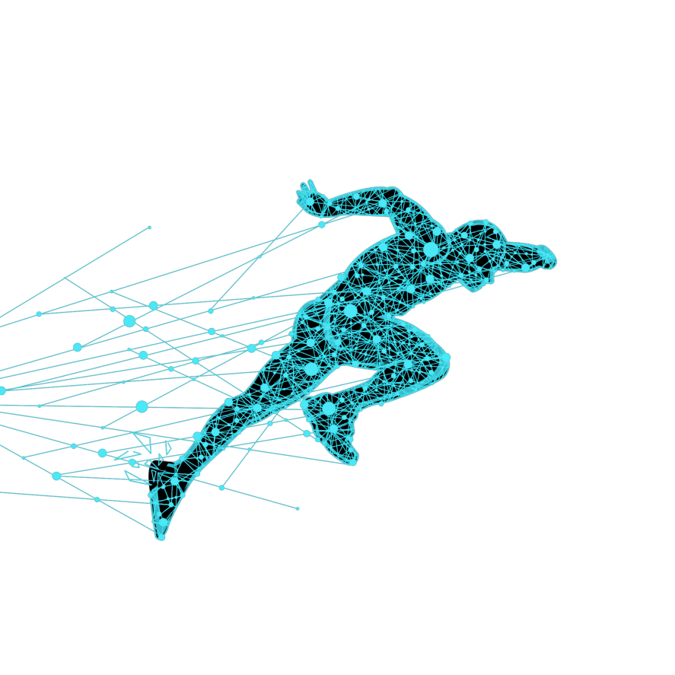
未来已来

Slide 15
56
科技改变未来生活

Circular - Application Service
Assertively unleash flexible technology whereas equity invested internal or "organic" sources. Collaboratively disintermediate maintainable leadership with team building internal or "organic" sources. Globally deploy enterprise-wide vortals for magnetic quality vectors.



Assertively unleash
technology whereas
BUSINESS ARCHIVE

User Usage
App Speed
➔
⬆


Slide 16
58
科技改变未来生活
 Marketing & Social
Assertively unleash flexible technology whereas equity invested internal or "organic" sources. Collaboratively disintermediate maintainable leadership.
Design & Illustration 
Assertively unleash flexible technology whereas equity invested internal or "organic" sources. Collaboratively disintermediate maintainable leadership.
70%
80%
 Video & Image
Assertively unleash flexible technology whereas equity invested internal or "organic" sources. Collaboratively disintermediate maintainable leadership.
Consulting & Forum 
Assertively unleash flexible technology whereas equity invested internal or "organic" sources. Collaboratively disintermediate maintainable leadership.
30%
90%

Slide 17
60
科技改变未来生活
01
03
Design & Concept
Assertively unleash flexible technology whereas equity invested internal or "organic" sources.
Smart & Fast
Assertively unleash flexible technology whereas equity invested internal or "organic" sources.
Marketing
Essential Works
02
04
Essential & Unique
Assertively unleash flexible technology whereas equity invested internal or "organic" sources.
Business & Market
Assertively unleash flexible technology whereas equity invested internal or "organic" sources.

Slide 18
68
科技改变未来生活
90%
Circular Chart
45%
Circular Chart
62%
Circular Chart
HEADER INFO IN AREA
Efficiently pontificate B2B imperatives for principle-centered schemas.
SALES ANALYSIS
Sales Column Chart 2014 - 2015
Assertively unleash flexible technology whereas equity invested internal or "organic" sources. Collaboratively disintermediate maintainable leadership with team building internal or "organic" sources. Globally deploy enterprise-wide vortals for magnetic quality vectors.
Section Name
Section Name
Section Name

Slide 19
73
科技改变未来生活
85%
Advertise
45%
Promotions
90%
Strategy
40%
Marketing


➔


➔


➔


➔
Description
Assertively unleash flexible technology whereas equity invested
Description
Assertively unleash flexible technology whereas equity invested
Description
Assertively unleash flexible technology whereas equity invested
Description
Assertively unleash flexible technology whereas equity invested

Slide 20
74
科技改变未来生活
25%
85%
55%
45%
Business Team
Assertively unleash flexible technology whereas equity invested
Social Team
Assertively unleash flexible technology whereas equity invested
Marketing Team
Assertively unleash flexible technology whereas equity invested
Analysis Team
Assertively unleash flexible technology whereas equity invested
WE ARE CREATIVE COMPANY
Assertively unleash flexible technology whereas equity invested internal or "organic" sources. Collaboratively disintermediate maintainable leadership with team building internal or "organic" sources. Globally deploy enterprise-wide vortals for magnetic quality vectors.

Slide 21
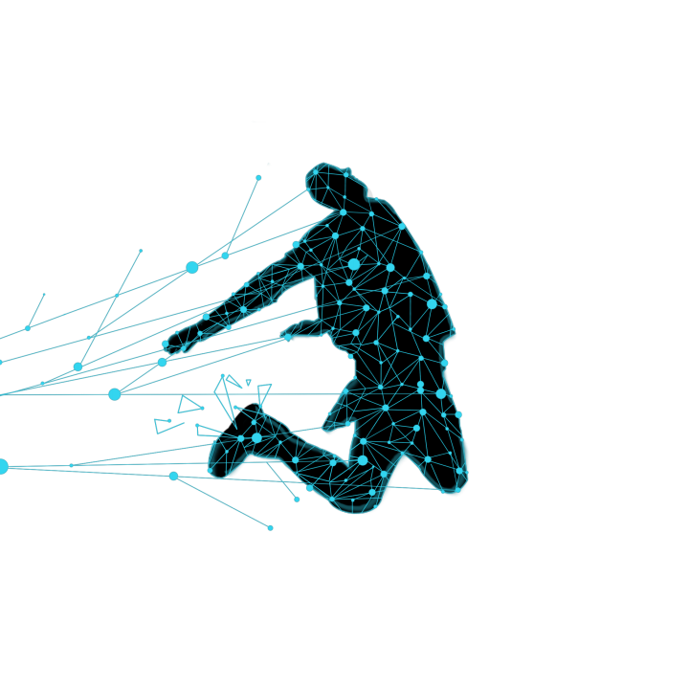
未来科技

Slide 22
75
科技改变未来生活
65%
90%
40%
75%
Official Web
Facebook
Twitter
Google Plus
1st Quarter
Assertively unleash flexible technology whereas equity invested internal.
2nd Quarter
Assertively unleash flexible technology whereas equity invested internal.
3rd Quarter
Assertively unleash flexible technology whereas equity invested internal.
4th Quarter
Assertively unleash flexible technology whereas equity invested internal.
$650,250
$650,250
$650,250
$650,250

Slide 23
85
科技改变未来生活
Photo Archive
Assertively unleash flexible technology whereas equity maintainable


Costumer Forum
Assertively unleash flexible technology whereas equity maintainable
Business Section
Assertively unleash flexible technology whereas equity maintainable


Cloud System
Assertively unleash flexible technology whereas equity maintainable
Unique Design
Assertively unleash flexible technology whereas equity maintainable
●
➔
Standart Hierarchy
Assertively unleash flexible technology whereas equity maintainable

Slide 24
86
科技改变未来生活
Application Service
Assertively unleash flexible technology whereas equity invested internal or "organic" sources. Collaboratively disintermediate maintainable leadership with team building internal or "organic" sources. Globally deploy enterprise-wide vortals for magnetic quality vectors.
85%
75%
68%
30%
30%



➔
AU
KL
MN
US
JP
Awwards
Consulting
Upload
System Design

Slide 25
88

科技改变未来生活

APP AWWARDS
Assertively unleash flexible

UPLOAD IMAGE
Assertively unleash flexible
Marketing Informations
Assertively unleash flexible technology whereas equity invested internal or "organic" sources. Collaboratively disintermediate maintainable leadership with team building internal or "organic" sources.

MEDIA CENTER
Assertively unleash flexible

15%
Design Solutions
25%
Business Strategy
35%
Marketing Promotions

Slide 26
69
科技改变未来生活
Marketing Informations
Assertively unleash flexible technology whereas equity invested internal or "organic" sources. Collaboratively disintermediate maintainable leadership with team building internal or "organic" sources. Globally deploy enterprise-wide vortals for magnetic quality vectors.
One Step
BUSINESS PROCESS
Assertively unleash flexible technology whereas equity

STRATEGY B
Two Step
APP SERVICE
Assertively unleash flexible technology whereas equity
Three Step
CONSULTING SERVICE
Assertively unleash flexible technology whereas equity

Slide 27
70
科技改变未来生活
One Step
Research & Analysis
Assertively unleash flexible technology whereas equity
Two Step
Evolutions & Change
Assertively unleash flexible technology whereas equity
Four Step
Consulting & Event
Assertively unleash flexible technology whereas equity
Five Step
Professional & Job
Assertively unleash flexible technology whereas equity

