Slide 1


你的爱情
是哪一种模样
THINKBUTION

Slide 2

2017
MEMORIAL DAY
我愿做每一天的晨光，在每天你刚醒来的时候，
嘟嘴的你的第一次眨眼，
总有一束温暖的阳光肆无忌惮的洒在你身上，
照耀你那如画般的美

Slide 3


There is a person, waiting for you in the depths of time. Chase your dreams became my goal, a grizzled troubadour captive of sorrow and tears
在时光深处，等你
A PERSON,
WAITING FOR YOU
IN THE DEPTHS OF TIME！
2017.2.15

Slide 4

2月
15日
有一个人，
在时光深处等你
A PERSON,
WAITING FOR YOU
IN THE DEPTHS OF TIME！
时光深处，等你
There is a person, waiting for you in the depths of time. Chase your dreams became my goal, a grizzled troubadour captive of sorrow and tears

Slide 5
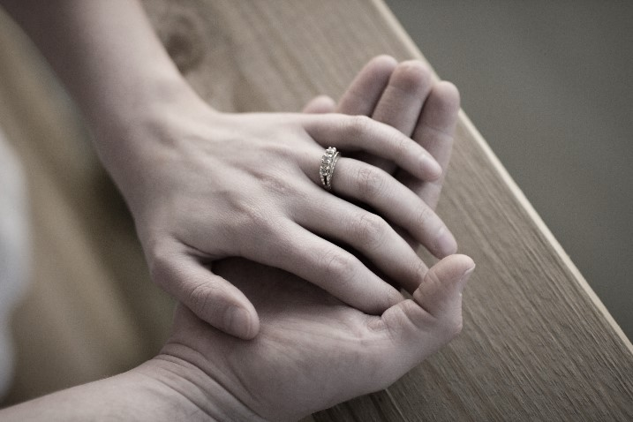
2月
15日
有一个人，
在时光深处等你
A PERSON,
WAITING FOR YOU
IN THE DEPTHS OF TIME！
时光深处，等你
There is a person, waiting for you in the depths of time. Chase your dreams became my goal, a grizzled troubadour captive of sorrow and tears

Slide 6


I
U
I would like to do every day morning, when you just wake up every day
我愿做每一天的晨光，在每天你刚醒来的时候

Slide 7





你好，安红
A PERSON,
WAITING FOR YOU
IN THE DEPTHS OF TIME！

Slide 8

我愿做每一天的晨光，在每天你刚醒来的时候，嘟嘴的你的第一次眨眼。

Slide 9
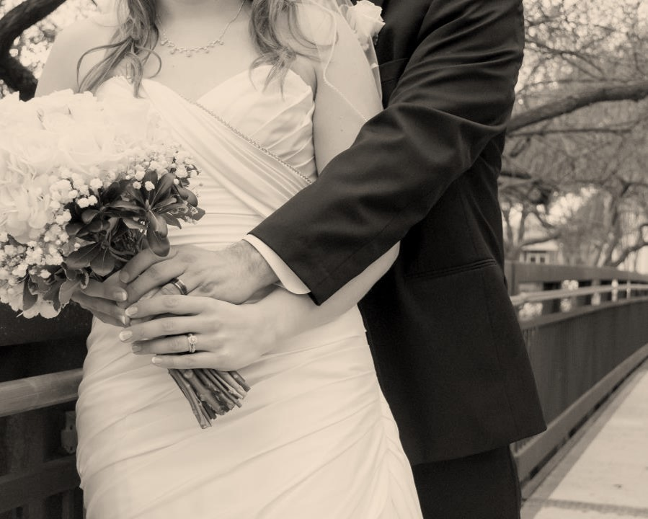
There is a person, waiting for you in the depths of time. Chase your dreams became my goal, a grizzled troubadour captive of sorrow and tears
I LOVE YOU
I would like to do every day morning, when you just wake up every day
我愿做每一天的晨光，在每天你刚醒来的时候

Slide 10
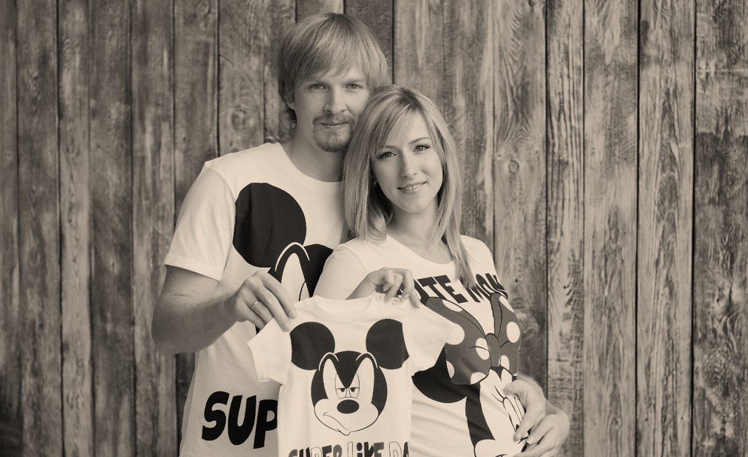

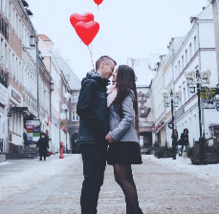
你好，安红
A PERSON,
WAITING FOR YOU
IN THE DEPTHS OF TIME！
There is a person, waiting for you in the depths of time. Chase your dreams became my goal, a grizzled troubadour captive of sorrow and tears

Slide 11
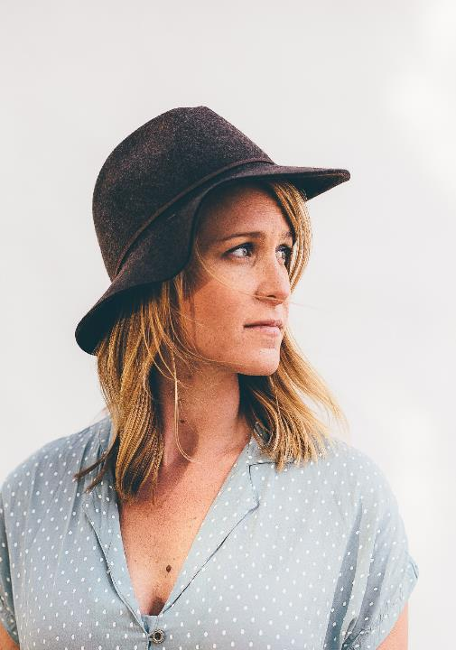
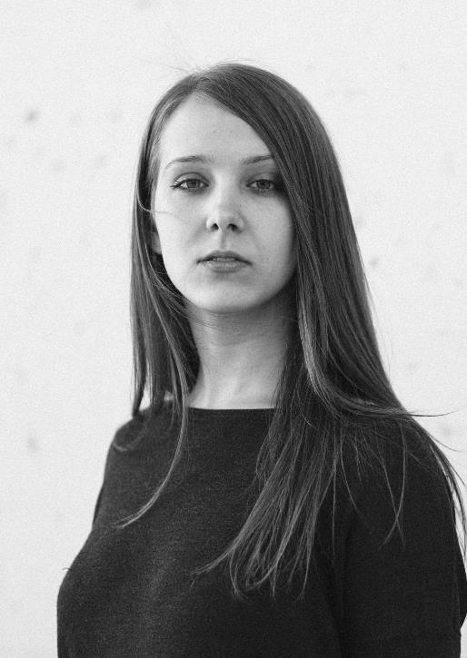
有一个人，
在时光深处等你

Slide 12

情人节
Each day is Valentine's day
VALENTINE'S DAY
你我的相遇，
上天的恩赐
2017.2.24
情人节

Slide 13


I would like to do every day morning, when you just wake up every day
因为经历，
所以懂得

Slide 14
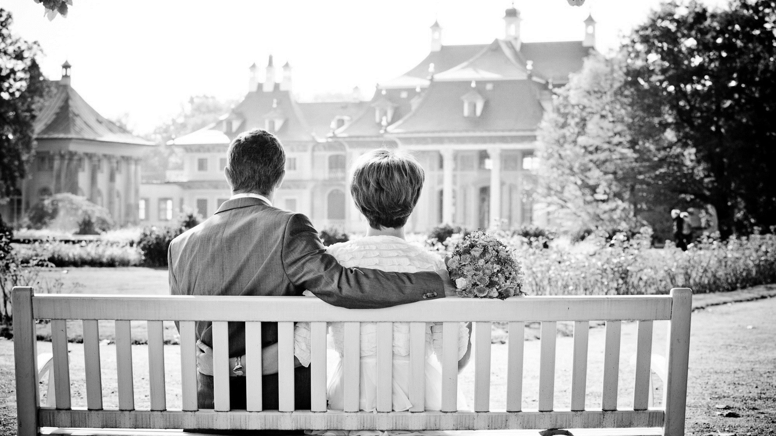
你好，爱情
KEEPING THE FAITH
There is a person, waiting for you in the depths of time. Chase your dreams became my goal, a grizzled troubadour captive of sorrow and tears

