Slide 1
I look at me like I'm a fool.I love you is the perfume of my clothes after I meet.Before you go to bed,I look at me like I'm a fool

Slide 2
love you

Slide 3
I love you takes one and a half hours to think about what to eat, and only one sandwich at the end.I love you makes wrinkles out of my nose when I look at me like I'm a fool.I love you is the perfume of my clothes after I meet.Before you go to bed, you are the one I most want to talk to

Slide 4
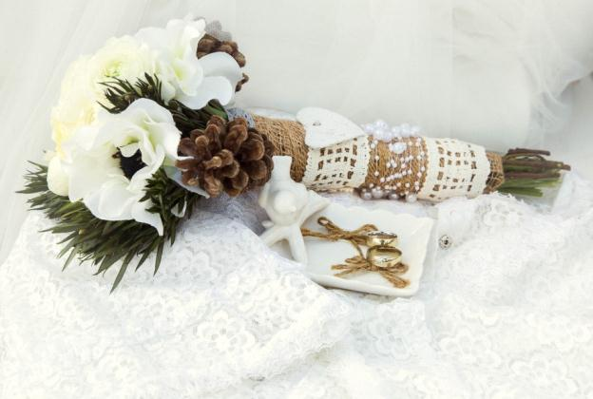
I love you takes one and a half hours to think about what to eat, and only one sandwich at the end.I love you makes wrinkles out of my nose when I look at me like I'm a fool.I love you is the perfume of my clothes after I meet.Before you go to bed, you are the one I most want to talk to.I'm not here because I'm lonely

Slide 5
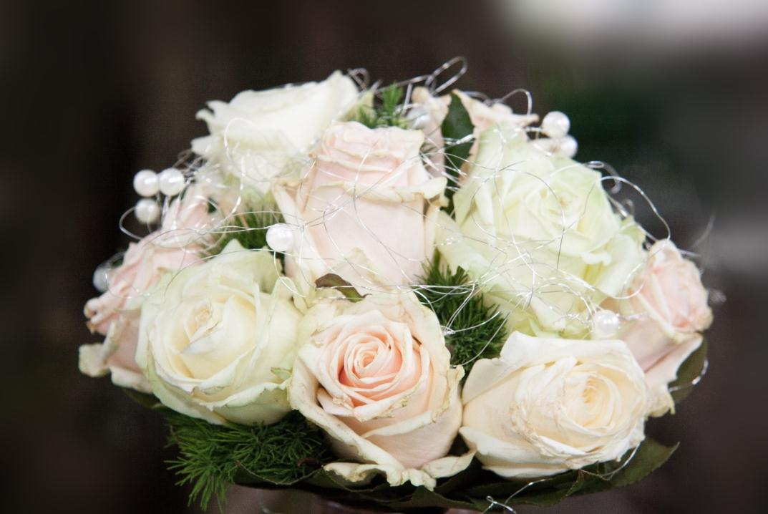
I love you takes one and a half hours to think about what to eat, and only one sandwich at the end.I love you makes wrinkles out of my nose when I look at me like I'm a fool.I love you is the perfume of my clothes after I meet.Before you go to bed, you are the one I most want to talk to.I'm not here because I'm lonely, or because it's New Year's eve, because if you want to spend the rest of your life with someone, you want to start the rest of your life as early as possible."

Slide 6
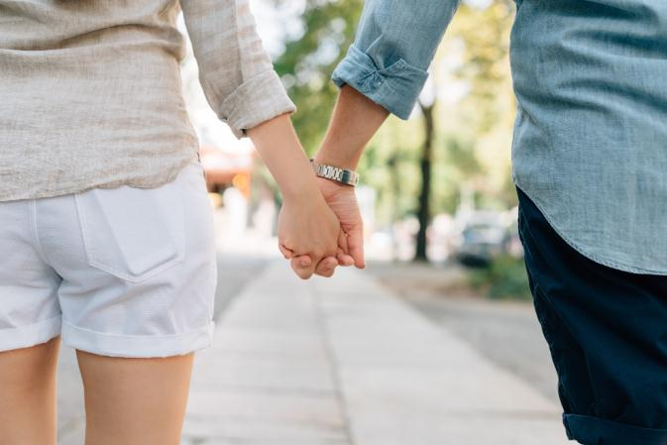
01
I love you takes one and a half hours to think about what to eat, and only one sandwich at the end.I love you makes wrinkles out of my nose
I love you takes one and a half hours to think about what to eat, and only one sandwich at the end.I love you makes wrinkles out of my nose when I look at me like I'm a fool.I love you is the perfume of my clothes after I meet.Before you go to bed, you are the one I most want to talk to.I'm not here because I'm lonely, or because it's New Year's eve, "
02
I love you takes one and a half hours to think about what to eat, and only one sandwich at the end.I love you makes wrinkles out of my nose

Slide 7
I love you takes one and a half hours to think about what to eat, and only one sandwich at the end.I love you makes wrinkles out of my nose when I look at me like I'm a fool.I love you is the perfume of my clothes after I meet.Before you go to bed, you are the one I most want to talk to.

Slide 8
I love you takes one and a half hours to think about what to eat, and only one sandwich at the end.I love you makes wrinkles out of my nose when I look at me like I'm a fool.I love you is the perfume of my clothes after I meet.Before you go to bed, you are the one I most want to talk to.I'm not here because I'm lonely, or because it's New Year's eve, because if you want to spend the rest of your life with someone, you want to start the rest of your life as early as possible."

Slide 9
I love you takes one and a half hours to think about what to eat, and only one sandwich at the end.I love you makes wrinkles out of my nose when I look at me like I'm a fool.I love you is the perfume of my clothes after I meet.Before you go to bed, you are the one I most want to talk to.I'm not here because I'm lonely, or because it's New Year's eve, because if you want to spend the rest of your life with someone, you want to start the rest of your life as early as possible."

Slide 10
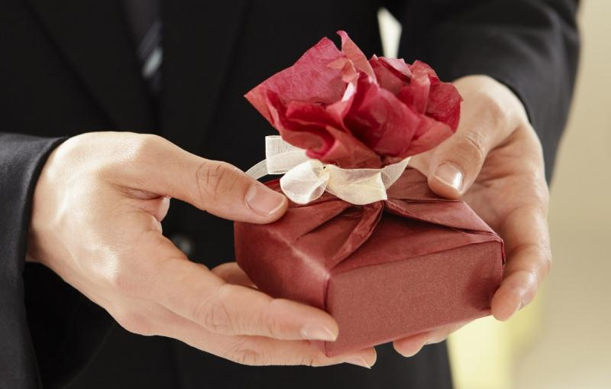
I love you takes one and a half hours to think about what to eat, and only one sandwich at the end.I love you makes wrinkles out of my nose when I look at me like I'm a fool.I love you is the perfume of my clothes after I meet.Before you go to bed, you are the one I most want to talk to.I'm not here because I'm lonely, or because it's New Year's eve, because if you want to spend the rest of your life with someone, you want to start the rest of your life as early as possible."

Slide 11
I love you takes one and a half hours to think about what to eat, and only one sandwich at the end.I love you makes wrinkles out of my nose when I look at me like I'm a fool.I love you is the perfume of my clothes after I meet.Before you go to bed, you are the one I most want to talk to.I'm not here because I'm lonely, or because it's New Year's eve, because if you want to spend the rest of your life with someone

Slide 12
love you
I love you takes one and a half hours to think about what to eat, and only one sandwich at the end.I love you makes wrinkles out

Slide 13
love you
I love you takes one and a half hours to think about what to eat, and only one sandwich at the end.I love you makes wrinkles out of my nose when I look at me like I'm a fool.I love you is the perfume of my clothes after I meet.Before you go to bed, you are the one I most want to talk to.I'm not here because I'm lonely, or because it's New Year's eve, because if you want to spend the rest of your life with someone, you want to start the rest of your life as early as possible."

Slide 14
love you
I love you takes one and a half hours to think about what to eat, and only one sandwich at the end.I love you makes wrinkles out of my nose when I look at me like I'm a fool.I love you is the perfume of my clothes after I meet.Before you go to bed

Slide 15
love
you
I love you takes one and a half hours to think about what to eat, and only one sandwich at the end.I love you makes wrinkles out of my nose when I look at me like I'm a fool.I love you is the perfume of my clothes

Slide 16
love you
I love you takes one and a half hours to think about what to eat, and only one sandwich at the end.I love you makes wrinkles out of my nose when I look at me like I'm a fool.I love you is the perfume of my clothes

Slide 17
love you
I love you takes one and a half hours to think about what to eat, and only one sandwich at the end.I love you makes wrinkles out of my nose when I look at me like I'm a fool.I love you is the perfume of my clothes

Slide 18
02
I love you takes one and a half hours to think about what to eat, and only one sandwich at the end.I love you makes wrinkles out of my nose
I love you takes one and a half hours to think about what to eat, and only one sandwich at the end.I love you makes wrinkles out of my nose when I look at me like I'm a fool.I love you is the perfume of my clothes after I meet.Before you go to bed, you are the one I most want to talk to.I'm not here because I'm lonely, or because it's New Year's eve, "
01
I love you takes one and a half hours to think about what to eat, and only one sandwich at the end.I love you makes wrinkles out of my nose

Slide 19
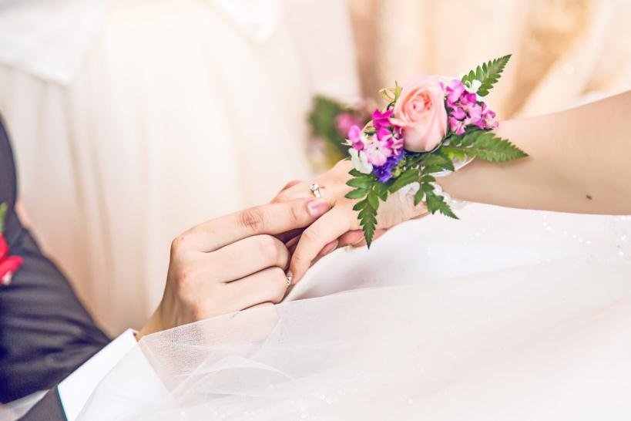
love you
I love you takes one and a half hours to think about what to eat, and only one sandwich at the end.I love you makes wrinkles out of my nose when I look at me like I'm a fool.I love you is the perfume of my clothes

Slide 20
I love you takes one and a half hours to think about what to eat, and only one sandwich at the end.I love you makes wrinkles out of my nose when I look at me like I'm a fool.I love you is the perfume of my clothes

Slide 21
I look at me like I'm a fool.I love you is the perfume of my clothes after I meet.Before you go to bed,I look at me like I'm a fool

