Slide 1
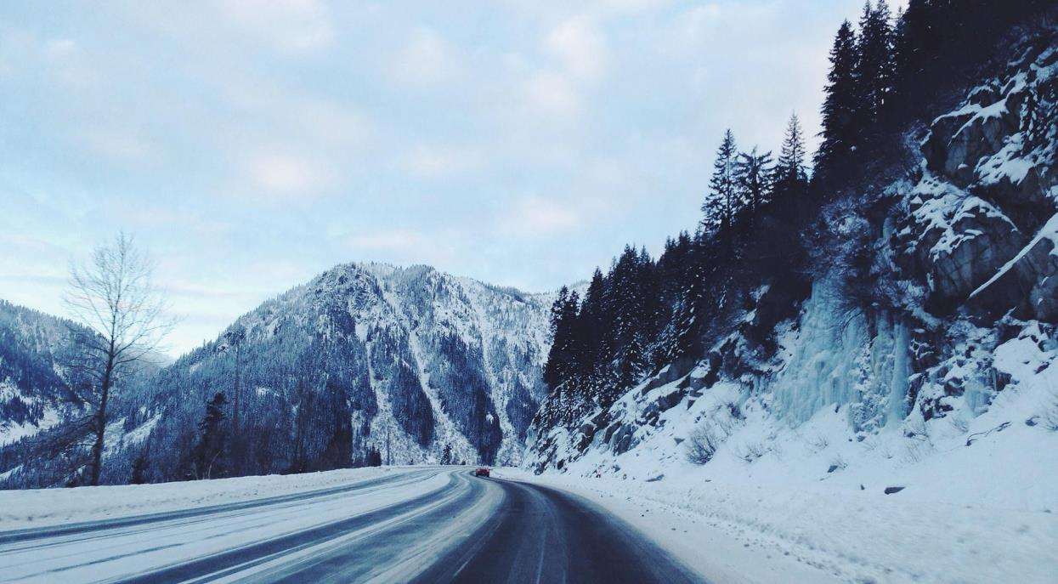
DESTINY
FREEDOM
ALL OR NOTHING
I love you more than I've ever loved any woman.

Slide 2
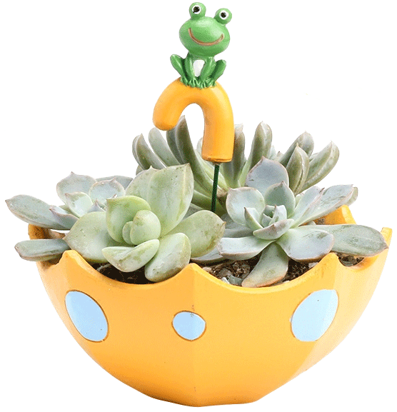
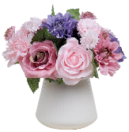
Contents
Click here to add your title
Click here to add your title
Click here to add your title
Click here to add your title

Slide 3
ONE
I love you more than I've ever loved any woman. And I've waited longer for you than I've waited for any woman.
I love you more than I've ever loved any woman. And I've waited longer for you than I've waited for any woman.I love you more than I've ever loved any woman. And I've waited longer for you than I've waited for any woman.
Click here to add your title

Slide 4
Click here to add your title
I love you more than I've ever loved any woman. And I've waited longer for you than I've waited for any woman.
I love you more than I've ever loved any woman. And I've waited longer for you than I've waited for any woman.I love you more than I've ever loved any woman. And I've waited longer for you than I've waited for any woman.

Slide 5
I love you more than I've ever loved any woman. And I've waited longer for you than I've waited for any woman.
I love you more than I've ever loved any woman. And I've waited longer for you than I've waited for any woman.
I love you more than I've ever loved any woman. And I've waited longer for you than I've waited for any woman.
I love you more than I've ever loved any woman. And I've waited longer for you than I've waited for any woman.
ONE
I love you more than I've ever loved any woman. And I've waited longer for you than I've waited for any woman.
I love you more than I've ever loved any woman. And I've waited longer for you than I've waited for any woman.
I love you more than I've ever loved any woman. And I've waited longer for you than I've waited for any woman.
I love you more than I've ever loved any woman. And I've waited longer for you than I've waited for any woman.
TWO

Slide 6
+
Click here to add your title
Click here to add your title
I love you more than I've ever loved any woman. And I've waited longer for you than I've waited for any woman.
I love you more than I've ever loved any woman. And I've waited longer for you than I've waited for any woman.I love you more than I've ever loved any woman. And I've waited longer for you than I've waited for any woman.
I love you more than I've ever loved any woman. And I've waited longer for you than I've waited for any woman.
I love you more than I've ever loved any woman. And I've waited longer for you than I've waited for any woman.I love you more than I've ever loved any woman. And I've waited longer for you than I've waited for any woman.

Slide 7
I love you more than I've ever loved any woman. And I've waited longer for you than I've waited for any woman.
I love you more than I've ever loved any woman. And I've waited longer for you than I've waited for any woman.I love you more than I've ever loved any woman. And I've waited longer for you than I've waited for any woman.
ART

Slide 8
TWO
I love you more than I've ever loved any woman. And I've waited longer for you than I've waited for any woman.
I love you more than I've ever loved any woman. And I've waited longer for you than I've waited for any woman.I love you more than I've ever loved any woman. And I've waited longer for you than I've waited for any woman.
Click here to add your title

Slide 9
And I've waited longer for you than I've waited for any woman.
DESTIN
FREEDOM
I love you more than I've ever loved any woman. And I've waited longer for you than I've waited for any woman.
I love you more than I've ever loved any woman. And I've waited longer for you than I've waited for any woman.I love you more than I've ever loved any woman. And I've waited longer for you than I've waited for any woman.
I love you more than I've ever loved any woman. And I've waited longer for you than I've waited for any woman.I love you more than I've ever loved any woman. And I've waited longer for you than I've waited for any woman.

Slide 10
Click here to add your title
I love you more than I've ever loved any woman. And I've waited longer for you than I've waited for any woman.
I love you more than I've ever loved any woman. And I've waited longer for you than I've waited for any woman.I love you more than I've ever loved any woman. And I've waited longer for you than I've waited for any woman.

Slide 11
DESTINY FREEDOM
Click here to add your title
Click here to add your title
Click here to add your title
I love you more than I've ever loved any woman. And I've waited longer for you than I've waited for any woman.
I love you more than I've ever loved any woman. And I've waited longer for you than I've waited for any woman.
I love you more than I've ever loved any woman. And I've waited longer for you than I've waited for any woman.
I love you more than I've ever loved any woman. And I've waited longer for you than I've waited for any woman.
I love you more than I've ever loved any woman. And I've waited longer for you than I've waited for any woman.
I love you more than I've ever loved any woman. And I've waited longer for you than I've waited for any woman.

Slide 12
Click here to add your title
Click here to add your title
Click here to add your title
I love you more than I've ever loved any woman. And I've waited longer for you than I've waited for any woman.
I love you more than I've ever loved any woman. And I've waited longer for you than I've waited for any woman.
I love you more than I've ever loved any woman. And I've waited longer for you than I've waited for any woman.
I love you more than I've ever loved any woman. And I've waited longer for you than I've waited for any woman.
I love you more than I've ever loved any woman. And I've waited longer for you than I've waited for any woman.
I love you more than I've ever loved any woman. And I've waited longer for you than I've waited for any woman.

Slide 13
DESTINY FREEDOM
I love you more than I've ever loved any woman. And I've waited longer for you than I've waited for any woman.
I love you more than I've ever loved any woman. And I've waited longer for you than I've waited for any woman.
I love you more than I've ever loved any woman. And I've waited longer for you than I've waited for any woman.
I love you more than I've ever loved any woman. And I've waited longer for you than I've waited for any woman.

Slide 14
THREE
I love you more than I've ever loved any woman. And I've waited longer for you than I've waited for any woman.
I love you more than I've ever loved any woman. And I've waited longer for you than I've waited for any woman.I love you more than I've ever loved any woman. And I've waited longer for you than I've waited for any woman.
Click here to add your title

Slide 15
DESTINY FREEDOM
I love you more than I've ever loved any woman. And I've waited longer for you than I've waited for any woman.
I love you more than I've ever loved any woman. And I've waited longer for you than I've waited for any woman.I love you more than I've ever loved any woman. And I've waited longer for you than I've waited for any woman.
ART

Slide 16
S
Click here to add your title
I love you more than I've ever loved any woman. And I've waited longer for you than I've waited for any woman.
I love you more than I've ever loved any woman. And I've waited longer for you than I've waited for any woman.I love you more than I've ever loved any woman. And I've waited longer for you than I've waited for any woman.
I love you more than I've ever loved any woman. And I've waited longer for you than I've waited for any woman.

Slide 17
W
Click here to add your title
I love you more than I've ever loved any woman. And I've waited longer for you than I've waited for any woman.
I love you more than I've ever loved any woman. And I've waited longer for you than I've waited for any woman.I love you more than I've ever loved any woman. And I've waited longer for you than I've waited for any woman.
I love you more than I've ever loved any woman. And I've waited longer for you than I've waited for any woman.

Slide 18
O
Click here to add your title
I love you more than I've ever loved any woman. And I've waited longer for you than I've waited for any woman.
I love you more than I've ever loved any woman. And I've waited longer for you than I've waited for any woman.I love you more than I've ever loved any woman. And I've waited longer for you than I've waited for any woman.
I love you more than I've ever loved any woman. And I've waited longer for you than I've waited for any woman.

Slide 19
T
Click here to add your title
I love you more than I've ever loved any woman. And I've waited longer for you than I've waited for any woman.
I love you more than I've ever loved any woman. And I've waited longer for you than I've waited for any woman.I love you more than I've ever loved any woman. And I've waited longer for you than I've waited for any woman.
I love you more than I've ever loved any woman. And I've waited longer for you than I've waited for any woman.

Slide 20
FOUR
I love you more than I've ever loved any woman. And I've waited longer for you than I've waited for any woman.
I love you more than I've ever loved any woman. And I've waited longer for you than I've waited for any woman.I love you more than I've ever loved any woman. And I've waited longer for you than I've waited for any woman.
Click here to add your title

Slide 21
Click here to add your title
I love you more than I've ever loved any woman. And I've waited longer for you than I've waited for any woman.
I love you more than I've ever loved any woman. And I've waited longer for you than I've waited for any woman.I love you more than I've ever loved any woman. And I've waited longer for you than I've waited for any woman.
I love you more than I've ever loved any woman. And I've waited longer for you than I've waited for any woman.

Slide 22
I love you more than I've ever loved any woman. And I've waited longer for you than I've waited for any woman.
ALL OR NOTHING
NOW OR NEVER
I love you more than I've ever loved any woman. And I've waited longer for you than I've waited for any woman.
I love you more than I've ever loved any woman. And I've waited longer for you than I've waited for any woman.
I love you more than I've ever loved any woman. And I've waited longer for you than I've waited for any woman.I love you more than I've ever loved any woman. And I've waited longer for you than I've waited for any woman.
I love you more than I've ever loved any woman. And I've waited longer for you than I've waited for any woman.

Slide 23
Click here to add your title
Click here to add your title
I love you more than I've ever loved any woman. And I've waited longer for you than I've waited for any woman.
I love you more than I've ever loved any woman. And I've waited longer for you than I've waited for any woman.I love you more than I've ever loved any woman. And I've waited longer for you than I've waited for any woman.
I love you more than I've ever loved any woman. And I've waited longer for you than I've waited for any woman.
I love you more than I've ever loved any woman. And I've waited longer for you than I've waited for any woman.
I love you more than I've ever loved any woman. And I've waited longer for you than I've waited for any woman.I love you more than I've ever loved any woman. And I've waited longer for you than I've waited for any woman.
I love you more than I've ever loved any woman. And I've waited longer for you than I've waited for any woman.

Slide 24
DESTINY FREEDOM
I love you more than I've ever loved any woman. And I've waited longer for you than I've waited for any woman.I love you more than I've ever loved any woman. And I've waited longer for you than I've waited for any woman.
I love you more than I've ever loved any woman. And I've waited longer for you than I've waited for any woman.I love you more than I've ever loved any woman. And I've waited longer for you than I've waited for any woman.
I love you more than I've ever loved any woman. And I've waited longer for you than I've waited for any woman.I love you more than I've ever loved any woman. And I've waited longer for you than I've waited for any woman.
I love you more than I've ever loved any woman. And I've waited longer for you than I've waited for any woman.I love you more than I've ever loved any woman. And I've waited longer for you than I've waited for any woman.

Slide 25
THE
END
THANK YOU
I love you more than I've ever loved any woman.

