Slide 1
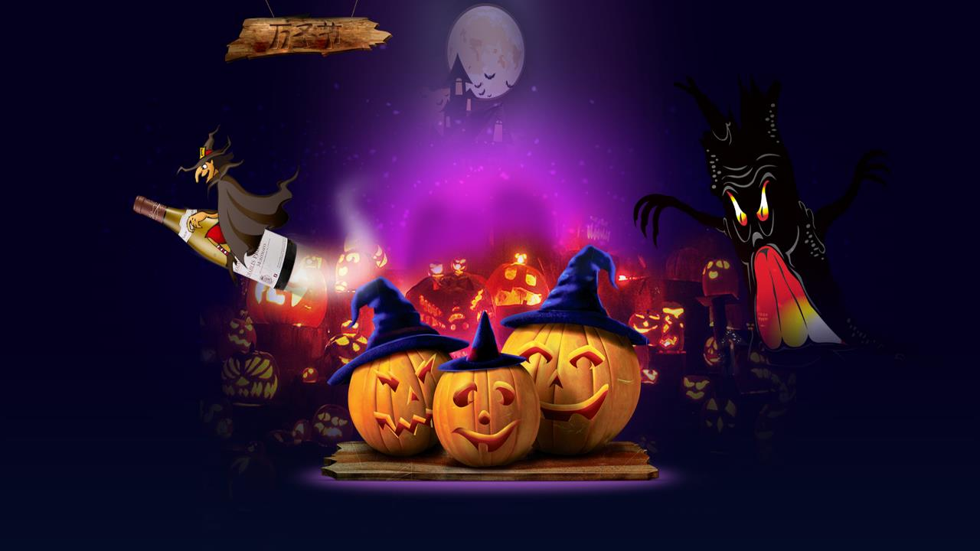
哈喽喂万圣节PPT模版
汇报人：xiazaii
汇报时间：XX年XX月

Slide 2
点击此处添加标题
Youth is not a time of life; it is a state of mind; it is not a matter of rosy cheeks, red lips and supple knees; it is a matter of the will, a quality of the imagination. Youth is not a time of life; it is a state of mind; it is not a matter of rosy cheeks, red lips and supple knees; it is a matter of the will, a quality of the imagination.

Slide 3
目录
CONTENT
I.
II.
III.
IV.
点击此处添加标题
点击此处添加标题
点击此处添加标题
点击此处添加标题

Slide 4
PART ONE
点击此处添加标题
Youth is not a time of life; it is a state of mind; it is not a matter of rosy cheeks, red lips and supple knees; it is a matter of the will, a quality of the imagination. Youth is not a time of life; it is a state of mind; it is not a matter of rosy cheeks, red lips and supple knees; it is a matter of the will, a quality of the imagination.

Slide 5
点击此处添加标题
Youth is not a time of life; it is a state of mind; it is not a matter of rosy cheeks, red lips and supple knees; it is a matter of the will, a quality of the imagination. Youth is not a time of life; it is a state of mind; it is not a matter of rosy cheeks, red lips and supple knees; it is a matter of the will, a quality of the imagination.
点击此处添加标题
Youth is not a time of life; it is a state of mind; it is not a matter of rosy cheeks, red lips and supple knees; it is a matter of the will, a quality of the imagination. Youth is not a time of life; it is a state of mind; it is not a matter of rosy cheeks, red lips and supple knees; it is a matter of the will, a quality of the imagination.

Slide 6
点击此处添加标题
Youth is not a time of life; it is a state of mind; it is not a matter of rosy cheeks, red lips and supple knees; it is a matter of the will, a quality of the imagination. Youth is not a time of life; it is a state of mind; it is not a matter of rosy cheeks, red lips and supple knees; it is a matter of the will, a quality of the imagination.
点击此处添加标题
Youth is not a time of life; it is a state of mind; it is not a matter of rosy cheeks, red lips and supple knees; it is a matter of the will, a quality of the imagination. Youth is not a time of life; it is a state of mind; it is not a matter of rosy cheeks, red lips and supple knees; it is a matter of the will, a quality of the imagination.

Slide 7
PART two
点击此处添加标题
Youth is not a time of life; it is a state of mind; it is not a matter of rosy cheeks, red lips and supple knees; it is a matter of the will, a quality of the imagination. Youth is not a time of life; it is a state of mind; it is not a matter of rosy cheeks, red lips and supple knees; it is a matter of the will, a quality of the imagination.

Slide 8
点击此处添加标题
Youth is not a time of life; it is a state of mind; it is not a matter of rosy cheeks, red lips and supple knees; it is a matter of the will, a quality of the imagination. Youth is not a time of life; it is a state of mind; it is not a matter of rosy cheeks, red lips and supple knees; it is a matter of the will, a quality of the imagination.
点击此处添加标题
Youth is not a time of life; it is a state of mind; it is not a matter of rosy cheeks, red lips and supple knees; it is a matter of the will, a quality of the imagination. Youth is not a time of life; it is a state of mind; it is not a matter of rosy cheeks, red lips and supple knees; it is a matter of the will, a quality of the imagination.

Slide 9
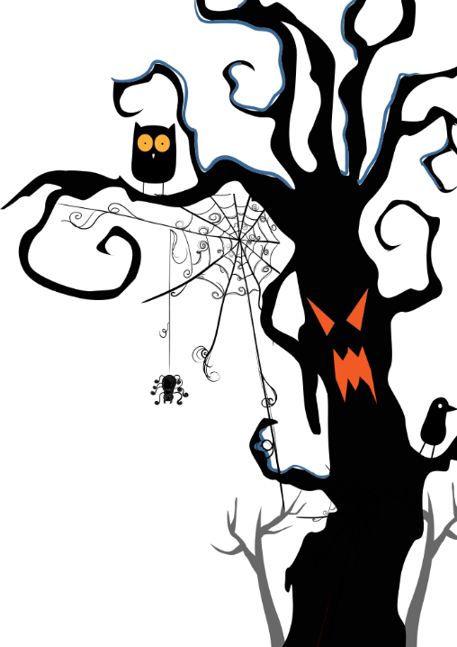
点击此处添加标题
Youth is not a time of life; it is a state of mind; it is not a matter of rosy cheeks, red lips and supple knees; it is a matter of the will, a quality of the imagination. Youth is not a time of life; it is a state of mind; it is not a matter of rosy cheeks, red lips and supple knees; it is a matter of the will, a quality of the imagination.
80%
70%
40%
70%

Slide 10
PART three
点击此处添加标题
Youth is not a time of life; it is a state of mind; it is not a matter of rosy cheeks, red lips and supple knees; it is a matter of the will, a quality of the imagination. Youth is not a time of life; it is a state of mind; it is not a matter of rosy cheeks, red lips and supple knees; it is a matter of the will, a quality of the imagination.

Slide 11
点击此处添加标题
Youth is not a time of life; it is a state of mind; it is not a matter of rosy cheeks, red lips and supple knees; it is a matter of the will, a quality of the imagination. Youth is not a time of life; it is a state of mind; it is not a matter of rosy cheeks, red lips and supple knees; it is a matter of the will, a quality of the imagination.
Youth is not a time of life; it is a state of mind; it is not a matter of rosy cheeks, red lips and supple knees; it is a matter of the will, a quality of the imagination. Youth is not a time of life; it is a state of mind; it is not a matter of rosy cheeks, red lips and supple knees; it is a matter of the will, a quality of the imagination.

Slide 12
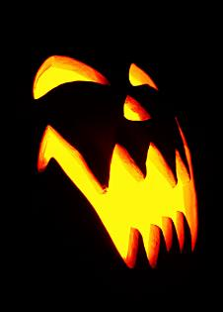
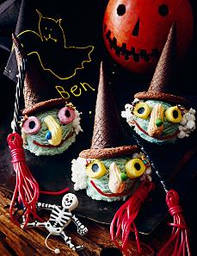
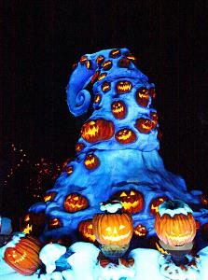
点击此处添加文本内容点击此处添加文本内容点击此处添加文本内容
点击此处添加文本内容点击此处添加文本内容点击此处添加文本内容
点击此处添加文本内容点击此处添加文本内容点击此处添加文本内容

Slide 13
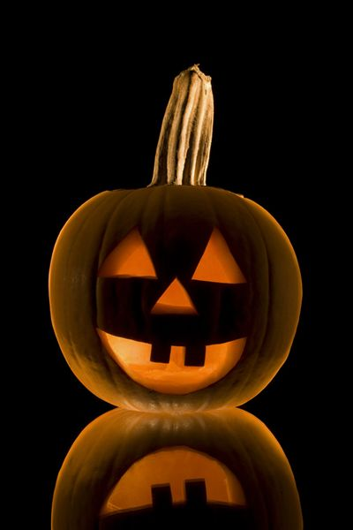
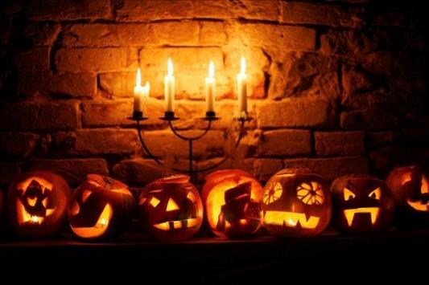
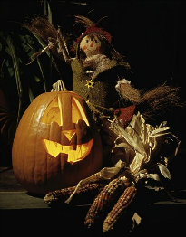
点击此处添加文本内容点击此处添加文本内容点击此处添加文本内容点击此处添加文本内容
Youth is not a time of life; it is a state of mind; it is not a matter of rosy cheeks, red lips and supple knees; it is a matter of the will, a quality of the imagination. Youth is not a time of life; it is a state of mind; it is not a matter of rosy cheeks, red lips and supple knees; it is a matter of the will, a quality of the imagination.

Slide 14
点击此处添加文本内容点击此处添加文本内容点击此处添加文本内容点击此处添加文本内容点击此处添加文本内容点击此处添加文本内容点击此处添加文本内容点击此处添加文本内容点击此处添加文本内容点击此处添加文本内容点击此处添加文本内容点击此处添加文本内容

Slide 15
哈喽喂万圣节PPT模版
谢谢观看

