Slide 1
HAPPY
HALLOWEEN
31.OCTOBER 2016
汇报人：xiazaii

Slide 2
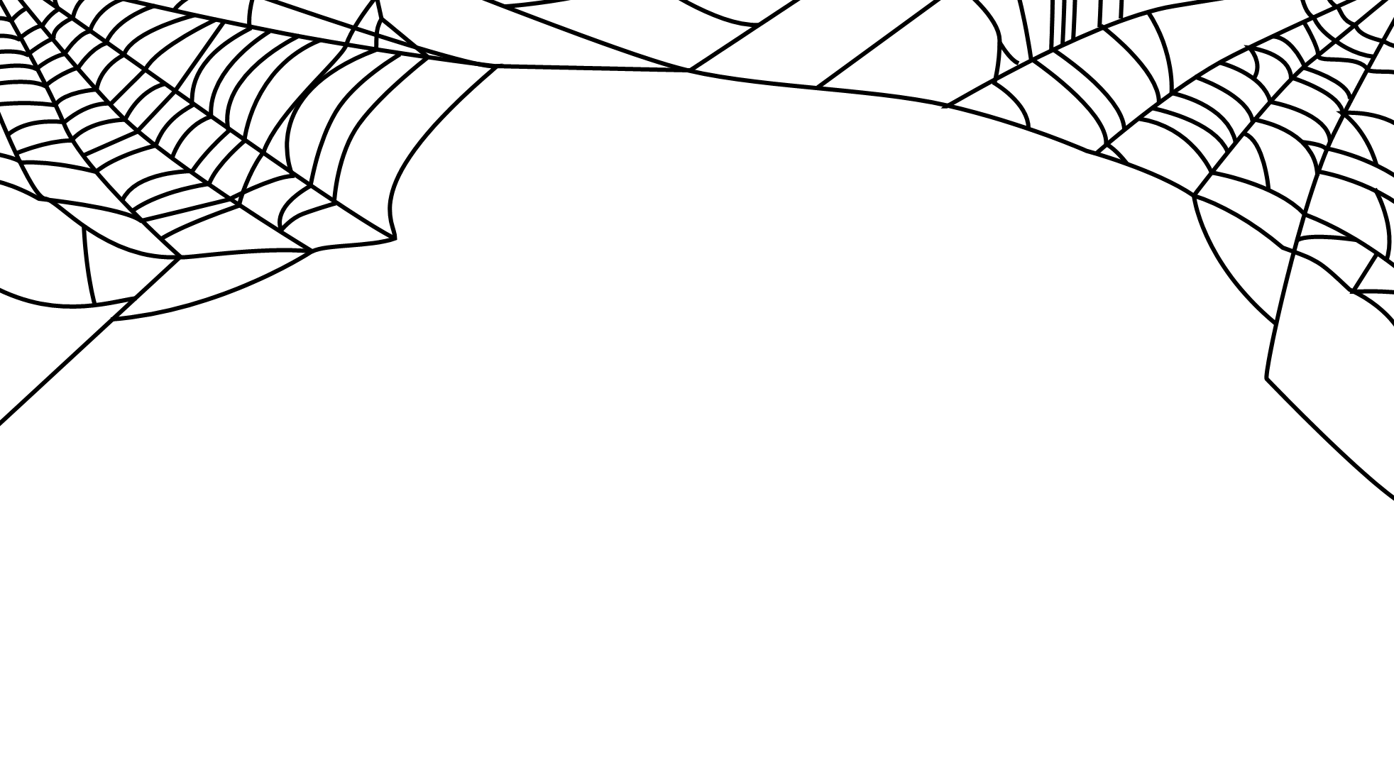
CATE
SUGAR
PUMPKIN

Slide 3
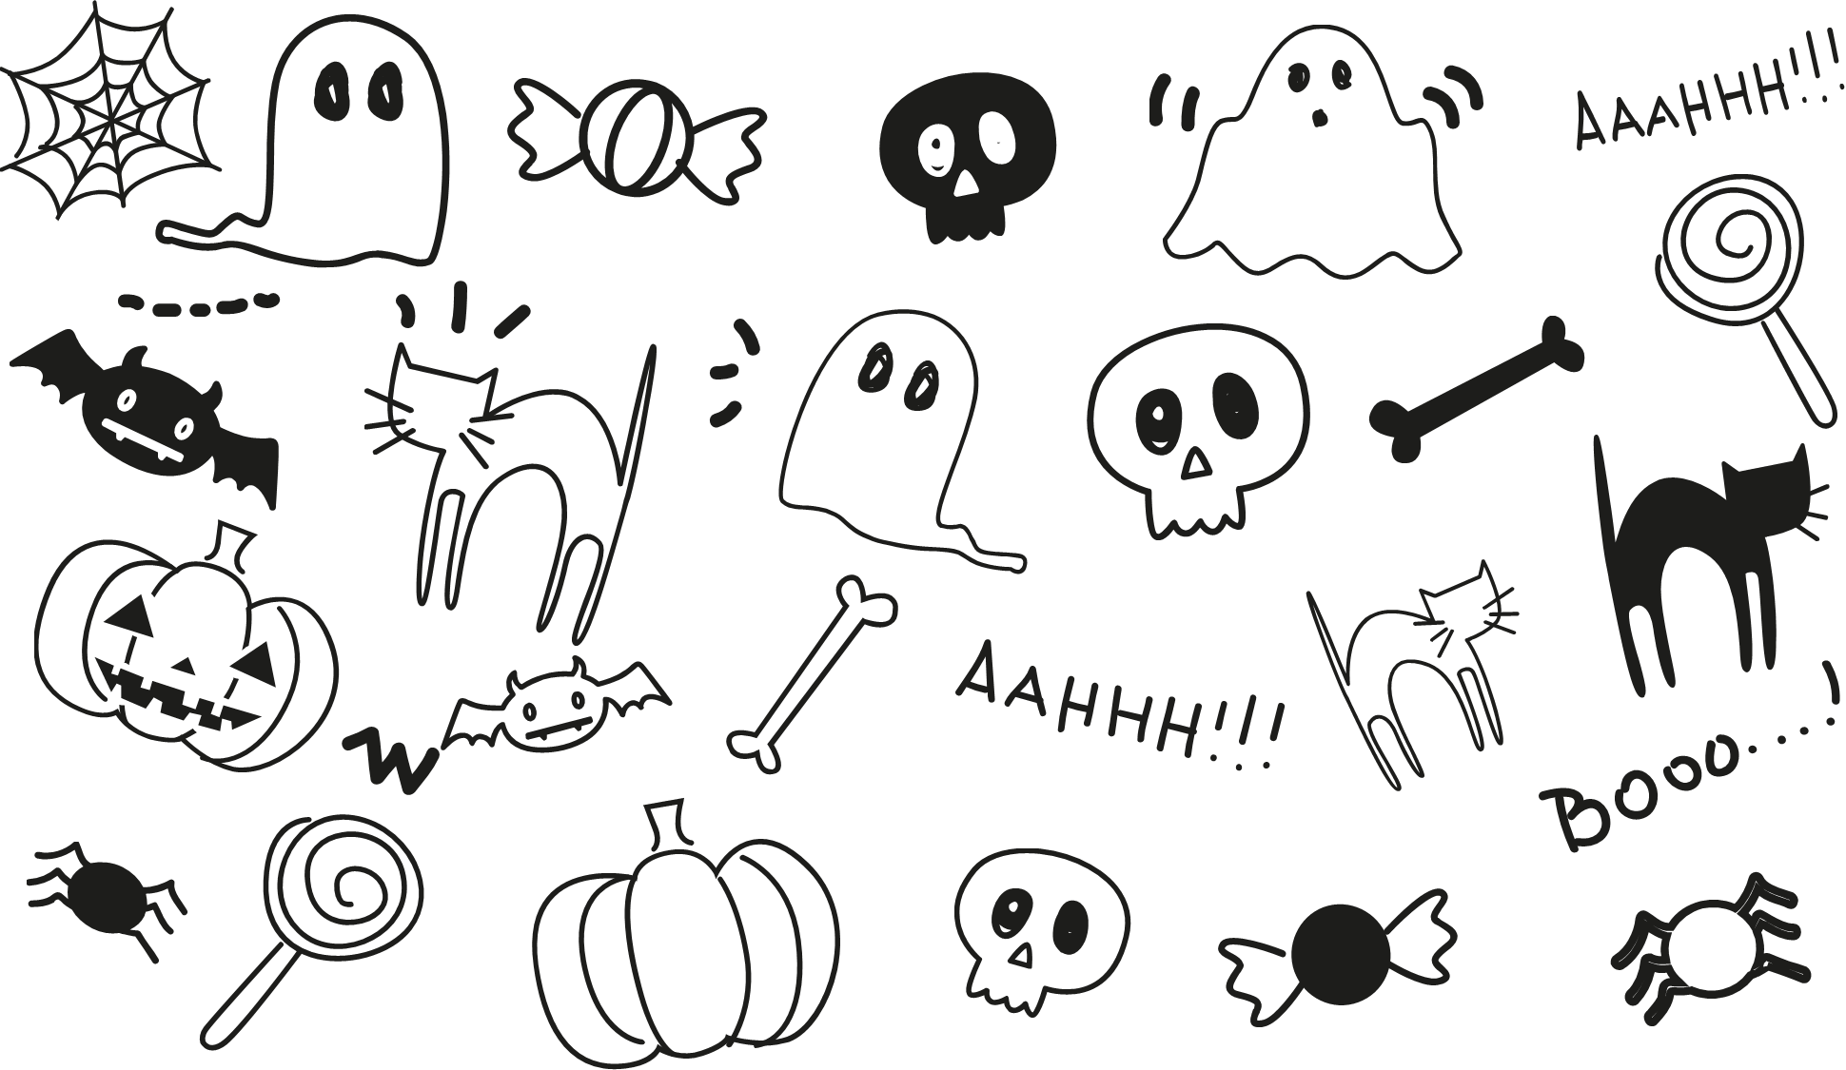
CATE

Slide 4
输入文本内容
输入文本内容
Bad omens are also part of Halloween celebrations. A bad omen is something that is believed to bring bad luck, like black cats, spiders or bats.
Bad omens are also part of Halloween celebrations. A bad omen is something that is believed to bring bad luck, like black cats, spiders or bats.

Slide 5
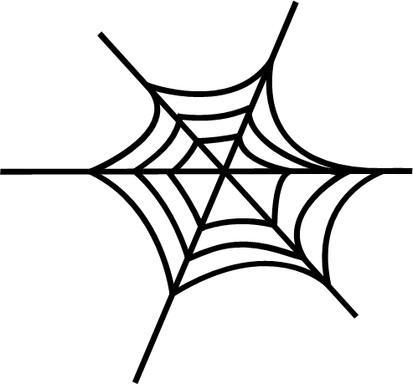
输入文本内容
Dressing up in costumes is one of the most popular Halloween customs, especially among children. According to tradition, people would dress up in costumes (wear special clothing, masks or disguises) to frighten the spirits away.
输入文本内容
Dressing up in costumes is one of the most popular Halloween customs, especially among children. According to tradition, people would dress up in costumes (wear special clothing, masks or disguises) to frighten the spirits away.

Slide 6
Popular Halloween costumes include vampires (creatures that dr)
Popular Halloween costumes include vampires (creatures that dr)
Popular Halloween costumes include vampires (creatures that dr)
Popular Halloween costumes include vampires (creatures that dr)

Slide 7
Halloween is also associated with supernatural creatures like ghosts and vampires. These creatures are not part of the natural world. They don't really exist... or do they?
There are many other superstitions associated with Halloween. A superstition is an irrational idea, like believing that the number 13 is unlucky!
HALLOWEEN

Slide 8
SUGAR

Slide 9
输入文本内容
The colors black and orange are also a part of Halloween. Black is a symbol for night and orange is the color of pumpkins. A jack-o’-lantern is a hollowed-out pumpkin with a face carved on one side. Candles are usually placed inside, giving the face a spooky glow.

Slide 10
输入文本内容
GHOST
BAT
Pumpkin
Human skeleton

Slide 11
输入文本内容
Popular Halloween costumes include vampires (creatures that drink blood), ghosts (spirits of the dead) and werewolves (people that turn into wolves when the moon is full).

Slide 12
Popular Halloween costumes include vampires (creatures that drink blood), ghosts (spirits of the dead) and werewolves (people that turn into wolves when the moon is full).
Vampire
Witch
Witches are popular Halloween characters that are thought to have magical powers. They usually wear pointed hats and fly around on broomsticks.

Slide 13
PUMPKIN

Slide 14
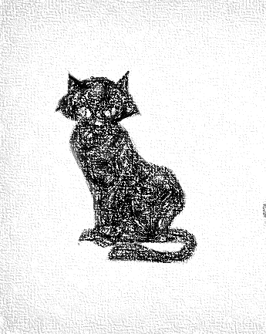

pointed hats
HALLOWEEN
PARTY
HALLOWEEN
PARTY
输入文本内容
输入文本内容
Bad omens are also part of Halloween celebrations. A bad omen is something that is believed to bring bad luck, like black cats, spiders or bats.
Witches are popular Halloween characters that are thought to have magical powers. They usually wear pointed hats and fly around on broomsticks.

Slide 15
HALLOWEEN PARTY
ONE
HALLOWEEN PARTY
TOW

Slide 16
HALLOWEEN PARTY
THREE
HALLOWEEN PARTY
FOUR
HALLOWEEN PARTY
FIVE
HALLOWEEN PARTY
SIX

Slide 17
HALLOWEEN PARTY
SEVEN
HALLOWEEN PARTY
EIGHT

Slide 19
31TH
OCT
ENJOY
HALLOWEEN
Welcome

