Slide 1

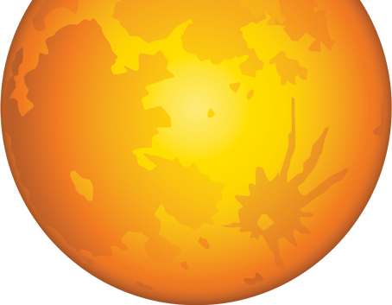
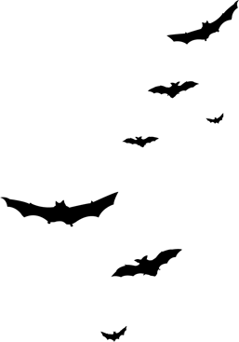
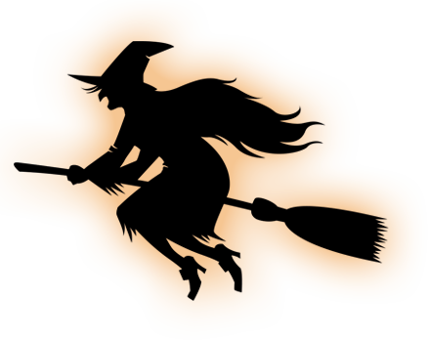
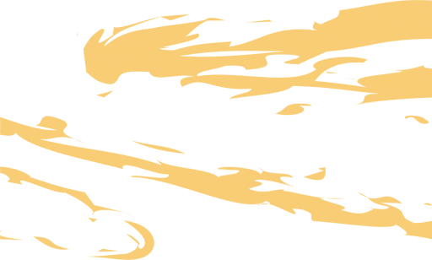
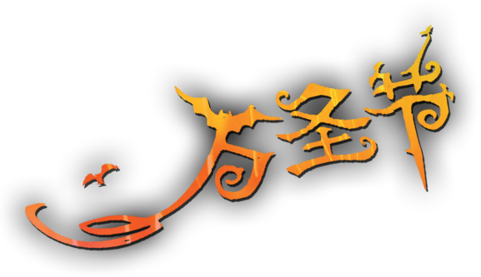
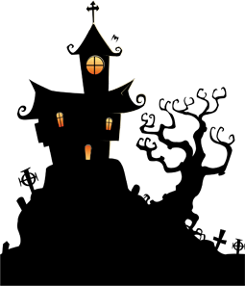
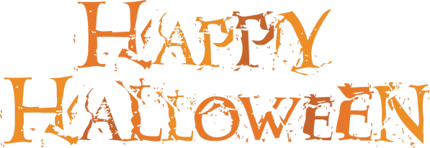
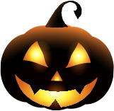
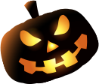

Slide 2
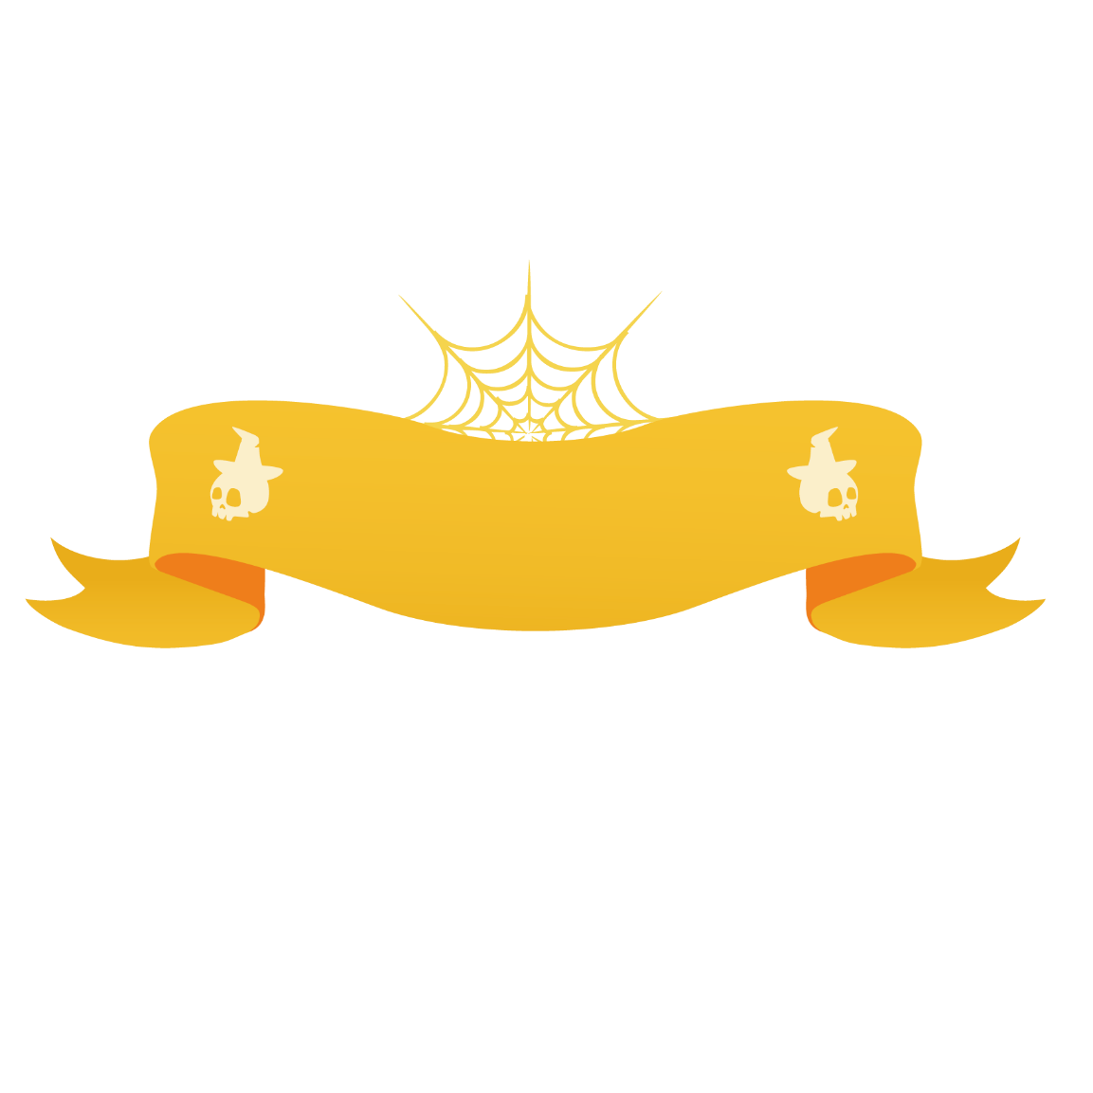
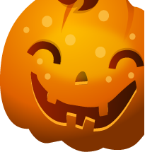
目录
万圣节的介绍
万圣节的由来
万圣节的象征
万圣节的美食

Slide 3
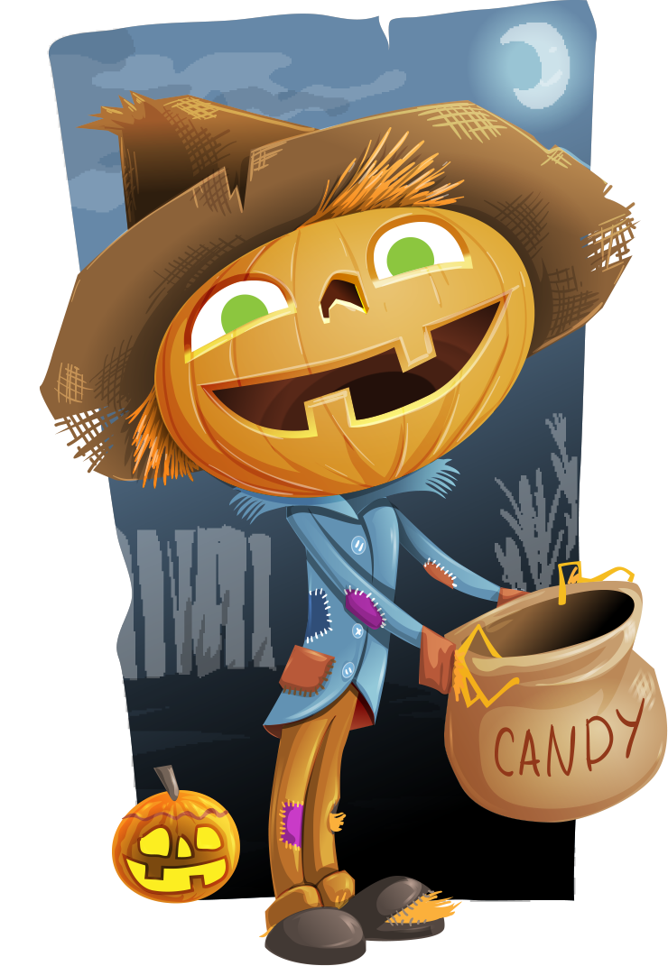
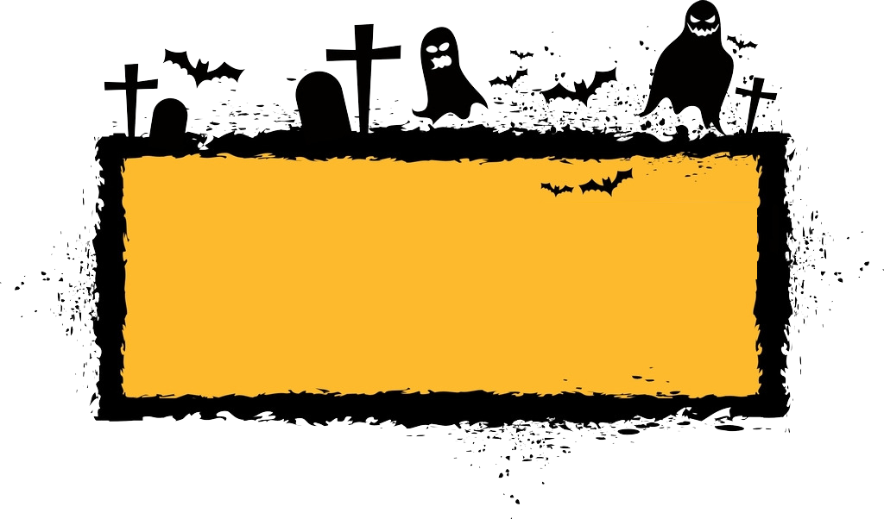
万圣节的介绍

Slide 4
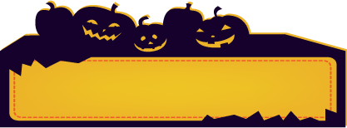
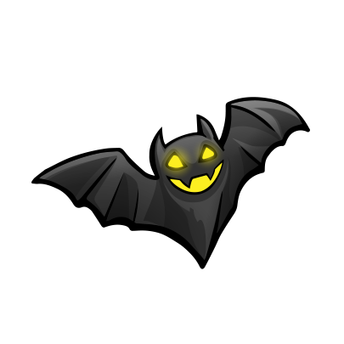
介绍
Halloween 是
All Hallow Even 的缩写.
类似于平安夜被称为chirstmasEve.

Slide 5
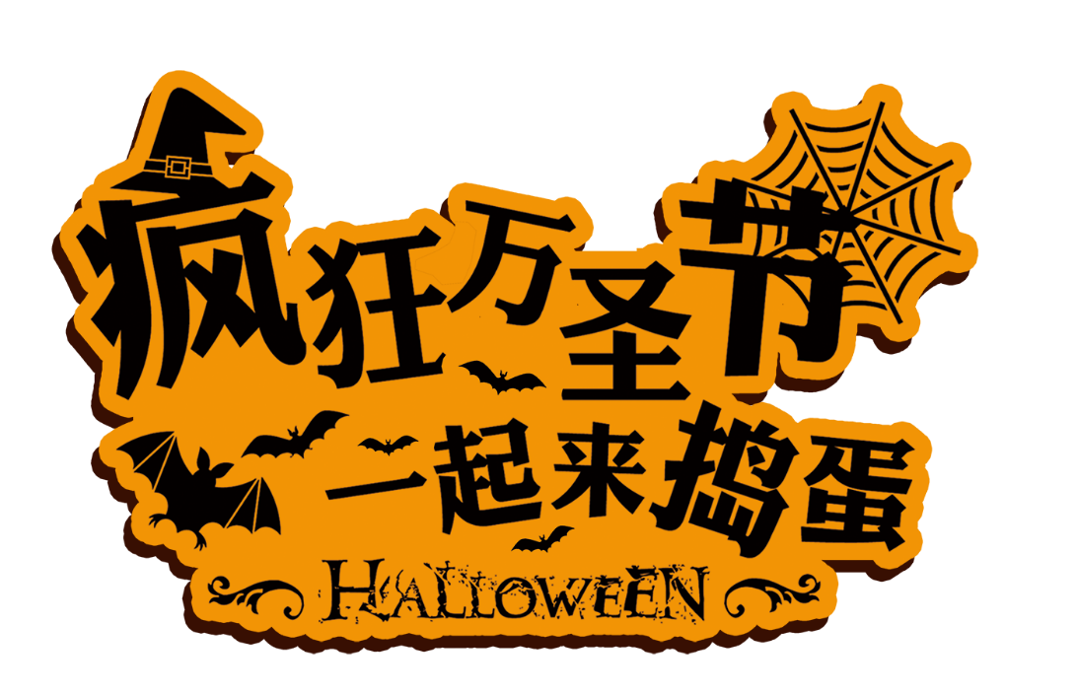
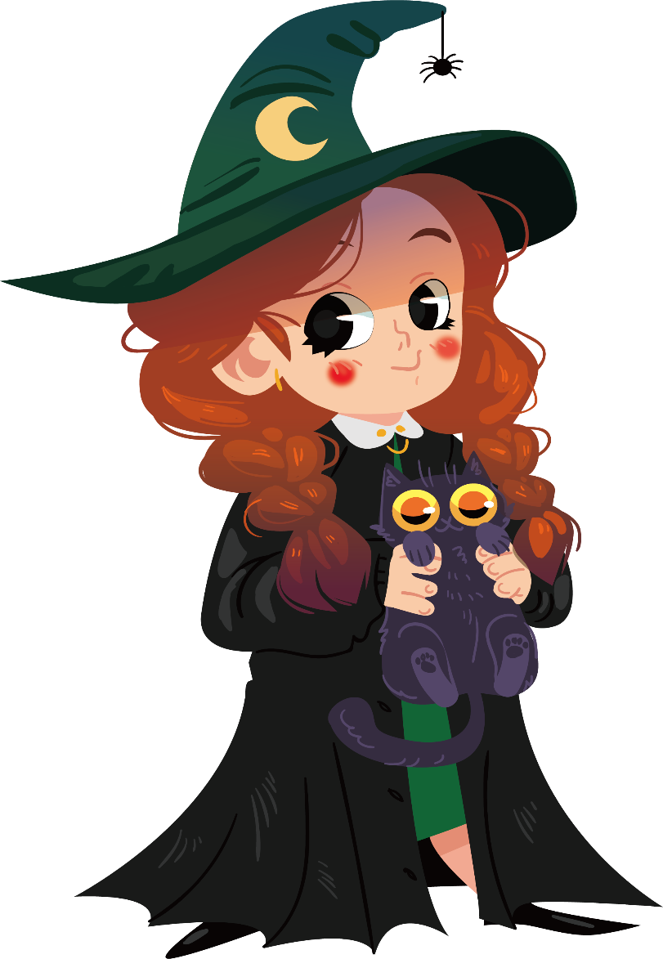
Halloween is one of the world’s oldest holidays
万圣节是世界上最古老的节日之一
celebrated in several countries around the Globe including the USA, Canada, England, Ireland, Scotland, Mexico, Latin America, and Spain.
是在美国、加拿大、英格兰、新西兰、爱尔兰、墨西哥、等国家

Slide 6
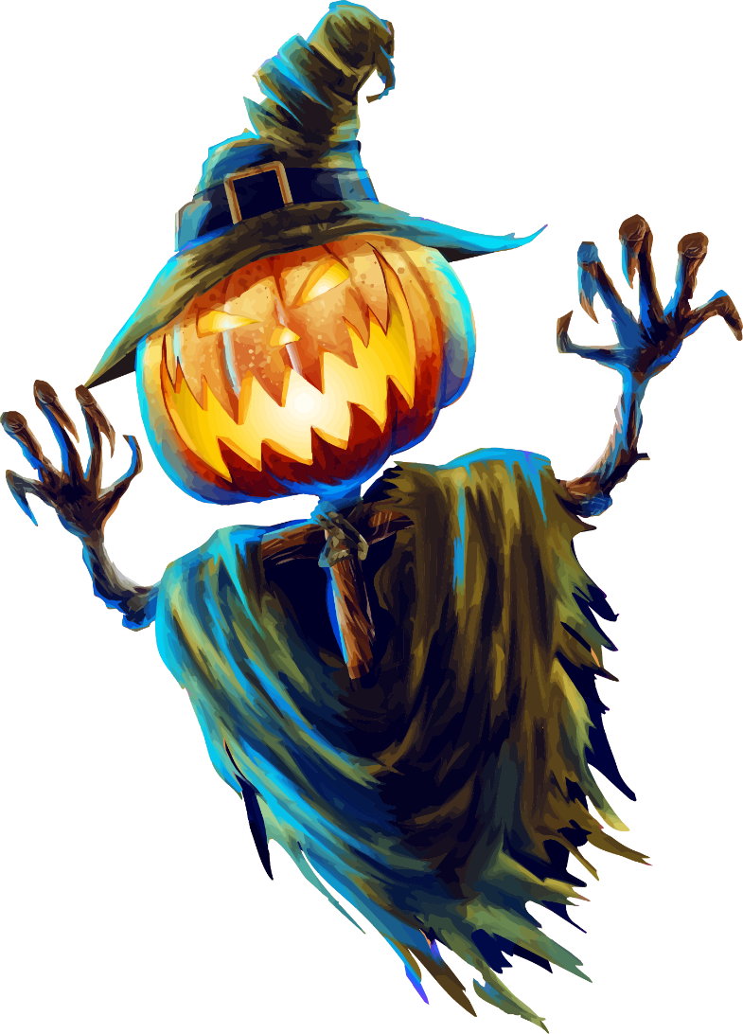
Halloween dates back to the traditional festival of
The British Celts
万圣节前夜起源于不列颠凯尔特人的传统节日
In this night,ghost walks around in the world.Because the night
is rather dangerous, the celts wear masks to scare evil spirits away.
这一天各种恶鬼出没，
死去人们的灵魂也会离开身体，
在世间游走，这一天的晚上也就格外危险。
人们会把食物放在门口吸引有主的鬼魂灵魂，
而为了吓走邪恶的鬼魂，凯尔特人会戴上面具。

Slide 7
万圣节的由来

Slide 8
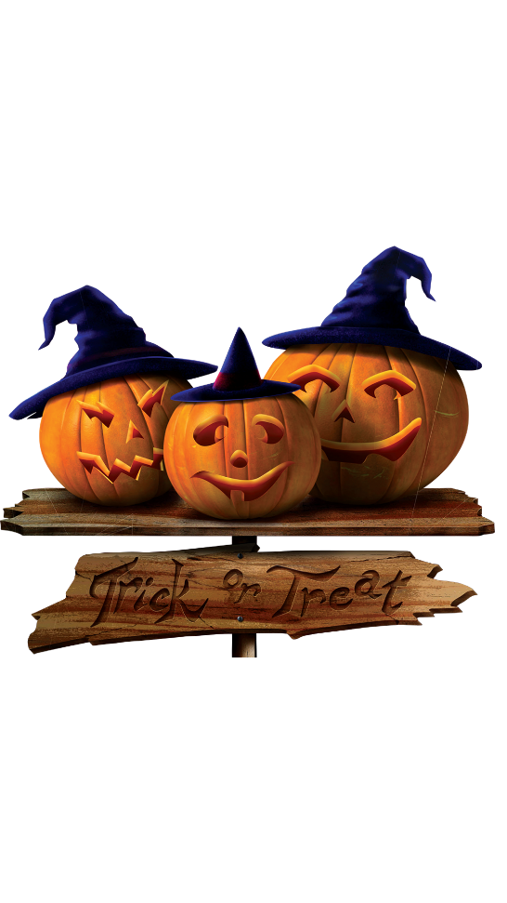
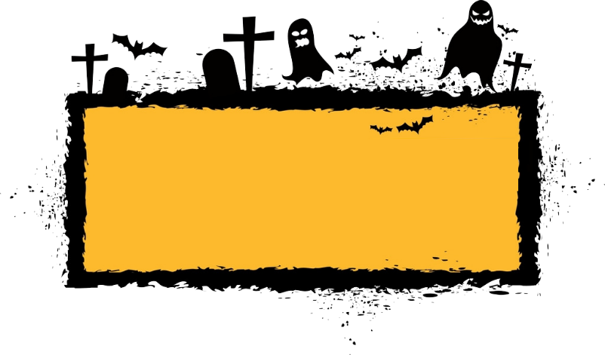
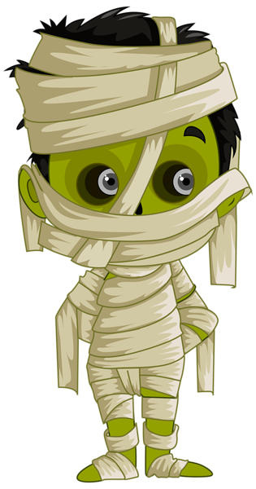
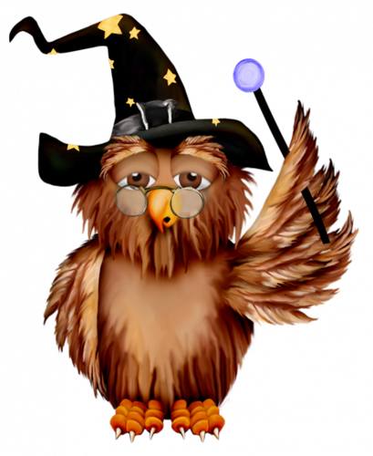
由来
This time of year was often associated with human death.
The Celts believed that on the night before the new year, the boundary between the worlds of the living and the dead became blurred as the dead searched for the afterlife.
万圣节的由来是因为天主教会试图以一个让异教徒感念天主教圣人的节日来取代异教的“缩温节”，缩温节是一年中很特别的日子，英国人和爱尔兰人在这个时候悼念他们死去的亲友。
这些人相信， 死去的灵魂会在这一天来到人世间，因此每年10月31日他们燃起篝火，举办盛宴以求好运。

Slide 9
万圣节的象征

Slide 10
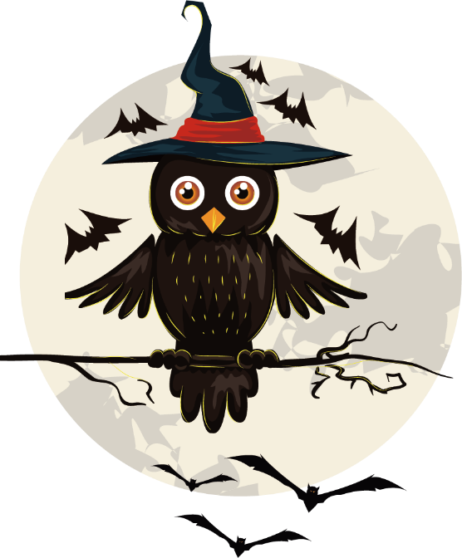
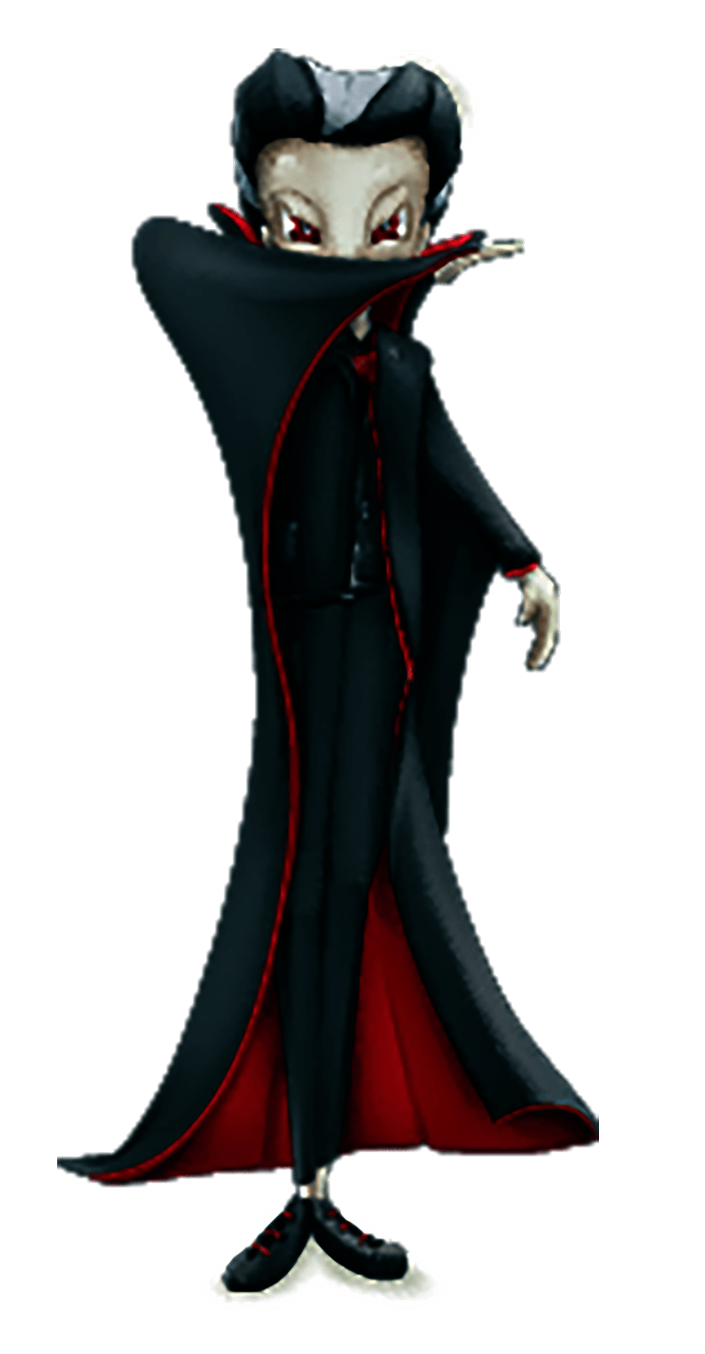
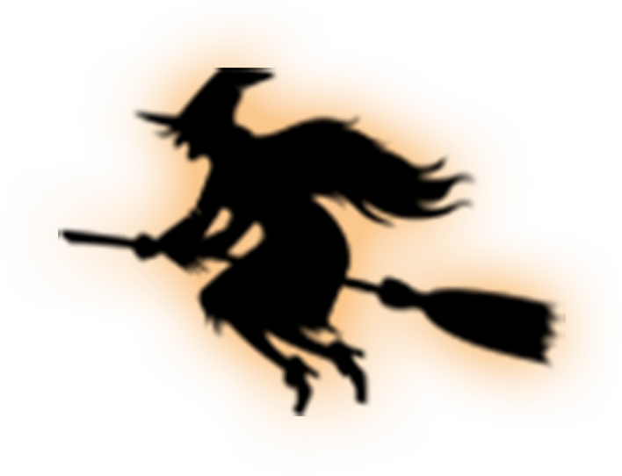
南瓜
老鹰
吸血鬼
蝙蝠
女巫

Slide 11
头骨
木乃伊
海盗
狼
骨头

Slide 12
万圣节的美食

Slide 13
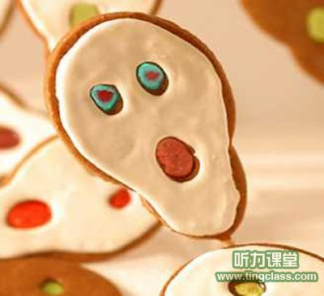
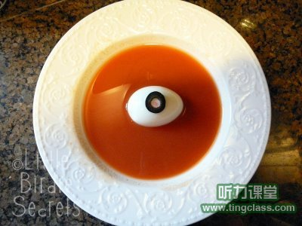

记得一个朋友说过，他被“看着”吃不下东西I remember a friend said he cannot eat something if he was "looked“.
Sugar hoarse声嘶力竭的糖

Slide 14

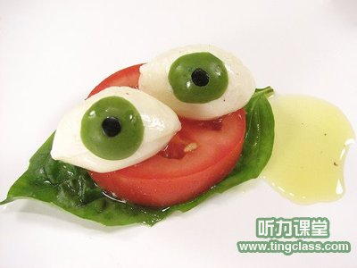
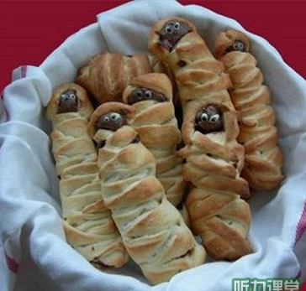
Terror and Nutrition ~恐怖与营养
Bread baby mummy木乃伊宝宝面包

Slide 15
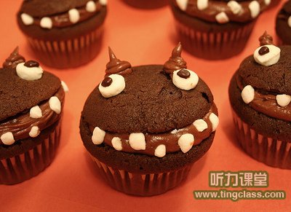
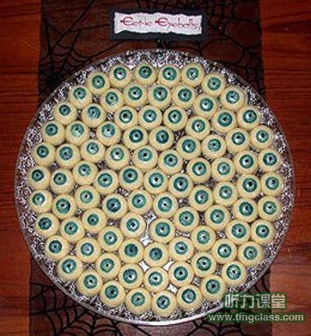
When thought of the big Chinese New Year bread
想到了中国过年时候的大馒头
The devil sent the cake be sweet
这个恶魔蛋糕算是可爱派了

Slide 16
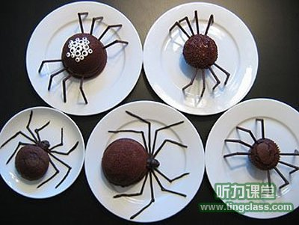
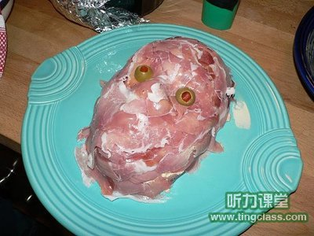
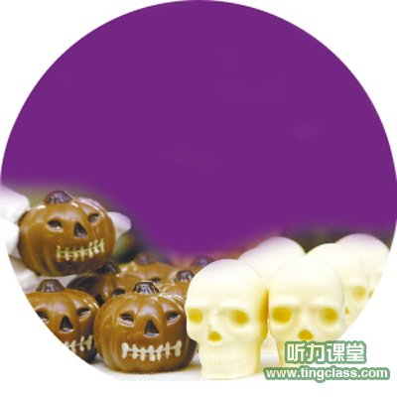
左上角那个，打死我也不吃
沉默的羔羊~~
This is the only saliva can drive a man leave the bar, not tears
这个是唯一能叫人留点口水而不是眼泪的吧

Slide 17
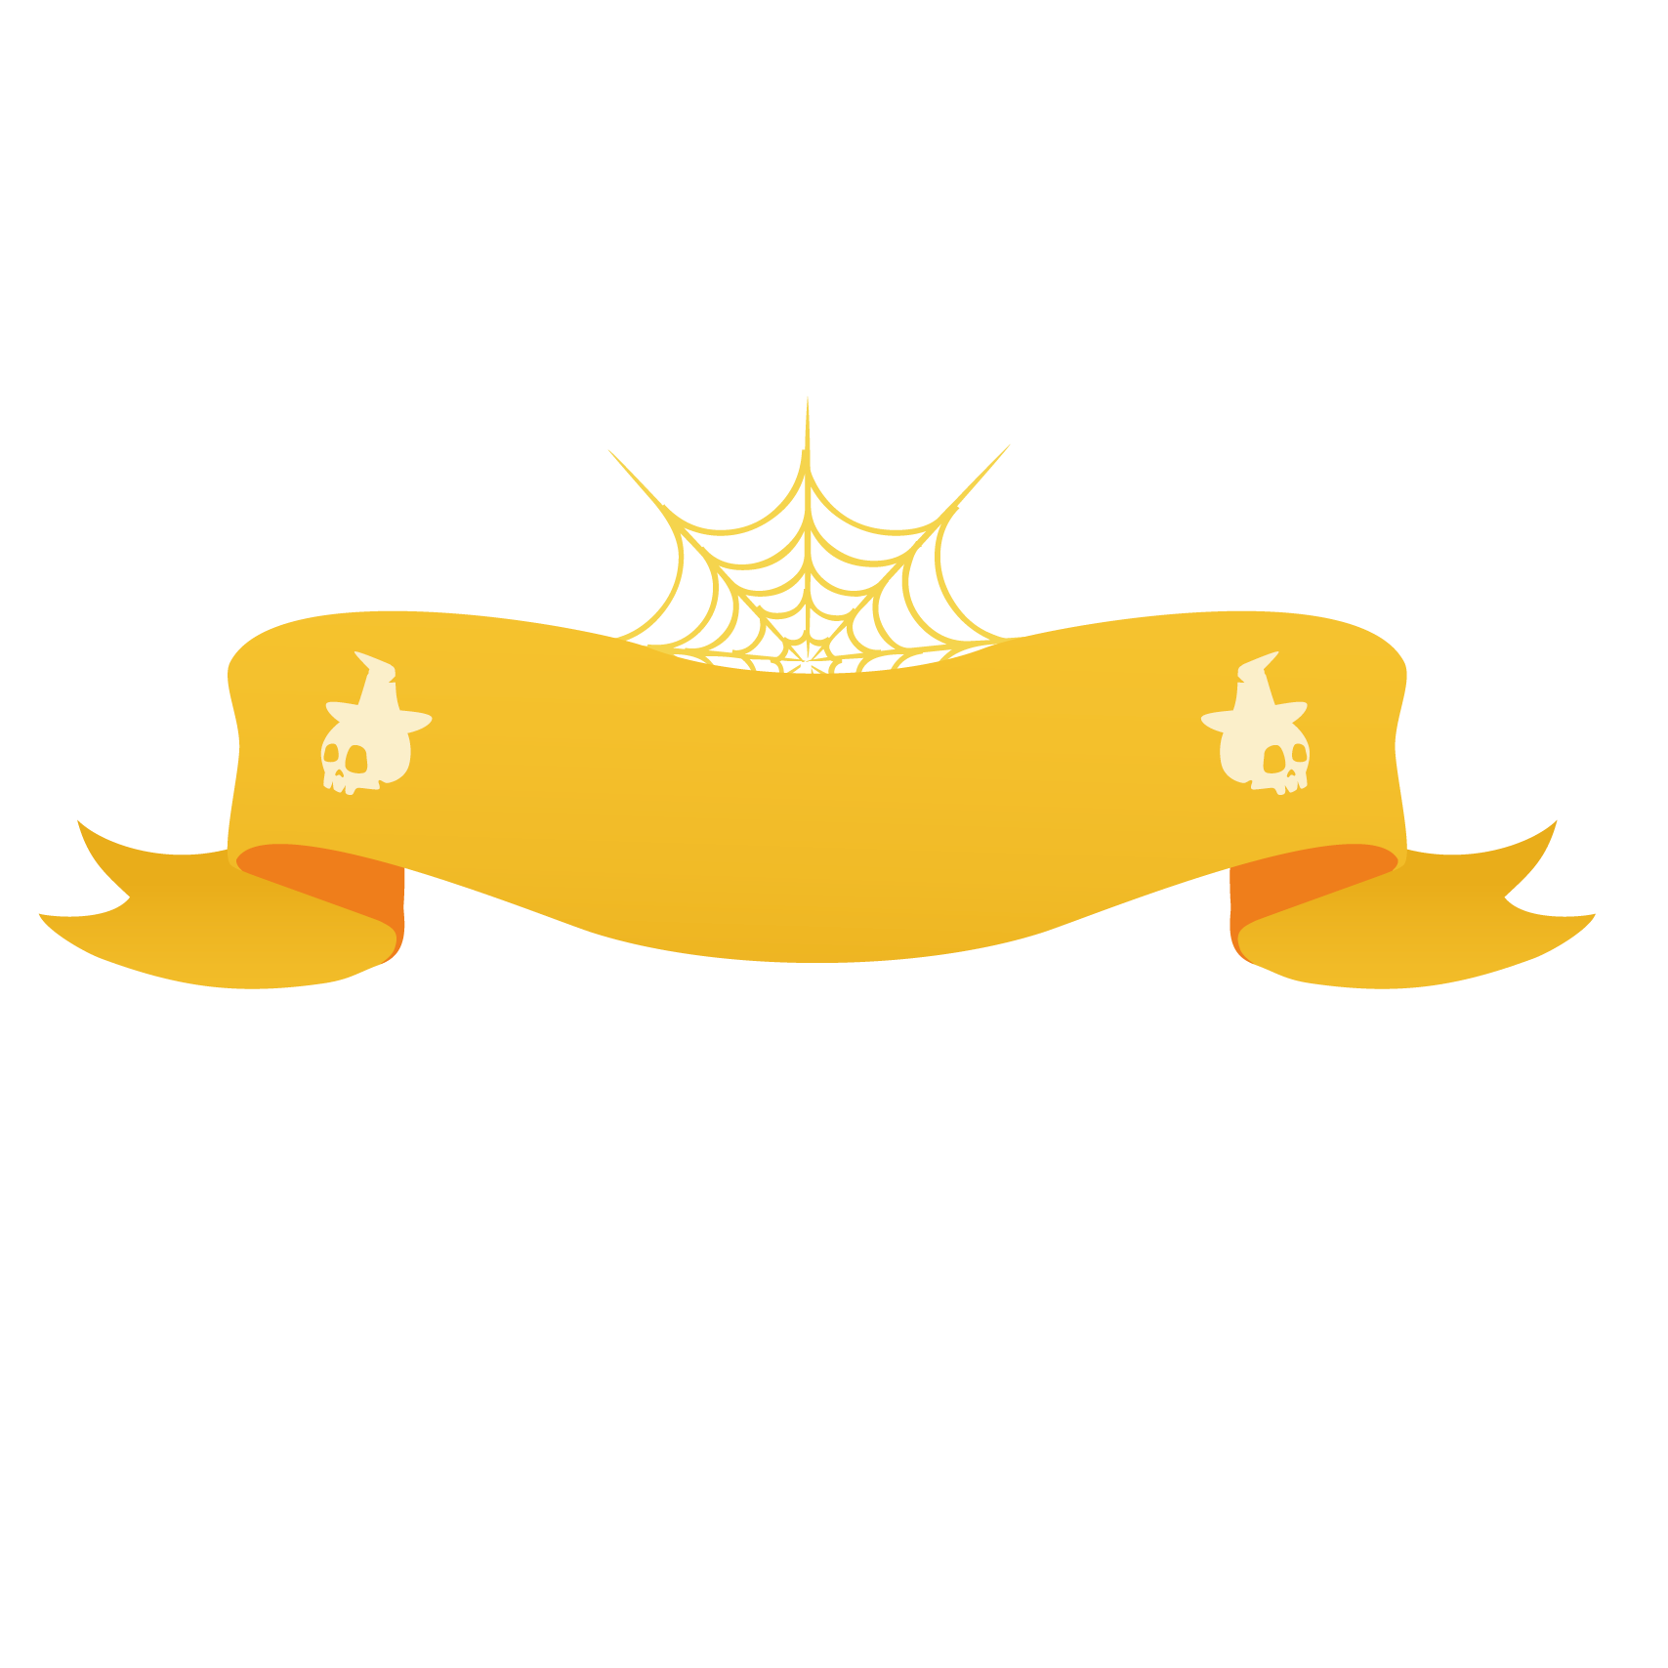
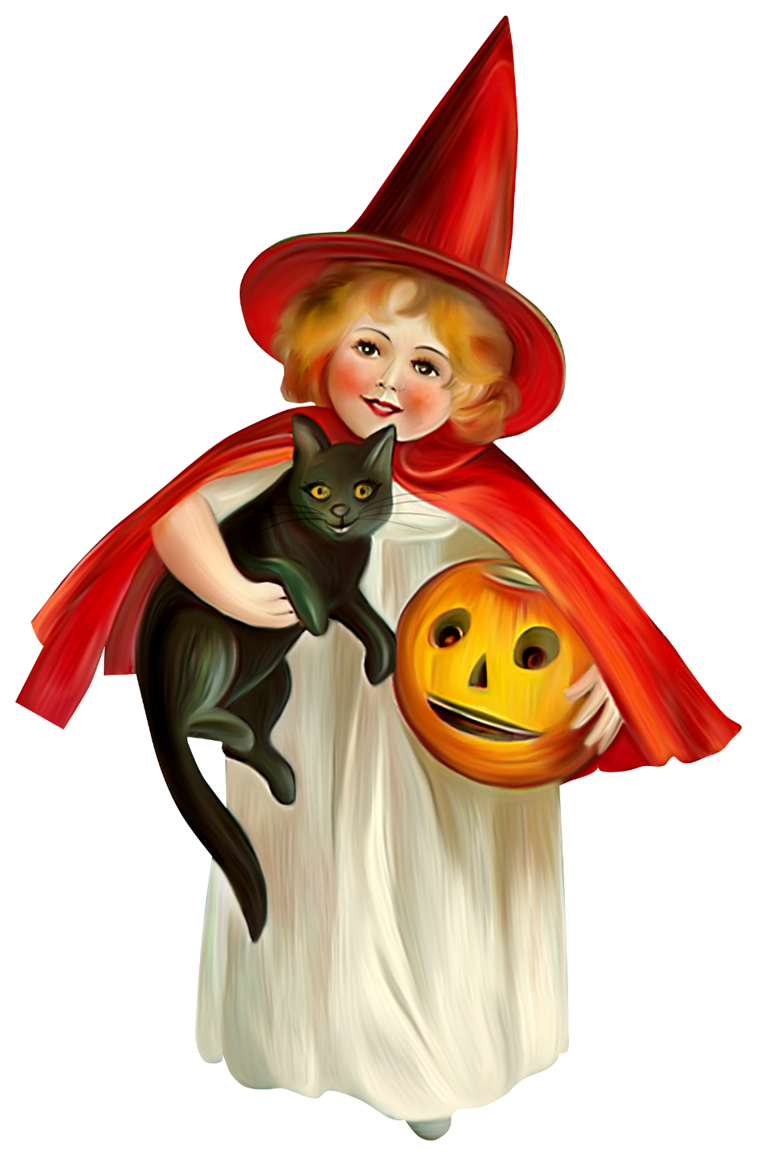
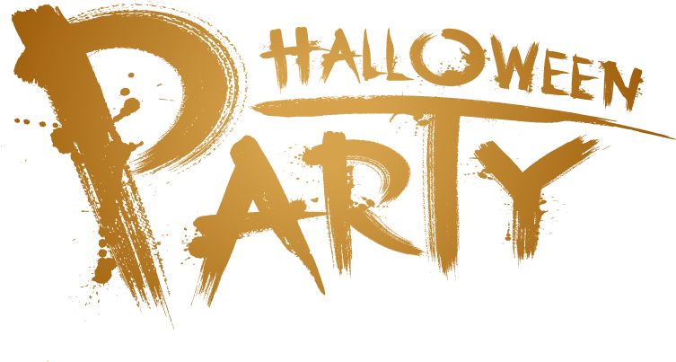
What do children do on Halloween?
孩子们在万圣节做什么？
They trick or treat.不给糖果就捣乱
They wear costumes.穿奇怪的服装
They carve pumpkin lanterns.提着南瓜灯
They watch scary movies.看恐怖电影
They visit haunted houses.去鬼屋探险

