Slide 1
总
结
点击输入本栏的具体文字，简明扼要的说明分项内容，此为概念图解，请根据您的具体内容酌情修改。
计
简约大气创意通用模板
划

Slide 2
目 录
上阶段总结
案例和方法论
Just for today I will try to live through this day only and not
Just for today I will try to live through this day only and not
研究成果展示及应用
下阶段展望
Just for today I will try to live through this day only and not
Just for today I will try to live through this day only and not

Slide 3
【 0 1 】
Just for today I will try to live through this day only and not tackle my whole life problem at once. Just for today I will try to live through this day only and not tackle my whole life problem at once.

Slide 4
添加标题
97%
Just for today I will try to live through this day only and not tackle my whole life problem at once Just for
添加标题
50%
Just for today I will try to live through this day only and not tackle my whole life problem at once Just for
Just for today I will try to live through this day only and not tackle my whole life problem at once Just for

Slide 5
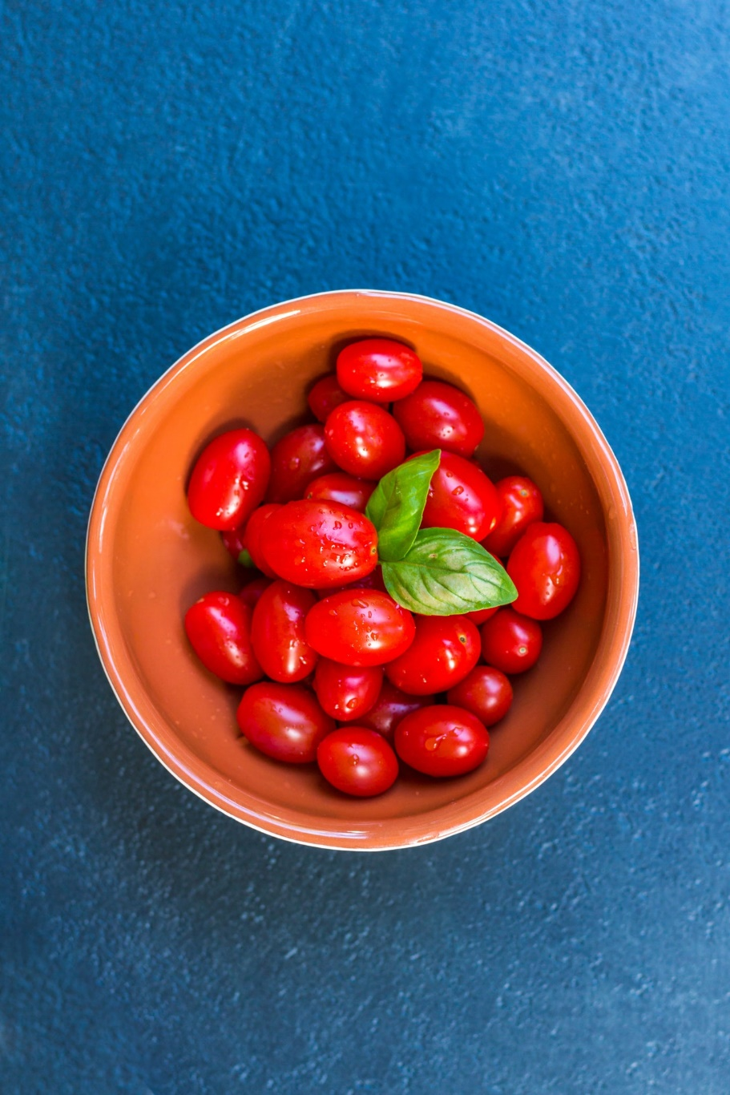
01
02
Just for today I will try to live through this day only and not tackle my whole life problem at once. I can do for twelve hours that Just for
Just for today I will try to live through this day only and not tackle my whole life problem at once. I can do for twelve hours that Just for

Slide 6
0 1
0 2
0 3
0 4
Just for today I will try to live through this day only and not tackle my whole life problem at once. I can do for twelve hours that Just for
Just for today I will try to live through this day only and not tackle my whole life problem at once. I can do for twelve hours that Just for
Just for today I will try to live through this day only and not tackle my whole life problem at once. I can do for twelve hours that Just for
Just for today I will try to live through this day only and not tackle my whole life problem at once. I can do for twelve hours that Just for

Slide 7
点击输入本栏的具体文字，简明扼要的说明分项内容，此为概念图解，请根据您的具体内容酌情修改。点击输入本栏的具体文字，简明扼要的说明分项内容，此为概念图解，请根据您的具体内容酌情修改。
01
点击输入本栏的具体文字，简明扼要的说明分项内容，此为概念图解，请根据您的具体内容酌情修改。点击输入本栏的具体文字，简明扼要的说明分项内容，此为概念图解，请根据您的具体内容酌情修改。
02
点击输入本栏的具体文字，简明扼要的说明分项内容，此为概念图解，请根据您的具体内容酌情修改。点击输入本栏的具体文字，简明扼要的说明分项内容，此为概念图解，请根据您的具体内容酌情修改。
03

Slide 8
【 0 2 】
Just for today I will try to live through this day only and not tackle my whole life problem at once. Just for today I will try to live through this day only and not tackle my whole life problem at once.

Slide 9
1
Just for today I will try to live through this day only and not tackle Just for today
2
Just for today I will try to live through this day only and not tackle Just for today
3
Just for today I will try to live through this day only and not tackle Just for today

Slide 10
1
2
3
4
Just for today I will try to live through this day only and not tackle my whole life problem at once. I can do for twelve hours that Just for
Just for today I will try to live through this day only and not tackle my whole life problem at once. I can do for twelve hours that Just for
Just for today I will try to live through this day only and not tackle my whole life problem at once. I can do for twelve hours that Just for
Just for today I will try to live through this day only and not tackle my whole life problem at once. I can do for twelve hours that Just for

Slide 11
0 1
Just for today I will try to live through this day only and not tackle my whole life problem at once. I can do for twelve hours that Just for
18%
0 2
Just for today I will try to live through this day only and not tackle my whole life problem at once. I can do for twelve hours that Just for
55%
12%
15%
0 3
Just for today I will try to live through this day only and not tackle my whole life problem at once. I can do for twelve hours that Just for

Slide 12
【 0 3 】
Just for today I will try to live through this day only and not tackle my whole life problem at once. Just for today I will try to live through this day only and not tackle my whole life problem at once.

Slide 13
01
02
03
04
YOUR TITLE
YOUR TITLE
YOUR TITLE
YOUR TITLE
three ways. I will do somebody a good turnJust for today I will try to live through this day only and
three ways. I will do somebody a good turnJust for today I will try to live through this day only and
three ways. I will do somebody a good turnJust for today I will try to live through this day only and
three ways. I will do somebody a good turnJust for today I will try to live through this day only and

Slide 14
【 0 4 】
Just for today I will try to live through this day only and not tackle my whole life problem at once. Just for today I will try to live through this day only and not tackle my whole life problem at once.

Slide 15
输入标题文本
输入标题文本
Just for today I will try to live through this day only and not tackle my whole life problem at once
Just for today I will try to live through this day only and not tackle my whole life problem at once
输入标题文本
Just for today I will try to live through this day only and not tackle my whole life problem at once
输入标题文本
Just for today I will try to live through this day only and not tackle my whole life problem at once

Slide 16
谢
谢
点击输入本栏的具体文字，简明扼要的说明分项内容，此为概念图解，请根据您的具体内容酌情修改。
大
简约大气创意通用模板
家

