Slide 1
ALL OR NOTHING
NOW OR NEVER
DESTINY
DREAM
FREEDOM

Slide 2
CONTENTS
ONE
THREE
TWO
FOUR
Click here to add your title
Click here to add your title
Click here to add your title
Click here to add your title

Slide 3
PART ONE
I love you more than I've ever loved any woman. And I've waited longer for you than I've waited for any woman.
I love you more than I've ever loved any woman. And I've waited longer for you than I've waited for any woman.
I love you more than I've ever loved any woman. And I've waited longer for you than I've waited for any woman.
Click here to add your title

Slide 4
ART
Click here to add your title
I love you more than I've ever loved any woman. And I've waited longer for you than I've waited for any woman.
I love you more than I've ever loved any woman. And I've waited longer for you than I've waited for any woman.I love you more than I've ever loved any woman. And I've waited longer for you than I've waited for any woman.

Slide 5
DESTINY FREEDOM
Click here to add your title
I love you more than I've ever loved any woman. And I've waited longer for you than I've waited for any woman.
DESTINY FREEDOM
I love you more than I've ever loved any woman. And I've waited longer for you than I've waited for any woman.
I love you more than I've ever loved any woman. And I've waited longer for you than I've waited for any woman.

Slide 6
Click here to add your title
And I've waited longer for you than I've waited for any woman.
DESTINY FREEDOM
DESTINY FREEDOM
DESTINY FREEDOM
I love you more than I've ever loved any woman. And I've waited longer for you than I've waited for any woman.
I love you more than I've ever loved any woman. And I've waited longer for you than I've waited for any woman.
I love you more than I've ever loved any woman. And I've waited longer for you than I've waited for any woman.

Slide 7
ALL OR NOTHING
NOW OR NEVER
DESTINY FREEDOM
I love you more than I've ever loved any woman. And I've waited longer for you than I've waited for any woman.
I love you more than I've ever loved any woman. And I've waited longer for you than I've waited for any woman.I love you more than I've ever loved any woman. And I've waited longer for you than I've waited for any woman.
I love you more than I've ever loved any woman. And I've waited longer for you than I've waited for any woman.

Slide 8
PART TWO
I love you more than I've ever loved any woman. And I've waited longer for you than I've waited for any woman.
I love you more than I've ever loved any woman. And I've waited longer for you than I've waited for any woman.
I love you more than I've ever loved any woman. And I've waited longer for you than I've waited for any woman.
Click here to add your title

Slide 9
FREEDOM
I love you more than I've ever loved any woman.
Click here to add your title
I love you more than I've ever loved any woman. And I've waited longer for you than I've waited for any woman.
I love you more than I've ever loved any woman. And I've waited longer for you than I've waited for any woman.I love you more than I've ever loved any woman. And I've waited longer for you than I've waited for any woman.

Slide 11
I love you more than I've ever loved any woman. And I've waited longer for you than I've waited for any woman.I love you more than I've ever loved any woman. And I've waited longer for you than I've waited for any woman.
DESTINY FREEDOM
I love you more than I've ever loved any woman. And I've waited longer for you than I've waited for any woman.I love you more than I've ever loved any woman. And I've waited longer for you than I've waited for any woman.
DESTINY FREEDOM
I love you more than I've ever loved any woman. And I've waited longer for you than I've waited for any woman.I love you more than I've ever loved any woman. And I've waited longer for you than I've waited for any woman.
DESTINY FREEDOM

Slide 12
I love you more than I've ever loved any woman. And I've waited longer for you than I've waited for any woman.I love you more than I've ever loved any woman. And I've waited longer for you than I've waited for any woman.
DESTINY FREEDOM
I love you more than I've ever loved any woman. And I've waited longer for you than I've waited for any woman.I love you more than I've ever loved any woman. And I've waited longer for you than I've waited for any woman.
DESTINY FREEDOM
I love you more than I've ever loved any woman. And I've waited longer for you than I've waited for any woman.I love you more than I've ever loved any woman. And I've waited longer for you than I've waited for any woman.
DESTINY FREEDOM

Slide 13
I love you more than I've ever loved any woman. And I've waited longer for you than I've waited for any woman.
I love you more than I've ever loved any woman. And I've waited longer for you than I've waited for any woman.I love you more than I've ever loved any woman. And I've waited longer for you than I've waited for any woman.
Click here to add your title

Slide 14
PART THREE
I love you more than I've ever loved any woman. And I've waited longer for you than I've waited for any woman.
I love you more than I've ever loved any woman. And I've waited longer for you than I've waited for any woman.
I love you more than I've ever loved any woman. And I've waited longer for you than I've waited for any woman.
Click here to add your title

Slide 15
Click here to add your title
I love you more than I've ever loved any woman. And I've waited longer for you than I've waited for any woman.
I love you more than I've ever loved any woman. And I've waited longer for you than I've waited for any woman.I love you more than I've ever loved any woman. And I've waited longer for you than I've waited for any woman.
FREEDOM
ALL OR NOTHING

Slide 16
Click here to add your title
I love you more than I've ever loved any woman. And I've waited longer for you than I've waited for any woman.
I love you more than I've ever loved any woman. And I've waited longer for you than I've waited for any woman.I love you more than I've ever loved any woman. And I've waited longer for you than I've waited for any woman.
I love you more than I've ever loved any woman. And I've waited longer for you than I've waited for any woman.

Slide 17
Click here to add your title
I love you more than I've ever loved any woman. And I've waited longer for you than I've waited for any woman.
I love you more than I've ever loved any woman. And I've waited longer for you than I've waited for any woman.I love you more than I've ever loved any woman. And I've waited longer for you than I've waited for any woman.
I love you more than I've ever loved any woman. And I've waited longer for you than I've waited for any woman.

Slide 18
Click here to add your title
I love you more than I've ever loved any woman. And I've waited longer for you than I've waited for any woman.
I love you more than I've ever loved any woman. And I've waited longer for you than I've waited for any woman.I love you more than I've ever loved any woman. And I've waited longer for you than I've waited for any woman.
I love you more than I've ever loved any woman. And I've waited longer for you than I've waited for any woman.

Slide 19
Click here to add your title
I love you more than I've ever loved any woman. And I've waited longer for you than I've waited for any woman.
I love you more than I've ever loved any woman. And I've waited longer for you than I've waited for any woman.I love you more than I've ever loved any woman. And I've waited longer for you than I've waited for any woman.
I love you more than I've ever loved any woman. And I've waited longer for you than I've waited for any woman.

Slide 20
PART FOUR
I love you more than I've ever loved any woman. And I've waited longer for you than I've waited for any woman.
I love you more than I've ever loved any woman. And I've waited longer for you than I've waited for any woman.
I love you more than I've ever loved any woman. And I've waited longer for you than I've waited for any woman.
Click here to add your title

Slide 21
I love you more than I've ever loved any woman. And I've waited longer for you than I've waited for any woman.
I love you more than I've ever loved any woman. And I've waited longer for you than I've waited for any woman.I love you more than I've ever loved any woman. And I've waited longer for you than I've waited for any woman.
Click here to add your title

Slide 22
ONE
Click here to add your title
THREE
Click here to add your title
I love you more than I've ever loved any woman. And I've waited longer for you than I've waited for any woman.
I love you more than I've ever loved any woman. And I've waited longer for you than I've waited for any woman.
TWO
Click here to add your title
FOUR
Click here to add your title
I love you more than I've ever loved any woman. And I've waited longer for you than I've waited for any woman.
I love you more than I've ever loved any woman. And I've waited longer for you than I've waited for any woman.

Slide 23
Click here to add your title
I love you more than I've ever loved any woman. And I've waited longer for you than I've waited for any woman.
I love you more than I've ever loved any woman. And I've waited longer for you than I've waited for any woman.I love you more than I've ever loved any woman. And I've waited longer for you than I've waited for any woman.
I love you more than I've ever loved any woman. And I've waited longer for you than I've waited for any woman.

Slide 24
Click here to add your title
Click here to add your title
I love you more than I've ever loved any woman. And I've waited longer for you than I've waited for any woman.
I love you more than I've ever loved any woman. And I've waited longer for you than I've waited for any woman.

Slide 25
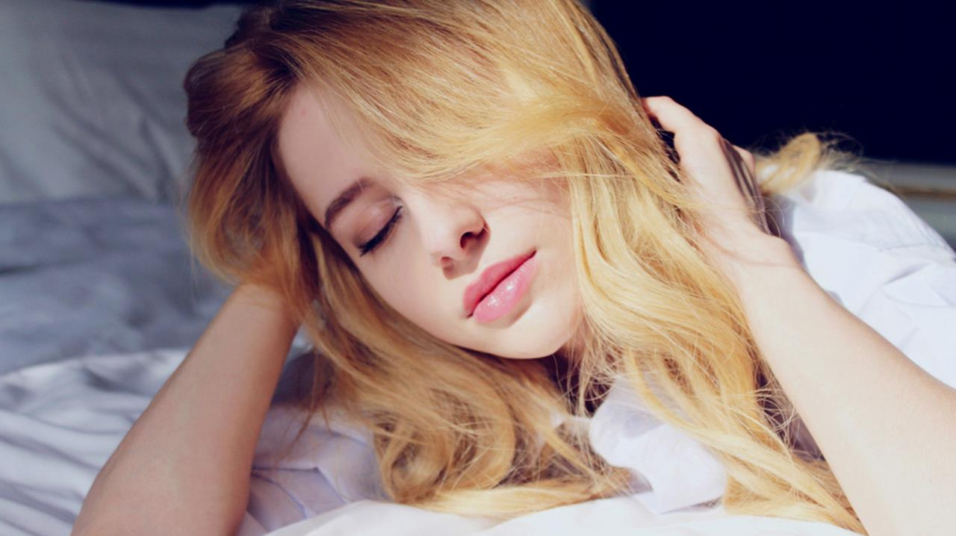
ALL OR NOTHING
THANK YOU
NOW OR NEVER

