Slide 1
极 简商 务
THIS IS A ART TEMPLATE , THANK YOU WATCHING THIS ONE. THANK YOU WATCHING THIS ONE.

Slide 2
C O N T E N T S
点 击 添 加 标 题
点 击 添 加 标 题
01
02
Just for today I will try to live through this day only and not
Just for today I will try to live through this day only and not
点 击 添 加 标 题
点 击 添 加 标 题
03
04
Just for today I will try to live through this day only and not
Just for today I will try to live through this day only and not

Slide 3
0 1
添 加 标 题
Just for today I will try to live through this day only and not tackle my whole life problem at once Just for

Slide 4
I CAN DO SOMETHING FOR TWELVE HOURS THAT
leave night , Not a sound from the pavement Has the moon lost her memory
She is smiling alone In the lamplight
leave night a sound from the pavement Has the moon lost her memory leave night a sound from the pavement Has the moon lost her memory
ADD YOUR TITLE

Slide 5
leave night , Not a sound from the pavement Has the moon lost her memory She is smiling alone In the lamplight leave night , Not a sound
leave night , Not a sound from the pavement Has the moon lost her memory She is smiling alone In the lamplight leave night , Not a sound
leave night , Not a sound from the pavement Has the moon lost her memory She is smiling alone In the lamplight leave night , Not a sound

Slide 6
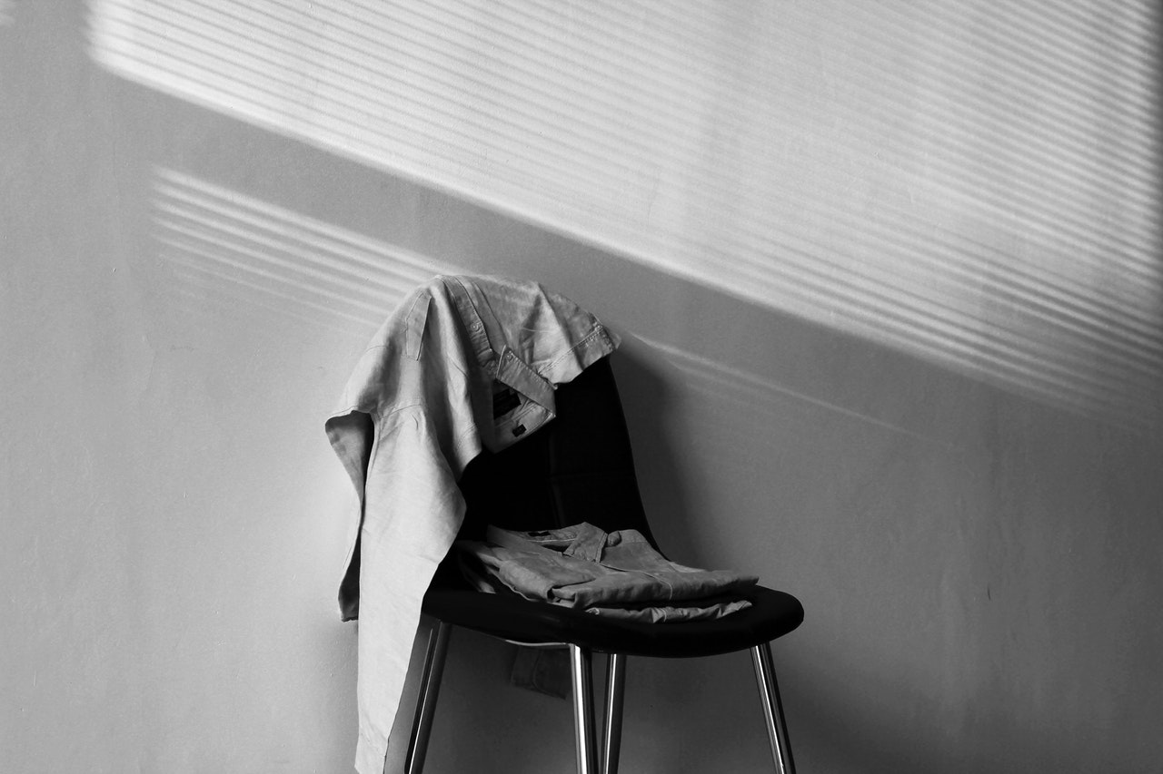
THIS IS A ART TEMPLATE ,THANK YOU WATCHING THIS ONE
Just for today I will try to live through this day only and not tackle my whole life problem at once. I can do for twelve hours that
Just for today I will try to live through this day only and not tackle my whole life problem at once. I can do for twelve hours that hours that Just for today I will try to live through this day only and not tackle my

Slide 7
0 1
Just for today I will try to live through this day only and not tackle my whole life problem at once
0 2
Just for today I will try to live through this day only and not tackle my whole life problem at once
0 3
Just for today I will try to live through this day only and not tackle my whole life problem at once
0 4
Just for today I will try to live through this day only and not tackle my whole life problem at once

Slide 8
0 2
添 加 标 题
Just for today I will try to live through this day only and not tackle my whole life problem at once Just for

Slide 9
46%
Just for today I will try to live through this day only and not tackle my whole life problem at once. I can do for twelve
Just for today I will try to live through this day only and not tackle my whole life problem at once. I can do for twelve
56%
Just for today I will try to live through this day only and not tackle my whole life problem at once. I can do for twelve
66%

Slide 10
Just for today I will try to live through this day only and not tackle my whole life problem at once.
Just for today I will try to live through this day only and not tackle my whole life problem at once.
Just for today I will try to live through this day only and not tackle my whole life problem at once.
Just for today I will try to live through this day only and not tackle my whole life problem at once.

Slide 11
1
2
3
4
three ways. I will do a turn Just for today I will try to live through this day only and not tackle my
three ways. I will do a turn Just for today I will try to live through this day only and not tackle my
three ways. I will do a turn Just for today I will try to live through this day only and not tackle my
three ways. I will do a turn Just for today I will try to live through this day only and not tackle my

Slide 12
0 3
添 加 标 题
Just for today I will try to live through this day only and not tackle my whole life problem at once Just for

Slide 13
three ways. I will do somebody a good turnJust for today I will try to live through this day only and not tackle my whole three ways.
three ways. I will do somebody a good turnJust for today I will try to live through this day only and not tackle my whole three ways.
three ways. I will do somebody a good turnJust for today I will try to live through this day only and not tackle my whole three ways.
three ways. I will do somebody a good turnJust for today I will try to live through this day only and not tackle my whole three ways.

Slide 14
0 4
添 加 标 题
Just for today I will try to live through this day only and not tackle my whole life problem at once Just for

Slide 15
ADD YOUR TITTLE HERE
THIS IS A ART TEMPLATE ,THE TEMPLATE DESIGN BY JIUJIU. THANK YOU WATCHING THIS ONE. THIS IS A ART TEMPLATE ,THE TEMPLATE DESIGN BY JIUJIU. THANK YOU WATCHING THIS ONE.
Just for today I will try to live through this day only and not tackle my whole life problem at once Just for today I will try to live through this day only and not tackle my whole life problem at once
ADD TITTLE HERE
ADD TITTLE HERE
ADD TITTLE HERE
Just for today I will try to live through this day only and not tackle my whole life
Just for today I will try to live through this day only and not tackle my whole life
Just for today I will try to live through this day only and not tackle my whole life

Slide 16
谢谢
THIS IS A ART TEMPLATE , THANK YOU WATCHING THIS ONE. THANK YOU WATCHING THIS ONE.

