Slide 1
深蓝创意线条
商务策划PPT模板
Synergistically utilize technically sound portals with, Synergistically utilize technically, Synergistically

Slide 2
CONTENTS
01.市场现状分析
02.营销目标及任务分解
03.营销执行策略
04.营销费用及预算

Slide 3
01.市场现状分析
Synergistically utilize technically sound portals with, Synergistically utilize technically, Synergistically

Slide 4
市场现状分析
$45,825
Synergistically utilize technically sound portals with, Synergistically
$41k
$56k
Synergistically utilize technically sound portals with, Synergistically
Synergistically utilize technically sound portals with, Synergistically utilize technically sound
Synergistically utilize technically sound portals with, Synergistically utilize technically sound
$27k
$70k
Synergistically utilize technically sound portals with, Synergistically

Slide 5
市场现状分析
Synergistically utilize technically sound portals with, Synergistically utilize technically sound, Synergistically utilize technically sound portals with, Synergistically utilize technically sound
Synergistically utilize technically sound portals with, Synergistically utilize technically sound, Synergistically utilize technically sound portals with, Synergistically utilize technically sound
Synergistically utilize technically sound portals with, Synergistically utilize technically sound, Synergistically utilize technically sound portals with, Synergistically utilize technically sound

Slide 6
市场现状分析
Synergistically utilize technically sound portals with, Synergistically utilize technically sound, Synergistically utilize technically sound portals with
Synergistically utilize technically sound portals with, Synergistically utilize technically sound, Synergistically utilize technically sound portals with

Slide 7
02.目标及任务分解
Synergistically utilize technically sound portals with, Synergistically utilize technically, Synergistically

Slide 8
营销目标分解
01.
04.
Synergistically utilize technically sound portals with frictionless chainsSynergistically，Synergistically utilize technically sound portals with frictionless chainsSynergistically
Synergistically utilize technically sound portals with frictionless chainsSynergistically，Synergistically utilize technically sound portals with frictionless chainsSynergistically
02.
05.
Synergistically utilize technically sound portals with frictionless chainsSynergistically，Synergistically utilize technically sound portals with frictionless chainsSynergistically
Synergistically utilize technically sound portals with frictionless chainsSynergistically，Synergistically utilize technically sound portals with frictionless chainsSynergistically
03.
06.
Synergistically utilize technically sound portals with frictionless chainsSynergistically，Synergistically utilize technically sound portals with frictionless chainsSynergistically
Synergistically utilize technically sound portals with frictionless chainsSynergistically，Synergistically utilize technically sound portals with frictionless chainsSynergistically

Slide 9
营销目标分解
Synergistically utilize technically sound portals with, Synergistically utilize technically sound
Synergistically utilize technically sound portals with, Synergistically utilize technically sound
Synergistically utilize technically sound portals with, Synergistically utilize technically sound
Synergistically utilize technically sound portals with, Synergistically utilize technically sound
Synergistically utilize technically sound portals with, Synergistically utilize technically sound
Synergistically utilize technically sound portals with, Synergistically utilize technically sound

Slide 10
营销目标分解
Synergistically utilize technically sound portals with, Synergistically utilize technically sound，Synergistically utilize technically sound portals with, Synergistically utilize
Synergistically utilize technically sound portals with, Synergistically utilize technically sound，Synergistically utilize technically sound portals with, Synergistically utilize
Synergistically utilize technically sound portals with, Synergistically utilize technically sound，Synergistically utilize technically sound portals with, Synergistically utilize
$125
$225
$325

Slide 11
营销目标分解
Synergistically utilize technically sound portals with, Synergistically utilize technically sound
Synergistically utilize technically sound portals with, Synergistically utilize technically sound
Synergistically utilize technically sound portals with, Synergistically utilize technically sound
Synergistically utilize technically sound portals with, Synergistically utilize technically sound
Synergistically utilize technically sound portals with, Synergistically utilize technically sound
Synergistically utilize technically sound portals with, Synergistically utilize technically sound

Slide 12
03.营销执行策略
Synergistically utilize technically sound portals with, Synergistically utilize technically, Synergistically

Slide 13
营销执行策略
Synergistically utilize technically sound portals with, Synergistically utilize technically sound, Synergistically utilize technically sound portals with, Synergistically
Synergistically utilize technically sound portals with, Synergistically utilize technically sound, Synergistically utilize technically sound portals with, Synergistically

Slide 14
Synergistically utilize technically sound portals with, Synergistically utilize technically sound
Synergistically utilize technically sound portals with, Synergistically utilize technically sound
Synergistically utilize technically sound portals with, Synergistically utilize technically sound
Synergistically utilize technically sound portals with, Synergistically utilize technically sound
01.
02.
03.
04.

Slide 15
营销执行策略
Synergistically utilize technically sound portals with, Synergistically utilize technically sound，Synergistically utilize technically sound
Synergistically utilize technically sound portals with, Synergistically utilize technically sound，Synergistically utilize technically sound
Synergistically utilize technically sound portals with, Synergistically utilize technically sound，Synergistically utilize technically sound

Slide 16
04.营销费用预算
Synergistically utilize technically sound portals with, Synergistically utilize technically, Synergistically

Slide 17
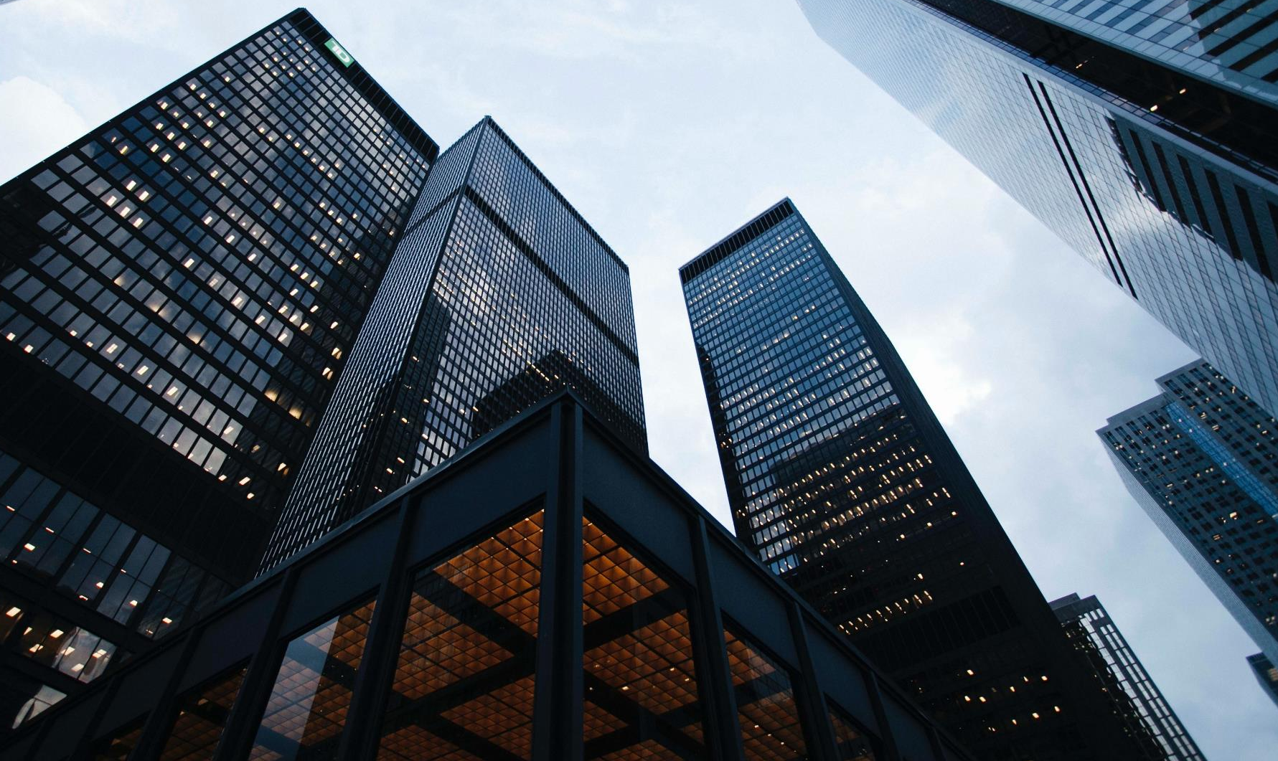
01.
02.
Synergistically utilize technically sound portals with, Synergistically utilize technically sound, Synergistically utilize technically sound portals with
Synergistically utilize technically sound portals with, Synergistically utilize technically sound, Synergistically utilize technically sound portals with

Slide 18
营销费用预算
Synergistically utilize technically sound portals with, Synergistically utilize technically sound, Synergistically
Synergistically utilize technically sound portals with, Synergistically utilize technically sound, Synergistically
Synergistically utilize technically sound portals with, Synergistically utilize technically sound, Synergistically
Synergistically utilize technically sound portals with, Synergistically utilize technically sound, Synergistically
Synergistically utilize technically sound portals with, Synergistically utilize technically sound, Synergistically

Slide 19
营销费用预算
Synergistically utilize technically sound portals with, Synergistically utilize technically sound, Synergistically utilize technically sound portals with
Synergistically utilize technically sound portals with, Synergistically utilize technically sound, Synergistically utilize technically sound portals with
Synergistically utilize technically sound portals with, Synergistically utilize technically sound, Synergistically utilize technically sound portals with
Synergistically utilize technically sound portals with, Synergistically utilize technically sound, Synergistically utilize technically sound portals with
Synergistically utilize technically sound portals with, Synergistically utilize technically sound, Synergistically utilize technically sound portals with

Slide 20
THANK YOU
Synergistically utilize technically sound portals with, Synergistically utilize technically, Synergistically

