Slide 1




Slide 2


New year
新年
Christmas
圣诞
Silent Night
平安夜

Slide 3

Silent Night
平安夜

Slide 4


Merry Christmas
广告集装箱
Silent Night
Silent night Holy night
All is calm all is bright
Round you virgin Mother and Child
Holy infant so tender and mild
Silent Night
Silent night Holy night
All is calm all is bright
Round you virgin Mother and Child
Holy infant so tender and mild
Silent Night
Silent night Holy night
All is calm all is bright
Round you virgin Mother and Child
Holy infant so tender and mild
Silent Night
Silent night Holy night
All is calm all is bright
Round you virgin Mother and Child
Holy infant so tender and mild

Slide 5
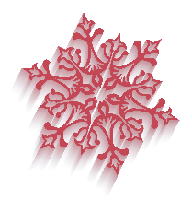
1
2
Silent Night
Silent night Holy night
All is calm all is bright
Round you virgin Mother and Child
Holy infant so tender and mild
Silent Night
Silent night Holy night
All is calm all is bright
Round you virgin Mother and Child
Holy infant so tender and mild
4
3
Silent Night
Silent night Holy night
All is calm all is bright
Round you virgin Mother and Child
Holy infant so tender and mild
Silent Night
Silent night Holy night
All is calm all is bright
Round you virgin Mother and Child
Holy infant so tender and mild

Slide 6
广告集装箱
Silent Night
Silent night Holy night
All is calm all is bright
广告集装箱
Silent Night
Silent night Holy night
All is calm all is bright
广告集装箱
Silent Night
Silent night Holy night
All is calm all is bright
广告集装箱
Silent Night
Silent night Holy night
All is calm all is bright

Slide 7
Christmas
圣诞

Slide 8
Silent Night
Silent night Holy night
All is calm all is bright
Round you virgin Mother and Child
Holy infant so tender and mild
Silent Night
Silent night Holy night
All is calm all is bright
Round you virgin Mother and Child
Holy infant so tender and mild
Merry Christmas
广告集装箱
广告集装箱
广告集装箱
Silent Night
Silent night Holy night
All is calm all is bright
Round you virgin Mother and Child
Holy infant so tender and mild
Silent Night
Silent night Holy night
All is calm all is bright
Round you virgin Mother and Child
Holy infant so tender and mild

Slide 9


广告集装箱
广告集装箱
广告集装箱
Merry Christmas
Happy new year
广告集装箱
Silent Night
Silent night Holy night
All is calm all is bright
Silent Night
Silent night Holy night
All is calm all is bright

Slide 10

Silent Night
Silent night Holy night
All is calm all is bright
Silent Night
Silent night Holy night
All is calm all is bright
Silent Night
Silent night Holy night
All is calm all is bright

Slide 11
New year
新年

Slide 12
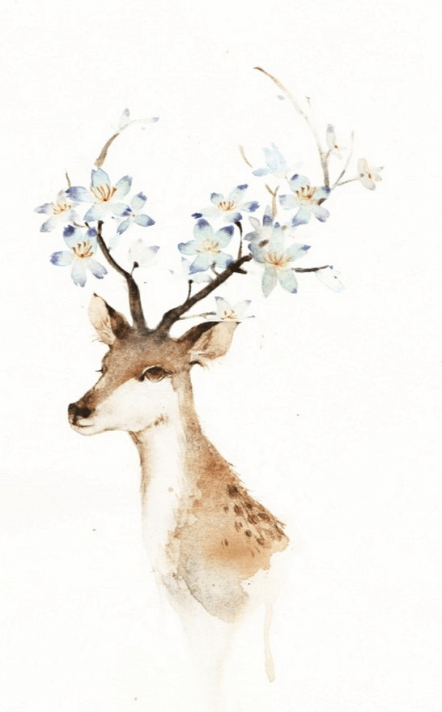

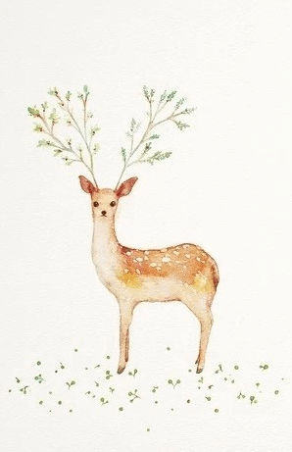
Silent Night，Silent night Holy night ，All is calm all is bright ，Round you virgin Mother and Child ，Holy infant so tender and mild，Sleep in heavenly peace ，Sleep in heavenly peace
Silent night, holy night, Shepherds quake at the sight. Glories stream from heaven afar,
Heav'nly hosts sing Alleluia; Christ the Savior is born; Christ the Savior is born.Silent night, holy night, Son of God, love's pure light. Radiant beams from Thy holy face, With the dawn of redeeming grace, Jesus, Lord, at Thy birth; Jesus, Lord, at Thy birth.

Slide 13



Silent Night
Silent night Holy night
All is calm all is bright
广告
集装箱
Silent Night
Silent night Holy night
All is calm all is bright
广告
集装箱
Silent Night
Silent night Holy night
All is calm all is bright
广告
集装箱
广告
集装箱
Silent Night
Silent night Holy night
All is calm all is bright

Slide 14


Silent Night
Silent night Holy night
All is calm all is bright
广告集装箱
Silent Night
Silent night Holy night
All is calm all is bright
广告集装箱
Merry Christmas
Happy new year
广告集装箱
Silent Night
Silent night Holy night
All is calm all is bright
广告集装箱
Silent Night
Silent night Holy night
All is calm all is bright
广告集装箱

Slide 15








S
T
Silent Night
Silent night Holy night
All is calm all is bright
Silent Night
Silent night Holy night
All is calm all is bright
O
W
Silent Night
Silent night Holy night
All is calm all is bright
Silent Night
Silent night Holy night
All is calm all is bright

Slide 16



