Slide 1
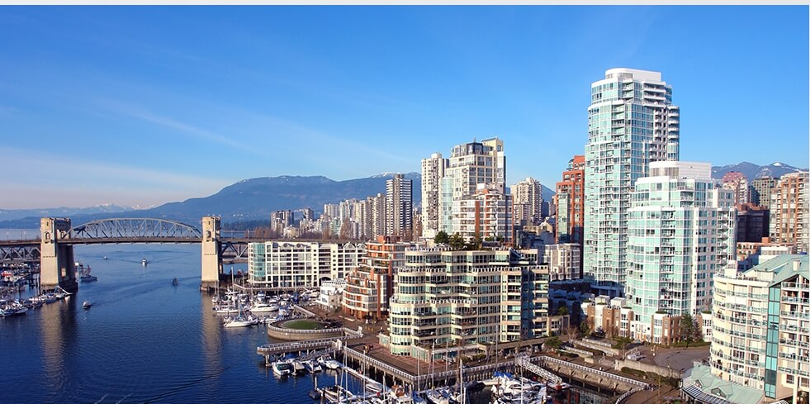



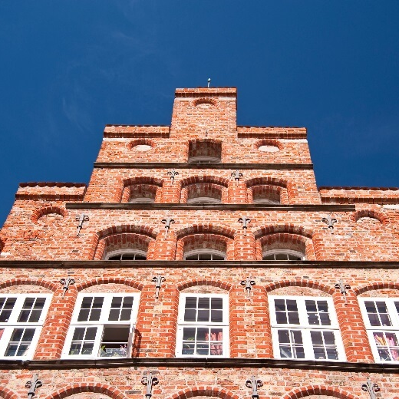
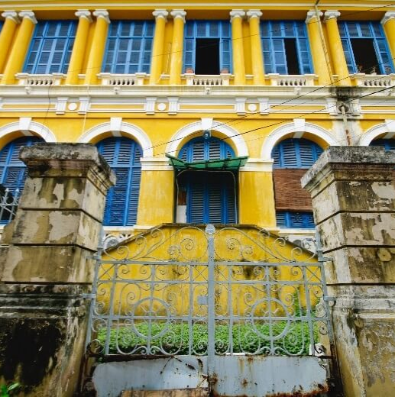
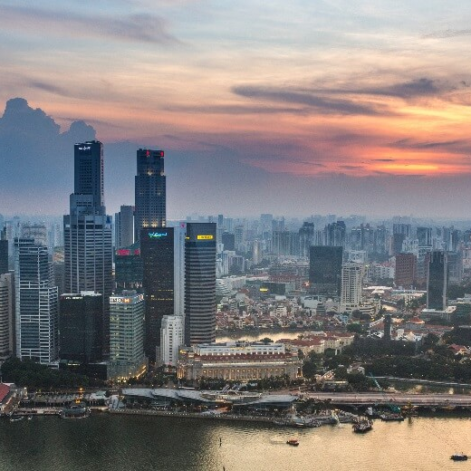



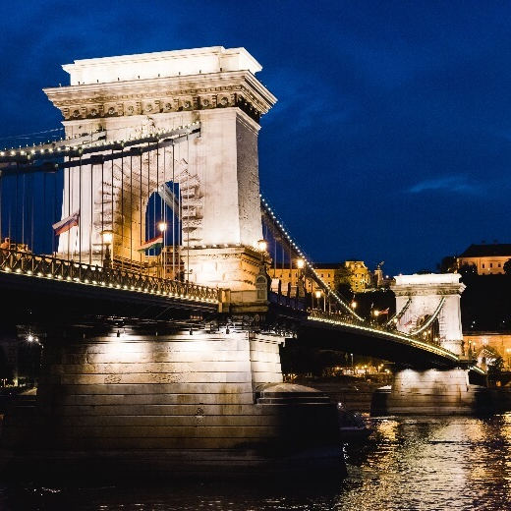

创意设计
简约画册
WRITE CAPTION HERE
There are many variations of passages of Big Daddy available, but the majority have suffered alteration in some form, by injected humour, or randomised words which.

Slide 2
WRITE CAPTION HERE
Design
Unique
Content —
Slide
There are many variations of passages of Big Daddy available, but the majority have suffered alteration in some form, by injected humour, or randomised words which.
Develop
There are many variations of passages of Big Daddy available, but the majority have suffered alteration in some form, by injected humour, or randomised words which.
Release
There are many variations of passages of Big Daddy available, but the majority have suffered alteration in some form, by injected humour, or randomised words which.

Slide 3





Integrate
Part—One
PROTOTYPING TOOLS

Slide 4






Imagination
Identify
Bench marketing
Analysis
Design
Prototyping

Slide 5


01
03
DESIGN
MARKETING
There are many variations of passages of Big Daddy available, but the majority have suffered alteration.
There are many variations of passages of Big Daddy available, but the majority have suffered alteration.
02
DEVELOP
There are many variations of passages of Big Daddy available, but the majority have suffered alteration.

Slide 6
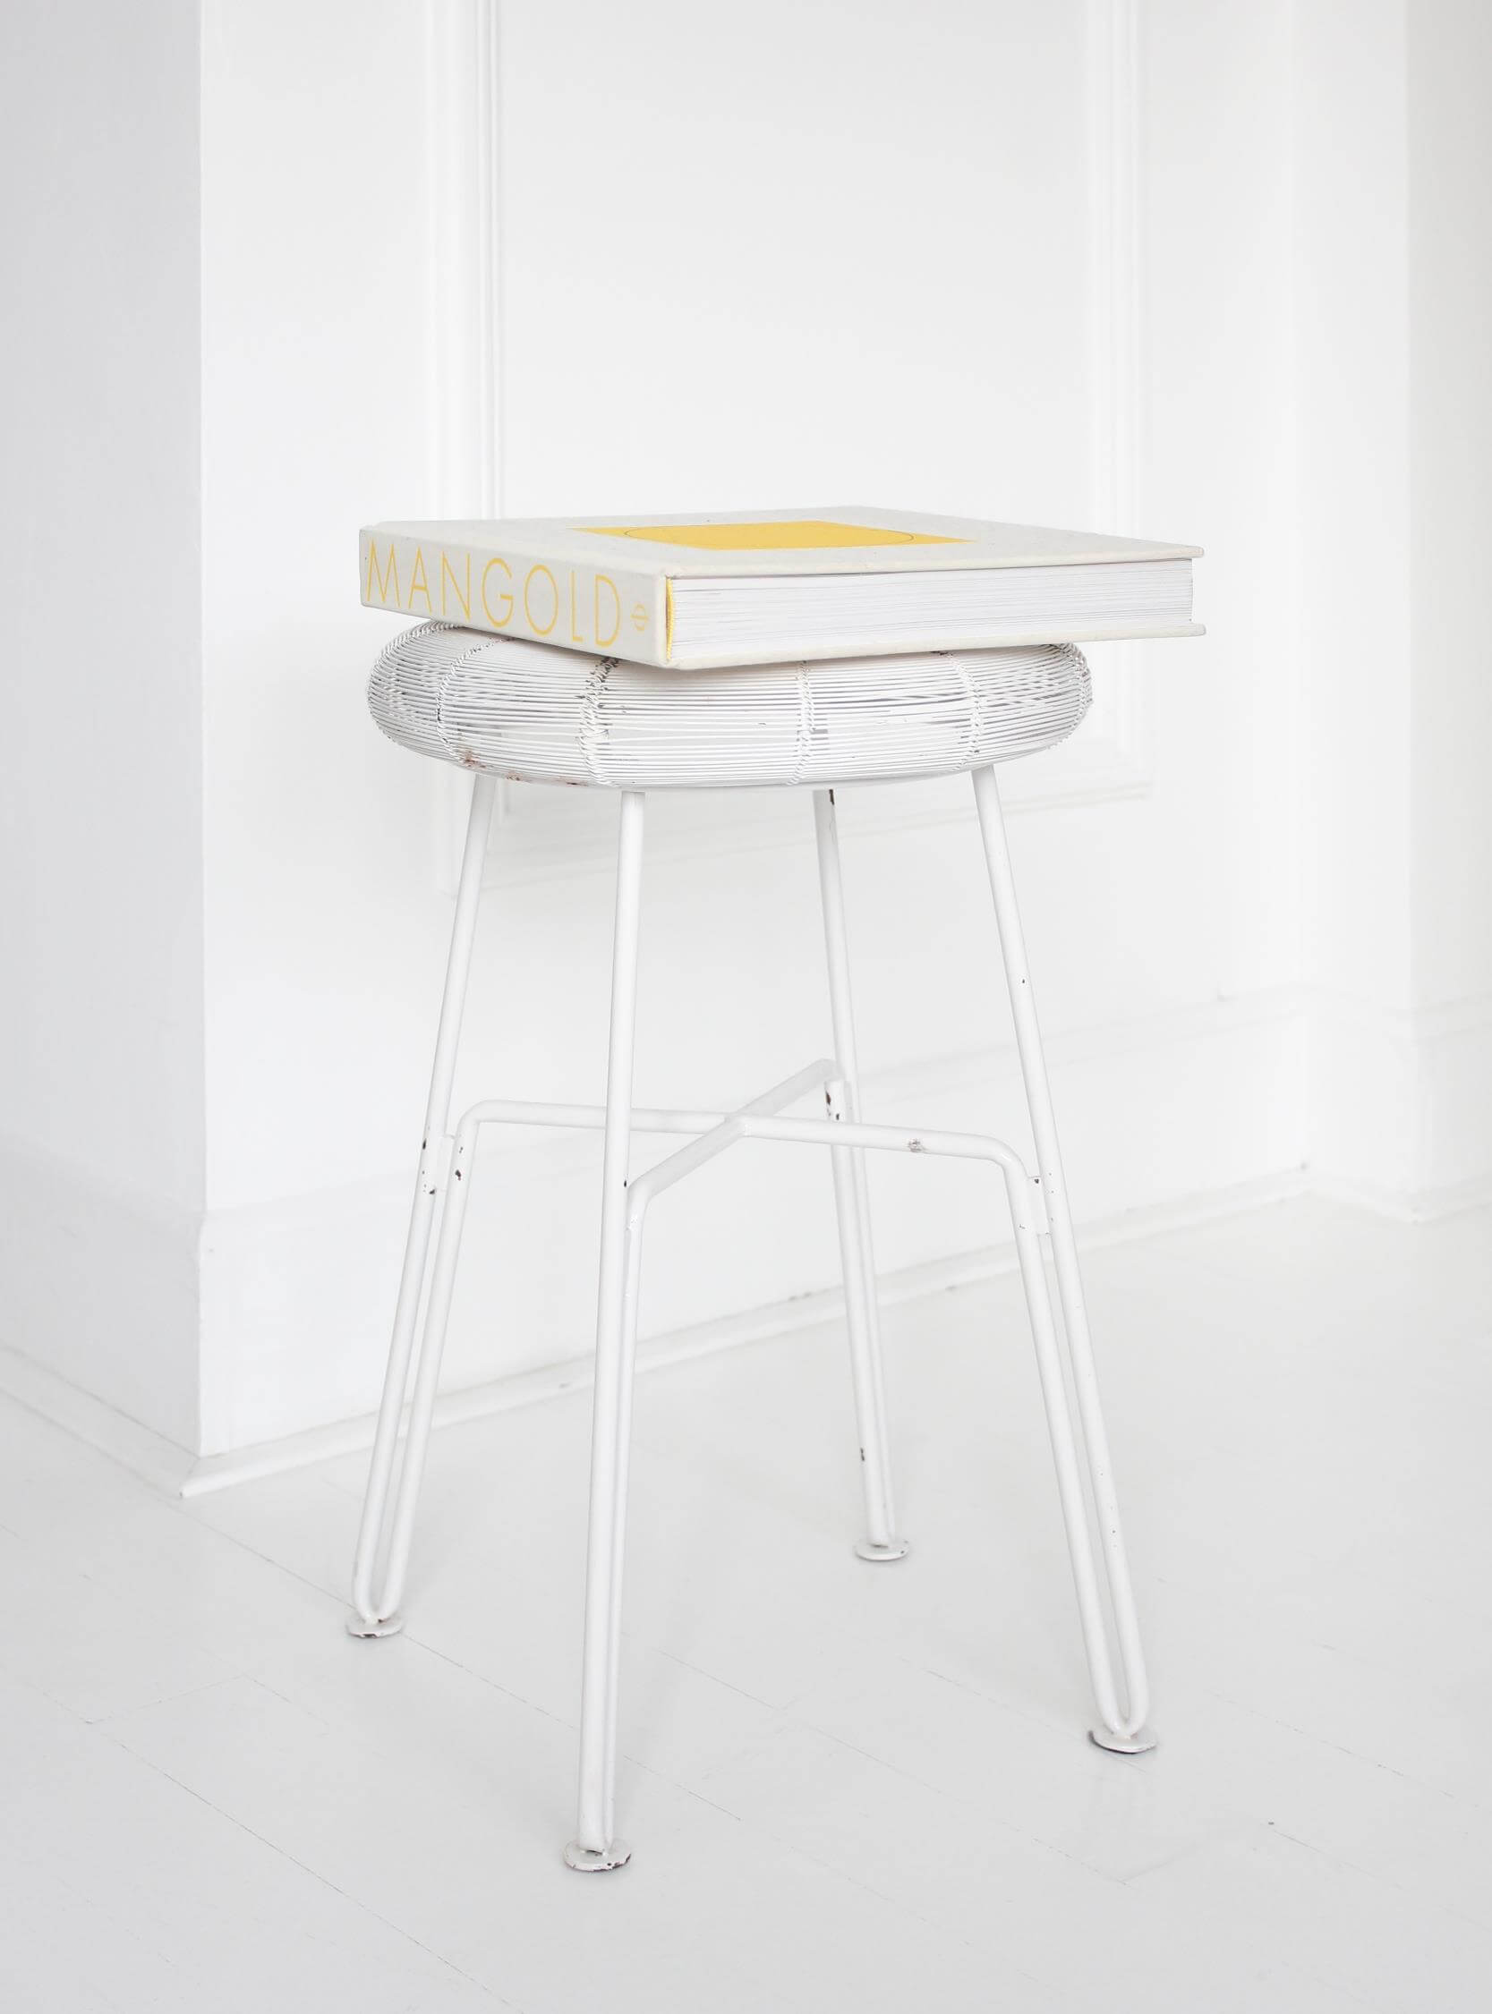
Part-Two
WRITE CAPTION HERE
Quick time-to-market
Reduced paper work, no legal hassles
Well-established payment processing
Setup costs
Complete financial control
General risks

Slide 7

Most popular
Available upon Request
Community
Starter
PRO
Free
$49/mo
$249/mo
Enterprise
Records
Records
Records
10 000
100 000
1 000 000
Ops/months
Ops/months
Ops/months
Ops/months
100 000
1 000 000
10 000 000
Customizable solutions
Support
Support
Support
Support
-
Forum
Email
Individualized support
Analytics
Analytics
Analytics
Analytics
-
30 Days
90 Days
Customizable time

Slide 8
Starter
$39.00
PRO
$149.00
All Extensions Included
Per Month
All Extensions Included
Per Month
.
.
Digital Asset Management
Free Access
Image & Video
Analytics
Distribution
Free Support
Analytics Tools
Financial Control Panel
Digital Asset Management
Free Access
Image & Video
Analytics
Distribution
Free Support
.
.

Slide 9




OUR TEAM
Bob Planets
Aida Winters
Founder, CEO
Developer
Eva Altezza
Alicia Bronx
Support Specialist
Designer

Slide 10
SUN
MON
TUE
WED
THU
FRI
SAT
MAY
01
02
03
04
05
06
07
.
08
09
10
11
12
13
.
14
15
16
17
18
19
20
21
22
.
23
24
25
26
27
28
29
30
31

Slide 11

.
Part Three
Main
Courthouse
in Boston
WRITE CAPTION HERE
Adam Bronx
Designer

Slide 12
.
Imagination
WRITE CAPTION HERE
Identify
Design
Prototyping
Integrate
Beta-testing
Release

Slide 13
Gold
Silver
Bronze
Platinum
Iridium
+ $50,048
+ $75.778
+ 100%
+ 75%
+ 50%
+ 25%
0
- 25%
- 50%
- 75%
- 100%
Gold
Silver
Bronze
Platinum
Iridium
- $50. 334
- $100. 078
- $50.112

Slide 14
Gold
Bronze
Silver
Rhodium
Steel
Platinum
Iridium

Slide 15
WRITE CAPTION HERE
Web
Graphic
Application
Story
Message
Smart
Social
Location
Statistic

Slide 16
88%
of customers liked our products

Slide 17
WRITE CAPTION HERE
Slide with Charts
30
50
Research
Meeting
There are many variations of passages of Big Daddy available, but the majority have suffered alteration in some form, by injected humour, or randomised words which don't look even slightly believable. If you are going to use a passage of Big Daddy, you need to be sure there isn't anything embarrassing hidden in the middle of text.
90
70
Discuss
Production

Slide 18
SUPPORT SYSTEM
DESIGN SYSTEM
PRODUCTION SYSTEM
MOTIVATION SYSTEM
TRAINING SYSTEM
DEVELOPMENT STRATEGY
PLANNING SYSTEM
ANALYSIS SYSTEM

Slide 19


AWESOME STEPS
Part Four
There are many variations of passages of Big Daddy available, but the majority have suffered alteration in some form, by injected humour, or randomised words which don't look even slightly believable. If you are going to use a passage of Big Daddy, you need to be sure there isn't anything embarrassing hidden in the middle of text.
ARCHITECTURE

Slide 20



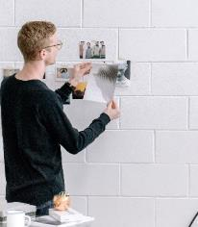
STRENGTHS
WEAKNESSES
OPPORTUNITIES
THREATS
There are many variations of passages of Big Daddy available, but the majority have suffered alteration in some form, by injected humour, or randomised words which.
There are many variations of passages of Big Daddy available, but the majority have suffered alteration in some form, by injected humour, or randomised words which.
There are many variations of passages of Big Daddy available, but the majority have suffered alteration in some form, by injected humour, or randomised words which.
There are many variations of passages of Big Daddy available, but the majority have suffered alteration in some form, by injected humour, or randomised words which.

Slide 21
ABOUT
There are many variations of passages of Big Daddy available, but the majority have suffered alteration in some form, by injected humour, or randomised words which.
DESIGN. DEVELOP. MARKETING.

Slide 22






.
.
.
.Main
Courthouse
in Boston
THOMAS LEWIS
CORNELIA GIBBS
STEVEN SIMPSON
Designer
Designer
Designer
.
.
.
WALTER WEST
STEWART COLE
DULCIE HANKOCK
Designer
Designer
Designer

Slide 23


WRITE CAPTION HERE
.
There are many variations of passages of Big Daddy available, but the majority have suffered alteration in some form, by injected humour, or randomised words which don't look even slightly believable. If you are going to use a passage of Big Daddy, you need to be sure there isn't anything embarrassing hidden in the middle of text.

Slide 24




Slide 25
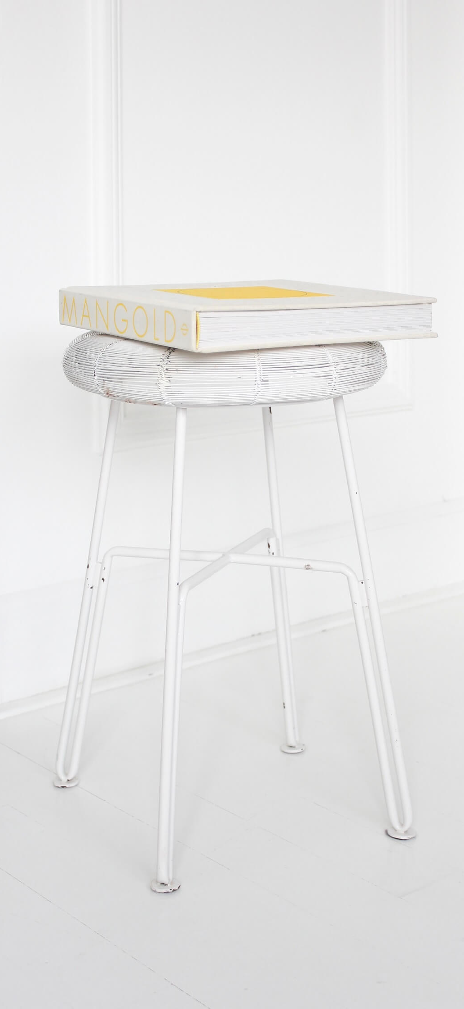
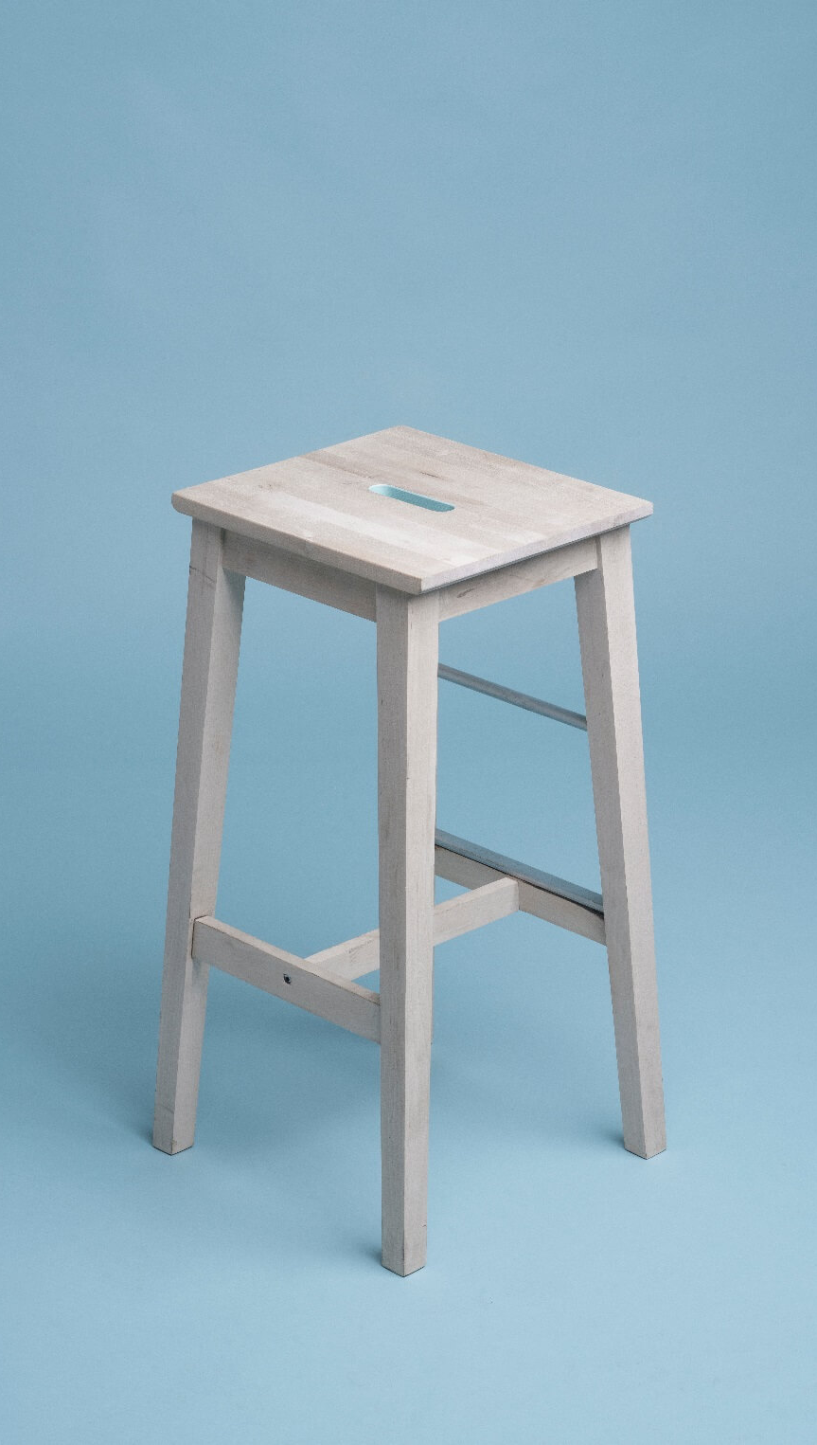

Write small caption here
Write small caption here
Write small caption here

Slide 26
Thank.
You.
Very much.

