Slide 1

POWER POINT
黑白简约商务计划书
汇报人：xiazaii

Slide 2
1.
标题文字添加此处
The user can demonstrate on a projector or computer
2.
标题文字添加此处
The user can demonstrate on a projector or computer
CONTENTS
3.
标题文字添加此处
The user can demonstrate on a projector or computer
4.
标题文字添加此处
The user can demonstrate on a projector or computer
5.
标题文字添加此处
The user can demonstrate on a projector or computer

Slide 3



01
标题文字添加此处
The user can demonstrate on a projector or computer

Slide 4

标题文字添加
标题文字添加
标题文字添加
The user can demonstrate on a projector or computer, or print the presentation and make it into a film to be used in a wider field
标题文字添加
标题文字添加
标题文字添加

Slide 5

标题文字添加
标题文字添加
The user can demonstrate on a projector orThe user can demonstrate on a projector or computer, or print the presentation and make it into a film to be used in a wider field computer, or print theThe user can demonstrate on a projector or computer, or print the presentation and make it into a film to be used in a wider field presentation and make it into a film to be used in a wider field

Slide 6




标题文字添加
标题文字添加
The user can demonstrate on a projector or computer, or print the presentation and make it into a film to be used in a wider field
The user can demonstrate on a projector or computer
The user demonstrate on a projector
The user demonstrate on a projector
The user demonstrate on a projector

Slide 7

标题文字添加
标题文字添加
The user can demonstrate on a projector or computer, or print the presentation and make it into a film to be used in a wider fieldThe user can demonstrate on a projector or computer, or print the presentation and make it into a film to be used in a wider field
标题文字添加
标题文字添加
标题文字添加
标题文字添加

Slide 8
02
标题文字添加此处
The user can demonstrate on a projector or computer

Slide 9
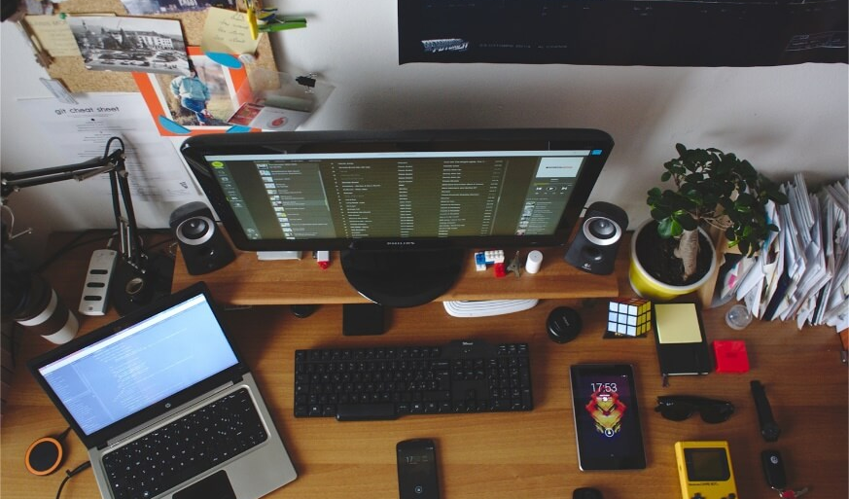
标题文字添加
Part 01
标题文字添加这里
Part 02
标题文字添加这里
Part 03
标题文字添加这里
Part 04
标题文字添加这里
The user can demonstrate on a projector or computer, or print the presentation and make it into a film to be used in a wider field

Slide 10
标题文字添加
The user can demonstrate on a projector or computer, or print the presentation and make it into a film to be used in a wider fieldThe user can demonstrate on a projector or computer, or print the presentation and make it into a film to be used in a wider field
标题文字添加
标题文字添加
标题文字添加
The user can demonstrate on a projector or computer, or print the presentation and make it into a film to be used in a wider field
The user can demonstrate on a projector or computer, or print the presentation and make it into a film to be used in a wider field
The user can demonstrate on a projector or computer, or print the presentation and make it into a film to be used in a wider field

Slide 11




标题文字添加
The user can demonstrate on a projector or computer, or print the presentation and make it into a film to be used in a wider field
The user can demonstrate on a projector or computer, or print the presentation and make it into a film to be used in a wider field
The user can demonstrate on a projector or computer, or print the presentation and make it into a film to be used in a wider field
The user can demonstrate on a projector or computer, or print the presentation and make it into a film to be used in a wider field

Slide 12
03
标题文字添加此处
The user can demonstrate on a projector or computer

Slide 13
标题文字添加
The user can demonstrate on a projector or computer, or print the presentation and make it into a film to be used in a wider field
The user can demonstrate on a projector or computer, or print the presentation and make it into a film to be used in a wider field
标题文字添加
标题文字添加
标题文字添加
标题文字添加
The user can demonstrate on a projector or computer, or print the presentation and make it into a film to be used in a wider field
The user can demonstrate on a projector or computer, or print the presentation and make it into a film to be used in a wider field

Slide 14
标题文字添加
标题文字添加
标题文字添加
标题文字添加
标题文字添加
The user can demonstrate on a projector or computer, or print the presentation and make it into a film to be used in a wider field
The user can demonstrate on a projector or computer, or print the presentation and make it into a film to be used in a wider field
The user can demonstrate on a projector or computer, or print the presentation and make it into a film to be used in a wider field
The user can demonstrate on a projector or computer, or print the presentation and make it into a film to be used in a wider field

Slide 15
标题文字添加

Slide 16




标题文字添加
01
02
03
04
文字添加
文字添加
文字添加
文字添加
The user can demonstrate on a projector or computer, or print the presentation and make it into a film to be used in a wider field
The user can demonstrate on a projector or computer, or print the presentation and make it into a film to be used in a wider field
The user can demonstrate on a projector or computer, or print the presentation and make it into a film to be used in a wider field
The user can demonstrate on a projector or computer, or print the presentation and make it into a film to be used in a wider field

Slide 17
04
标题文字添加此处
The user can demonstrate on a projector or computer

Slide 18
标题文字添加
标题文字添加
01
标题文字添加
The user can demonstrate on a projector or computer, or print the presentation and make it into a film to be used in a wider field
The user can demonstrate on a projector or computer, or print the presentation and make it into a film to be used in a wider field
04
02
标题文字添加
03
标题文字添加
The user can demonstrate on a projector or computer, or print the presentation and make it into a film to be used in a wider field
The user can demonstrate on a projector or computer, or print the presentation and make it into a film to be used in a wider field

Slide 19

标题文字添加
标题文字添加
The user can demonstrate on a projector or computer, or print the presentation and make it into a film to be used in a wider field
标题文字添加
The user can demonstrate on a computer, or print the presentation and make it into a film to
标题文字添加
The user can demonstrate on a computer, or print the presentation and make it into a film to
标题文字添加
The user can demonstrate on a projector or computer, or print the presentation and make it into a film to be used in a wider field

Slide 20
标题文字添加
标题文字添加
The user can demonstrate on a projector or computer, or print the presentation and make it into a film to be used in a wider field
标题文字添加
The user can demonstrate on a projector or computer, or print the presentation and make it into a film to be used in a wider field
POWER POINT
标题文字添加
The user can demonstrate on a projector or computer, or print the presentation and make it into a film to be used in a wider field

Slide 21
05
标题文字添加此处
The user can demonstrate on a projector or computer

Slide 22
标题文字添加
标题文字添加
The user can demonstrate on a projector or computer, or print the presentation and make it into a film
标题文字添加
The user can demonstrate on a projector or computer, or print the presentation and make it into a film
标题文字添加
The user can demonstrate on a projector or computer, or print the presentation and make it into a film
标题文字添加
The user can demonstrate on a projector or computer, or print the presentation and make it into a film

Slide 23
标题文字添加
The user can demonstrate on a projector or computer, or print the presentation and make it into a film to be used in a wider field
The user can demonstrate on a projector or computer, or print the presentation and make it into a film to be used in a wider field
The user can demonstrate on a projector or computer, or print the presentation and make it into a film to be used in a wider field
The user can demonstrate on a projector or computer, or print the presentation and make it into a film to be used in a wider field
The user can demonstrate on a projector or computer, or print the presentation and make it into a film to be used in a wider field
The user can demonstrate on a projector or computer, or print the presentation and make it into a film to be used in a wider field

Slide 24

标题文字添加
标题文字添加
The user can demonstrate on a projector or computer
The user can demonstrate on a projector or computer, or print the presentation and make it into a film to be used in a wider fieldThe user can demonstrate on a projector or computer, or print the presentation and make it into a film to be used in a wider field
The user can demonstrate on a projector or computer, or print the presentation and make it into a film to be used in a wider fiel
The user can demonstrate on a projector or computer
The user can demonstrate on a projector or computer
The user can demonstrate on a projector or computer

Slide 25
THANK YOU
黑白简约商务计划书
汇报人：xiazaii

