Slide 1
时尚杂志风
FASHION

Slide 2
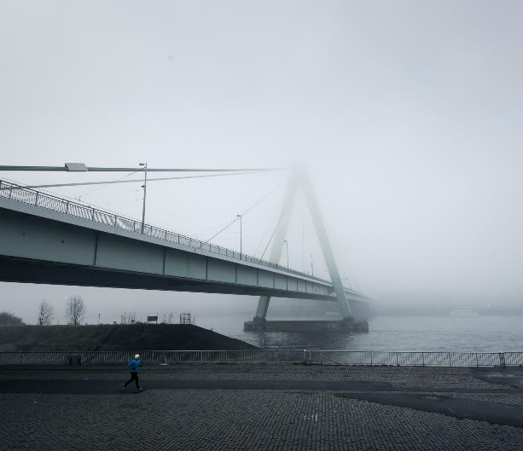
WRITE
YOUR TITLE
HERE
Entrepreneurial activities differ substantially depending on the type of organization and creativity involved. Entrepreneurship ranges in scale from solo. Entrepreneurial activities differ substantially depending on the type of organization and

Slide 3
THE
GRADIENT
ONE
SLIDEDIZER

Slide 4
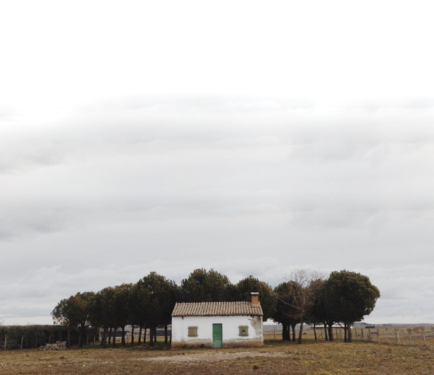
WRITE
YOUR TITLE
HERE
Entrepreneurial activities differ substantially depending on the type of organization and creativity involved. Entrepreneurship ranges in scale from solo. Entrepreneurial activities differ substantially depending on the type of organization and

Slide 5
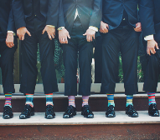
OUR
PROJECTS

Slide 6
------------
------------
------------
点击添加标题
点击添加标题
点击添加标题
点击此处添加文本
点击此处添加文本
点击此处添加文本
点击此处添加文本
点击此处添加文本
点击此处添加文本
点击此处添加文本
点击此处添加文本
点击此处添加文本
点击此处添加文本
点击此处添加文本
点击此处添加文本

Slide 7
Keywords
Clean, Minimalist, Flat, Powerful and Flexible PowerPoint template, perfect for business, corporate and personal use. Very easy to change the color schemes.
Keywords
Clean, Minimalist, Flat, Powerful and Flexible PowerPoint template, perfect for business, corporate and personal use. Very easy to change the color schemes.

Slide 8
SWITZERLAND
Fully Editable Map
When selecting a typeface for body text, your primary concern should be readability. Don’t concern yourself with personality at this stage. I’m of the school of thought that believes that you’re better off mastering a few typeface.
WHITE PEOPLE
65 %
BLACK PEOPLE
93 %
HISPANIC PEOPLE
57 %

Slide 9
FEATURE 1
FEATURE 2
FEATURE 3
Frequently, your initial font choice is taken out of your awesome hands also we are companies
Frequently, your initial font choice is taken out of your awesome hands also we are companies
Frequently, your initial font choice is taken out of your awesome hands also we are companies

Slide 10
Add your tittle
Youth means a temperamental predominance of courage over timidity, of the appetite for adventure over the love of ease. This often exists in a man of 60 more than a boy of 20. Nobody grows old merely by a number of years. We grow old by deserting our ideals.
Add your text
Add your text
Add your text
Add your text
write something to describe your theme with the introduction
write something to describe your theme with the introduction
write something to describe your theme with the introduction
write something to describe your theme with the introduction

Slide 11
Compare Websites
01
02
LATEST NEWS
FROM THE WORLD
LATEST NEWS
FROM THE WORLD
www.yourcompanyname.com
www.yourcompanyname.com

Slide 12
MULTI
HEXAGON
PICTURE
Entrepreneurial activities differ substantially depending on the type of organization and creativity involved. Entrepreneurial activities differ substantially depending on the type of organization and
Entrepreneurship ranges in scale from solo. Entrepreneurial activities differ substantially depending on the type of organization and

Slide 13
YOUR TITLE
Entrepreneurial activities differ substantially depending on the type of organization and creativity involved. Entrepreneurship ranges in scale from solo. Entrepreneurial activities differ
Your Second Title goes here
Entrepreneurial activities differ substantially depending on the type of organization and creativity involved. Entrepreneurship ranges in scale from solo. Entrepreneurial activities differ
Your Second Title goes here
Entrepreneurial activities differ substantially depending on the type of organization and creativity involved. Entrepreneurship ranges in scale from solo. Entrepreneurial activities differ

Slide 14
PROJECT NAME
Entrepreneurial activities differ substantially depending on the type of organization.

Slide 15
You Can Write Here
WRITE HERE SOMETHING ABOUT
You Can Write Here
Your Title
外观
添加联系方式
添加标题
创意
添加联系方式
单击此处添加副标题或详细文本描述
专业
感受
品牌

Slide 16
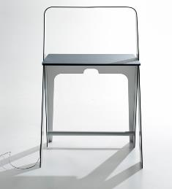
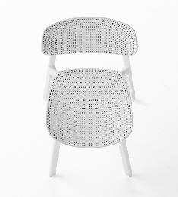
You Can Write Here
WRITE HERE SOMETHING ABOUT
You Can Write Here
02
project title
& details
02
04
06
Entrepreneurial activities differ substantially depending on the type of organization and creativity. Entrepreneurial activities differ substantially depending on the type of organization and creativity. Entrepreneurial activities differ substantially depending on the type

Slide 17
AREA GRAPH
01
WRITE A TITLE
Entrepreneurial activities differ substantially depending on the type of organization and
02
WRITE A TITLE
Entrepreneurial activities differ substantially depending on the type of organization and
03
WRITE A TITLE
Entrepreneurial activities differ substantially depending on the type of organization and

Slide 18
You Can Write Here
Your Title
01
Entrepreneurial activities differ substantially depending on the type of organization and creativity. Entrepreneurial activities differ substantially depending on the type of organization and creativity. Entrepreneurial activities differ substantially depending on the type of organization and creativity. Entrepreneurial activities differ substantially.
02
04
06
LEARN MORE

Slide 19
WRITE THE NAME
OF YOUR PROJECT
WRITE THE NAME
OF YOUR PROJECT
WRITE THE NAME
OF YOUR PROJECT

Slide 20
OUR
PROJECTS

Slide 21
YOUR TITLE
WRITE A TITLE IN THIS SECTION
Entrepreneurial activities differ substantially depending on the type of organization and creativity involved. Entrepreneurship ranges in scale from solo. Entrepreneurial activities differ
WRITE A TITLE IN THIS SECTION
Entrepreneurial activities differ substantially depending on the type of organization and creativity involved. Entrepreneurship ranges in scale from solo. Entrepreneurial activities differ
WRITE A TITLE IN THIS SECTION
Entrepreneurial activities differ substantially depending on the type of organization and creativity involved. Entrepreneurship ranges in scale from solo. Entrepreneurial activities differ

Slide 22
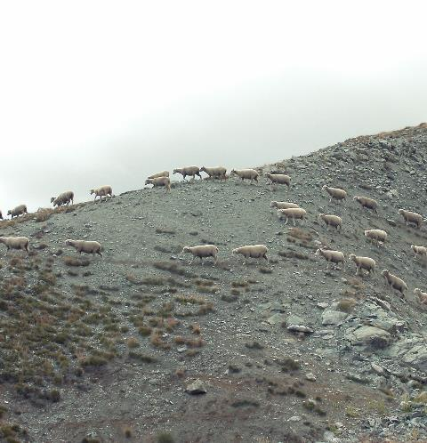
WRITE HERE
A GREAT TITLE
Entrepreneurial activities differ substantially depending on the type of organization and creativity involved.
Entrepreneurial activities differ substantially depending on the
Entrepreneurial activities differ substantially depending on the
Entrepreneurial activities differ substantially depending on the

Slide 23
Entrepreneurial activities differ substantially depending on the type of organization and creativity involved. Entrepreneurship ranges in scale from solo. Entrepreneurial activities differ substantially depending on the type of
STATISTICS
DESIGN
Entrepreneurial activities differ substantially depending on the type of organization and creativity involved.
Entrepreneurial activities differ substantially depending on the type of organization and creativity involved.
PICTURES
MESSAGES
Entrepreneurial activities differ substantially depending on the type of organization and creativity involved.
Entrepreneurial activities differ substantially depending on the type of organization and creativity involved.

Slide 24
You Can Write Here
WRITE HERE SOMETHING ABOUT
Little title here
Acting as if nothing borne in mind is the best revenge. It's all for myself to live better life.
WRITE SOMETHING
Little title here
Always listen to your heart because even though it's on your left side, it's always right.
Little title here
Blessedness is of comparative degree,you will feel it with more ease when there is something under you.

