Slide 1
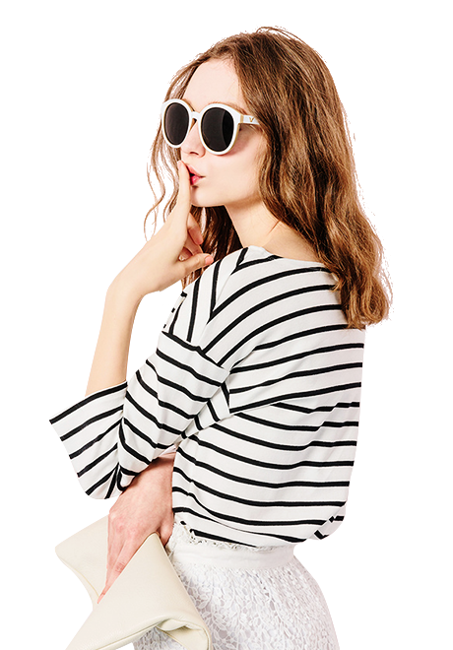
Sunshine
▪▪▪▪▪▪▪▪▪▪▪
▪▪▪▪▪▪▪▪▪▪▪
▪▪▪▪▪▪▪▪▪▪▪
▪▪▪▪▪▪▪▪▪▪▪
Fashion magazine
BAOTUWANG
XIAOLONGBAO
2018
时尚杂志风相册模板
I love you more than I've ever loved any woman. And I've waited longer for you than I've waited for any woman.

Slide 2

Contents
▪▪▪▪▪▪▪▪▪▪▪
▪▪▪▪▪▪▪▪▪▪▪
▪▪▪▪▪▪▪▪▪▪▪
▪▪▪▪▪▪▪▪▪▪▪
01
Click here to add your title
02
Click here to add your title
03
Click here to add your title
04
Click here to add your title

Slide 3

01
Click here to add your title
I love you more than I've ever loved any woman. And I've waited longer for you than I've waited for any woman.

Slide 4

▪▪▪▪▪▪▪▪▪▪▪▪▪
▪▪▪▪▪▪▪▪▪▪▪▪▪
▪▪▪▪▪▪▪▪▪▪▪▪▪
▪▪▪▪▪▪▪▪▪▪▪▪▪
I love you more than I've ever loved any woman. And I've waited longer for you than I've waited for any woman.
I love you more than I've ever loved any woman. And I've waited longer for you than I've waited for any woman.
BAOTU
WANG
XIAO
LONGBAO
I love you more than I've ever loved any woman. And I've waited longer for you than I've waited for any woman.

Slide 5
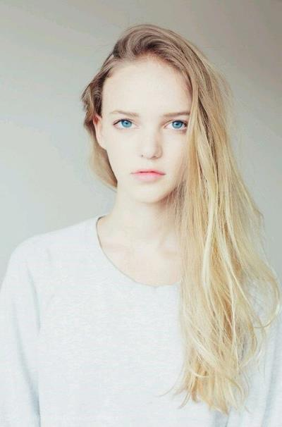

Click here to add your title
I love you more than I've ever loved any woman. And I've waited longer for you than I've waited for any woman.
I love you more than I've ever loved any woman. And I've waited longer for you than I've waited for any woman.
Click here to add your title
I love you more than I've ever loved any woman. And I've waited longer for you than I've waited for any woman.I love you more than I've ever loved any woman. And I've waited longer for you than I've waited for any woman.

Slide 6
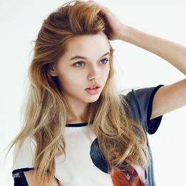
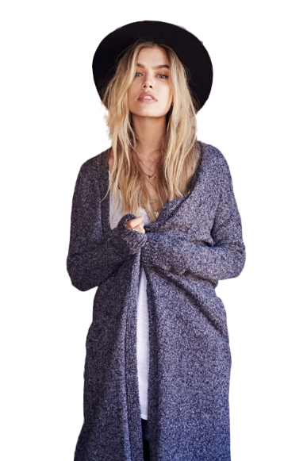

I love you more than I've ever loved any woman. And I've waited longer for you than I've waited for any woman.
I love you more than I've ever loved any woman. And I've waited longer for you than I've waited for any woman.
BAOTU
WANG
XIAO
LONGBAO

Slide 7

▪▪▪▪▪▪▪▪▪▪▪▪▪
▪▪▪▪▪▪▪▪▪▪▪▪▪
▪▪▪▪▪▪▪▪▪▪▪▪▪
▪▪▪▪▪▪▪▪▪▪▪▪▪
I love you more than I've ever loved any woman. And I've waited longer for you than I've waited for any woman.
I love you more than I've ever loved any woman. And I've waited longer for you than I've waited for any woman.

Slide 8
02
Click here to add your title
I love you more than I've ever loved any woman. And I've waited longer for you than I've waited for any woman.

Slide 9
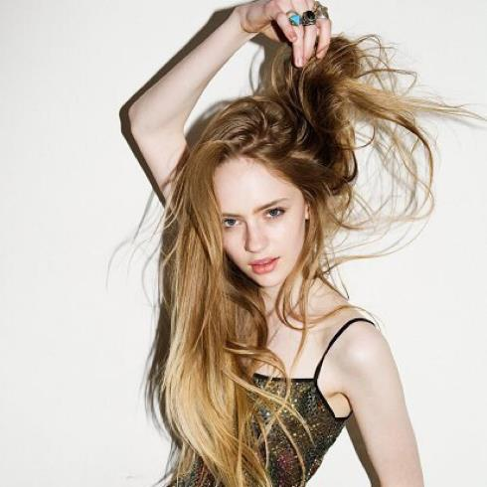
▪▪▪▪▪▪▪▪▪▪▪▪▪
▪▪▪▪▪▪▪▪▪▪▪▪▪
▪▪▪▪▪▪▪▪▪▪▪▪▪
Click here to add your title
I love you more than I've ever loved any woman. And I've waited longer for you than I've waited for any woman.
I love you more than I've ever loved any woman. And I've waited longer for you than I've waited for any woman.
I love you more than I've ever loved any woman. And I've waited longer for you than I've waited for any woman.
BAOTUWANG
XIAOLONGBAO

Slide 10
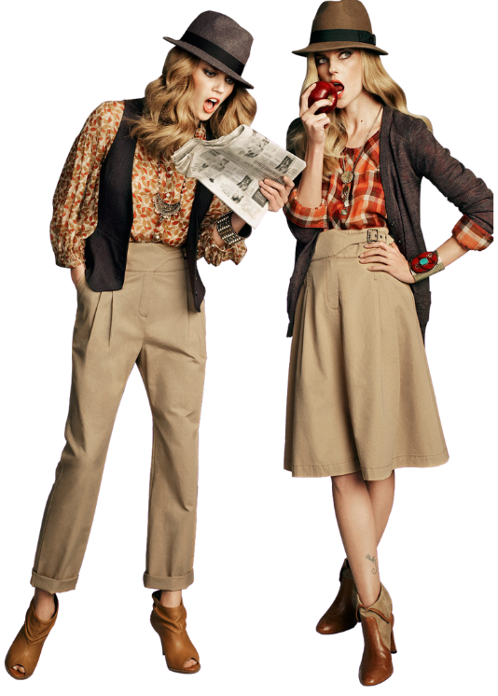
Click here to add your title
I love you more than I've ever loved any woman. And I've waited longer for you than I've waited for any woman.I love you more than I've ever loved any woman. And I've waited longer for you than I've waited for any woman.
Click here to add your title
I love you more than I've ever loved any woman. And I've waited longer for you than I've waited for any woman.I love you more than I've ever loved any woman. And I've waited longer for you than I've waited for any woman.

Slide 11
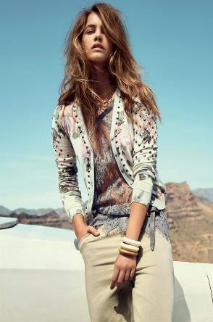

BAOTU
WANG
XIAO
LONGBAO
▪▪▪▪▪▪▪▪▪▪▪▪▪▪▪▪▪▪▪▪▪▪
BAOTU
WANG
XIAO
LONGBAO
Do what you say,say what you do.Do what you say,say what you do.Do what you say,say what you do.Do what you say,say what you do.
Do what you say,say what you do.
Do what you say,say what you do.
Do what you say,say what you do.
Do what you say,say what you do.
Fashion
Magazine

Slide 12

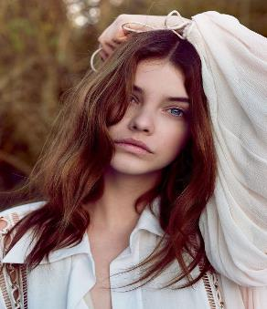
Do what you say,say what you do.Do what you say,say what you do.Do what you say,say what you do.Do what you say,say what you do.
Do what you say,say what you do.Do what you say,say what you do.Do what you say,say what you do.Do what you say,say what you do.
Click here to add your title
I love you more than I've ever loved any woman. And I've waited longer for you than I've waited for any woman.
I love you more than I've ever loved any woman. And I've waited longer for you than I've waited for any woman.I love you more than I've ever loved any woman. And I've waited longer for you than I've waited for any woman.
I love you more than I've ever loved any woman. And I've waited longer for you than I've waited for any woman.
SOME
PEOPLE
HAVE TO
CHANGE
THAT STYLE

Slide 13
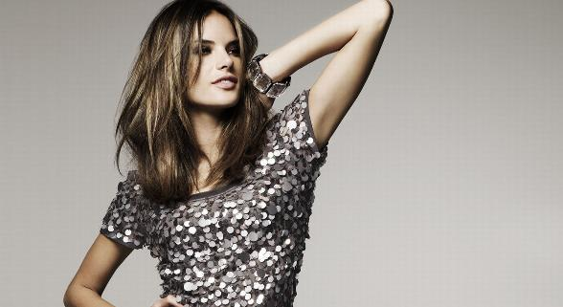

▪▪▪▪▪▪▪▪▪▪▪▪▪
▪▪▪▪▪▪▪▪▪▪▪▪▪
▪▪▪▪▪▪▪▪▪▪▪▪▪
Click here to add your title
I love you more than I've ever loved any woman. And I've waited longer for you than I've waited for any woman.
I love you more than I've ever loved any woman. And I've waited longer for you than I've waited for any woman.
BAOTU
WANG
XIAO
LONGBAO

Slide 14
03
Click here to add your title
I love you more than I've ever loved any woman. And I've waited longer for you than I've waited for any woman.

Slide 15
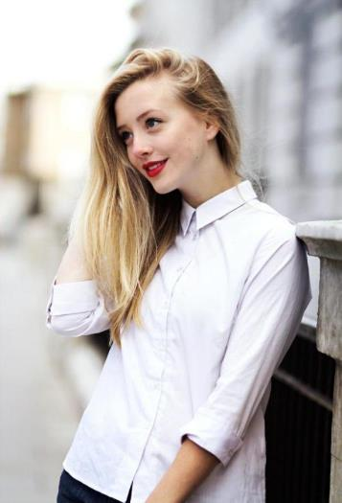
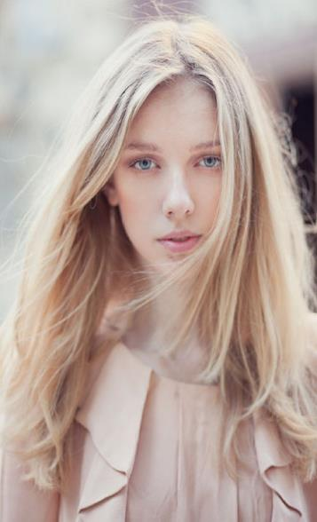
BAOTU
WANG
XIAO
LONGBAO
▪▪▪▪▪▪▪▪▪▪▪▪▪
▪▪▪▪▪▪▪▪▪▪▪▪▪
▪▪▪▪▪▪▪▪▪▪▪▪▪
Do what you say,say what you do.Do what you say,say what you do.Do what you say,say what you do.Do what you say,say what you do.
Do what you say,say what you do.Do what you say,say what you do.Do what you say,say what you do.Do what you say,say what you do.

Slide 16

1
Click here to add your title
I love you more than I've ever loved any woman. And I've waited longer for you than I've waited for any woman.
I love you more than I've ever loved any woman. And I've waited longer for you than I've waited for any woman.
2
Click here to add your title
I love you more than I've ever loved any woman. And I've waited longer for you than I've waited for any woman.
I love you more than I've ever loved any woman. And I've waited longer for you than I've waited for any woman.

Slide 17
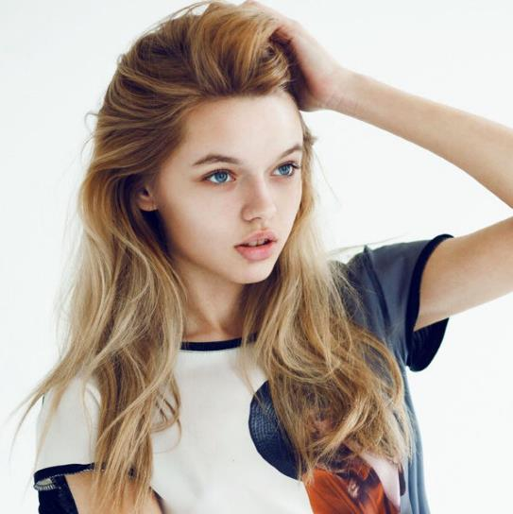
▪▪▪▪▪▪▪▪▪▪▪▪▪
▪▪▪▪▪▪▪▪▪▪▪▪▪
▪▪▪▪▪▪▪▪▪▪▪▪▪
Click here to add your title
I love you more than I've ever loved any woman. And I've waited longer for you than I've waited for any woman.
I love you more than I've ever loved any woman. And I've waited longer for you than I've waited for any woman.
Fashion
Magazine

Slide 18


SOME
PEOPLE
HAVE TO
CHANGE
THAT STYLE
I love you more than I've ever loved any woman. And I've waited longer for you than I've waited for any woman.I love you more than I've ever loved any woman. And I've waited longer for you than I've waited for any woman.

Slide 19
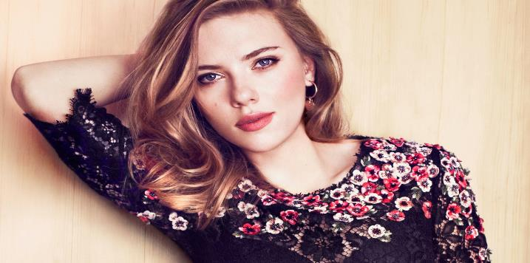

▪▪▪▪▪▪▪▪▪▪▪▪▪
▪▪▪▪▪▪▪▪▪▪▪▪▪
▪▪▪▪▪▪▪▪▪▪▪▪▪
Click here to add your title
I love you more than I've ever loved any woman. And I've waited longer for you than I've waited for any woman.
Do what you say,say what you do.Do what you say,say what you do.Do what you say,say what you do.Do what you say,say what you do.
Do what you say,say what you do.Do what you say,say what you do.Do what you say,say what you do.Do what you say,say what you do.

Slide 20
04
Click here to add your title
I love you more than I've ever loved any woman. And I've waited longer for you than I've waited for any woman.

Slide 21

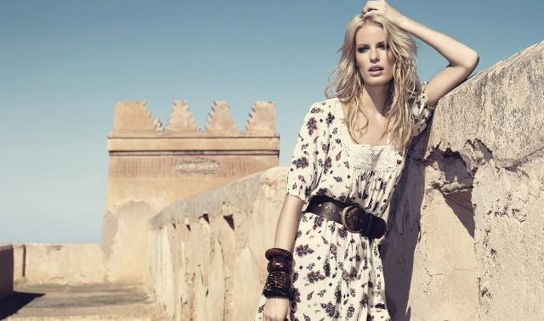

Sunshine
Do what you say,say what you do.
Do what you say,say what you do.
Do what you say,say what you do.
Do what you say,say what you do.
Fashion magazine
Do what you say,say what you do.
Do what you say,say what you do.
Do what you say,say what you do.
Do what you say,say what you do.
Do what you say,say what you do.
Do what you say,say what you do.
Do what you say,say what you do.
Do what you say,say what you do.

Slide 22
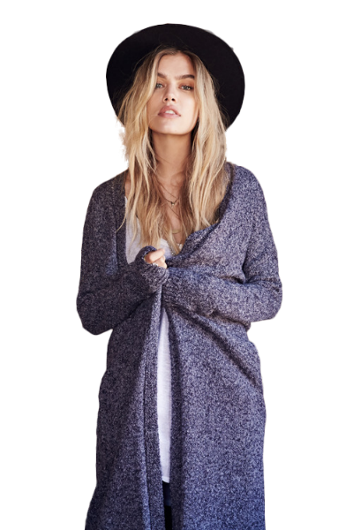
▪▪▪▪▪▪▪▪▪▪▪
▪▪▪▪▪▪▪▪▪▪▪
▪▪▪▪▪▪▪▪▪▪▪
▪▪▪▪▪▪▪▪▪▪▪
Click here to add your title
I love you more than I've ever loved any woman. And I've waited longer for you than I've waited for any woman.
I love you more than I've ever loved any woman. And I've waited longer for you than I've waited for any woman.
Click here to add your title
I love you more than I've ever loved any woman. And I've waited longer for you than I've waited for any woman.

Slide 23
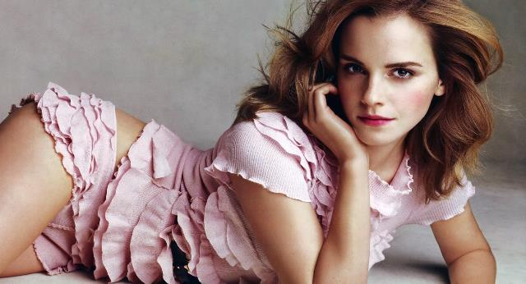
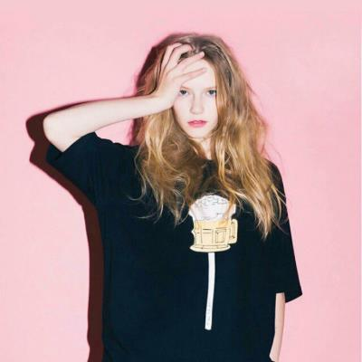
▪▪▪▪▪▪▪▪▪▪▪▪▪
▪▪▪▪▪▪▪▪▪▪▪▪▪
▪▪▪▪▪▪▪▪▪▪▪▪▪
Fashion
Magazine
Click here to add your title
I love you more than I've ever loved any woman. And I've waited longer for you than I've waited for any woman.
I love you more than I've ever loved any woman. And I've waited longer for you than I've waited for any woman.

Slide 24
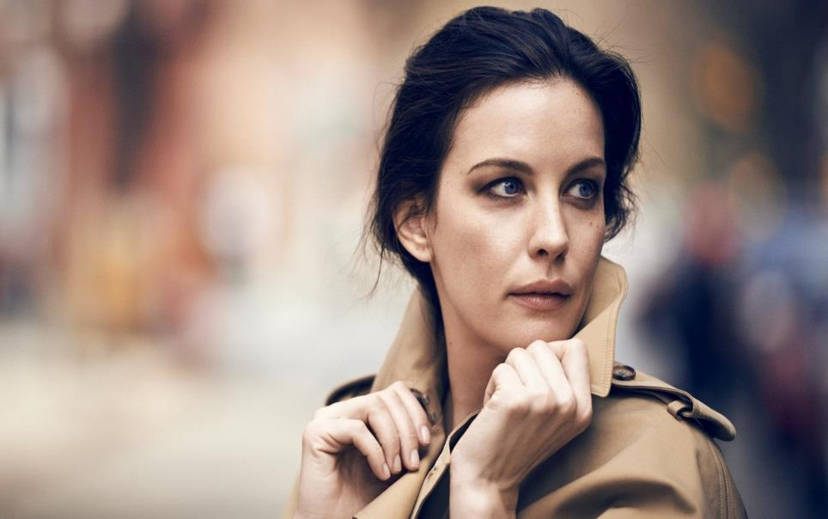
SOME
PEOPLE
HAVE TO
CHANGE
THAT STYLE
Do what you say,say what you do.
Do what you say,say what you do.
Do what you say,say what you do.
Do what you say,say what you do.

Slide 25
THANK YOU

