Slide 1


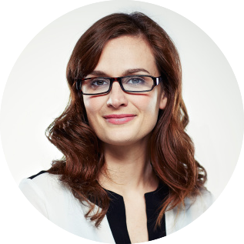
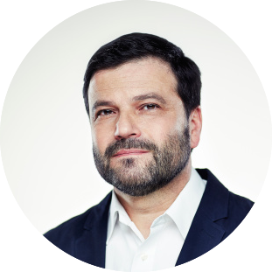
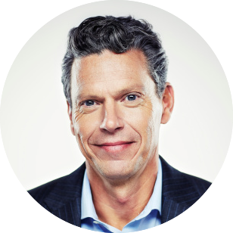
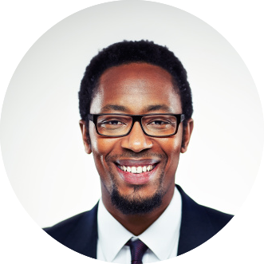
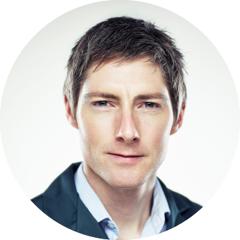

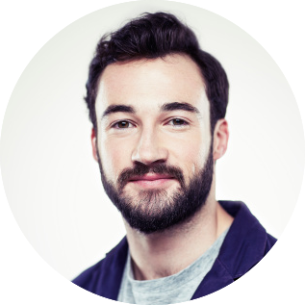
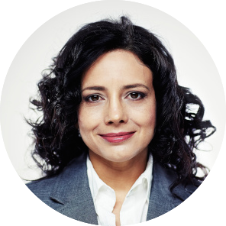
ORGANIZATION STRUCTION
JANE DOE
JANE DOE
JANE DOE
JOHN DOE
JOHN DOE
JOHN DOE
JOHN DOE
JOHN DOE
JANE DOE
JOHN DOE
JANE DOE
03

