Slide 1
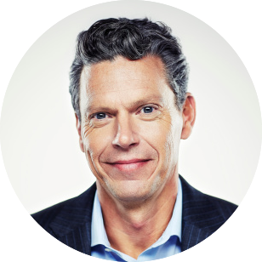


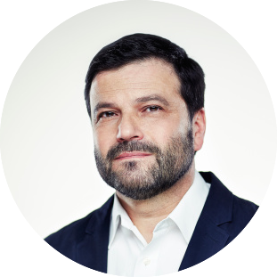


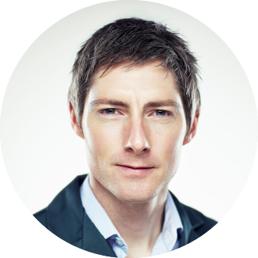

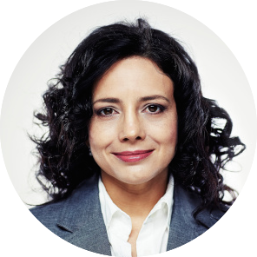
ORGANIZATION STRUCTION
JOHN DOE
JANE DOE
JANE DOE
JOHN DOE
JOHN DOE
JANE DOE
JOHN DOE
JANE DOE
JANE DOE
02

Slide 2
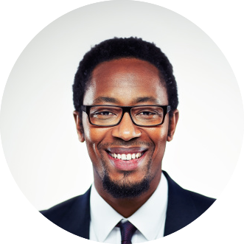
ORGANIZATION STRUCTION
JANE DOE
JOHN DOE
JANE DOE
JOHN DOE
JOHN DOE
JANE DOE
JOHN DOE
JOHN DOE
JANE DOE
JANE DOE
01

