Slide 1
FASHION
室内家居PPT模板
汇报人：xiazaii 汇报时间：2020年1月1日

Slide 2
点击添加标题

Slide 3
Y O U C A N W R I T E H E R E
点击添加标题
A company is an association or collection of individuals, whether natural persons, legal persons, or a mixture of both. Company members share a common purpose and unite in order to focus their various talents and organize their collectively available skills or resources to achieve specific, declared goals.
A company is an association or collection of individuals, whether natural persons, legal persons, or a mixture of both. Company members share a common purpose and unite in order to focus their various talents and organize their collectively available skills or resources to achieve specific, declared goals.
LEARN MORE

Slide 4
点击添加标题
点击添加标题
A company is an association or collection of individuals, whether natural persons, legal persons, or a
A company is an association or collection of individuals, whether natural persons, legal persons, or a
点击添加标题
点击添加标题
A company is an association or collection of individuals, whether natural persons, legal persons, or a
A company is an association or collection of individuals, whether natural persons, legal persons, or a

Slide 5
点击添加标题
A company is an association or collection of individuals, whether natural persons, legal persons, or a mixture of both. Company members share a common purpose and unite in order to focus their various talents and organize their
A company is an association or collection of individuals, whether natural persons, legal persons, or a mixture of both. Company members share a common purpose and unite in order to focus their various talents and organize their
JOHN DOE
MARK ZUCK

Slide 6
J E N N I F E R A.
A company is an association or collection of individuals, whether natural persons, legal persons, or a mixture of both. Company members share a common purpose.
A company is an association or collection of individuals, whether natural persons, legal persons, or a mixture of
LEARN MORE

Slide 7
You Can Write Here
点击添加标题
A company is an association or collection of individuals, whether natural persons, legal persons, or a mixture of both

Slide 8
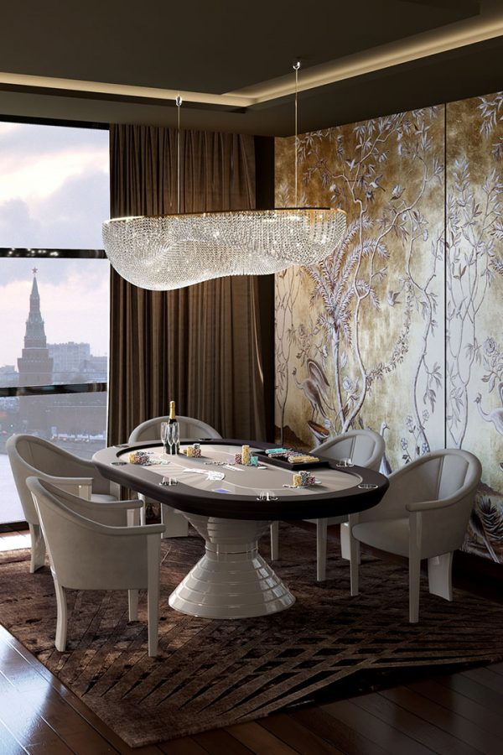
点击添加标题
A company is an association or collection of individuals, whether natural persons,
点击添加标题
A company is an association or collection of individuals, whether natural persons,

Slide 9
Y O U C A N W R I T E H E R E
WHAT ARE OUR
COMMON SERVICES
A company is an association or collection of individuals, whether natural persons, legal persons, or a mixture of both. Company members share a common purpose and unite in order to focus their various talents and organize their collectively available skills or resources to achieve specific, declared goals. A company or association of persons can be created at law as

Slide 10
点击添加标题
点击添加标题
Entrepreneurial activities differ substantially depending on the type of
Entrepreneurial activities differ substantially depending on the type of

Slide 12
Y O U C A N W R I T E H E R E
点击添加标题
A company is an association or collection of individuals, whether natural persons, legal persons, or a mixture of both. Company members share a common purpose and.

Slide 13
97
标题
A company is an association or collection of individuals,
104
标题
A company is an association or collection of individuals,

Slide 14
点击添加标题
A company is an association or collection of individuals, whether natural persons, legal persons, or a mixture of both. Company members

Slide 15
Y O U C A N W R I T E H E R E
点击添加标题

Slide 16
点击添加标题
A company is an association or collection of individuals, whether natural persons, legal persons, or a mixture of both. Company members share a common purpose.
A company is an association or collection of individuals, whether natural persons, legal persons, or a mixture of
LEARN MORE

Slide 17
P E R S O N A L
ENTERPRISE
点击添加标题
点击添加标题
A company is an association or collection of individuals, whether natural persons, legal persons, or
A company is an association or collection of individuals, whether natural persons, legal persons, or
LEARN MORE
LEARN MORE

Slide 18
点击添加标题
WRITE HERE SOMETHING

Slide 19
Y O U C A N W R I T E H E R E
点击添加标题
GREAT COMPANIES AROUND THE
EARTH
A company is an association or collection of individuals, whether natural persons, legal persons, or a mixture of both. Company members share a common purpose and unite in order to focus their various

Slide 20
感谢一路有你
THANKS

