Slide 1
Design by：二三年
2
020

Slide 2
Content
01
灵感
Inspiration is he waiting for the distance
02
如果
If the selection is filled with may

Slide 3
1
PART ONE
01
灵感
Inspiration is he waiting for the distance

Slide 4
01
02
Point I
Point II
03
I know people always only
saw the thing of luminescence, perhaps some things had to shine
I know people always only
saw the thing of luminescence, perhaps some things had to shine
Point III
I know people always only saw the thing of luminescence,
perhaps some things had to shine

Slide 5
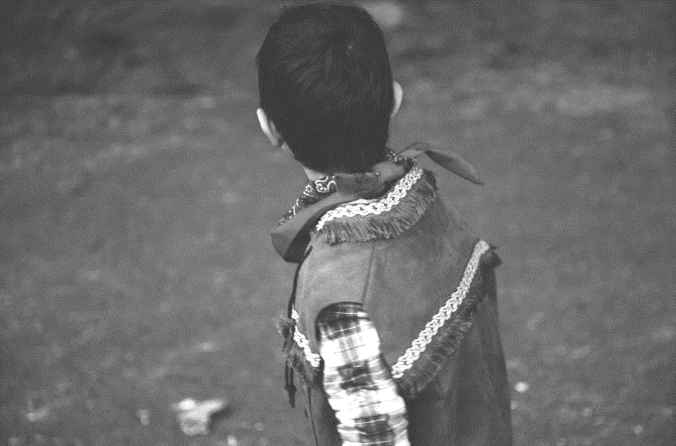
少年
I know people always only
saw the thing of luminescence,
perhaps some things had to shine
红领巾和少年的旧上衣
Juvenile
Red scarf and the young old coat
.

Slide 6
2
PART ONE
02
如果
If the selection is filled with may

Slide 7
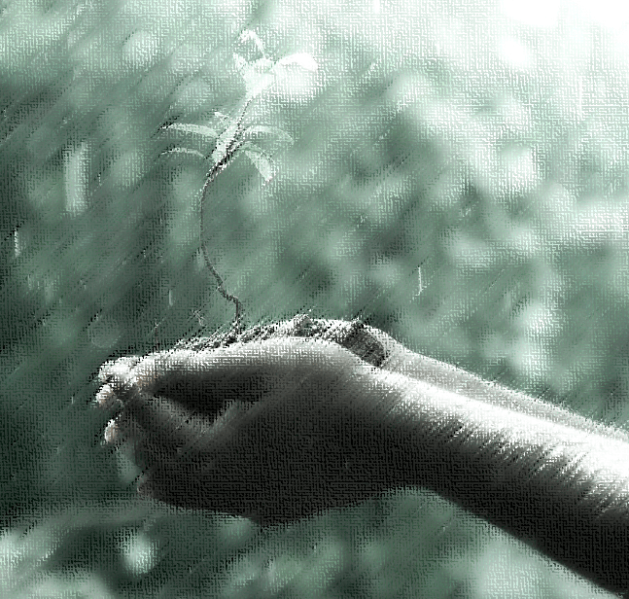
The grass
诠释
-
I know people always only
saw the thing of luminescence, perhaps some things had to shine
草
-
I know people always only
saw the thing of luminescence, perhaps some things had to shine

Slide 8
01
I know people always only
saw the thing of luminescence, perhaps some things had to shine
五边形
About the world
540°
02
I know people always only
saw the thing of luminescence, perhaps some things had to shine

Slide 9
System I
System III
If the selection is filled with may
If the selection is filled with may
2016 – 8 - 6
2016 – 8 - 21
TOPIC
System II
System IV
If the selection is filled with may
If the selection is filled with may
2016 – 8 - 15
2016 – 8 - 28

Slide 10
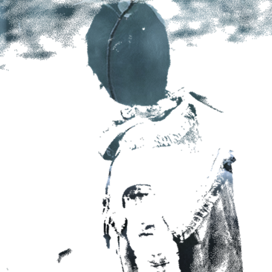
Thank
有一天、小草成了他的身体
One day, the grass was his body

Slide 11
Design by 二三年
微博：@两三年_1945

