Slide 1
2020
极简线条通用PPT模板
Without ideal, life is a desert, not angry; Without ideal, life is like night, without light; Without ideal, life is like a maze, without direction.
汇报人：xiazaii
汇报时间：2020.XX.XX

Slide 2
CONTENTS
1
2
3
4
添 加 标 题
添 加 标 题
添 加 标 题
添 加 标 题

Slide 3
Part one
添 加 标 题
Trust me

Slide 4
输入你的标题
文字描述
文字描述
文字描述
7
1
文字描述
3
6
5
8
2
文字描述
4
文字描述
文字描述
文字描述

Slide 5
输入你的标题
相同之处：
不同之处：
请添加文字描述请添加文字描述请添加文字描述请添加文字描述请添加文字描述请添加文字描述请添加文字描述请添加文字描述请添加文字描述
请添加文字描述请添加文字描述请添加文字描述请添加文字描述请添加文字描述请添加文字描述请添加文字描述请添加文字描述请添加文字描述请添加文字描述

Slide 6
输入你的标题
点击添加标题
文字描述文字描述文字描述文字描述文字描述
点击添加标题
文字描述文字描述文字描述文字描述
点击添加标题
文字描述文字描述文字描述文字描述文字描述文字描述

Slide 7




输入你的标题
标题文字添加
标题文字添加
The user can demonstrate on a projector or computer, or print the presentation and make it into a film to be used in a wider field.
The user can demonstrate on a projector or computer, or print the presentation and make it into a film to be used in a wider field.
标题文字添加
标题文字添加
The user can demonstrate on a projector or computer, or print the presentation and make it into a film to be used in a wider field.
The user can demonstrate on a projector or computer, or print the presentation and make it into a film to be used in a wider field.

Slide 8



输入你的标题
标题文字添加
The user can demonstrate on a projector or computer, or print the presentation and make it into a film to be used in a wider field.
标题文字添加
The user can demonstrate on a projector or computer, or print the presentation and make it into a film to be used in a wider field.

Slide 9
Part two
添 加 标 题
Trust me

Slide 10
输入你的标题
标题文字添加
标题文字添加
The user can demonstrate on a projector or computer, or print the presentation and make it into a film to be used in a wider field.
The user can demonstrate on a projector or computer, or print the presentation and make it into a film to be used in a wider field.
01
02
标题文字添加
03
04
标题文字添加
The user can demonstrate on a projector or computer, or print the presentation and make it into a film to be used in a wider field.
The user can demonstrate on a projector or computer, or print the presentation and make it into a film to be used in a wider field.

Slide 11
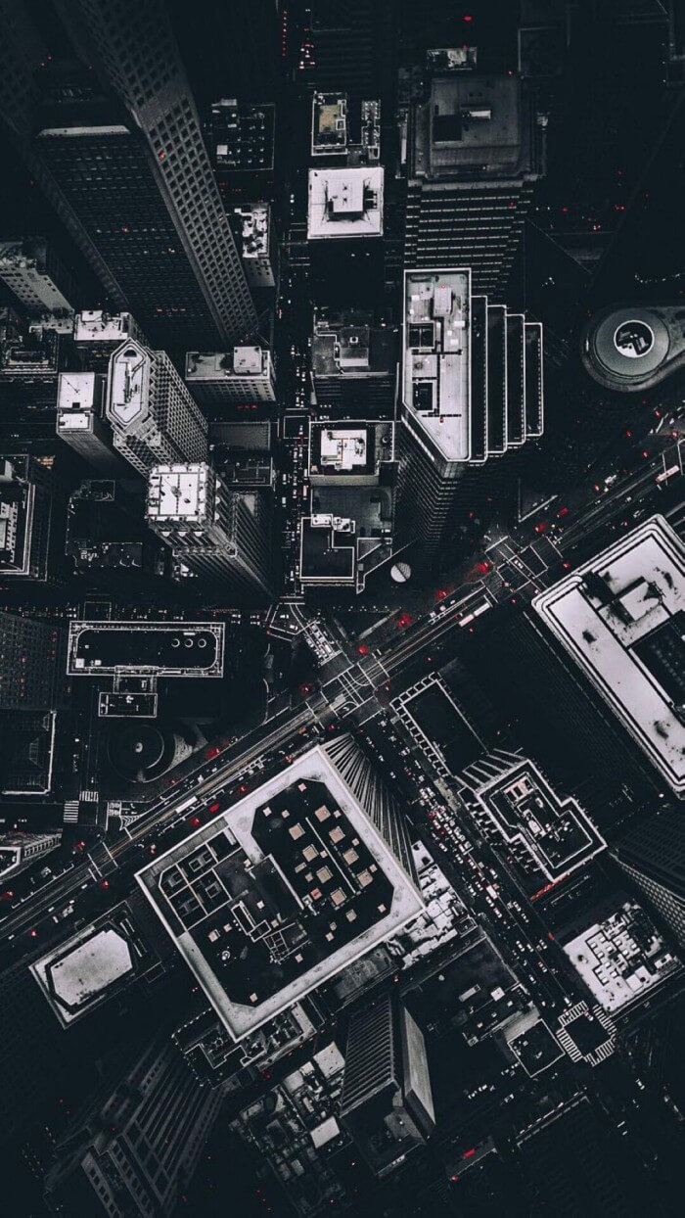
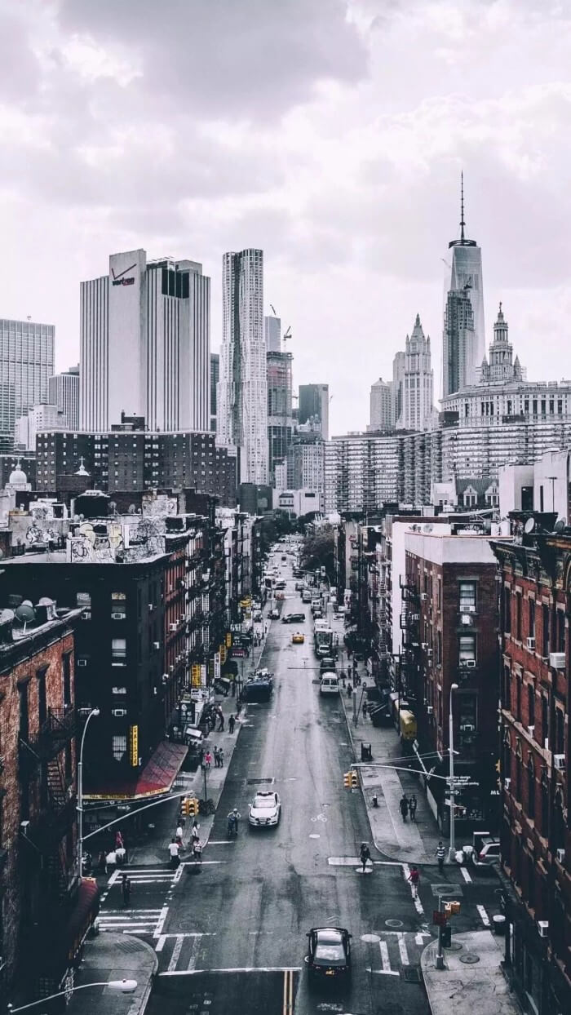
输入你的标题
标题文字添加
The user can demonstrate on a projector or computer, or print the presentation and make it into a film to be used in a wider field.
标题文字添加
The user can demonstrate on a projector or computer, or print the presentation and make it into a film to be used in a wider field.

Slide 12
输入你的标题
01
添加标题
请添加文字描述请添加文字描述请添加文字描述请添加文字描述请添加文字描述
02
添加标题
请添加文字描述请添加文字描述请添加文字描述请添加文字描述
03
添加标题
请添加文字描述请添加文字描述请添加文字描述

Slide 13
输入你的标题
请添加文字描述
请添加文字描述
请添加文字描述
请添加文字描述
》
》
》

Slide 14
输入你的标题
标题文字添加
The user can demonstrate on a projector or computer, or print the presentation and make it into a film to be used in a wider field.
21.3
标题文字添加
The user can demonstrate on a projector or computer, or print the presentation and make it into a field.
96.8
标题文字添加
43.5
The user can demonstrate on a projector or computer, or print the presentation and make it into a film to be used in a wider field.
The user can demonstrate on a projector or computer, or print the presentation and make it into a film to be The user can demonstrate on a projector or computer, or print the presentation and make it into a film to be used in a wider field.used in a wider field

Slide 15
Part three
添 加 标 题
Trust me

Slide 16
输入你的标题
1
标题文字添加
The user can demonstrate on a projector or computer, or print the presentation and make it into.
标题文字添加
The user can demonstrate on a projector or computer, or print the presentation and make it into a film to be used in a wider field. The user can demonstrate on a
2
标题文字添加
3
The user can demonstrate on a projector or computer, or print the presentation and make it.

Slide 17


输入你的标题
请添加文字描述请添加文字描述
请添加文字描述
请添加文字描述请添加文字描述请添加文字描述
请添加文字描述请添加文字描述请添加文字描述请添加文字描述
请添加文字描述请添加文字描述请添加文字描述

Slide 18
输入你的标题
添加标题
添加标题
文字描述文字描述文字描述文字描述文字描述文字描述文字描述文字描述文字描述文字描述文字描述文字描述
文字描述文字描述文字描述文字描述文字描述文字描述文字描述文字描述
文字描述文字描述文字描述文字描述文字描述文字描述
文字描述文字描述
添加标题
添加标题

Slide 19
输入你的标题
标题文字添加
标题文字添加
The user can demonstrate on a projector or computer, or print the presentation and make it into a film to be used in a wider field.
The user can demonstrate on a projector or computer, or print the presentation and make it into a film to be used in a wider field.
标题文字添加
标题文字添加
The user can demonstrate on a projector or computer, or print the presentation and make it into a film to be used in a wider field.
The user can demonstrate on a projector or computer, or print the presentation and make it into a film to be used in a wider field.

Slide 20
Part four
添 加 标 题
Trust me

Slide 21
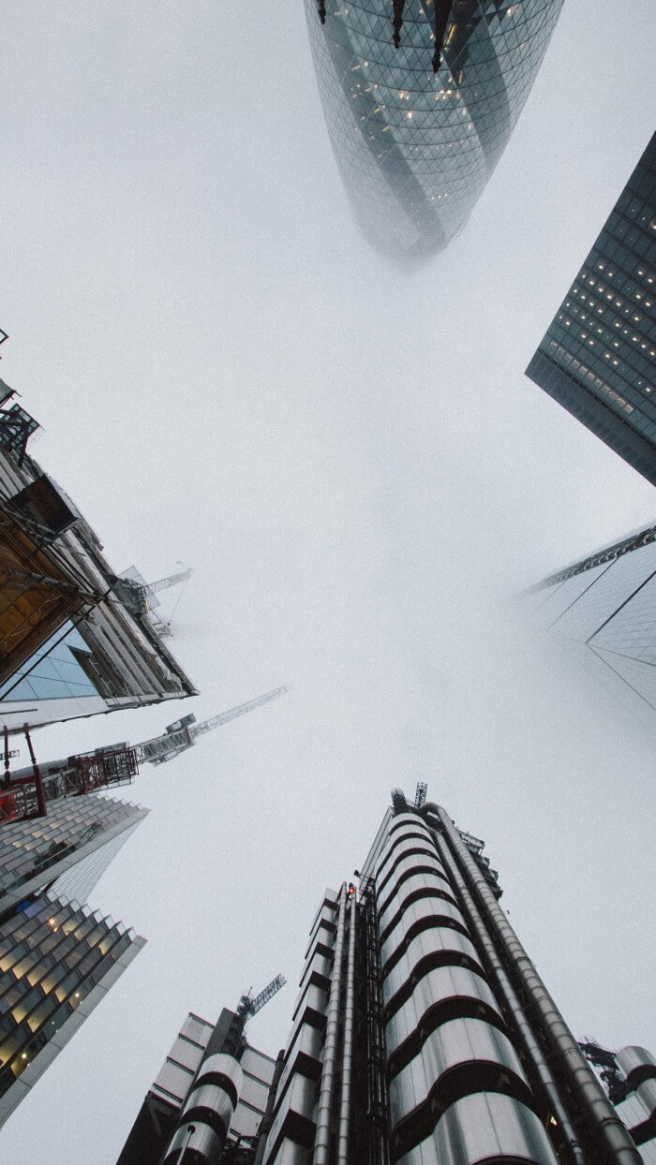
输入你的标题
标题文字添加
The user can demonstrate on a projector or computer, or print the presentation and make it into a film to be used in a wider field.
The user can demonstrate on a projector or computer, or print the presentation and make it into a film to be used in a wider field.
The user can demonstrate on a projector or computer, or print the presentation and make it into a film to be used in a wider field.

Slide 22
输入你的标题
点击添加标题
点击添加标题
点击添加标题
请添加文字描述请添加文字描述请添加文字描述请添加文字描述请添加文字描述请添加文字描述
请添加文字描述请添加文字描述请添加文字描述请添加文字描述请添加文字描述请添加文字描述
请添加文字描述请添加文字描述请添加文字描述请添加文字描述

Slide 23
输入你的标题
标题文字添加
The user can demonstrate on a projector or computer, or print the presentation and make it into a film to be used in a wider field.
标题文字添加
The user can demonstrate on a projector or computer, or print the presentation and make it into a film to be used in a wider field.
标题文字添加
The user can demonstrate on a projector or computer, or print the presentation and make it into a film to be used in a wider field.
标题文字添加
The user can demonstrate on a projector or computer, or print the presentation and make it into a film to be used in a wider field.

Slide 24
2020
感谢您的观看
Without ideal, life is a desert, not angry; Without ideal, life is like night, without light; Without ideal, life is like a maze, without direction.
汇报人：xiazaii
汇报时间：2020.XX.XX

