Slide 1
How many pink balls?
UnitX, Module8
1 2 3 4 5 6 7 8 9 10

Slide 2
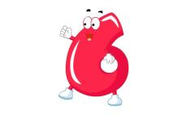
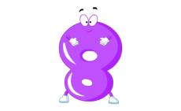
Look and read.

Slide 3
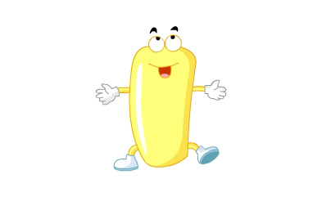
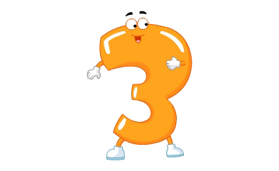
one
two
three

Slide 4
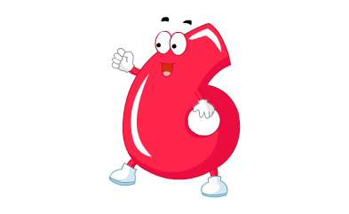
four
five
six

Slide 5
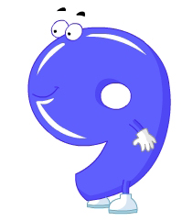
seven
eight
nine
ten

Slide 6
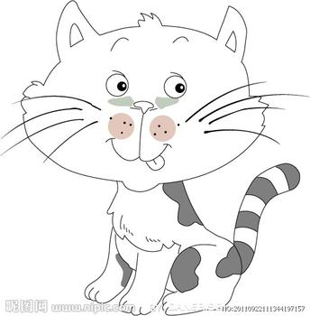
1 cat
2 cats
3 cats
4 cats
5 cats

Slide 7
blue
red
green
black
white
yellow
cat
brown
orange
pink
purple

Slide 8
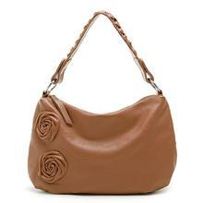
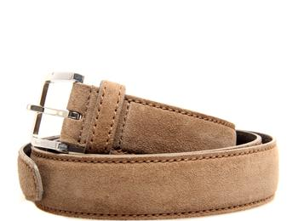
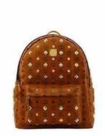
br
ow
n
It’s brown.

Slide 9
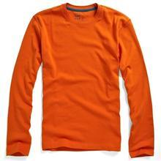
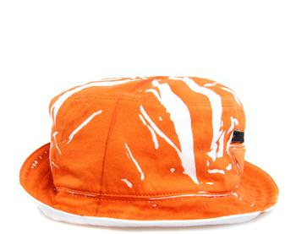
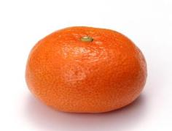
It’s orange.
orange

Slide 10
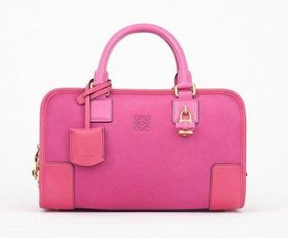
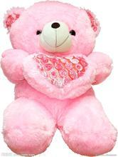
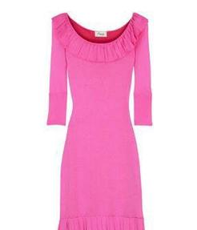
It’s pink.
pink

Slide 11
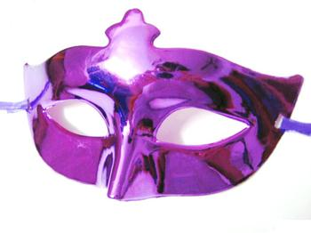
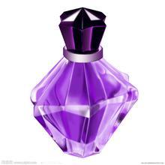
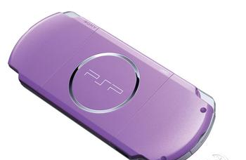
It’s purple.
purple

Slide 12
How many orange cats?
How many cats?

Slide 13
How many green cats?
How many cats?

Slide 14
How many white cats?
How many cats?

Slide 15
How many orange cats?

Slide 16
How many yellow dogs?
Three yellow dogs.
How many blue dogs?
Five blue dogs.

Slide 17
How many green birds?
Five green birds.
How many red birds?
Six red birds.

Slide 18
ball
It’s a ball.
It’s a brown ball.

Slide 19
Let’s chant
How many brown, brown balls?
Three, three, three.
How many pink, pink balls?
Five, five, five.
How many orange, orange balls?
Seven, seven, seven.

Slide 20
Look and colour.
Two red balls
Five green balls
Eight yellow balls
Six blue balls
Four black balls

Slide 21
Look and colour.
Two red balls
Five green balls
Eight yellow balls
Six blue balls
Four black balls

Slide 22
Look and colour.
Two red balls
Five green balls
Eight yellow balls
Six blue balls
Four black balls

Slide 23
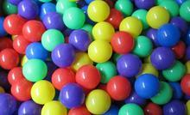
Wow, so many balls.

Slide 24
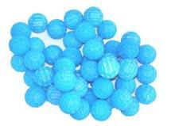
Wow, so many
blue balls.

Slide 25
Thank you!

