Slide 1
淡雅風
点击输入本栏的具体文字，简明扼要的说明分项内容，此为概念图解，请根据您的具体内容酌情修改。
xiazaii

Slide 2
01
02
03
04
点击输入本栏的具体文字，简明扼要的说明分项内容，此为概念图解
点击输入本栏的具体文字，简明扼要的说明分项内容，此为概念图解
点击输入本栏的具体文字，简明扼要的说明分项内容，此为概念图解
点击输入本栏的具体文字，简明扼要的说明分项内容，此为概念图解
目錄

Slide 3
一章
点击输入本栏的具体文字，简明扼要的说明分项内容，此为概念图解，请根据您的具体内容酌情修改。

Slide 4
此处输入标题
Just for today I will try to live through this day only and not tackle my whole life problem at once.
Just for today I will try to live through this day only and not tackle my whole life problem at once.
此处输入标题
Just for today I will try to live through this day only and not tackle my whole life problem at once.

Slide 5
01
TITTLE HERE
Just for today I will try to live through this day only and not tackle my whole life problem at once. Just for today I will try to live through this day only and not tackle my whole life problem at once.
02
TITTLE HERE
Just for today I will try to live through this day only and not tackle my whole life problem at once. Just for today I will try to live through this day only and not tackle my whole life problem at once.

Slide 6
Tittle here
The waves beside them danced; but they Out-did the sparkling waves in glee: A poet could not but be gay The waves beside them danced; but they Out-did the
Tittle here
The waves beside them danced; but they Out-did the sparkling waves in glee: A poet could not but be gay The waves beside them danced; but they Out-did the

Slide 7
ADD YOUR TITTLE HERE
Just for today I will try to live through this day only and not tackle my whole life problem at once. I can do for twelve hours that Just for
ADD YOUR TITTLE HERE
Just for today I will try to live through this day only and not tackle my whole life problem at once. I can do for twelve hours that Just for

Slide 8
二章
点击输入本栏的具体文字，简明扼要的说明分项内容，此为概念图解，请根据您的具体内容酌情修改。

Slide 9
此处输入标题
此处输入标题
Just for today I will try to live through this day only and not tackle my whole life problem at once.
40%
65%
Just for today I will try to live through this day only and not tackle my whole life problem at once.
此处输入标题
73%
此处输入标题
60%
Just for today I will try to live through this day only and not tackle my whole life problem at once.
Just for today I will try to live through this day only and not tackle my whole life problem at once.

Slide 10
0 1
0 2
Just for today I will try to live through this day only and not tackle my whole life problem at once. I can do for twelve hours that Just for
Just for today I will try to live through this day only and not tackle my whole life problem at once. I can do for twelve hours that Just for
0 3
0 4
Just for today I will try to live through this day only and not tackle my whole life problem at once. I can do for twelve hours that Just for
Just for today I will try to live through this day only and not tackle my whole life problem at once. I can do for twelve hours that Just for

Slide 11
三章
点击输入本栏的具体文字，简明扼要的说明分项内容，此为概念图解，请根据您的具体内容酌情修改。

Slide 12
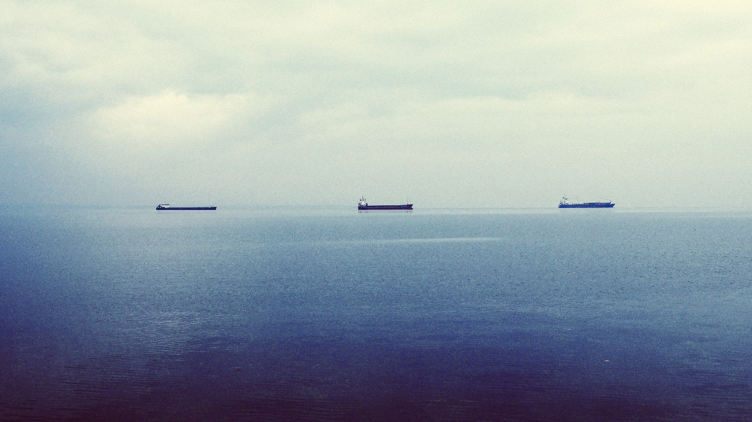
点 击 标 题
Just for today I will try to live through this day only and not tackle my whole life problem at once. Just for today I will try to live through this day only and not tackle my whole life problem at once.
Just for today I will try to live through this day only and not tackle my whole life problem at once. Just for today I will try to live through this day only and not tackle my whole life problem at once.

Slide 13
四章
点击输入本栏的具体文字，简明扼要的说明分项内容，此为概念图解，请根据您的具体内容酌情修改。

Slide 14
ADD YOUR TITTLE
TITTLE
TITTLE
Just for today I will exercise my soul in three ways. I will do somebody a turn
ADD YOUR TITTLE
Just for today I will exercise my soul in three ways. I will do somebody a turn
ADD YOUR TITTLE
Just for today I will exercise my soul in three ways. I will do somebody a turn
TITTLE
TITTLE
ADD YOUR TITTLE
Just for today I will exercise my soul in three ways. I will do somebody a turn

Slide 15
谢
谢
点击输入本栏的具体文字，简明扼要的说明分项内容，此为概念图解，请根据您的具体内容酌情修改。

