Slide 1
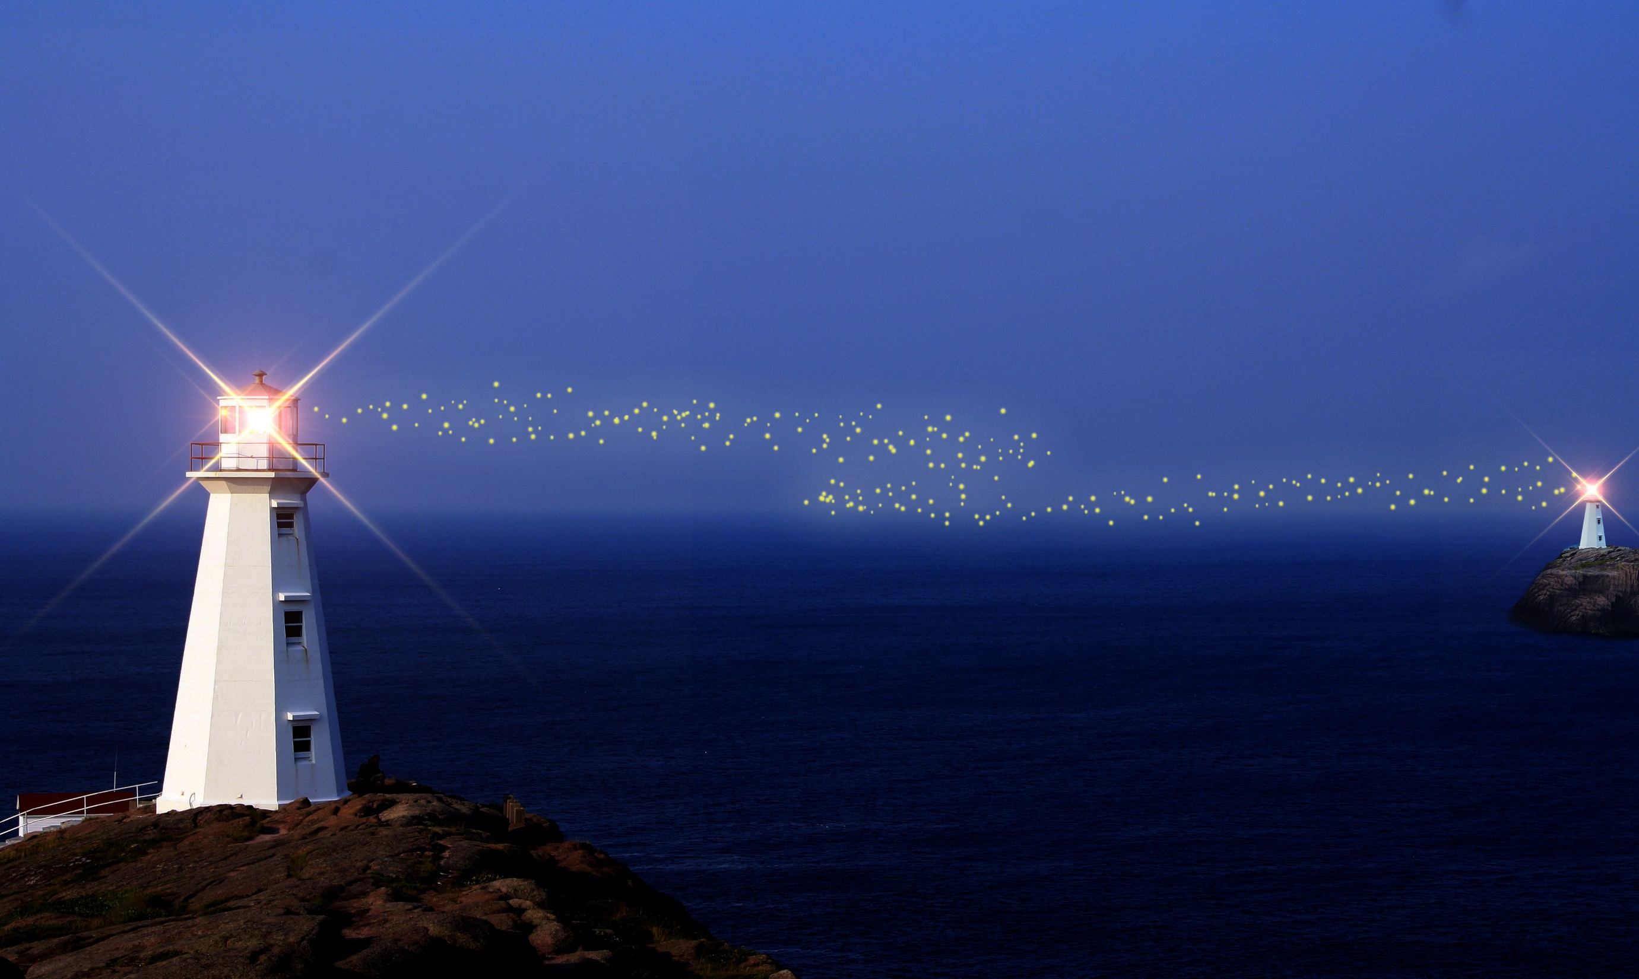


点亮心中的灯塔
Light up the lighthouse in your heart
The ideal is Stone, knock out the spark; The ideal is fire, lighting the extinguished light; Ideal is a lamp, illuminating the way of night travel; Ideal is the way, leading you to the dawn.

Slide 2
01
标题添加此处
The user can demonstrate on a projector or computer
目
录
02
标题添加此处
CONTENTS
The user can demonstrate on a projector or computer
03
标题添加此处
The user can demonstrate on a projector or computer
04
标题添加此处
The user can demonstrate on a projector or computer

Slide 3
PART 01
标题文字添加此处
Users can demonstrate on projectors or computers, or print presentations and film them for use in a wider range of fields.

Slide 4
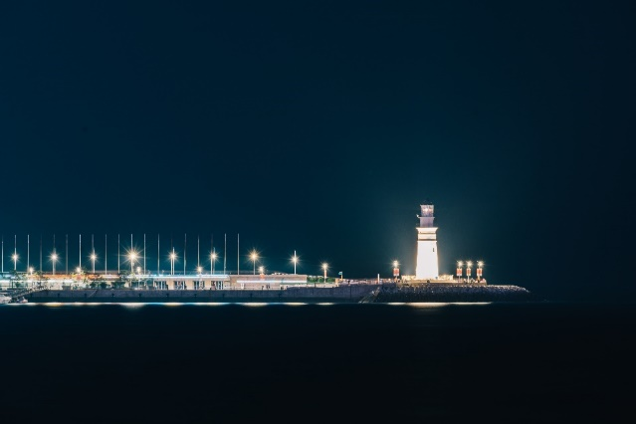

01
02
03
标题文字添加此处
标题文字添加此处
标题文字添加此处
Users can demonstrate on projectors or computers, or print presentations and film them for use in a wider range of fields.
Users can demonstrate on projectors or computers, or print presentations and film them for use in a wider range of fields.
Users can demonstrate on projectors or computers, or print presentations and film them for use in a wider range of fields.

Slide 5
标题文字
标题文字
Users can demonstrate on projectors or computers.
Users can demonstrate on projectors or computers.
您的标题
标题文字
标题文字
Users can demonstrate on projectors or computers.
您的标题
Users can demonstrate on projectors or computers.
您的标题
您的标题
您的标题
您的标题
标题文字
标题文字
Users can demonstrate on projectors or computers.
Users can demonstrate on projectors or computers.

Slide 6
PART 02
标题文字添加此处
Users can demonstrate on projectors or computers, or print presentations and film them for use in a wider range of fields.

Slide 7


标题文字添加此处
Users can demonstrate on projectors or computers, or print presentations and film them for use in a wider range of fields.
标题文字添加此处
Users can demonstrate on projectors or computers, or print presentations and film them for use in a wider range of fields.
标题文字添加此处
Users can demonstrate on projectors or computers, or print presentations and film them for use in a wider range of fields.

Slide 8

标题文字添加此处
Users can demonstrate on projectors or computers, or print presentations and film them for use in a wider range of fields.
标题文字添加此处
Users can demonstrate on projectors or computers, or print presentations and film them for use in a wider range of fields.
标题文字添加此处
Users can demonstrate on projectors or computers, or print presentations and film them for use in a wider range of fields.

Slide 9
PART 03
标题文字添加此处
Users can demonstrate on projectors or computers, or print presentations and film them for use in a wider range of fields.

Slide 10

标题文字添加此处
标题文字
01
Users can demonstrate on projectors or computers.
标题文字
Users can demonstrate on projectors or computers.
02
03
标题文字
标题文字
Users can demonstrate on projectors or computers.
Users can demonstrate on projectors or computers.
04

Slide 11


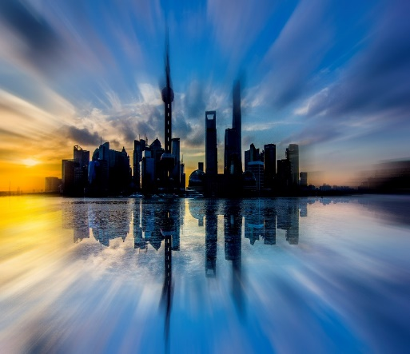
A
标题文字添加此处
Users can demonstrate on projectors or computers, or print presentations and film them for use in a wider range of fields.
B
标题文字添加此处
Users can demonstrate on projectors or computers, or print presentations and film them for use in a wider range of fields.
C
标题文字添加此处
Users can demonstrate on projectors or computers, or print presentations and film them for use in a wider range of fields.

Slide 12
PART 04
标题文字添加此处
Users can demonstrate on projectors or computers, or print presentations and film them for use in a wider range of fields.

Slide 13


标题文字添加此处
标题文字添加此处
标题文字添加此处
Users can demonstrate on projectors or computers, or print presentations and film them for use in a wider range of fields.
Users can demonstrate on projectors or computers, or print presentations and film them for use in a wider range of fields.
Users can demonstrate on projectors or computers, or print presentations and film them for use in a wider range of fields.

Slide 14




04
添加标题
Users can demonstrate on projectors or computers, or print presentations and film them for use in a wider range of fields.
03
添加标题
Users can demonstrate on projectors or computers, or print presentations and film them for use in a wider range of fields.
02
01
添加标题
Users can demonstrate on projectors or computers, or print presentations and film them for use in a wider range of fields.
添加标题
Users can demonstrate on projectors or computers, or print presentations and film them for use in a wider range of fields.

Slide 15
感谢您的观看
Thank you for watching
The ideal is Stone, knock out the spark; The ideal is fire, lighting the extinguished light; Ideal is a lamp, illuminating the way of night travel; Ideal is the way, leading you to the dawn.

